Slide 1

AB InBev
Data science challenge
Sebastián tinoco

Slide 2
Scope
Key variables:
Share of Market (SOM)
Traded Volume (hL)
Objectives:
Impact evaluation of price reduction in market_006.
Demand forecast and sensitivity analysis in market_004.

Slide 3
Methodology
Impact evaluation:
Difference-in-Differences (DD)
Analysis of correlations between markets
Forecast and sensitivy:
Train and evaluation of ML model
Model deployment

Slide 4
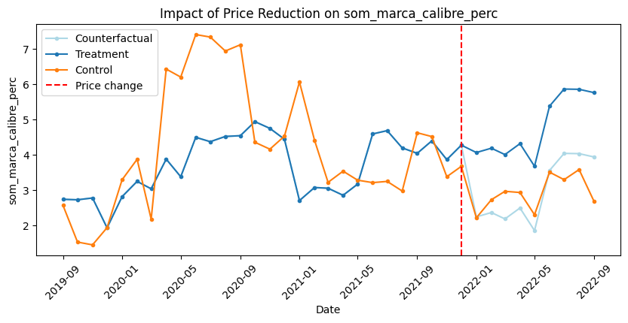
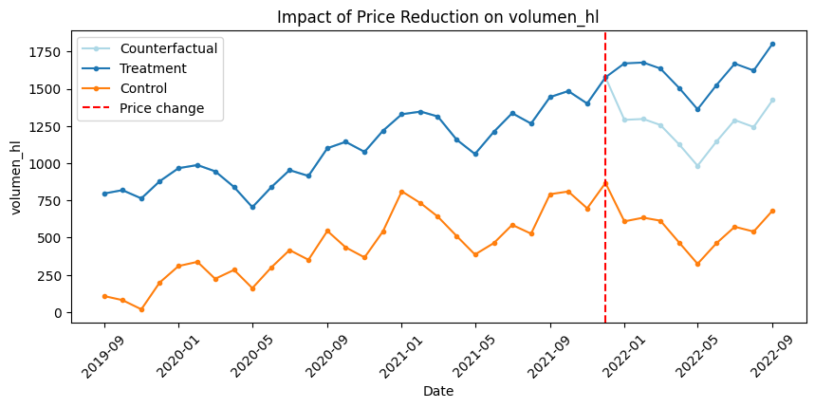
Impact evaluation: Difference-in-Differences
Main insights:
Inconclusive assessment for SOM series on market_006 due to non-parallel trends.
Positive impact on Volume on market_006 from price reduction (in consideration of parallel trends).
The price reduction increased the traded volume by 379 hL (statistically significant).
See Annex 1 for implementation details.

Slide 5
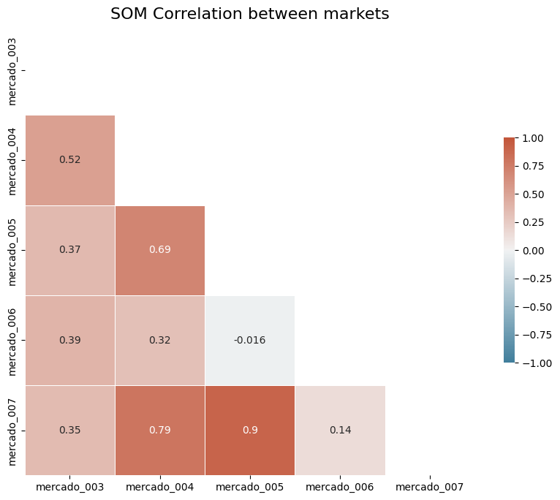
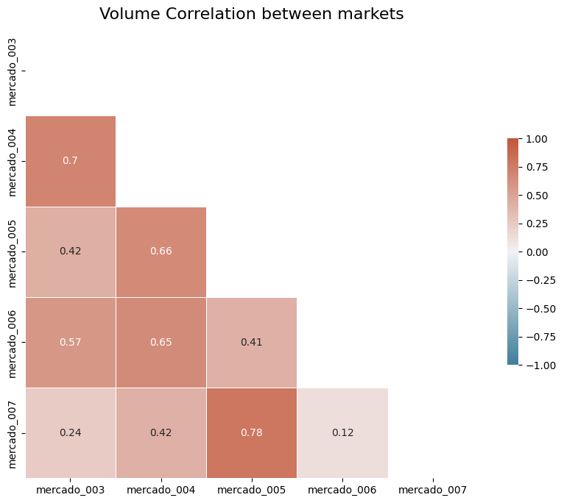
Impact evaluation: Correlation between markets
Main insight: The analysis reveals a negative correlation between market_006 and market_005 on SOM, suggesting a potential cannibalization effect between these markets.

Slide 6
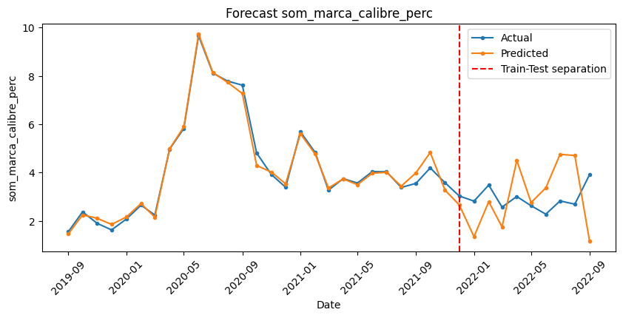
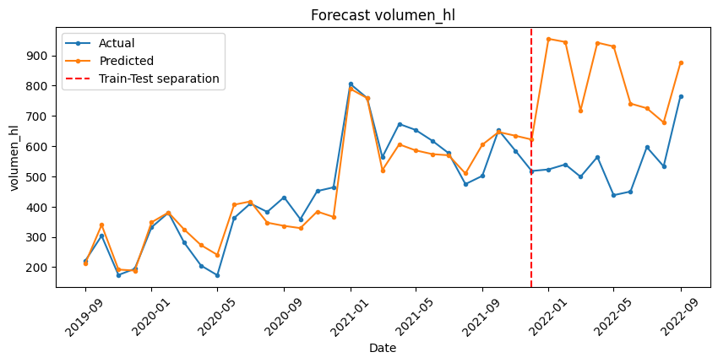
Forecast and Sensitivity: Train and Evaluation
Mean absolute error: 1.38 p.p.
Mean absolute error: 288.95 hL
Considerations:
Used Prophet ML model to forecast series on Market_004.
Train split: 2019-09 to 2021-12.
Test split: 2022-01 to 2022-09.

Slide 7
Forecast and Sensitivity: Model Deployment
Forecast Model (click here)
For optimal experience, it is advised to open the link on a desktop computer.
Main insights:
A 5% year-to-year price reduction over the next 3 months increases market share by 0.75 p.p on average compared to maintaining previous year's prices on Market_004.
Similarly, a 5% year-to-year price reduction over the next 3 months boosts traded volume by 7.12 hL on average compared to maintaining previous year's prices on Market_004.

Slide 8
Conclussions and Future Work
Key Results
Price reduction increased the traded volume by 379 hL on Market_006.
Potential cannibalization between market_005 and market_006 due to price reduction on SOM.
Evidence suggests a price reduction would increase SOM and Traded Volume on Market_004.
Future Work
Improve DiD by considering temporal dependencies.
Test statistical significance of correlations.
Hyperparameter tuning, expand regressors, increase training data, explore neural networks.

Slide 9
AB InBev
Data science challenge
Sebastián tinoco

Slide 10
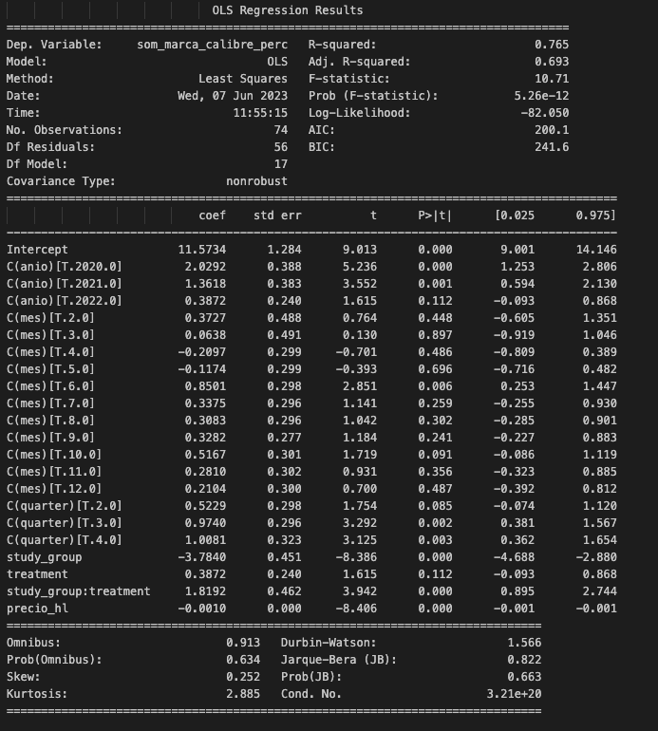
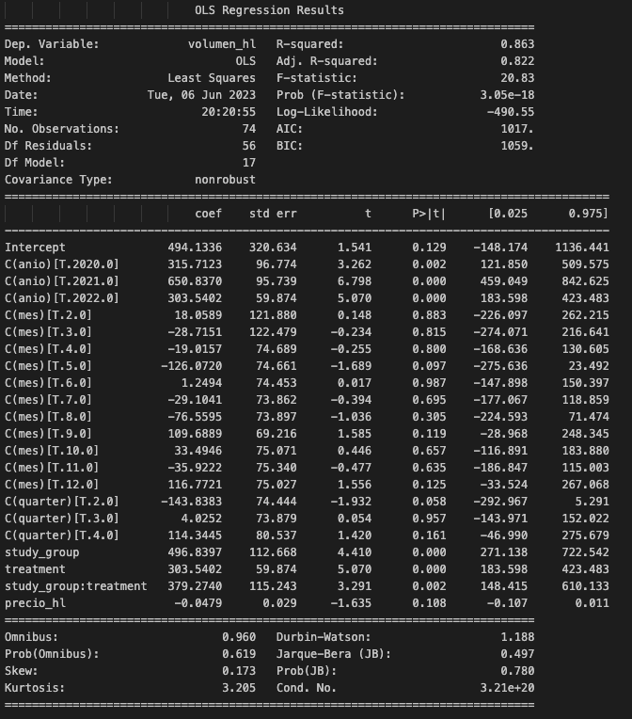
Annex 1: DiD Results
Treatment group: Market_006
Control group: Market_004
Control variables: Year, Month, Quarter

