Slide 1
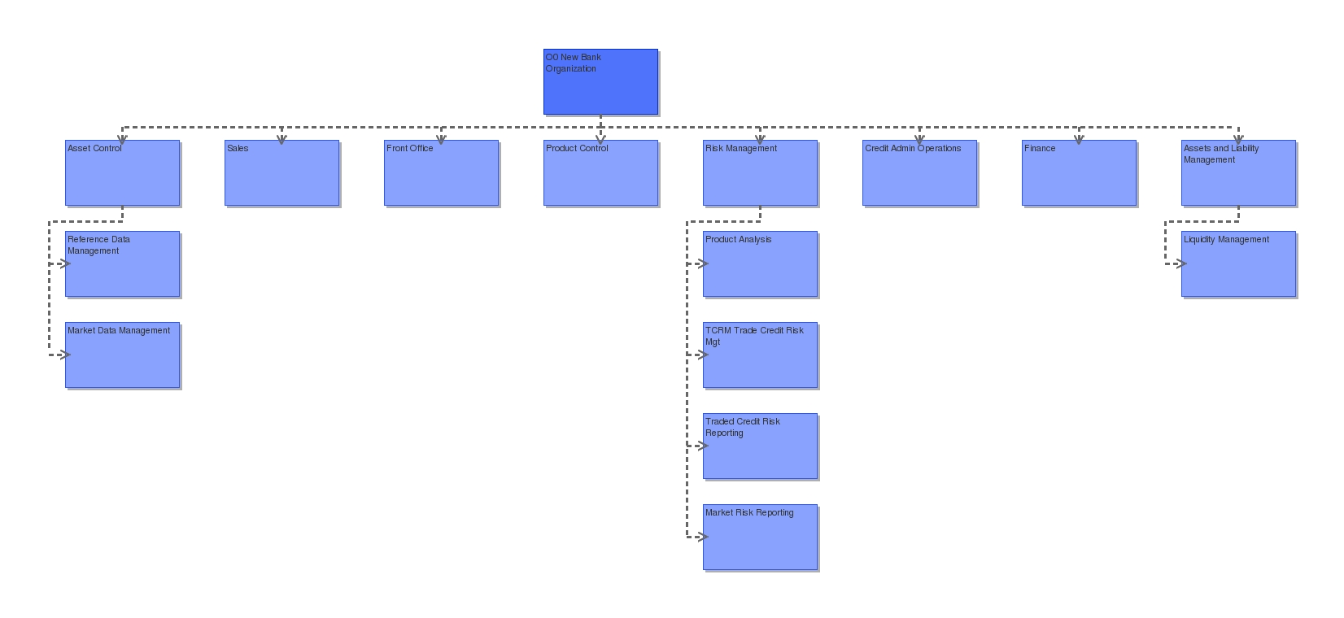
Master Head
i4Change – empower people to exceed expectations

