Slide 1
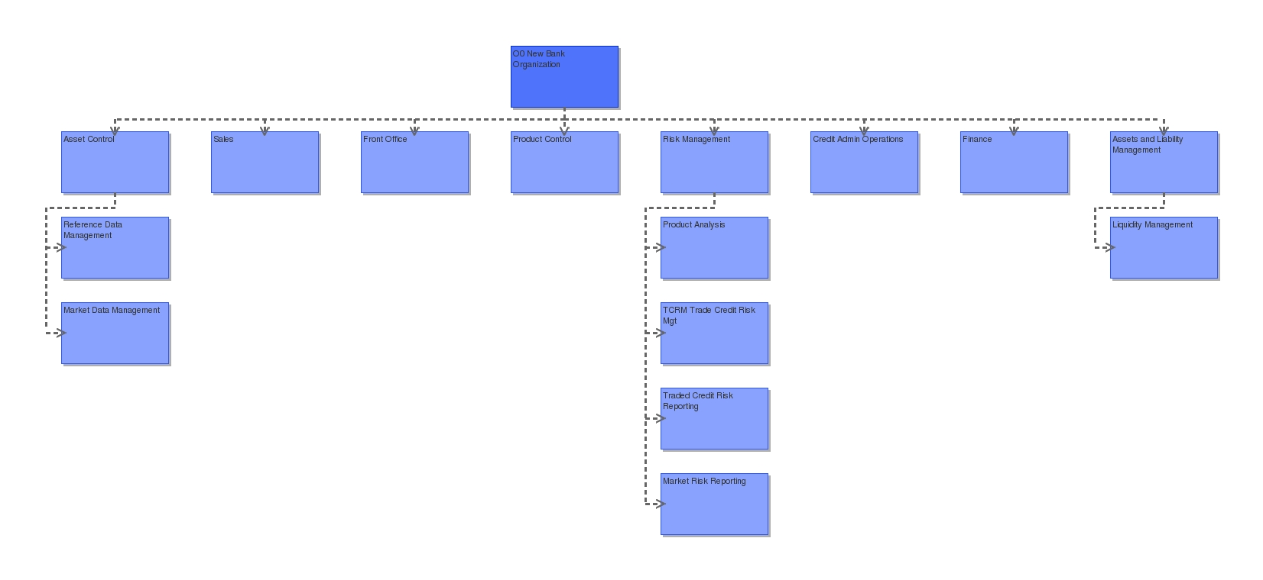
O0 Company Organization (Arial 24 pts bold RGB 0 76 76)
Please make font on shapes larger and better contract eg white on blue
i4Change export to ppt Test 001 v1msp 23mar09.ppt

Slide 2
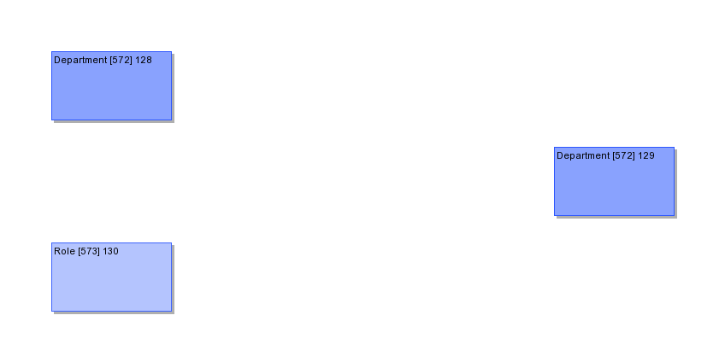
O0 Company Organization (Arial 24 pts bold RGB 0 76 76)
Please make font on shapes larger and better contract eg white on blue
i4Change export to ppt Test 001 v1msp 23mar09.ppt

Slide 3
Diagram-Name_19_03_2009_at_21_01
i4Change Рempower people to exceed expectations

