Slide 1
Concept Video
Team 2

Slide 2
Wavelength
Connecting compatible listeners
It can be hard to find friends with the same taste in music…
We propose Wavelength, a platform where users are matched with one another based on sampled music taste and geographical proximity. We encourage users to chat about their music taste, share songs with each other, or even meet in real life and go to a concert together.

Slide 3







Market Research
TasteBuds, POM
Soundcloud, Apple Music, Spotify
8tracks, Monolist
Connection of users based on music tastes, the main purpose is for users to date and meet in real life
Exploration and consumption of music, limited social components
Playlist and new music exploration
Our unique take: emphasis on 1 on 1 interaction, music discovery, excitement of successfully connecting, and we aren’t trying to make you date

Slide 4


Market Research
WAVELENGTH
Finding People
Finding Music

Slide 5
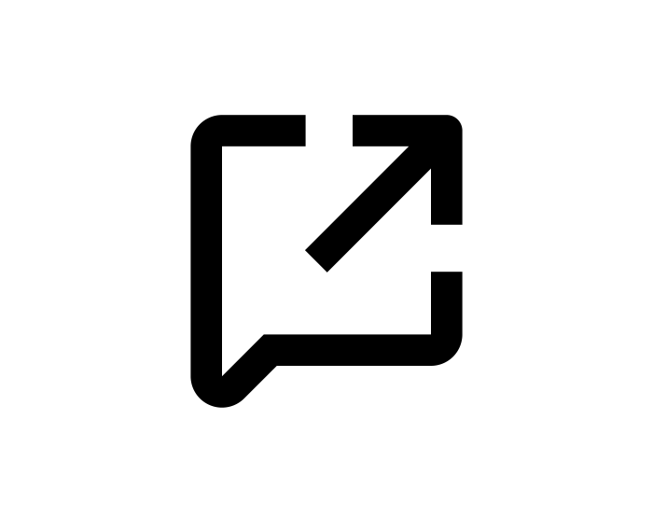
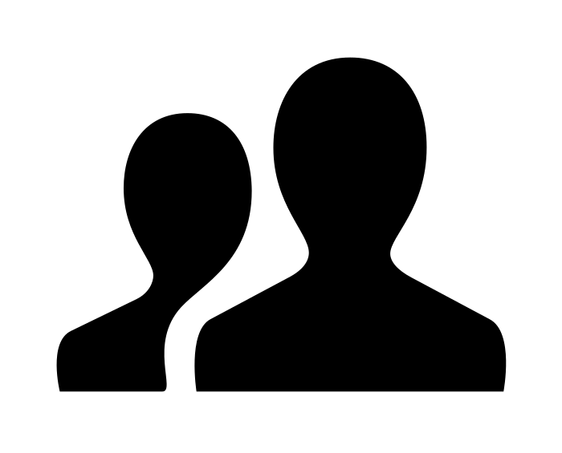
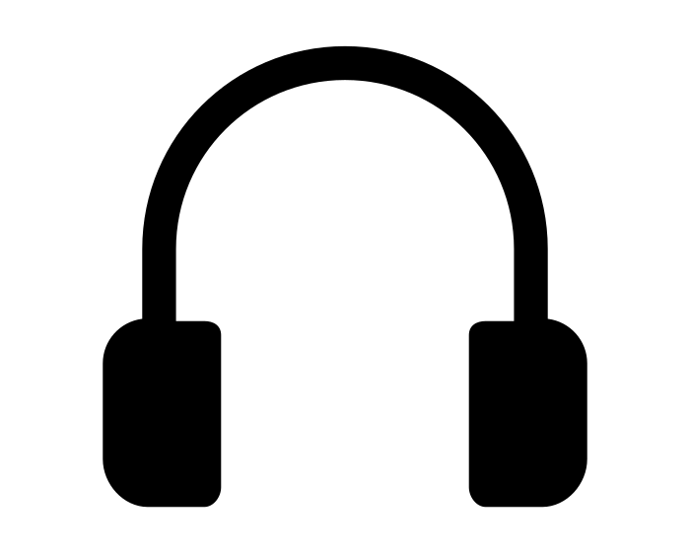
3 Levels of Tasks
Simple
Medium
Complex
Sharing a profile
Introducing candidate pairs
Live listener-to-listener interaction

Slide 6

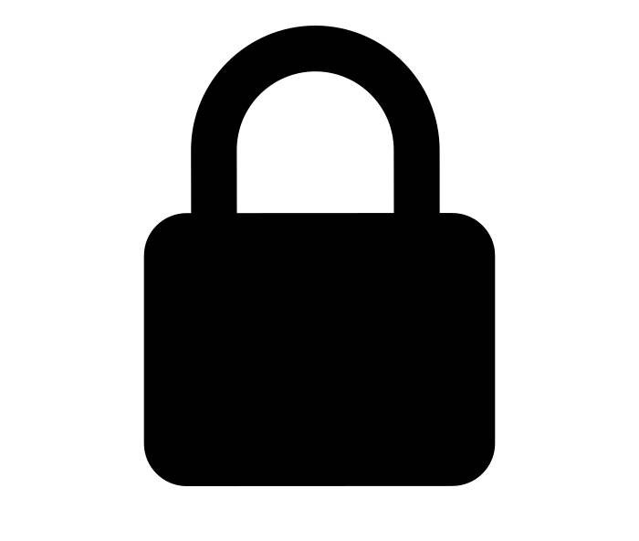
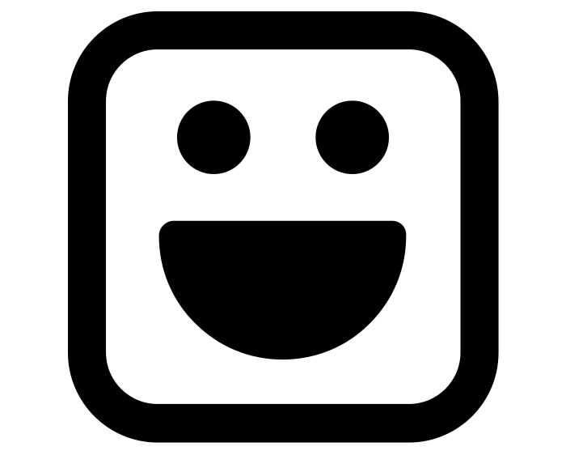
Values in Design
Simplicity
Protection of privacy
Fun!
We want our interface to be sleek and easy to navigate, while still providing users with the necessary features.
We want to keep users’ listening data private, sharing only with matched users.
The app will present matches in a way that gets the user excited.
Simplicity and fun may conflict. In creating a simple interface, we might lack exciting and engaging aesthetics. To combat this, we need to strike the right balance between visual appeal and ease of use.

Slide 7
Storyboarding

Slide 8
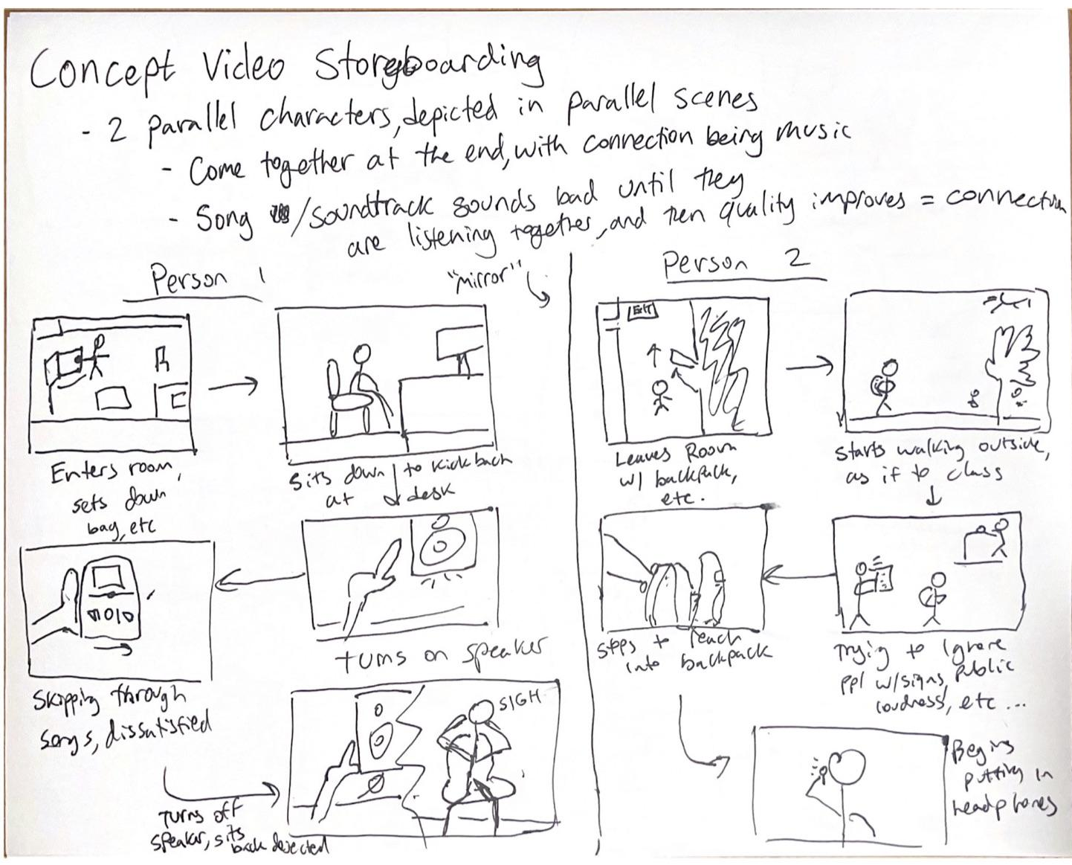
1

Slide 9
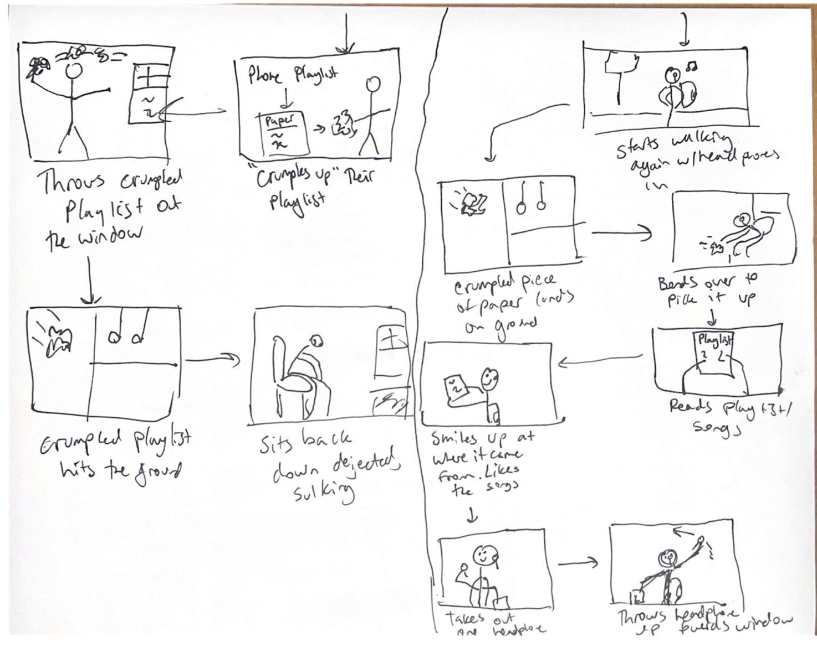
2

Slide 10
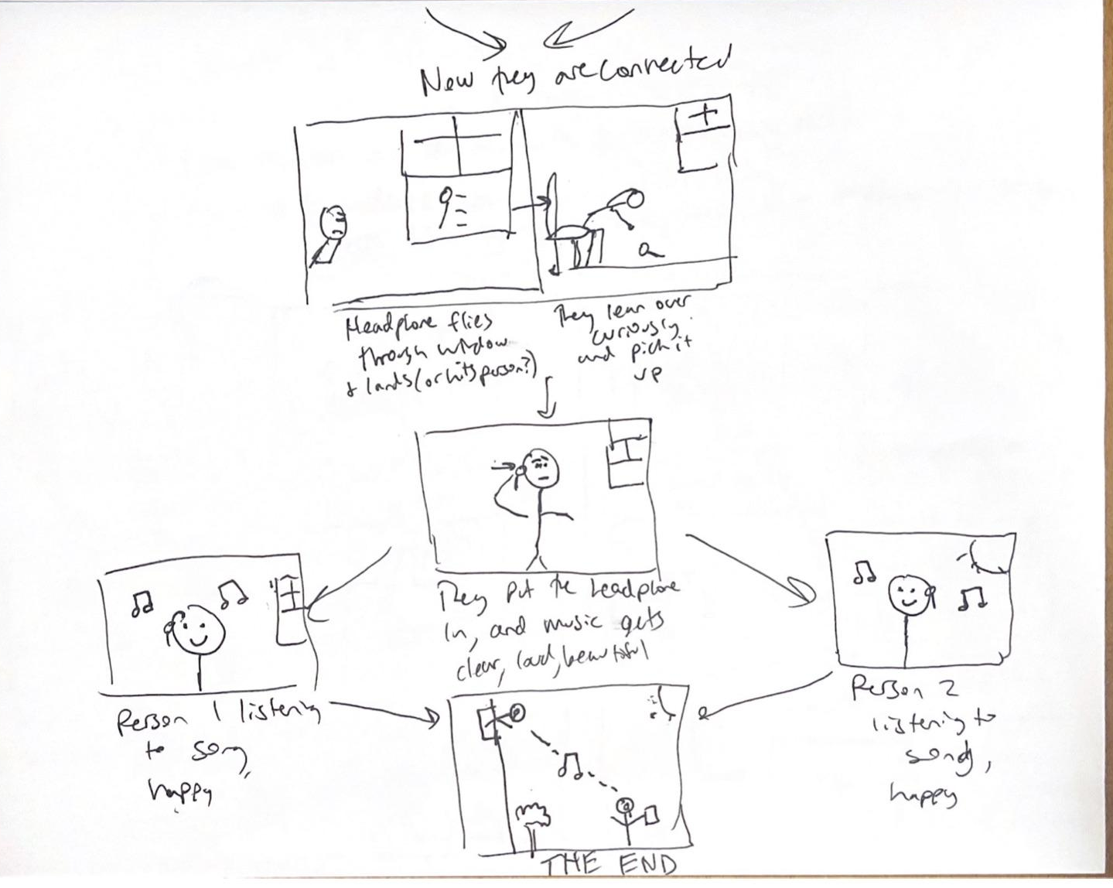
3

