Slide 1

Outnumbered
Sebastian Coles
Engineering Manager @ Clear Bank

Slide 2
House Keeping
My talk is in two parts, the first I want to talk about my rational when building roadmaps from ground zero. The second are the force multipliers that have worked for me to deliver at pace, there will be time for questions at the end.
I need more engineers in Infosec
Much of this talk is transferable
Every organisation is unique – market, tech, culture – All I am sharing is experience and reflections. I am sure the ethos of Credibility, Compassion & Collaboration will succeed regardless.

Slide 3


Ground Zero

Slide 4



Clear Bank
People
~400 people and 50% are in tech
We provide clearing and embedded finance products.
The vast majority of our offering is cloud native on a MS stack.
Volume
~1million transaction a week (now ~3million)
Estate
~500 deployable units of software

Slide 5
A Scalable Approach
You need to build the capability, not be the capability
Roadmap
You need a year plan that people can invest in and follow.
Report
You need a way to show the world is getting better.
Future
You need to enable todays infeasible things
A few things not to do
Panic and tell everyone to fix all the things, leading to frustration, burnout & martyrdom
Buy stuff (yet)
Write code
Put things in pipelines
…Fix things. Seriously.

Slide 6
Roadmap
Risk = Likelihood vs Impact
Business Mission
Infosec Strategy
Jugular Veins
Dumb Risk
Impact = Build the case around CIA (Confidentiality, Integrity and Availability) and value of assets. Lean on your Infosec team to help assess this argument
Do this one
Likelihood = Ease of access (public vs internal) increases risk, complexity, privileges and user interaction decrease risk,
The sweet spot is in the middle!
Make the narrative fit
… You can’t do everything this year. Accept it, and if you do well this year, you will be given more resource next year

Slide 7
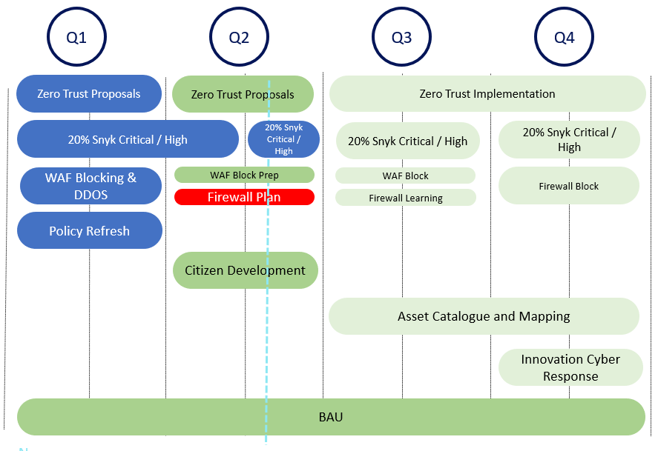
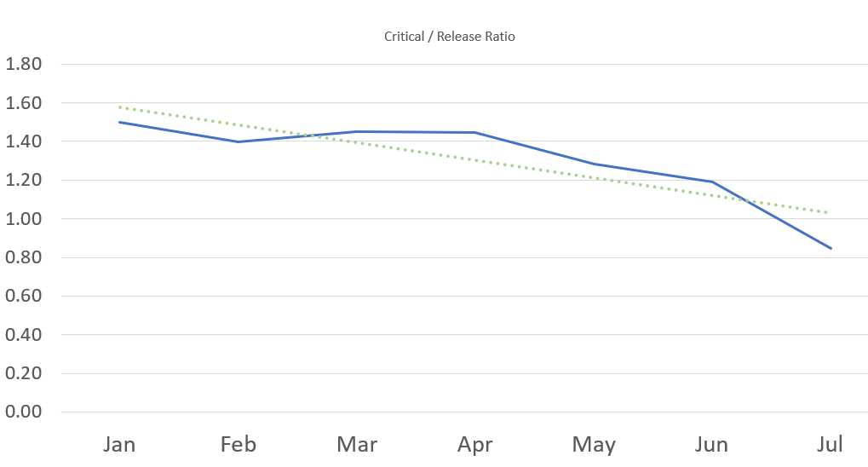
 |  |  |  |  | May | +/- | To go..
Prevent | % Software Security Training | <0.8 | <9.5 | >9.5 | 0.49 | -2.04% | 46.00%
 | % Threat Model Coverage | <0.02 | <0.04 | >0.04 | 0.04 | - | -
 | Consultancy Engagements | <0.01 | <0.02 | >0.02 | 0.02 | - | -
Find & Fix | Snyk Critical | >0.4 | >0.2 | <0.2 | 0.85 | -40.00% | -54.63%
 | Snyk High | >1.6 | >0.7 | <0.7 | 9.59 | -23.57% | -858.81%
 | Azure Security Policies | >0.2 | >0.1 | <0.1 | 1.37 | 16.06% | -127.30%
 | Manual Security Findings | >0.04 | >0.02 | <0.02 | 0.00 | - | 2.00%
Risk | Total Risk Issue Unmanaged | >0.04 | >0.02 | <0.02 | 0.16 | 6.25% | -13.57%
 | Risk Accepted | >0.04 | >0.02 | <0.02 | 0.01 | - | -
 | Promoted to RCSA Action | <0.02 | >0.02 | >0.04 | 0.00 | 0% | 1.59%
 | Resolved | <0.02 | >0.02 | >0.04 | 0.02 | 0% | 1.95%
Access | High Risk Access | >0.04 | <0.04 | <0.02 | 0.09 | -22.22% | -6.81%
 | Medium Risk Access | >0.02 | <0.2 | <0.1 | 0.06 | - | -
 | Low Risk Access | >0.4 | <0.4 | <0.2 | 0.16 | - | -
Report
01. Value
Proving the world is getting better through metrics helps build trust and evidence ROI
02. Transparency
If everything is green why should you get help? Red is a powerful colour.
03. Gamification
No one wants to be called out as the team with most flaws

Slide 8
Force Multipliers

Slide 9
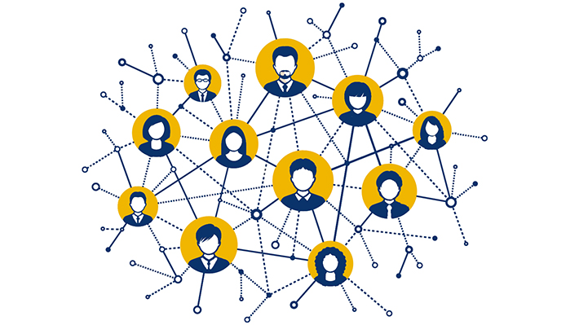
Think Network
Be One Hop Away
I don’t need an expert in every team. I need every team knowing who and when to bring in an expert.
Channels
Use the channels that your customers use to communicate. Lower the threshold for reaching out, do it on your customers terms.
Find Customers
Go and make friends before you need them. Go and listen to people's problems and extend your network. You’re a business partner now.
Be Helpful
Provide a useful service that people want to use. Engineers are smart enough to go around you

Slide 10

Trust is your currency
Safety enables change
Your asking engineers, teams & departments to work differently, to change. Change is hard, it’s even harder if we are feeling fear.
Things that build trust
Over communicating
Advertising changes and sticking to the plan
Being reasonable and sharing goals
Being vulnerable (emotionally)
Being honest, accountable and say sorry
Stop making security scary
Nothing makes me twitch more then hearing the phrase “what if we get hacked” as a rational to push a control. Don’t use current affairs or other organizations horror stories to scare people into action. It’s not sustainable and is the same as lighting your well-earned cash on fire.

Slide 11
SCARF
01
Status
We all have a story and experiences to share. We all provide our own value to the organization. Treat everyone with respect.
02
Certainty
Psychological safety enables rational conversation. Providing certainty in the world will help build trust.
03
Autonomy
Provide direction, advice and choices. We are all individuals and don’t enjoy being told how to do things
04
Relatedness
Why I generally only hire engineers. Everyone is doing too much, engineers have many pressures, be compassionate
05
Fairness
I try to build my personal brand on being reasonable. Sometimes security is should be at the top of the list, most of the time it shouldn’t, but it should always be managed
Your Brain at Work - David Rock
Notes:
https://www.interaction-design.org/literature/topics/design-thinking
Stage 1: Empathize—Research Your Users' Needsb
The first stage of the design thinking process allows you to gain an empathetic understanding of the problem you’re trying to solve, typically through user research. Empathy is crucial to a human-centered design process like design thinking because it allows you to set aside your own assumptions about the world and gain real insight into users and their needs.
Stage 2: Define—State Your Users' Needs and Problems
In the Define stage, you accumulate the information you created and gathered during the Empathize stage. You analyze your observations and synthesize them to define the core problems you and your team have identified so far. You should always seek to define the problem statement in a human-centered manner as you do this.
Stage 3: Ideate—Challenge Assumptions and Create Ideas
Designers are ready to generate ideas as they reach the third stage of design thinking. The solid background of knowledge from the first two phases means you can start to “think outside the box”, look for alternative ways to view the problem and identify innovative solutions to the problem statement you’ve created.
Stage 4: Prototype—Start to Create Solutions
This is an experimental phase, and the aim is to identify the best possible solution for each of the problems identified during the first three stages. Design teams will produce a number of inexpensive, scaled-down versions of the product (or specific features found within the product) to investigate the problem solutions generated in the previous stage.
Stage 5: Test—Try Your Solutions Out
Designers or evaluators rigorously test the complete product using the best solutions identified in the Prototype phase. This is the final phase of the model but, in an iterative process such as design thinking, the results generated are often used to redefine one or more further problems. Designers can then choose to return to previous stages in the process to make further iterations, alterations and refinements to rule out alternative solutions.

Slide 12
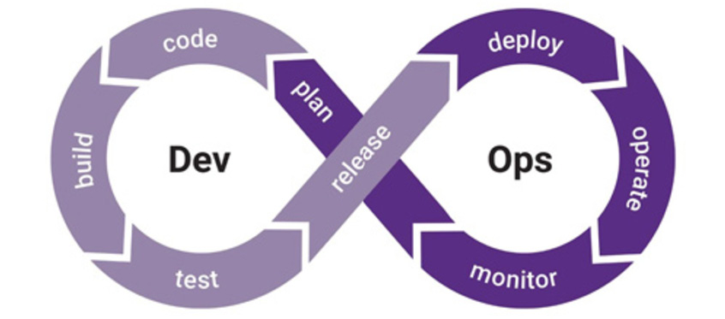
Invest in the process
When you focus on the process every product wins
Every product going through the process will gain the benefit. When a vulnerability is found, the root cause is in the process and that is the priority. My to do list does not go out the window because .NET has a new vulnerability. We all have limited resources, and this is the better investment. Sometimes things need to smolder a little…
Notes:
https://www.interaction-design.org/literature/topics/design-thinking
Stage 1: Empathize—Research Your Users' Needsb
The first stage of the design thinking process allows you to gain an empathetic understanding of the problem you’re trying to solve, typically through user research. Empathy is crucial to a human-centered design process like design thinking because it allows you to set aside your own assumptions about the world and gain real insight into users and their needs.
Stage 2: Define—State Your Users' Needs and Problems
In the Define stage, you accumulate the information you created and gathered during the Empathize stage. You analyze your observations and synthesize them to define the core problems you and your team have identified so far. You should always seek to define the problem statement in a human-centered manner as you do this.
Stage 3: Ideate—Challenge Assumptions and Create Ideas
Designers are ready to generate ideas as they reach the third stage of design thinking. The solid background of knowledge from the first two phases means you can start to “think outside the box”, look for alternative ways to view the problem and identify innovative solutions to the problem statement you’ve created.
Stage 4: Prototype—Start to Create Solutions
This is an experimental phase, and the aim is to identify the best possible solution for each of the problems identified during the first three stages. Design teams will produce a number of inexpensive, scaled-down versions of the product (or specific features found within the product) to investigate the problem solutions generated in the previous stage.
Stage 5: Test—Try Your Solutions Out
Designers or evaluators rigorously test the complete product using the best solutions identified in the Prototype phase. This is the final phase of the model but, in an iterative process such as design thinking, the results generated are often used to redefine one or more further problems. Designers can then choose to return to previous stages in the process to make further iterations, alterations and refinements to rule out alternative solutions.

Slide 13

Security is like managing a portfolio
It’s a game of risk
There are two types of risk in the stock market. Systemic risk – a risk associated with given market such as O&G – and firm specific risk – the risk the CFO is embezzling. It is generally infeasible to reduce the latter risk through research – it is reduced through diversification.
IMH - possibly controversial - O, I feel the same way about SDLC assurance controls. I would much rather have a diversification of people, process and tool controls to cover many basis along the SDLC that are 80% effective, then to have a few that are 99%
And by risk, I mean
The control doesn’t catch a security flaw
Engineers do not adopt, avoid, game the control
The control doesn’t live up to the pre-sales talk
The renewal blows your budget our of the water
Notes:
https://www.interaction-design.org/literature/topics/design-thinking
Stage 1: Empathize—Research Your Users' Needsb
The first stage of the design thinking process allows you to gain an empathetic understanding of the problem you’re trying to solve, typically through user research. Empathy is crucial to a human-centered design process like design thinking because it allows you to set aside your own assumptions about the world and gain real insight into users and their needs.
Stage 2: Define—State Your Users' Needs and Problems
In the Define stage, you accumulate the information you created and gathered during the Empathize stage. You analyze your observations and synthesize them to define the core problems you and your team have identified so far. You should always seek to define the problem statement in a human-centered manner as you do this.
Stage 3: Ideate—Challenge Assumptions and Create Ideas
Designers are ready to generate ideas as they reach the third stage of design thinking. The solid background of knowledge from the first two phases means you can start to “think outside the box”, look for alternative ways to view the problem and identify innovative solutions to the problem statement you’ve created.
Stage 4: Prototype—Start to Create Solutions
This is an experimental phase, and the aim is to identify the best possible solution for each of the problems identified during the first three stages. Design teams will produce a number of inexpensive, scaled-down versions of the product (or specific features found within the product) to investigate the problem solutions generated in the previous stage.
Stage 5: Test—Try Your Solutions Out
Designers or evaluators rigorously test the complete product using the best solutions identified in the Prototype phase. This is the final phase of the model but, in an iterative process such as design thinking, the results generated are often used to redefine one or more further problems. Designers can then choose to return to previous stages in the process to make further iterations, alterations and refinements to rule out alternative solutions.

Slide 14

Get over “politics”
The minute you started needing time on someone else’s backlog…
It got political.
There are always “Human Factors”

Slide 15
My Reading List
Books I would recommend if you want to make an impact at pace
Your Brain at Work – David Rock
Never Split The Difference – Chris Voss
Crucial Conversations – Kerry Patterson
How To Talk So Kids Will Listen – Adele Faber
Turn the Ship Around – David Marquet
Good Strategy Bad Strategy – Richard Rumelt
First Break All the Rules – Marcus Buckingham
Thinking Fast and Slow – Daniel Kahneman
The Chimp Paradox – Steve Peters
Accelerate – Gene Kim
… Software Security is a people problem. I battle with psychology more then hackers
Notes:
https://www.interaction-design.org/literature/topics/design-thinking
Stage 1: Empathize—Research Your Users' Needsb
The first stage of the design thinking process allows you to gain an empathetic understanding of the problem you’re trying to solve, typically through user research. Empathy is crucial to a human-centered design process like design thinking because it allows you to set aside your own assumptions about the world and gain real insight into users and their needs.
Stage 2: Define—State Your Users' Needs and Problems
In the Define stage, you accumulate the information you created and gathered during the Empathize stage. You analyze your observations and synthesize them to define the core problems you and your team have identified so far. You should always seek to define the problem statement in a human-centered manner as you do this.
Stage 3: Ideate—Challenge Assumptions and Create Ideas
Designers are ready to generate ideas as they reach the third stage of design thinking. The solid background of knowledge from the first two phases means you can start to “think outside the box”, look for alternative ways to view the problem and identify innovative solutions to the problem statement you’ve created.
Stage 4: Prototype—Start to Create Solutions
This is an experimental phase, and the aim is to identify the best possible solution for each of the problems identified during the first three stages. Design teams will produce a number of inexpensive, scaled-down versions of the product (or specific features found within the product) to investigate the problem solutions generated in the previous stage.
Stage 5: Test—Try Your Solutions Out
Designers or evaluators rigorously test the complete product using the best solutions identified in the Prototype phase. This is the final phase of the model but, in an iterative process such as design thinking, the results generated are often used to redefine one or more further problems. Designers can then choose to return to previous stages in the process to make further iterations, alterations and refinements to rule out alternative solutions.

Slide 16
Thanks! Question Time https://www.linkedin.com/in/sebastiancoles/

