Slide 1
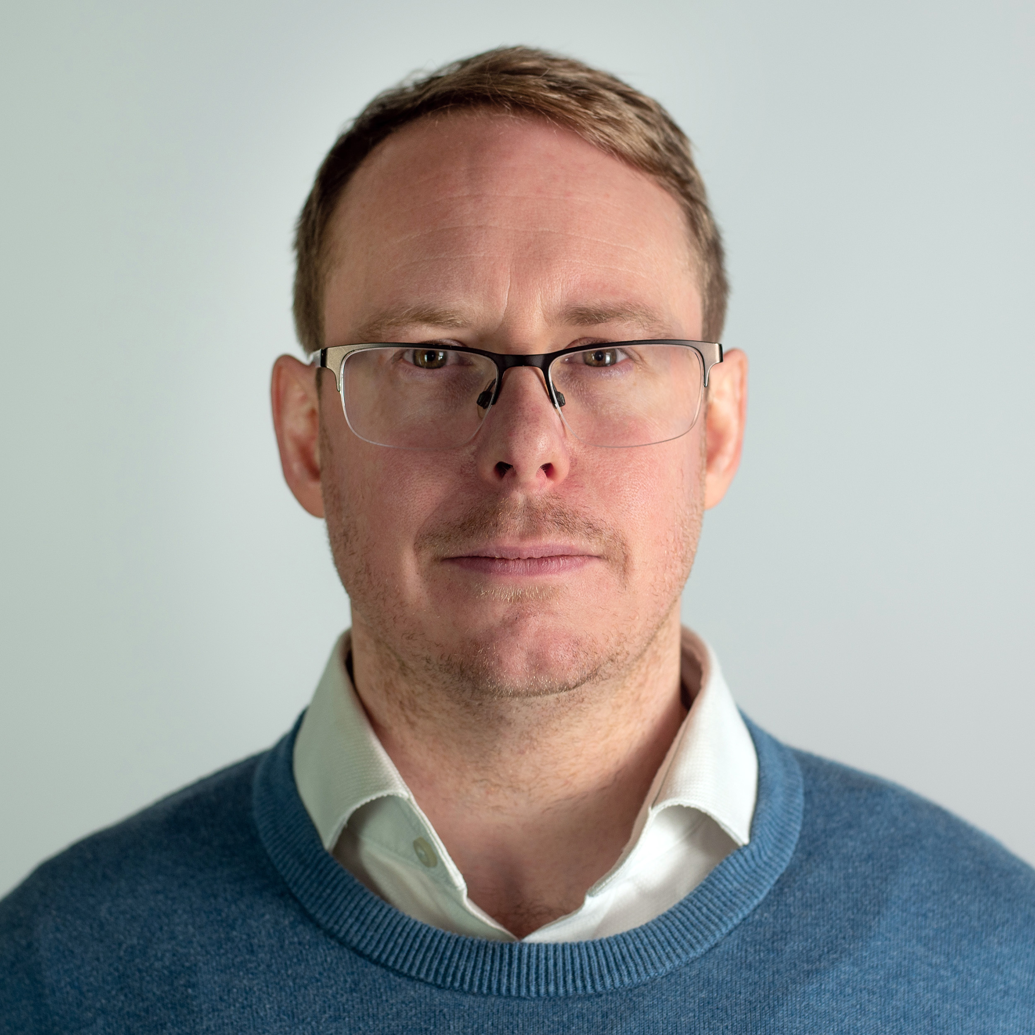
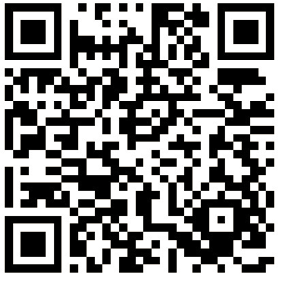

Grand Social Engineering DevSecOps and Influence
Seb Coles
Infosec & IT @ Seccl

Slide 2



Planning for Change
How to play the game, the literature and theories on how to win this well researched topic.
How DevSecOps starts and ends
Talented engineer with an interest in security wants to change the organisation for the better!
They are moved into an influencing role with no support or training (and they don’t even know the game they are playing has changed)
They get frustrated that they can’t change things, They can’t get time on team’s backlogs and people are not adopting the tools.
They Burnout, They Give Up, They Quit
Stakeholder Management
This isn’t just a CV buzz word; this is your invisible power within the organisation, and you need to cultivate it
How DevSecOps starts and ends
Talented engineer with an interest in security wants to change the organisation for the better!
They understand the rules of the game they are playing, one of influence and change
They realise they are battling psychology more then hackers.
They understand this game can take awhile, but they will win eventually
Changing a Mind
It doesn’t matter how virtuous your chance is, its still hard. Plan and learn the skills to overcome it
Changing an Organisation
FUD management & consistent, clear communications, Leadership

Slide 3

Planning for Change
6. Short Term Wins
People First
Measure Engagement
Automatic Metric SAST, SCA, IaC Scanning, CSPM selection and implementation
Kotters 8 Steps
1. Urgency
Posture
Developer Security Education so you can build common language
Security Maturity Model BSIMM, SAMM, NIST SDF, SALSA – I like BSIMM
Threat Modelling to allow frequent touch points
Ground Zero
Year 1
Year 2
Develop a Roadmap Showing nirvana and the destination
Secondments and Rotations to help share knowledge and working practises
Security Chapters providing a network, development ground, feedback, fans, resourcing, market insights
Succession Planning and being generous with responsibilities
3. Vision
5. Empower
Change
8. Make it Stick
2. Coalition
Gamification promote the teams who are doing well and help that teams that are struggling
Establishing Front Door and Onboarding being accessible and training the next 10%
7. Don’t Let Up
4. Communicate
Frequently Present and the all-hand platforms
Kotter, J., 1999. What Leaders Really Do, 1st Edition, Harvard Business School, 1999

Slide 4





Stakeholder Management
Key Players
High Power / High Interest – Must cultivate
Irrelevant
Low Power / Low Interest – Minimise efforts
Sleeping Giants
High Power / Low Interest – Keep Satisfied
Gadflies
Low Power / High Interest – Keep Informed
Slack, N., 2015. Operations Strategy. 4th ed. Harlow: Pearson Education.

Slide 5
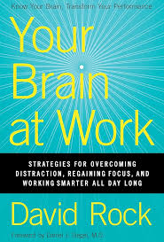
Changing a Mind
Context of Rolling out Pipeline Blocking Vulnerability Scanning Tool…
Status
Certainty
Autonomy
Acknowledge each team member's role to boost engagement.
Provide clear rules to the game to reduce ambiguity.
Allow decision-making freedom to enhance ownership.
"You’re now part of an elite group that ships secure, enterprise-grade code."
Be crystal clear about when and why a block happens, and what teams can do about it
Allow controlled bypasses and education, guides on how to remediate
Relatedness
Fairness
We’re all stretched to thin, and were all trying to build a quality product
Ensure equal treatment to maintain morale, treat all teams the same
Acknowledge the painful but explain why you’re doing it, and be available to help
Ensure consistent application and levels of support across all teams
Rock, D. (2009). Your Brain at Work: New York: Harper Business

Slide 6

Changing a Mind
Anger
Acceptance
Context of Removing Local Admin…
How dare the take my permissions away!
Maybe its for the best..
Listening, Validation, but avoid selling with logic and give time for emotions to simmer
You’ve ridden the wave and made it through, without taking it personally!
Denial
Bargaining
They won’t take my permissions away
Remain firm at this stage and avoid bargaining, certainty and time are needed
Can it be granted on approval? Just in time?
Depression
Now we have buy-in, lets work together to make it better
Security getting in the way and putting up barriers to execution
Give Time, Be available and start to share hope of improvements
Kübler-Ross, E. (1969) On Death and Dying. New York: Macmillan.​

Slide 7
Changing an Organisation
DevSecOps is not a rebellion. It can be Novel, it can be Virtuous, but it’s also just good business, align this to Customer Value, Compliance and Risk Reduction Initiatives. Alignment gives your story credibility
People like stories, theres a wealth of literature on this. Plots that make sense, Characters who are relatable, and of course Heros. Practice and Plan the story you want to tell
Alignment with Strategy
Audience Centric Design
Consistency Across Channels
Clarity and Simple
Credibility
Narrative Planning
Understand your audience (developers, infosec, senior management) and tailor you're messaging. Every other change in the business is being lazy (broadcasting, single channel). If you want to win, spend the time to make your story interesting.
If you're leading this charge you need to be the change you want to be. Honest, Transparent, Believable. Don’t Over Hype statements, Don’t use FUD.
Go deep with interested folk in the right settings (such as security champions). When taking advantage of platforms such as All Hands, keep it simple, clear, memorable!
Yes, you will need to use a multi channel approach. Not all your stakeholders use email, slack, or turn up to the meetings you think. Consistency builds trust.
Argenti, P.A., 2007. Corporate Communication. 4th ed. New York: McGraw-Hill/Irwin.

Slide 8
Learn about Change Management 8 Steps for Change – John Kotter – What Leaders Really Do Manage your Stakeholders Power Interest Grid - Nigel Slack - Operations Strategy Plan for Resistance SCARF Model - David Rock – Brain at Work Greif Cycles – Elizabeth Kubler-Ross – On Death and Dying Communicate Like a Boss Internal Comms Model – Paul Argenti – Corporate Communications
Thank You & Questions

