Slide 1
Python for Data Science/ML Getting Started
Introduction to Deep Learning

Slide 2
Learning outcomes
Why Python?
Installation
Jupyter

Slide 3
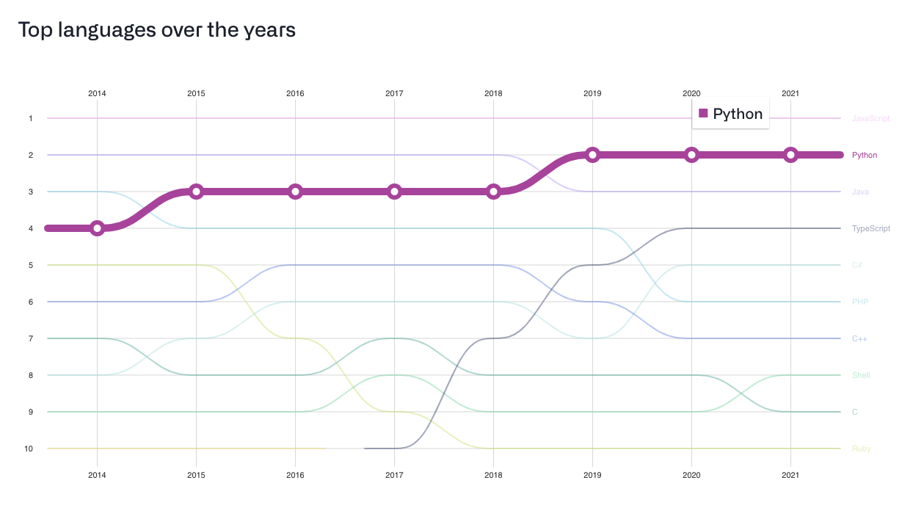
Why Python?
https://octoverse.github.com/#top-languages-over-the-years
Notes:
Javascript great for webapps, backend front-end
Python closely following js there is a lot of development and innovation happening in Python universe
2nd most used language with in github

Slide 4
Why Python?
You don’t have to start from scratch PyPI
ML with scikit-learn https://scikit-learn.org/stable/
ML with Pandas https://pandas.pydata.org/
TensorFlow https://www.tensorflow.org/
PyTorch https://pytorch.org/
Hugging Face https://huggingface.co/
  SOTA NLP
Notes:
Libraries
API … all using python

Slide 5
Installation: Environment Initialization
We start our tutorial with introduction to environments.
Creating environments prevents many errors including contradictions between libraries, bugs in recently updated libraries, problems with migrations and many more.
It is a good habit to create a separate environment for each project.
pip is a package-management system written in Python used to install and manage software packages.
PIP is already installed if you are using Python 3 >=3.4 downloaded from python.org or if you are working in a Virtual Environment created by virtualenv or pyvenv. Just make sure to upgrade pip. If it is not the case, download pip from the link (https://bootstrap.pypa.io/ ), then you can run following command in the COMAND PROMPT.
Notes:
Libraries
API … all using python

Slide 6
Installation: Environment Initialization
      $ cd /path/to/downloadsfolder
      $ python get-pip.py
Now you can use pip command, let's try it with installation of the environment library.
$ pip3 install virtualenv
You have just installed library virtualenv which allows you to create environments as follows:
$ virtualenv myfirstenvironment
$ source myfirstenvironment/bin/activate
Notes:
Libraries
API … all using python

Slide 7
Installation: Environment Initialization
      Now, you can install any package you want to the environment. For instance, you can install numpy - a very popular library for working with vectors
$ pip install numpy
Jupyterlab you’ll be using throughout the course
$ pip install jupyterlab
You can also use Conda, Follow the guide on moodle /Week1/Getting_started Notebook
You can also use
Colab
Notes:
Libraries
API … all using python

