Slide 1
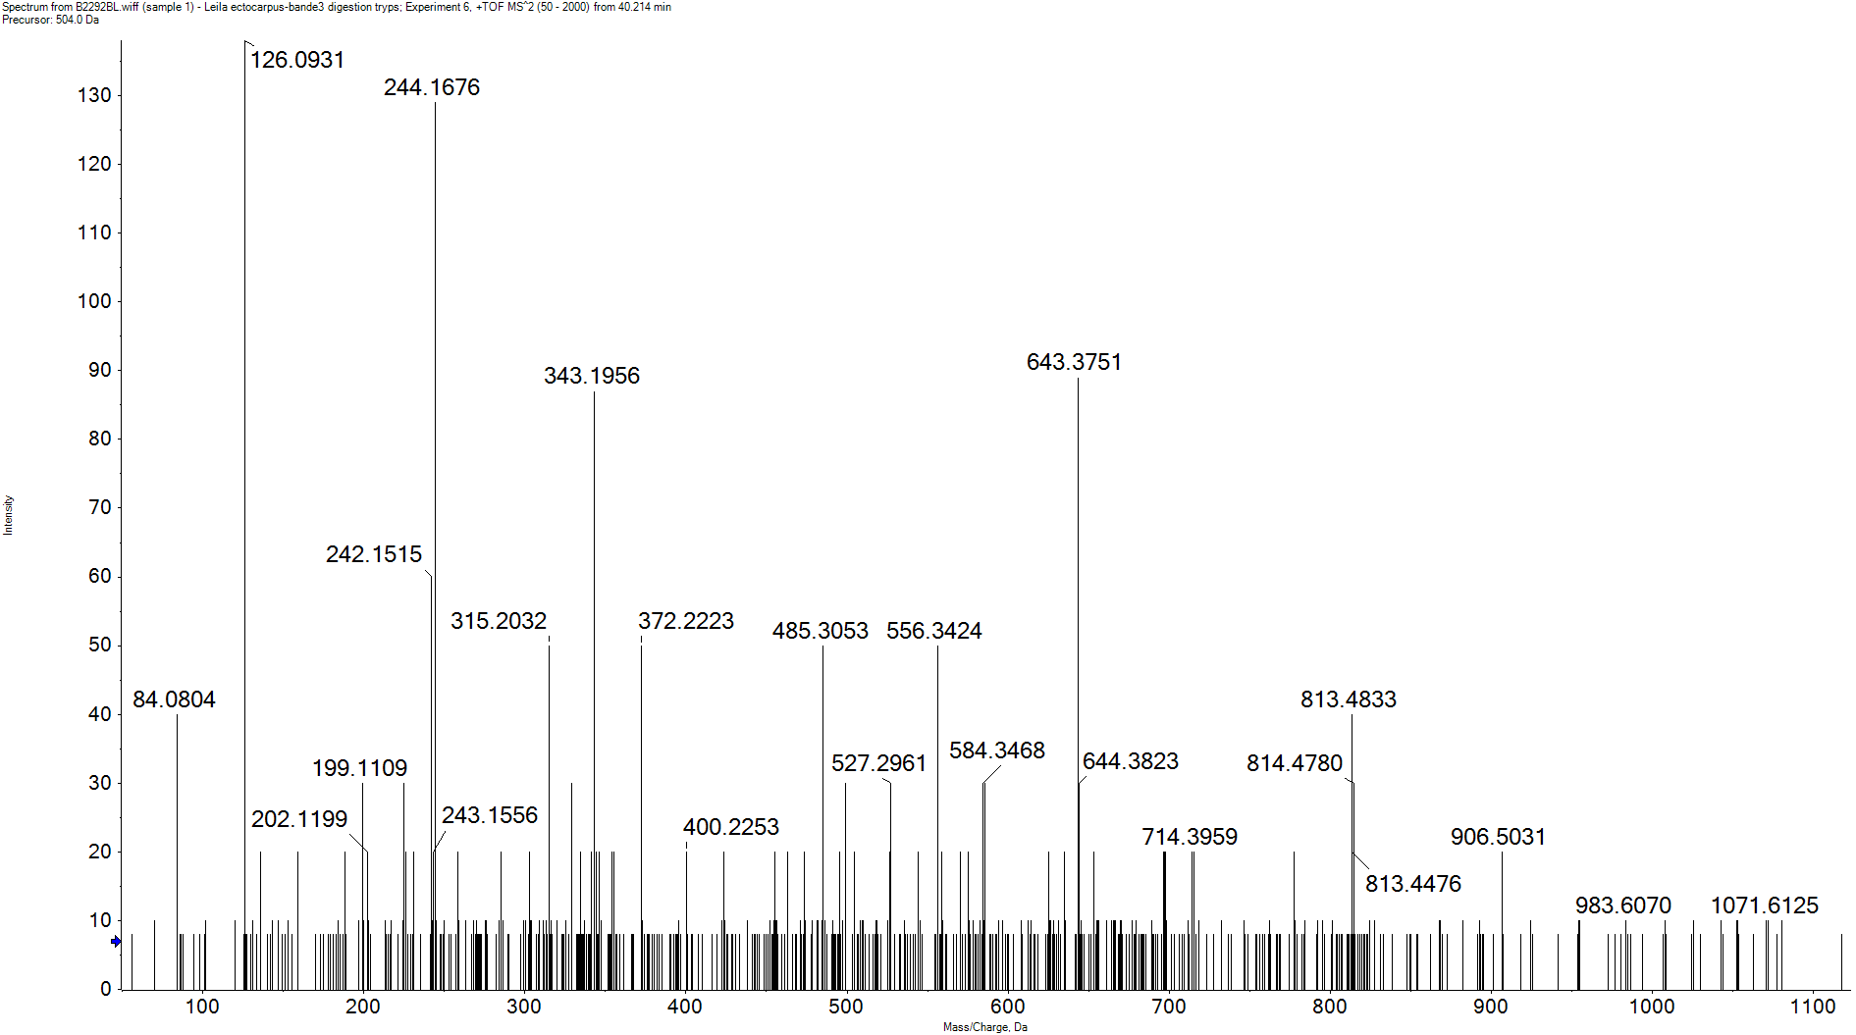
H2B Ac (K2, K6, K7 and K10)
Y10²⁺
y8
y7
y2
y9
y6
y5
y4
y3
A KAc T P S KAc KAc S A KAc A P K
b2
b3
b5
b7
b8
a10²⁺
y2
Im Kac-NH3
b3
y6
b2
y3
y4
y5
y10²⁺
y7
b5
a10²⁺
b8
y8
y9
b7

Slide 2
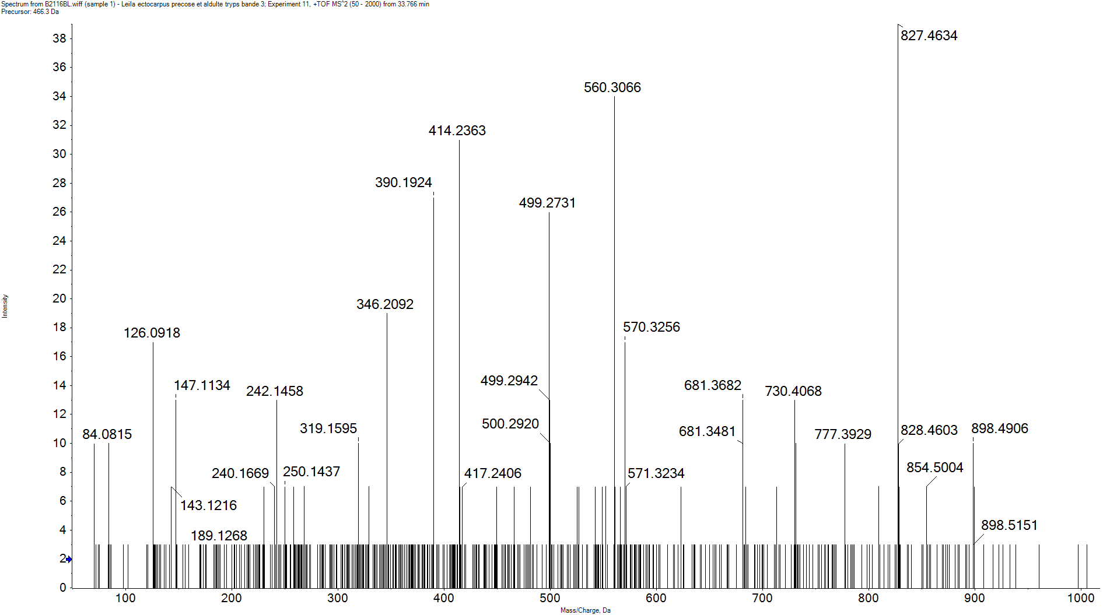
H2B Ac (K7, K10, K13 and K14)
y7²⁺
y8
y7
y6
y5
y4
y3
y1
KAc S A KAc A P KAc KAc A G D K
b2
b3
b4
b5
a2
y5
y7
y7²⁺
y4
b4
Im Kac-NH3
b5
y1
y6
y3
y8
a2
b2
[M+3H]³⁺
b3

Slide 3
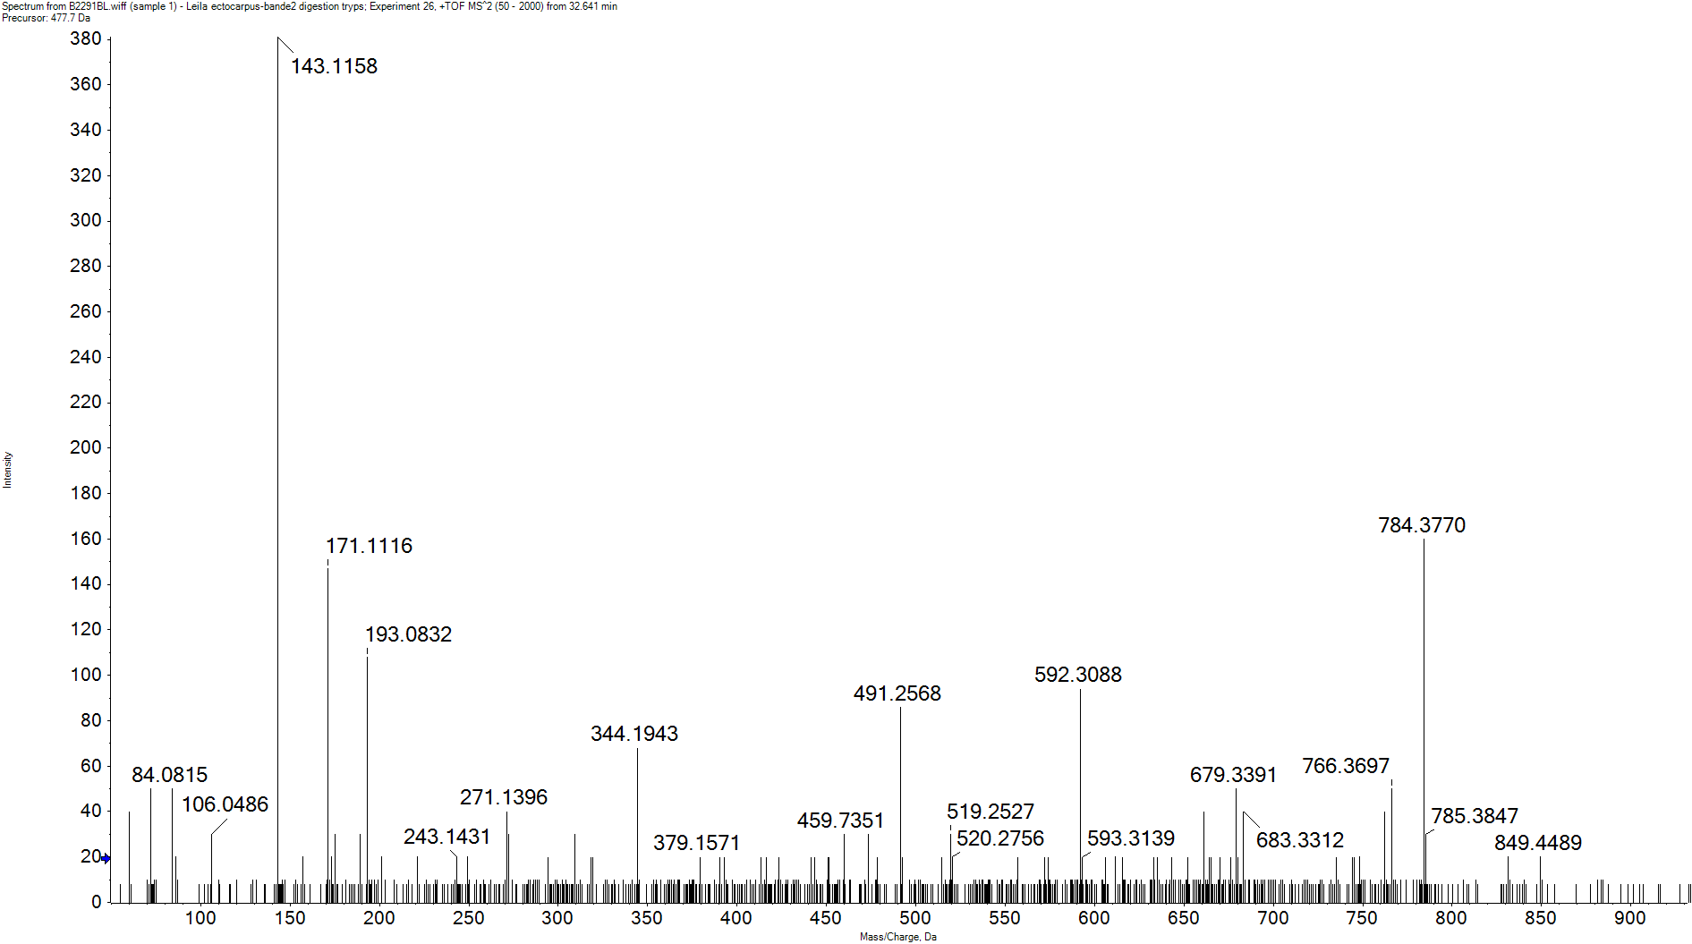
H2B Ub (K111)
GG
y7
y6
y5
y4
y3
y2
y1
A V T K F T S S
b2
b4
b5
b6
b7
a2
y6
b2
y2
b5-AV
b6-AV
b4-AV
b7-AV
b8-AV
y1
b5
y5
b6
b7
y3
y4
b4
y7

Slide 4
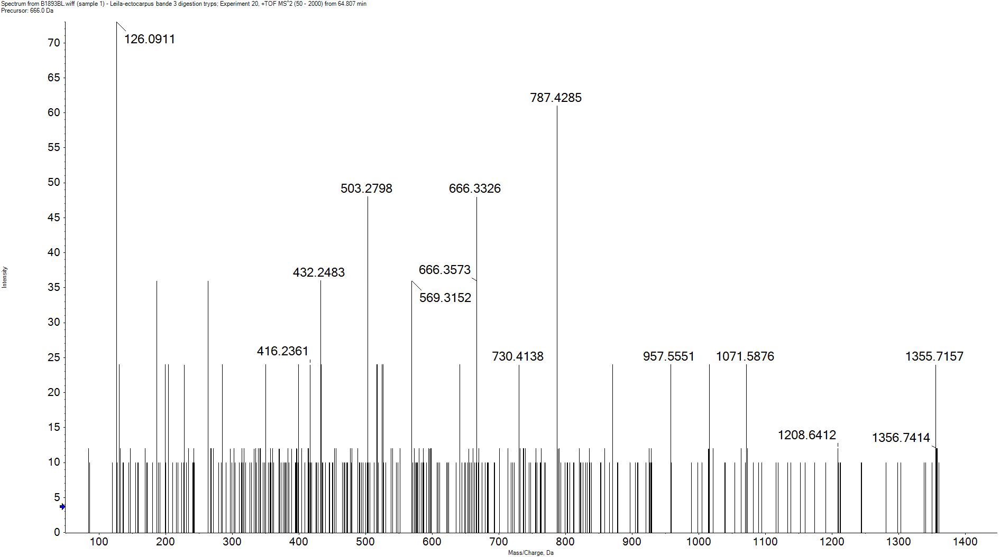
H2A (D7) Ac (K3, K6, K9, K12 and K15) and Ac N-ter
y14
y10
y9
y8
y7
y5
y4
y2
y1
y11
Ac-S G KAc G G KAc G G KAc G G KAc G G KAc A P T S K
b3
b6
Im Kac-NH3
y8
y5
[M+3H]³⁺
y4
y7
y9
y10
y11
y14
b6
y1
y2
b3

Slide 5
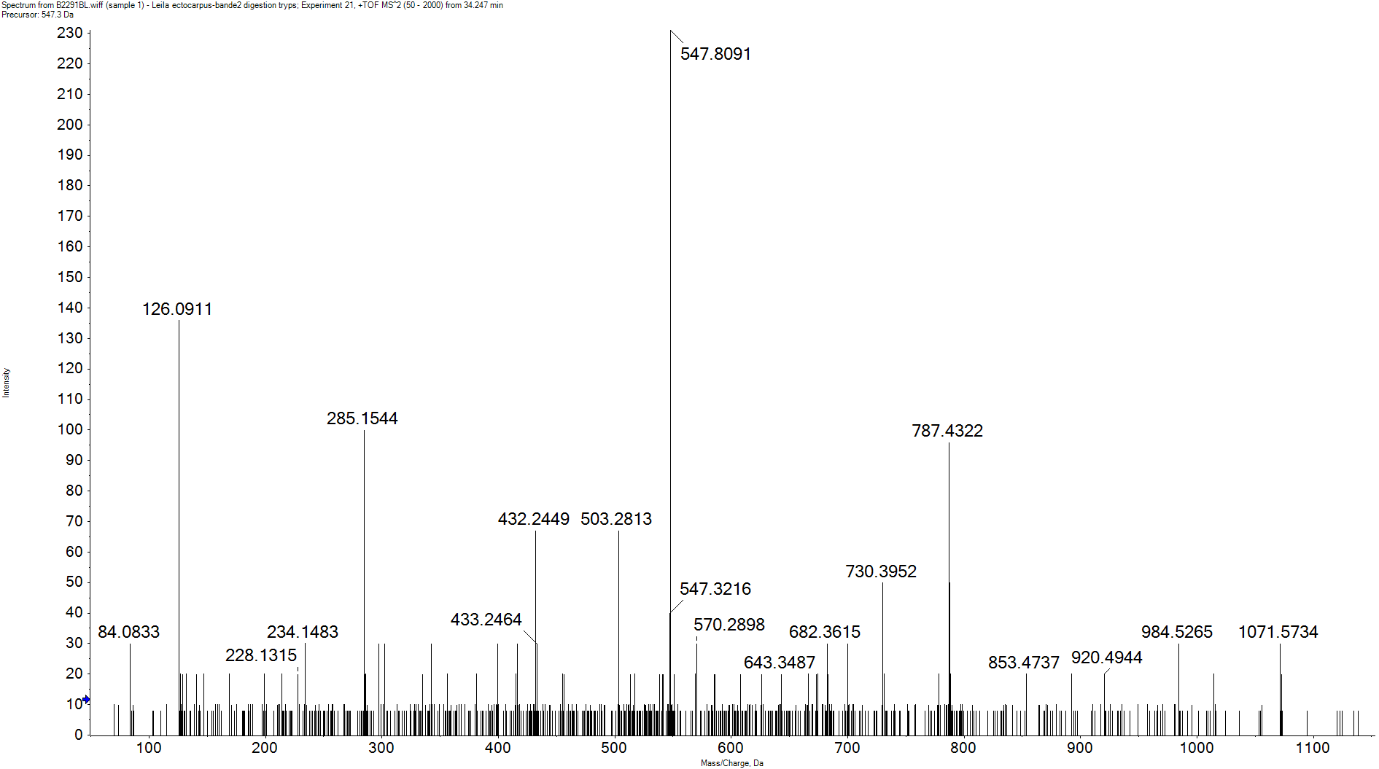
H2A (D7) Ac (K6, K9, K12 and K15)
y11
y10
y8
y7
y6
y5
y4
y3
y2
y1
G G KAc G G KAc G G KAc G G KAc A P T S K
b3
b4
b5
b6
b7
b9
[M+3H]³⁺
Im Kac-NH3
b3
y8
y4
y5
y7
y2
b5
b6
y6
y11
b4
b9
y1
y3
b7
y10

Slide 6
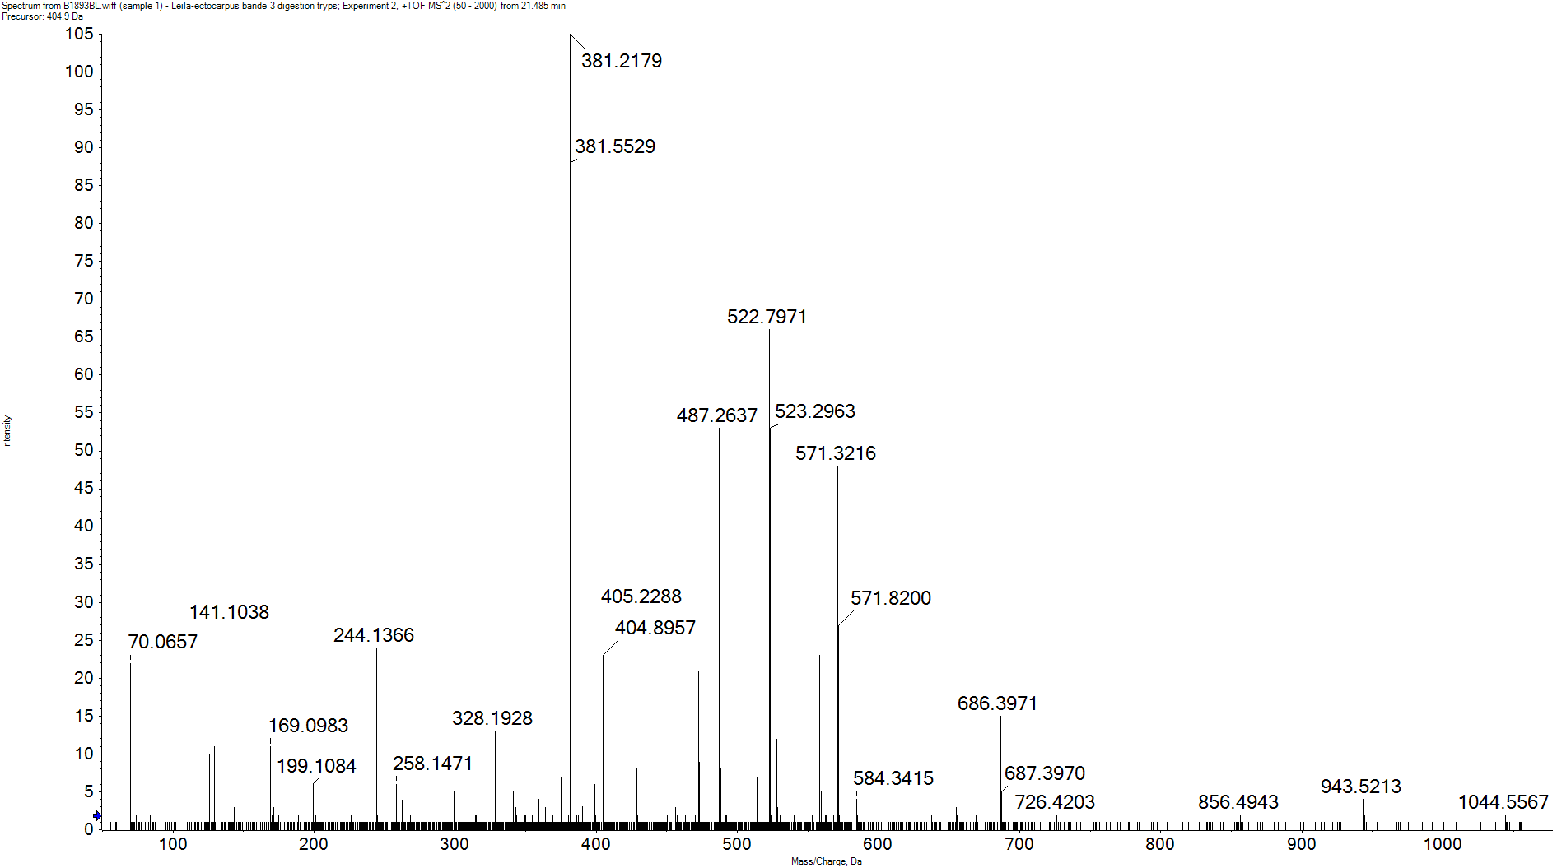
H2A (D7) Ac (K20) AND Ac N-ter
y10³⁺
y9²⁺
y8²⁺
y7²⁺
y4²⁺
y9
y8
y6
y5
y4
y10²⁺
y7
y3
y2
y1
A P T S K KAc A P Q S R
b2
b3
b5
b6
b7
a2
b6²⁺
y10³⁺
y9²⁺
y4
y10²⁺
a2
[M+3H]³⁺
y4²⁺
y5
y8²⁺
y6
b2
b6²⁺
b3
b5
b7
y7²⁺
y8
y9
y1
y2
y3
b6
y7

Slide 7
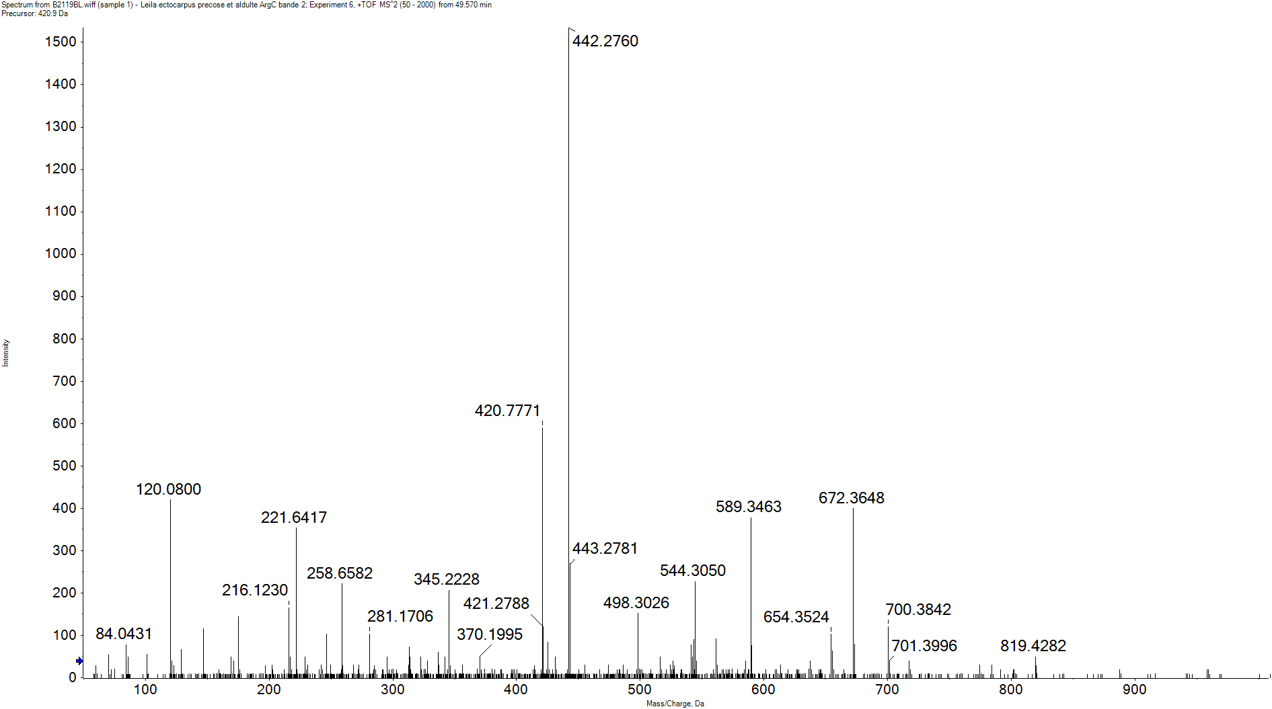
H2A (D7) Me (R38)
y6*
y4²⁺
y9
y8
y6
y5
y4
y3
y2
S S K A G L Q F P V G RMe
b2
b5
b6
b7
b8
a2
a6²⁺
b7º
b7²⁺
y4
[M+3H]³⁺
y5
b7
y4²⁺
a6²⁺
y3
b6
b7º
y6*
a2
b2
y2
b5
y6
b8
b7²⁺
y8
y9

Slide 8
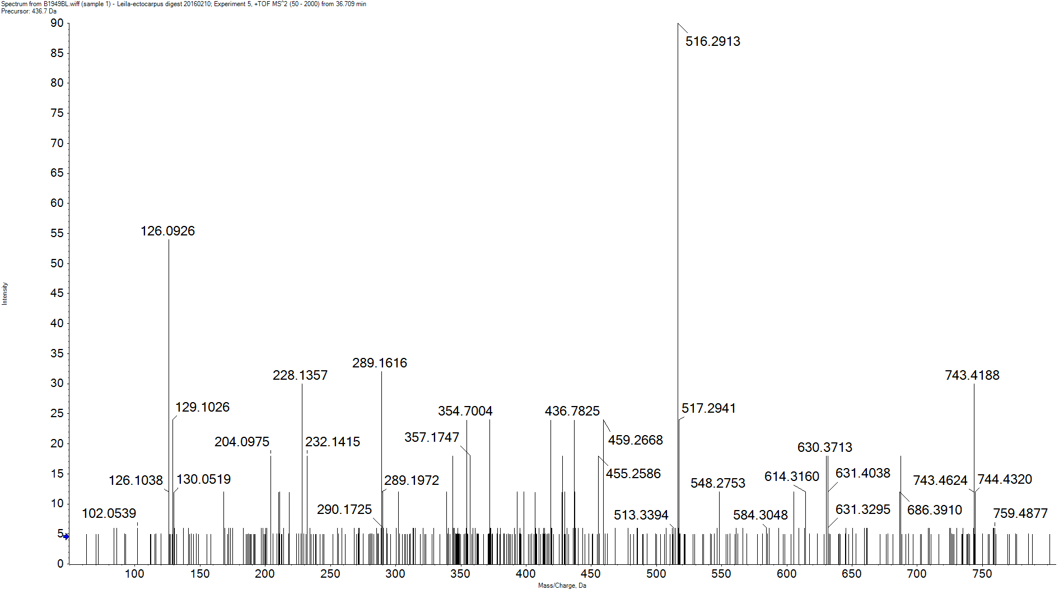
H2A (D8) Ac (K3 and K5) and Ac N-ter
y7²⁺
y6²⁺
y7
y6
y5
y4
y3
y2
Ac-S G KAc G KAc G G R
b3
y5
Im Kac-NH3
y3
y7
[M+2H]²⁺
y6²⁺
y7²⁺
y4
y2
y6
b3

Slide 9
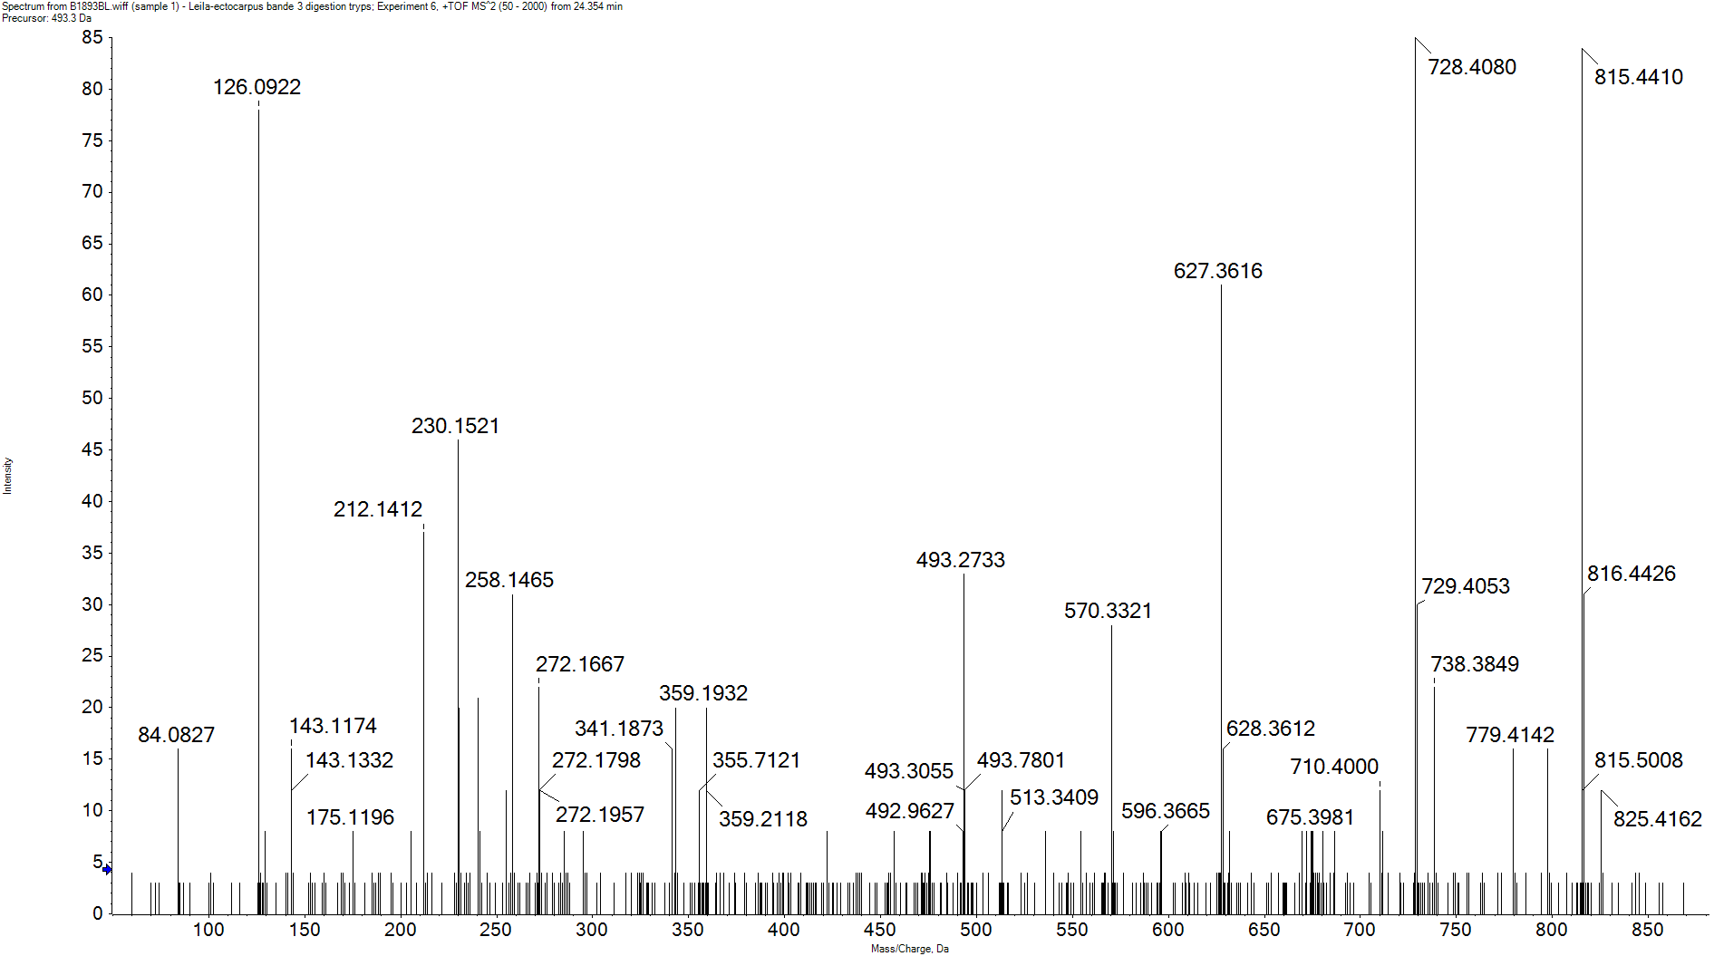
H3 (D7 or D8) Ac (K9 and K14)
y8
y7
y6
y5
y4
y3
y2
y1
KAc S T G G KAc A P R
b2
b3
b3º
a2
y7
y8
Im Kac-NH3
y6
a2
b2
[M+2H]²⁺
y5
y2
y3
b3
b3º
y4
y1

Slide 10
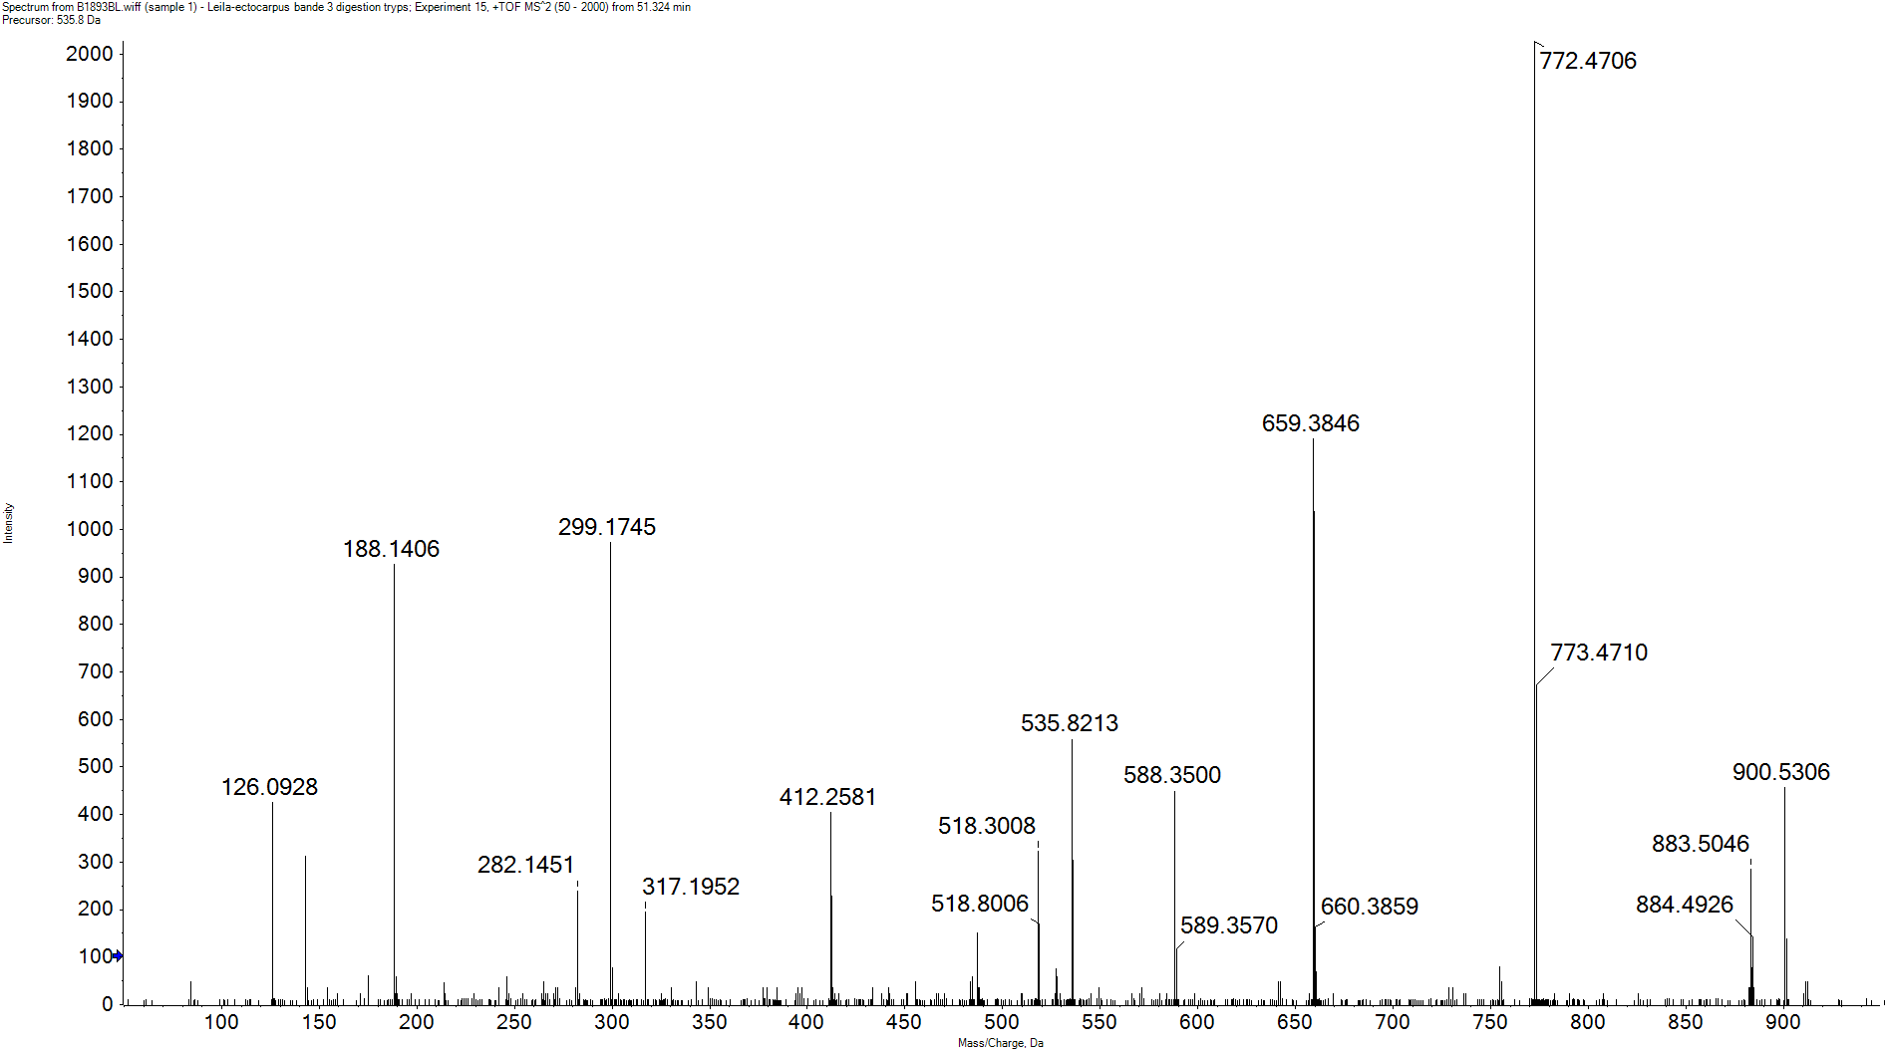
H3 (D7 or D8) Ac (K18 and K23)
y8*
y8
y7
y6
y5
y4
y3
y2
y1
KAc Q L A T KAc A A R
b2
b3
b2*
y7
y6
b2
[M+2H]²⁺
y5
y8
Im Kac-NH3
b3
[M+2H-H₂O-NH₃]²⁺
b2*
y8*
y3
y4
y1
y2

Slide 11
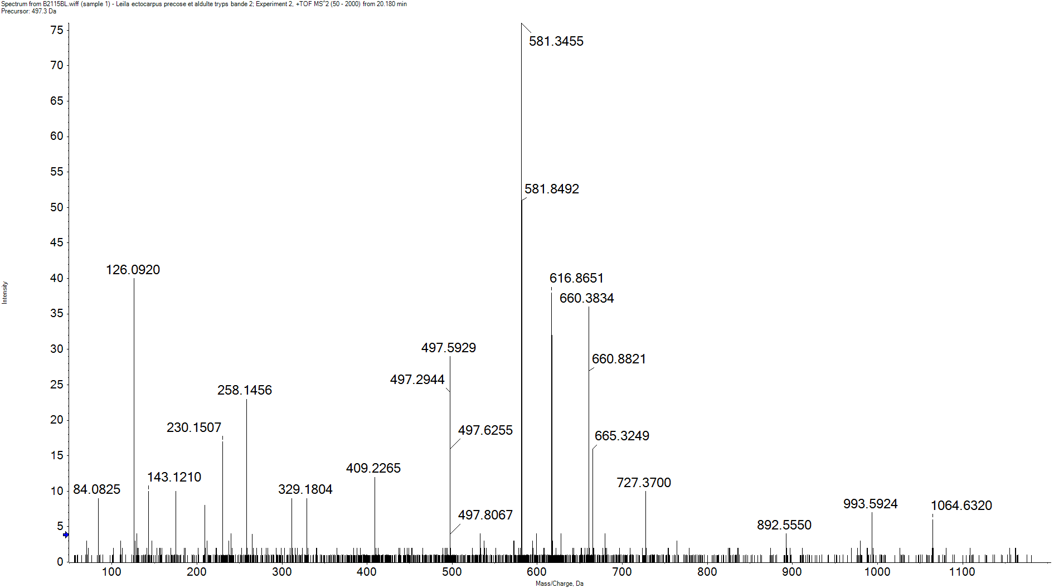
H3 (D7) Ac (K27) and Me (K36)
y11²⁺
y13²⁺
y12²⁺
y10
y9
y7
y6
y4
y3
y11
y8
y5
y1
KAc S A P A T G G V KMe K P H R
b2
b3
a2
b3º
y11²⁺
y13²⁺
Im Kac-NH3
y12²⁺
[M+3H]³⁺
b2
a2
b3
y3
y1
b3º
y4
y9
y10
y5
y8
y6
y7
y11

Slide 12
H3 (D7) DiMe (K27)
y9º
y9
y7
y5
y4
y3
y2
y1
KDiMe S A P A T G G V K
b2
b3
b5
b6
b7
b8
b9
[M+2H]²⁺
y1
y2
b3
b8
y5
y9
b2
y3
y7
b9
y4
b5
b6
b7
y9º

Slide 13
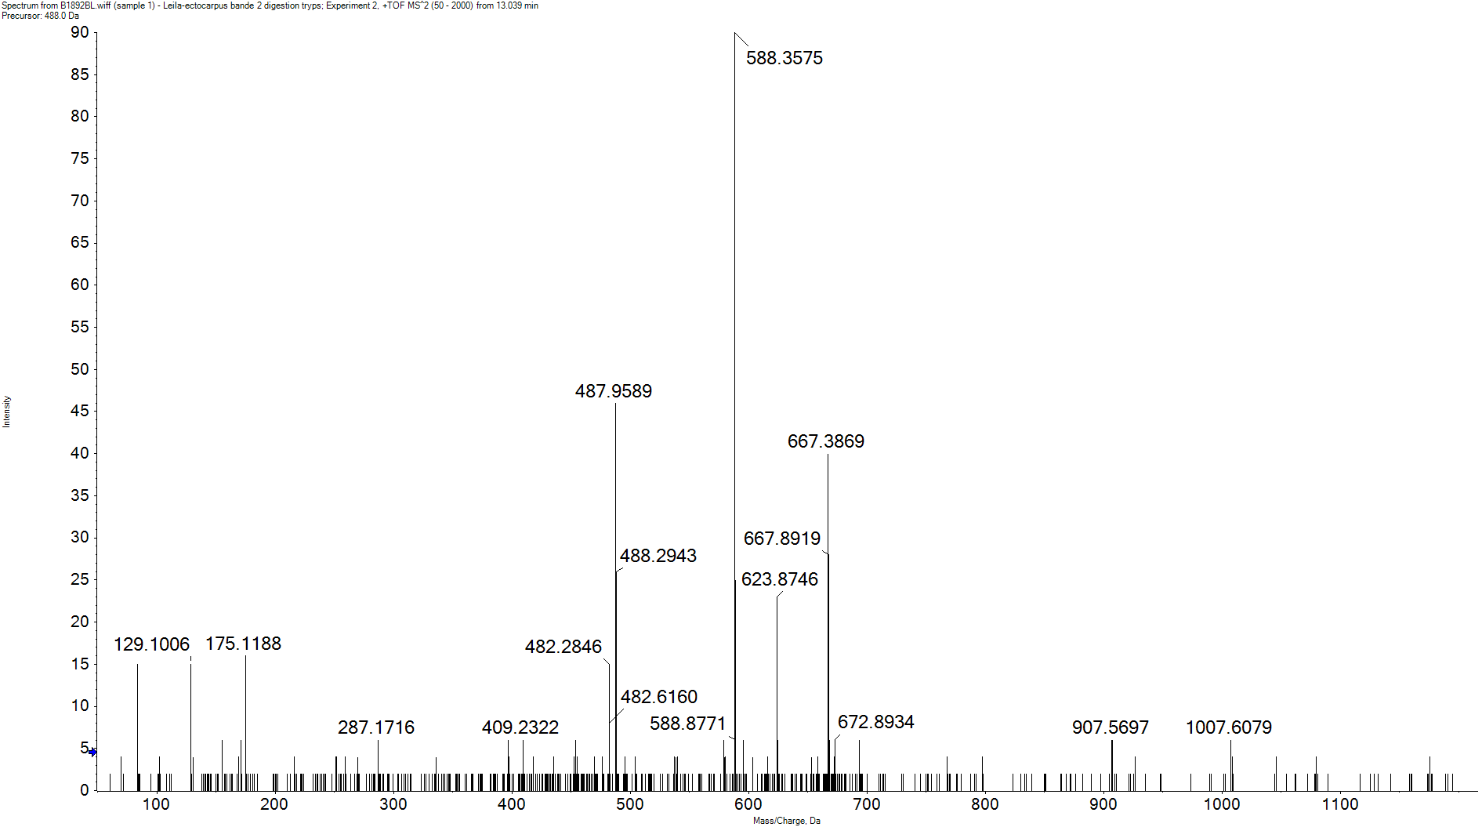
H3 (D7) DiMe (K36)
y11²⁺
y11
y4
y13²⁺
y12²⁺
y10
y9
y8
y5
y3
y1
K S A P A T G G V KDiMe K P H R
b1
b2
b3
y11²⁺
[M+3H]³⁺
y13²⁺
y12²⁺
b1
y1
[M+3H-NH₃]³⁺
b3
y3
y5
y8
y9
b2
y4
y10
y11

Slide 14
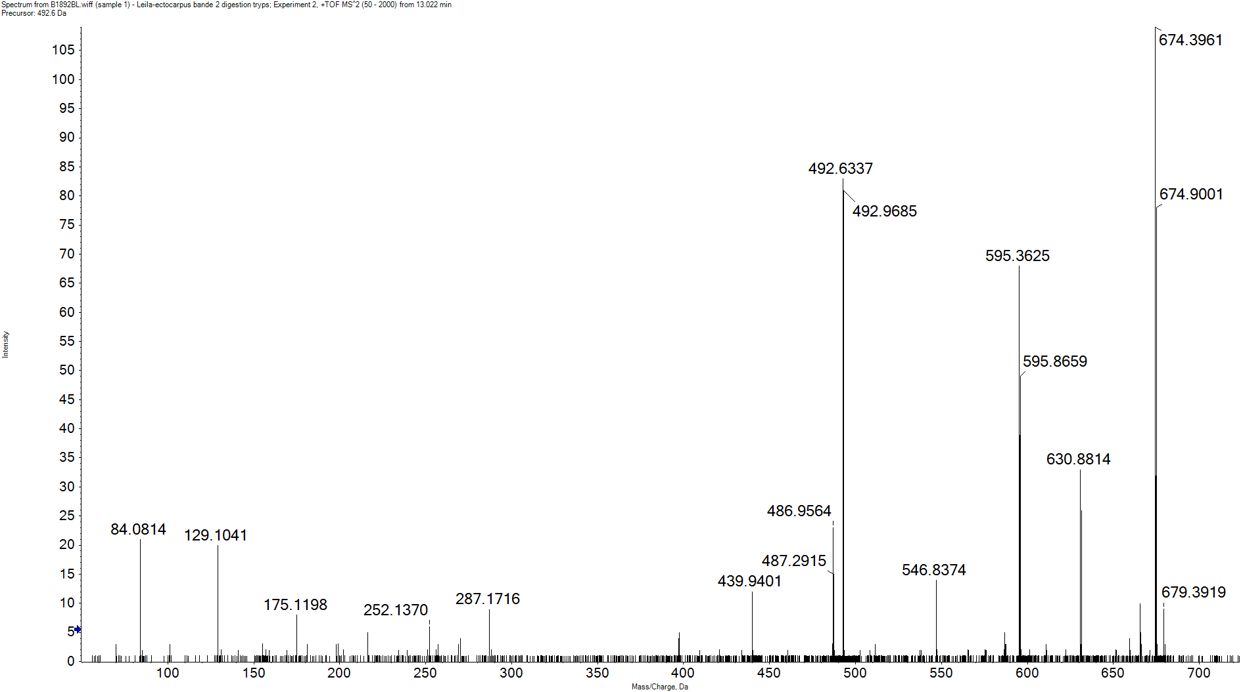
H3 (D7) TriMe (K36)
y13^{o2+}
y11³⁺
y13²⁺
y12²⁺
y11²⁺
y10²⁺
y9²⁺
y8²⁺
y5
y4
y3
y1
K S A P A T G G V KTriMe K P H R
b1
b2
b3
y13²⁺
[M+3H]³⁺
y11²⁺
y12²⁺
[M+3H-H₂O]³⁺
b1
y10²⁺
y1
b3
y13^{o2+}
b2
y11³⁺
y3
y8²⁺
y9²⁺
y4
y5

Slide 15
H3 (D7) Me (K79)
y9²⁺
y8²⁺
y6²⁺
y10²⁺
y9
y8
y7
y6
y5
y4
y2
y1
E I A Q D F KMe S D L R
b2
b5
b9
y2
a2
b9º
[M+2H]²⁺
a2
b9
[M+2H-H₂O]²⁺
y1
y9²⁺
y6²⁺
y6
b9º
y9
b2
y4
y8²⁺
y10²⁺
y7
y8
b5
y5

Slide 16
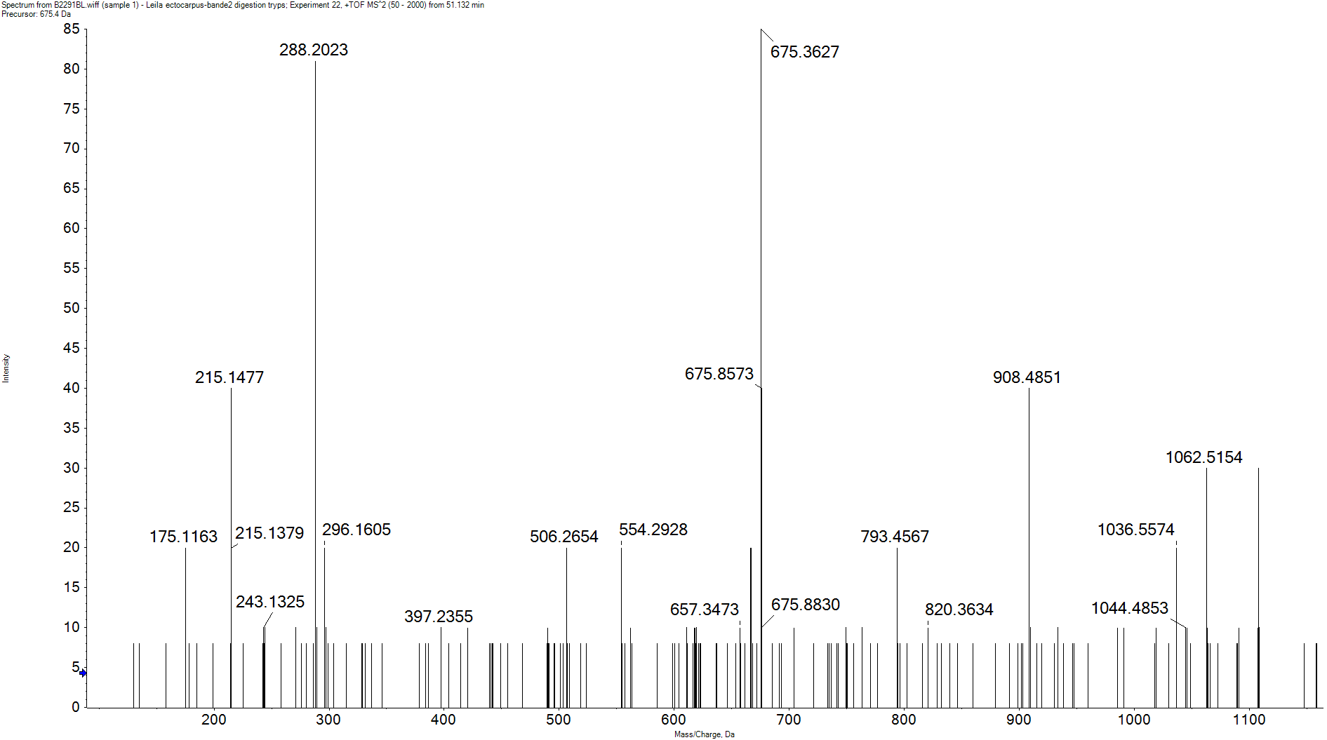
H3 (D7) DiMe (K79)
y9²⁺
y9
y8
y7
y6
y4
y2
y1
E I A Q D F KDiMe S D L R
b2
b3º
a2
y2
[M+2H]²⁺
a2
y7
b9
y9
b3º
y9²⁺
y1
y6
y8
b2
y4

Slide 17
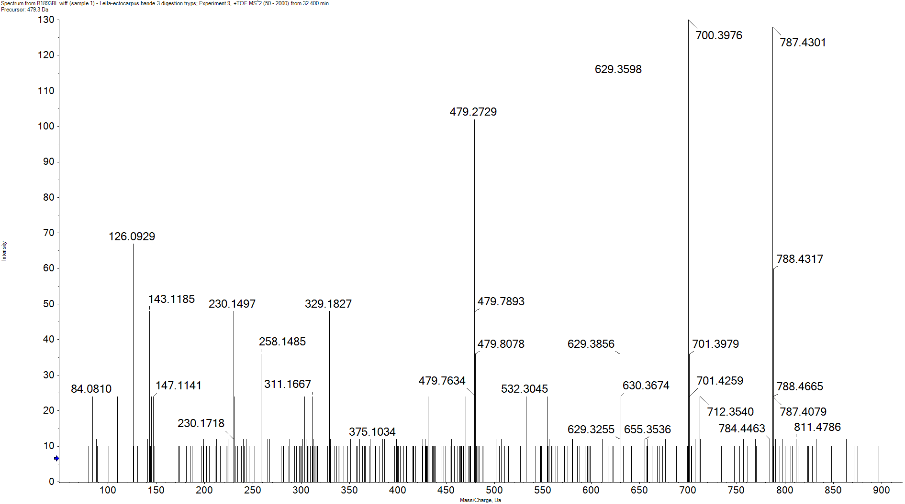
H3 (D8) Ac (K27)
y9
y8
y7
y6
y5
y3
y1
KAc S A P T A G G V K
b2
b3
a2
y8
y9
y7
[M+2H]²⁺
Im Kac-NH3
a2
b3
b2
y1
y3
y5
y6
b8

Slide 18
H3 (D8) Me (K36)
y11²⁺
y9²⁺
y8²⁺
y12²⁺
y11
y10
y9
y8
y7
y5
y4
y3
y1
S A P T A G G V KMe K P H R
b2
b3
b10
b12
[M+2H]²⁺
y11²⁺
b2
y1
y3
y12²⁺
y8
b3
y4
y5
y7
b10
y9
y10
b12
y11
y8²⁺
y9²⁺

Slide 19
H3 (D8) DiMe (K36)
y11²⁺
y11
y10
y9
y8
y7
y5
y4
y3
y1
S A P T A G G V KDiMe K P H R
b2
b9
b10
b11
[M+2H]²⁺
y11²⁺
y1
y3
y8
y9
y10
b2
y4
y5
b9
b10
b11
y11
y7

Slide 20
H3 (D8) Me (K79)
y9²⁺
y8²⁺
y7²⁺
y6²⁺
y10²⁺
y9
y8
y7
y6
y5
y4
y3
y2
y1
E I A Q D F KMe T D L R
b2
b8
b9
a2
b9º
y2
[M+2H]²⁺
b9
a2
[M+2H-H₂O]²⁺
y1
y9²⁺
b2
y3
y10²⁺
y6
y8
y9
y6²⁺
y4
y8²⁺
y5
y7
b9º
y7²⁺
b8

Slide 21
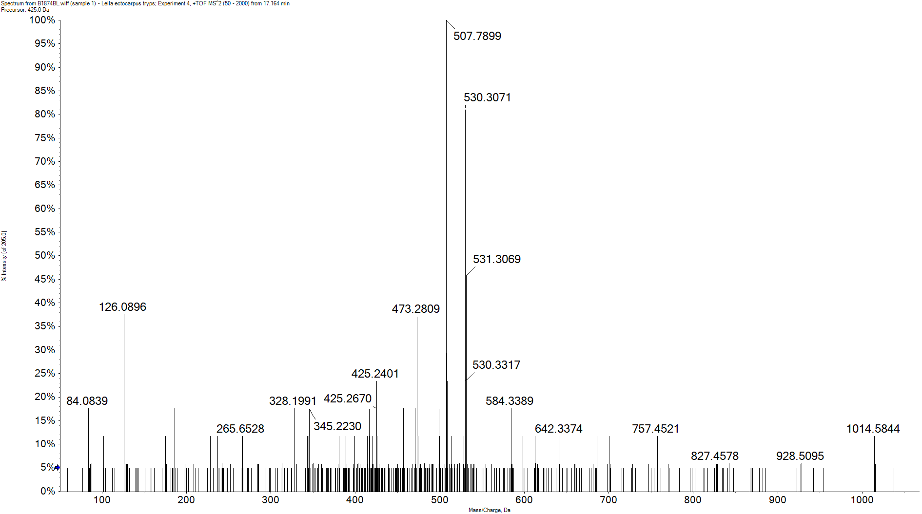
H4 Ac (K12 and K16)
y5²⁺
y16³⁺
y9
y7
y6
y5
y4
y3
y2
y1
Ac-S G R G K G G K G L G KAc G G A KAc R
b3
b5
b7
b8
b10²⁺
b11²⁺
b12²⁺
b13²⁺
y5
Im Kac-NH3
y4
[M+4H]⁴⁺
y2
y3
b10²⁺
b12²⁺
b7
y5²⁺
b11²⁺
y6
y7
y1
b3
b5
b13²⁺
y9
b8

Slide 22
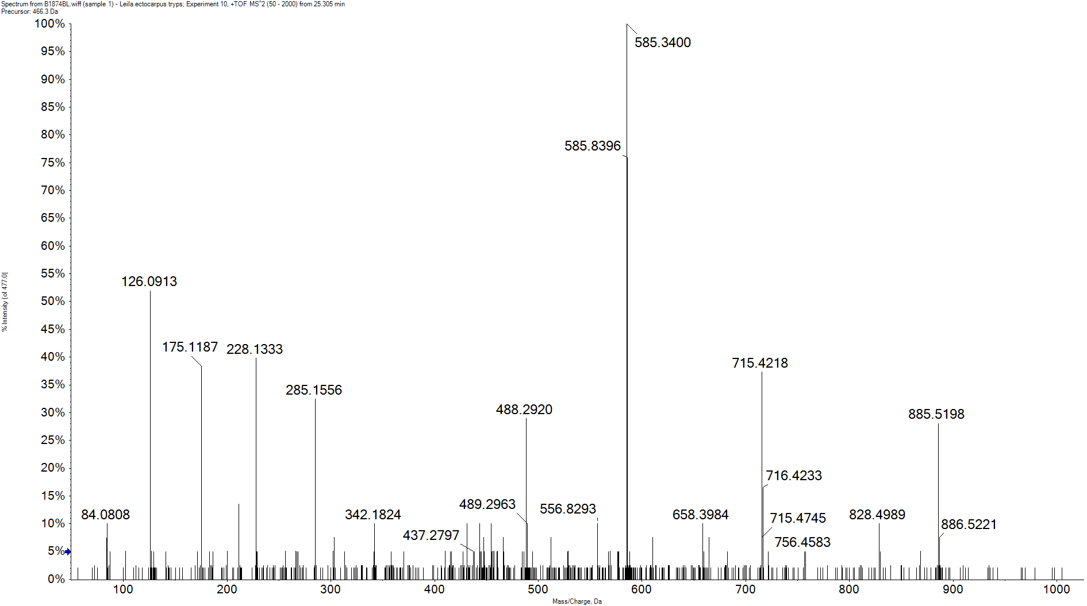
H4 Ac (K5, K8 and K16)
y11²⁺
y12²⁺
y11²⁺
y9
y8
y7
y6
y5
y4
y2
y1
G KAc G G KAc G L G KAc G G A K R
b2
b3
b4
b5
b6
b7
b2*
y12²⁺
Im Kac-NH3
y1
b2
y7
b3
y5
y9
y13³⁺
b2*
b4
y4
y6
y8
y11²⁺
y2
b5
b6
b7

Slide 23
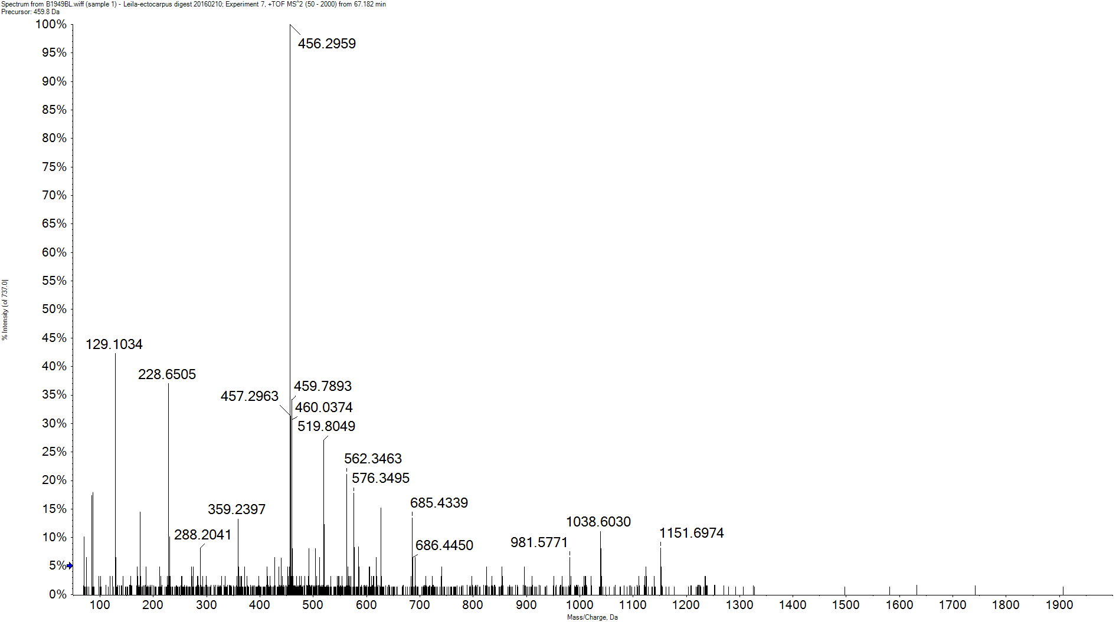
H4 Me (K20)
y4²⁺
y15³⁺
y6
y5
y4
y3
y2
y1
KMe V L R D N I Q G I T K P A I R
b2
b6
b7
b8
b9
b10
b11
b12²⁺
b7²⁺
b8²⁺
b9²⁺
b10²⁺
b11*
a10²⁺
b11²⁺
y4
Im R
y4²⁺
b9²⁺
a10²⁺
b10²⁺
y1
y3
y6
y2
b11²⁺
b9
b10
b8²⁺
y5
b12²⁺
b8
b2
b7²⁺
b6
b7
b11*
b11

Slide 24
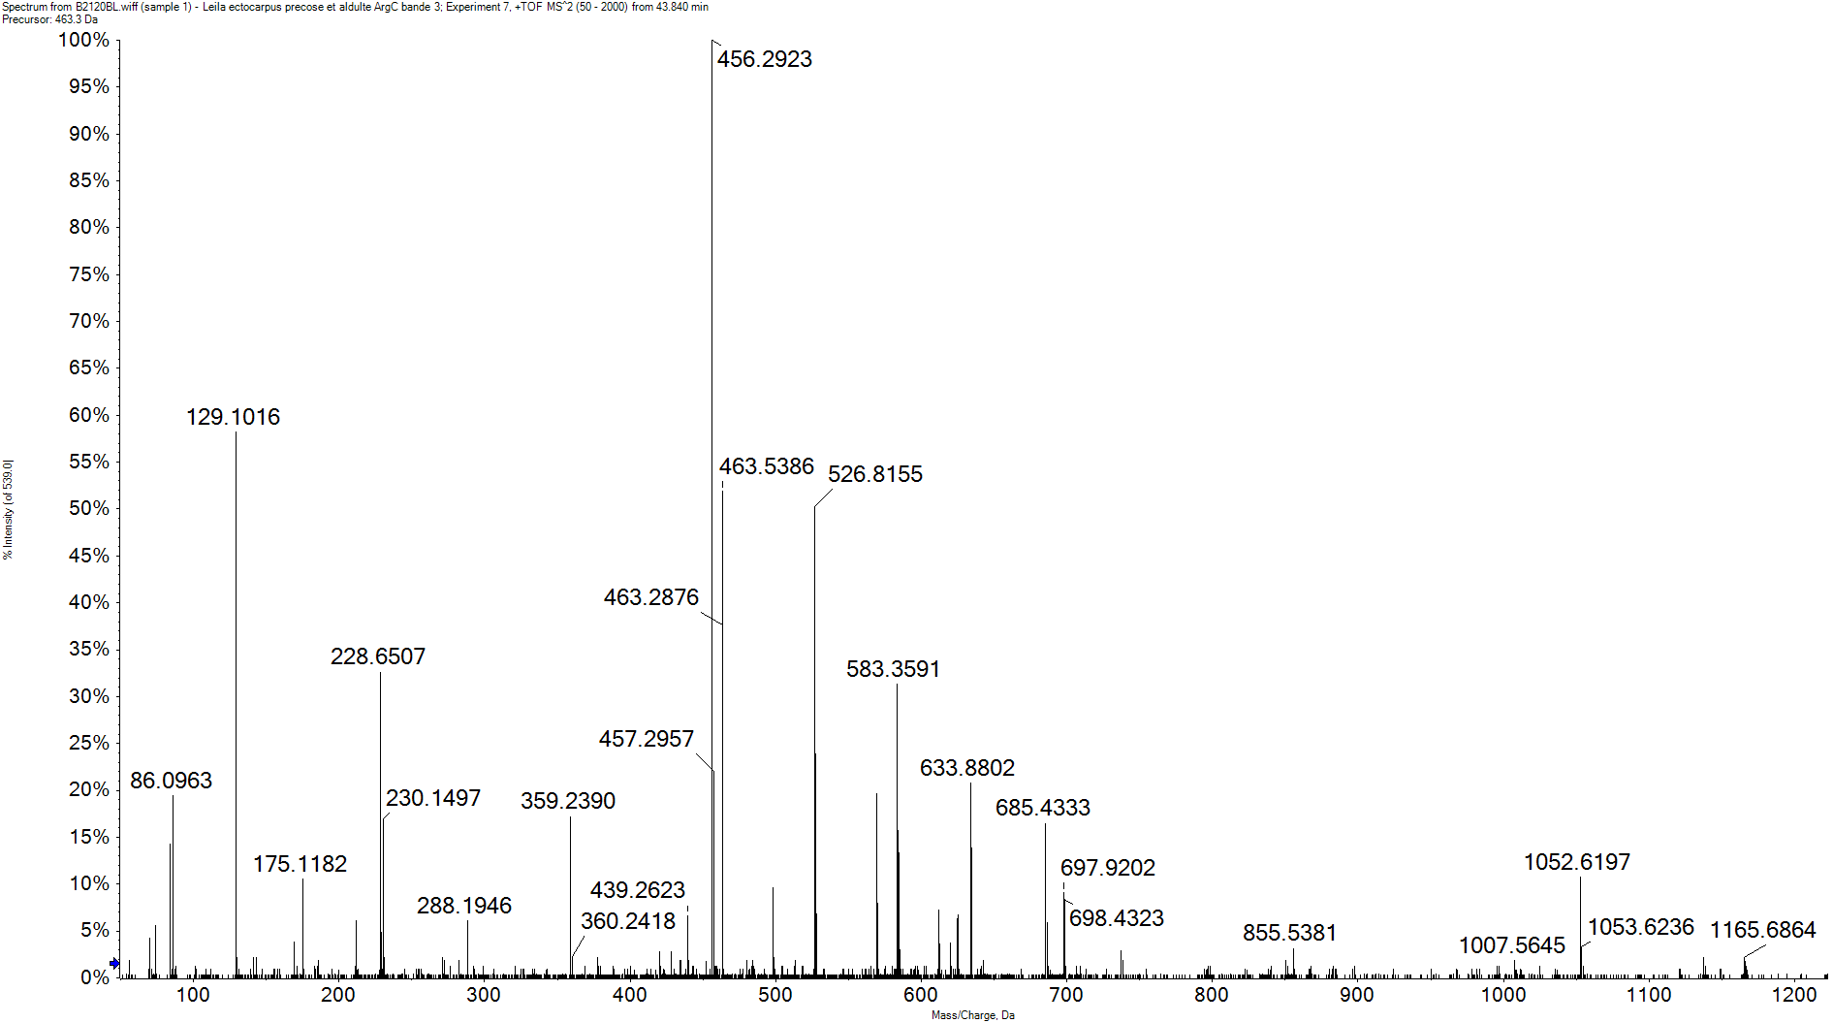
H4 DiMe (K20)
y4²⁺
y15³⁺
y8
y6
y5
y4
y3
y2
y1
KDiMe V L R D N I Q G I T K P A I R
b6
b7*
b8
b9
b10
b11²⁺
b12²⁺
b6*
b8²⁺
b10²⁺
b9²⁺
y4
a10²⁺
Im R
[M+4H]⁴⁺
b9²⁺
y4²⁺
b10²⁺
b11²⁺
y3
a10²⁺
y6
y1
y5
b12²⁺
b9
y2
b8²⁺
b6*
y8
b8
b10
b7*
y15³⁺
b6

Slide 25
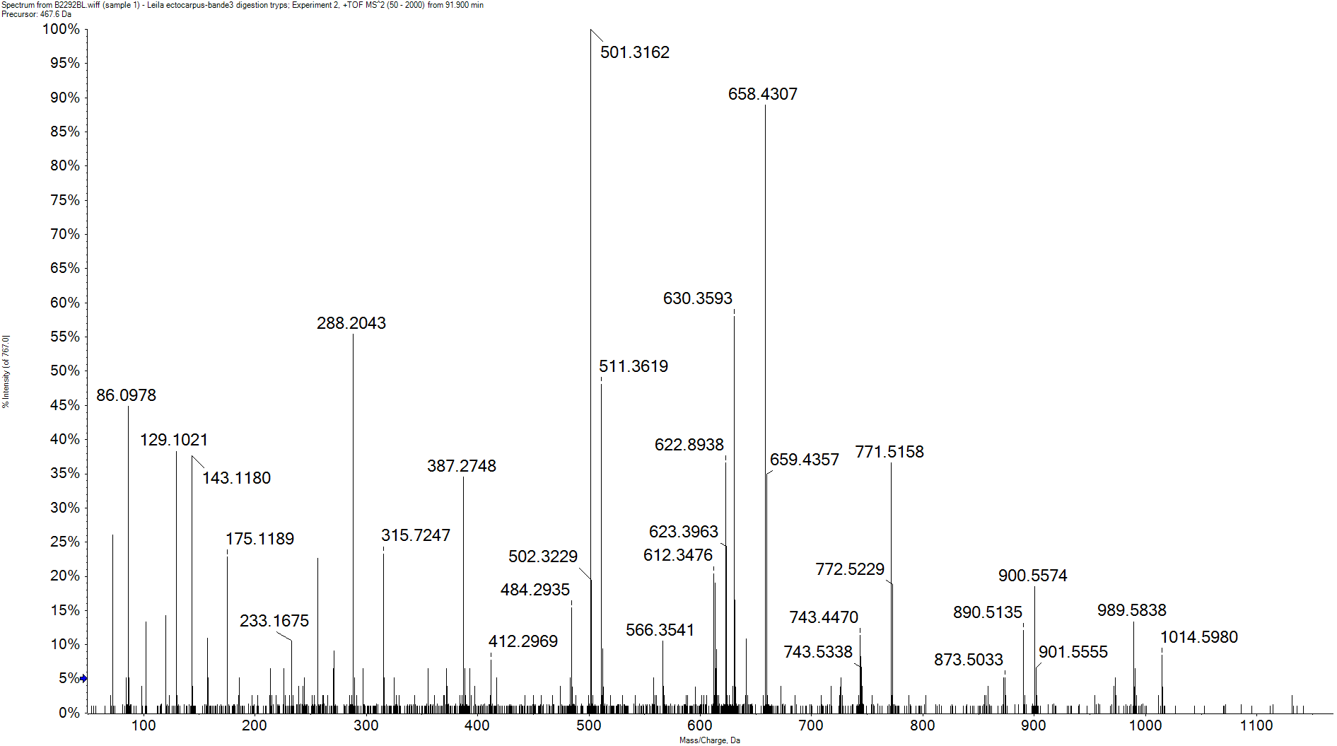
H4 Me (K59)
y5²⁺
y9²⁺
y7*
y6²⁺
y5º
y4*
y10²⁺
y7
y6
y4
y3
y2
y1
y9
y8
y5
G V L KMe V F L E N V I R
b2
b3
b4
b5
b6
b7
b8
b9
y4
b6
y5
y2
b5
Im R
y10²⁺
b7
y3
y1
y5²⁺
y4*
y5º
b8
y9²⁺
y7
y8
y6
b9
b2
b3
b4
y6²⁺
y7*
y9

Slide 26
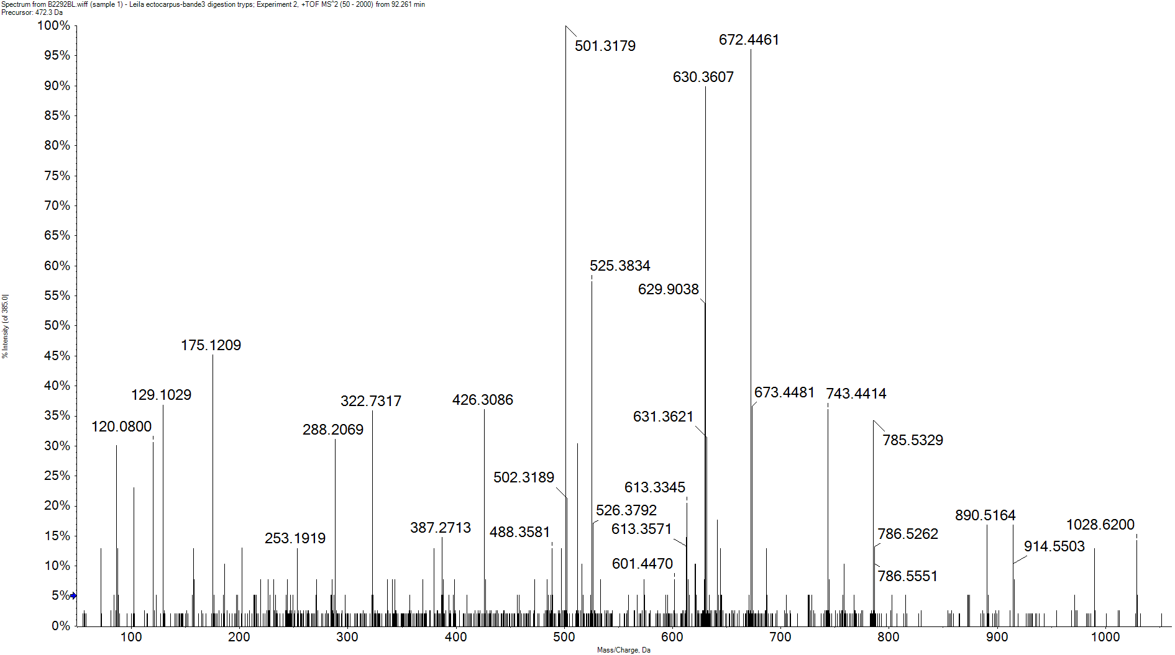
H4 DiMe (K59)
y5*
y8
y7
y6
y5
y4
y3
y2
y1
G V L KDiMe V F L E N V I R
b2
b4
b5
b6
b7
b8
b9
a6
b6²⁺
y4
b6
a6²⁺
y5
b5
y1
Im R
a6²⁺
b4
y6
y2
y5*
b7
y3
a6
y7
b8
y8
b9
b2
b6²⁺

Slide 27
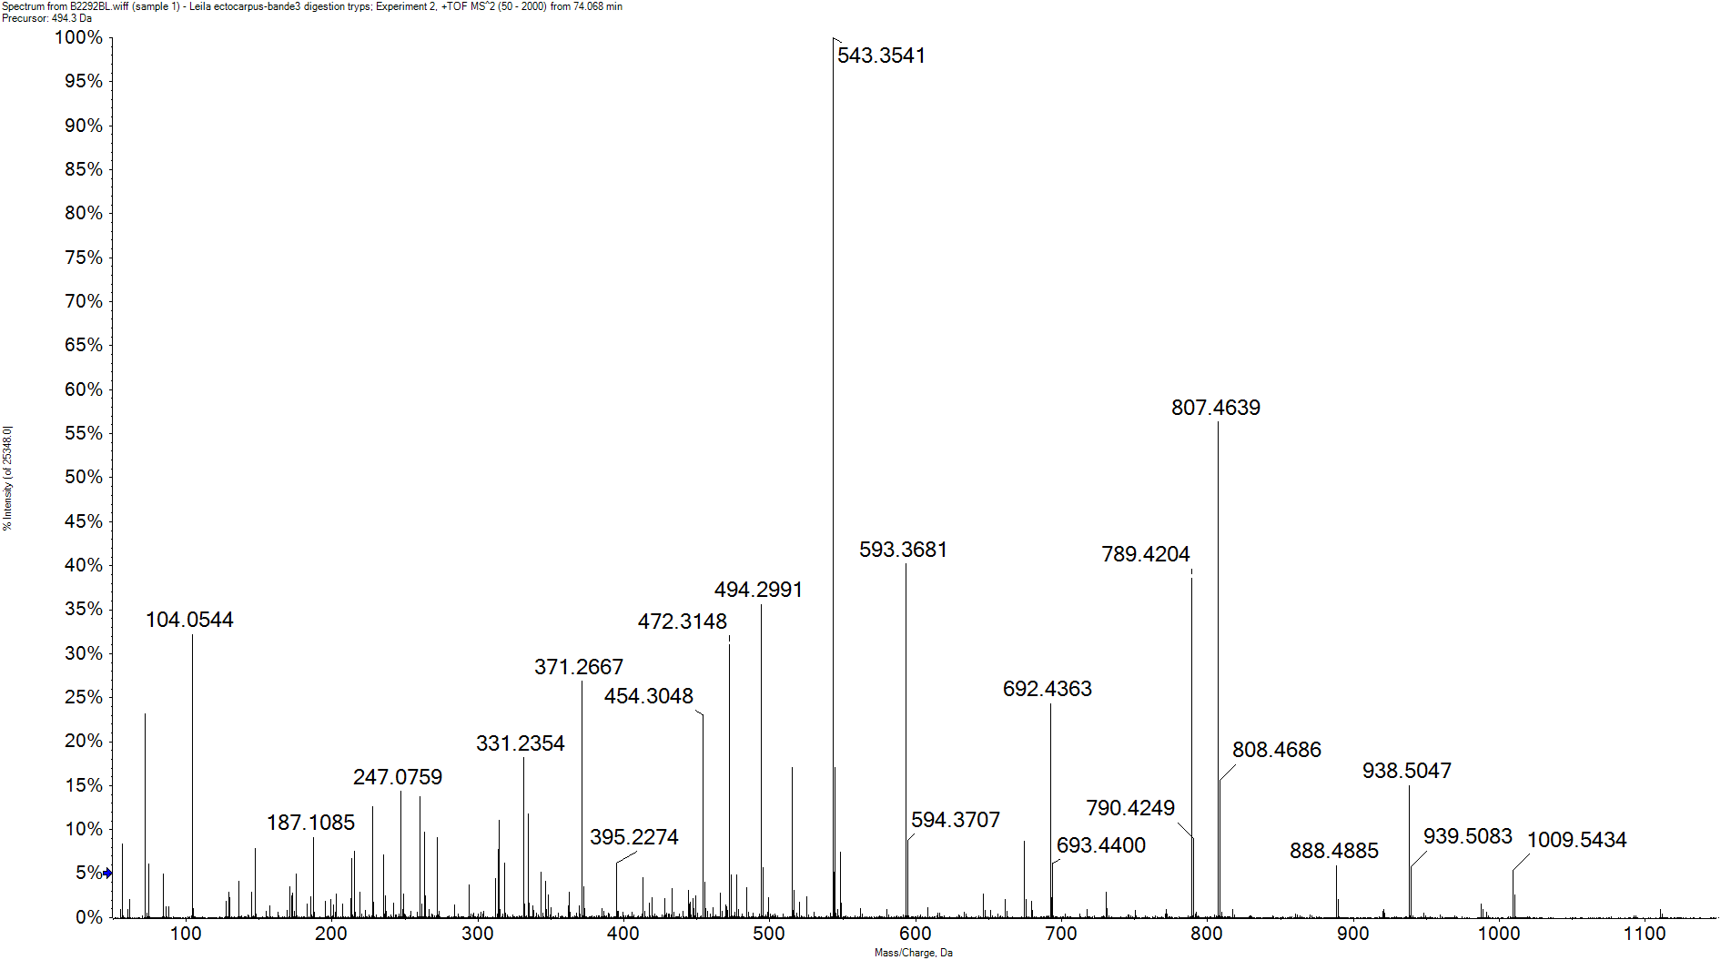
H4 TriMe (K79)
y9
y6
y5
y2
y10
y8
y7
y4
y3
y1
KTriMe T V T A M D V V Y A L K
b1
b2
b3
b4
b5
b6
b7
b8
b9
b4º
a5
b5
y7
y5
b7
y4
b4
b3
b4º
y6
y3
y8
y2
a5
y1
b2
b6
b8
y9
b1
b9
y10

Slide 28
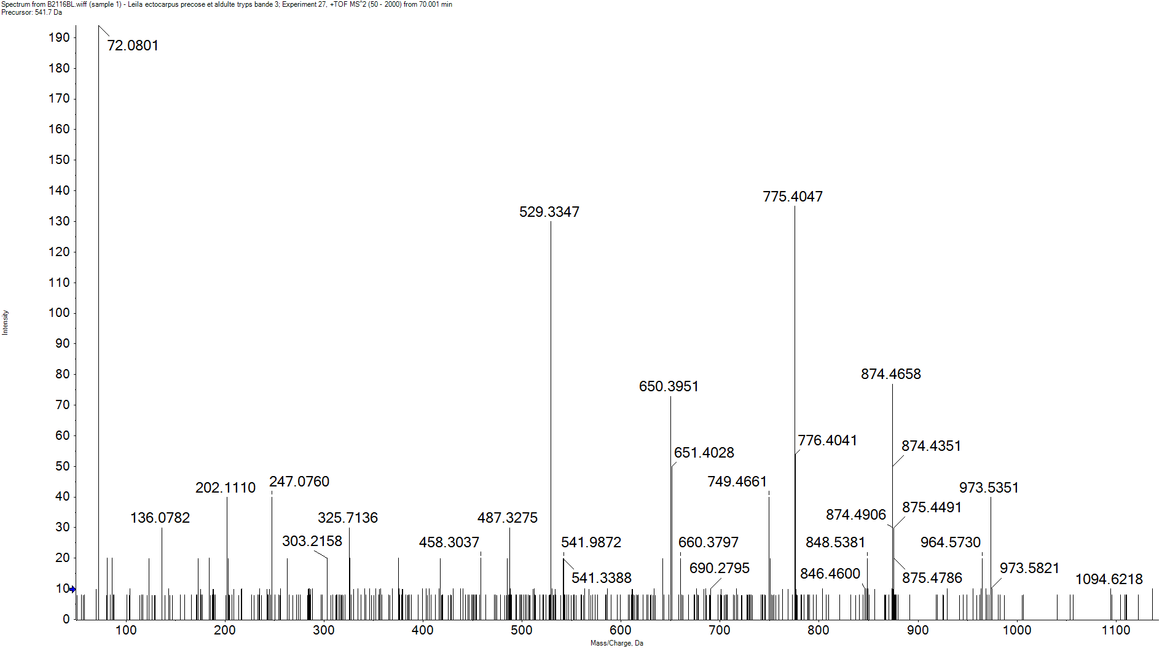
H4 DiMe (K79)
y9
y8
y7
y6
y5
y4
y3
y2
y1
KDiMe T V T A M D V V Y A L K R
b4
b5
b6
b7
b8
b9
b5
b7
y5
b8
y6
y4
b9
y2
b6
b4
y7
y8
y1
y9
y3

Slide 29
H4 Ac (K8, K12 and K16) and Prop (K5)
y12
y11
y10
y9
y8
y7
y5
y4
y3
y2
y1
G KProp G G KAc G L G KAc G G A KAc R
b2
b3
b5
[M+2H]²⁺
y9
y7
y12
y1
y5
b2
b3
b5
y8
y11
y2
y4
y10
y3

