Slide 1

Hello! I am Sergio Benavides

Slide 2
JQUERYEvents
These methods are used to register behaviors to take effect when the user interacts with the browser, and to further manipulate those registered behaviors.
We must take into account importing the most recent JQUERY library, in this case it is the following:
<head> <script src="jquery-3.5.1.min.js"></script> </head>
2. You can work directly from the html or with a JS file.

Slide 3
Capture events by NAME
HTML
<body>
<h1> HELLO WORLD</h1>
</body>
JS
$(function() {
$(”h1”).click(function(event) {
alert(“YOU HAVE CLICKED”);
});
});

Slide 4
Capture with the “ON” function
HTML
<body>
<h1> HELLO WORLD</h1>
</body>
JS
$(function() {
$(”h1”).on( “click”,function(event) {
alert(“CLICK ON”);
});
});

Slide 5
TRIGGER EVENTS
HTML
<body>
<h1> HELLO WORLD</h1>
</body>
JS
$(function() {
$(”h1”).click(function(event) {
alert(“YOU HAVE CLICKED”);
});
$(“h1”).trigger(“mouseenter”)
});

Slide 6
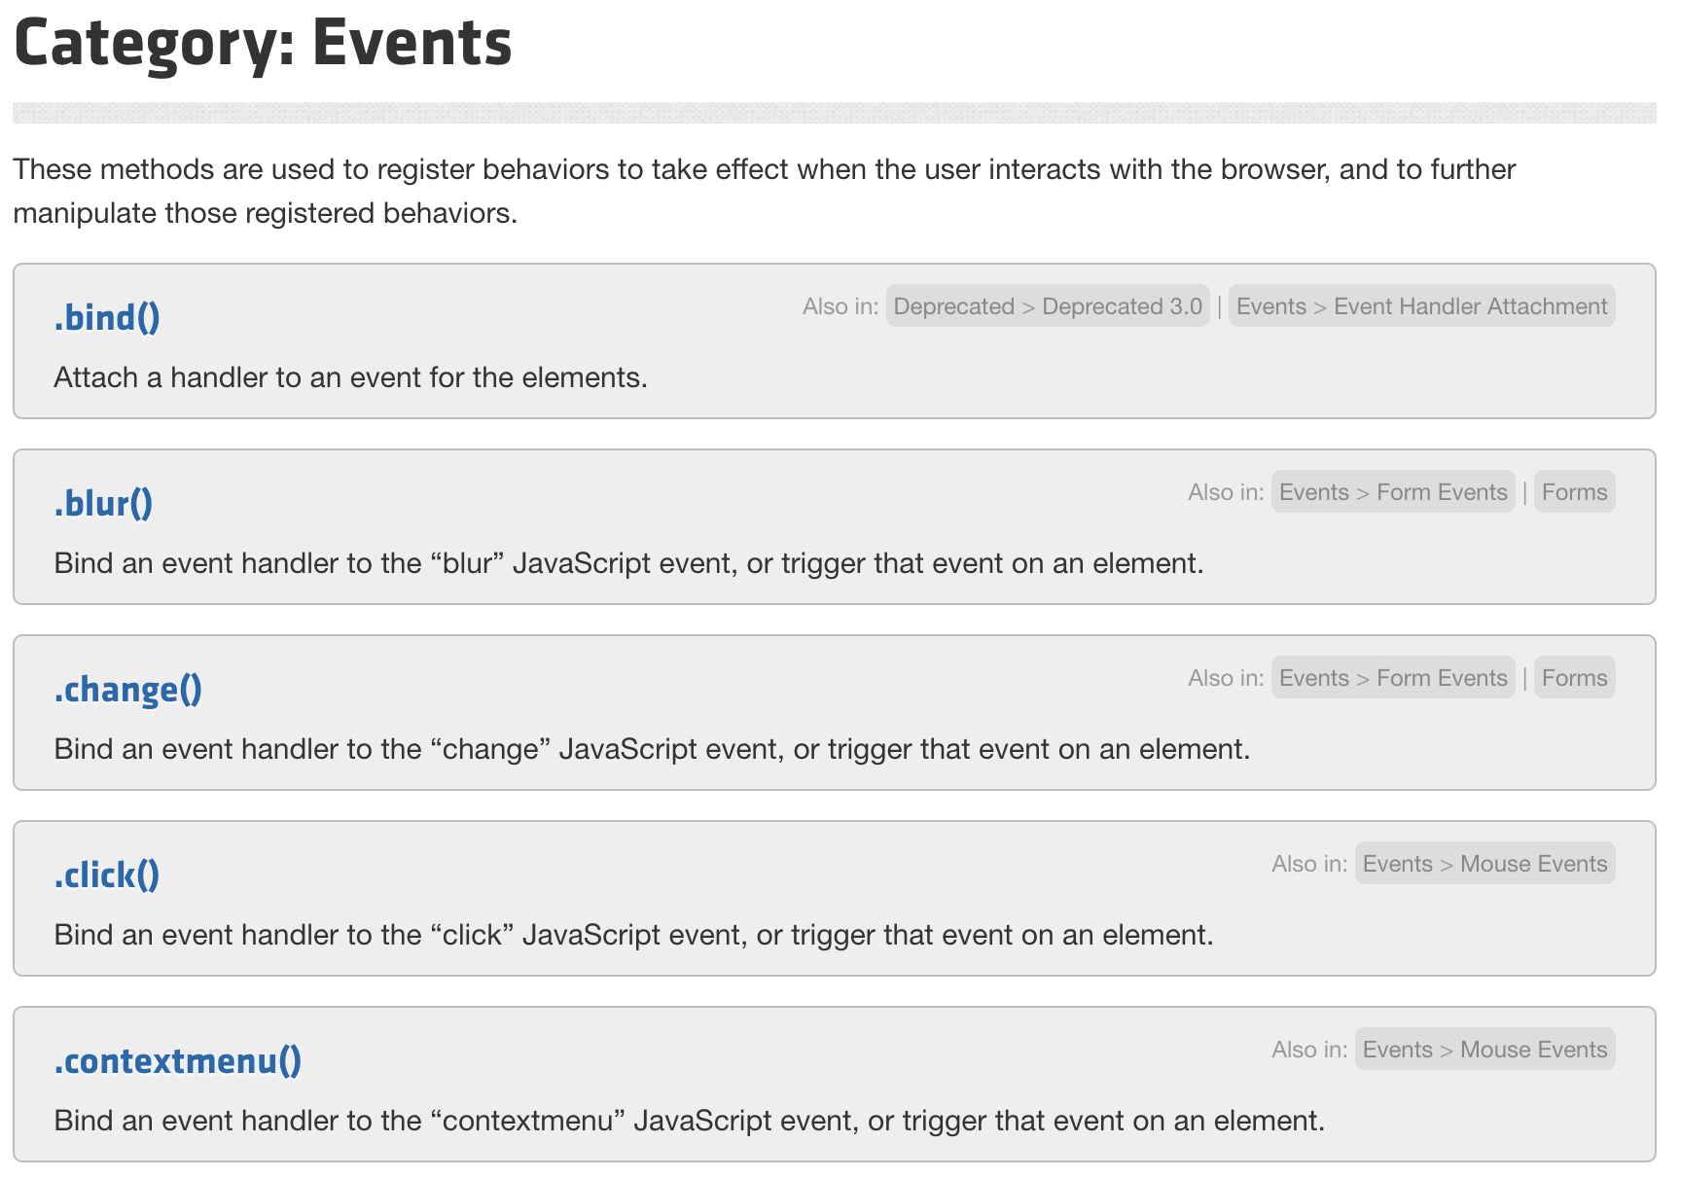
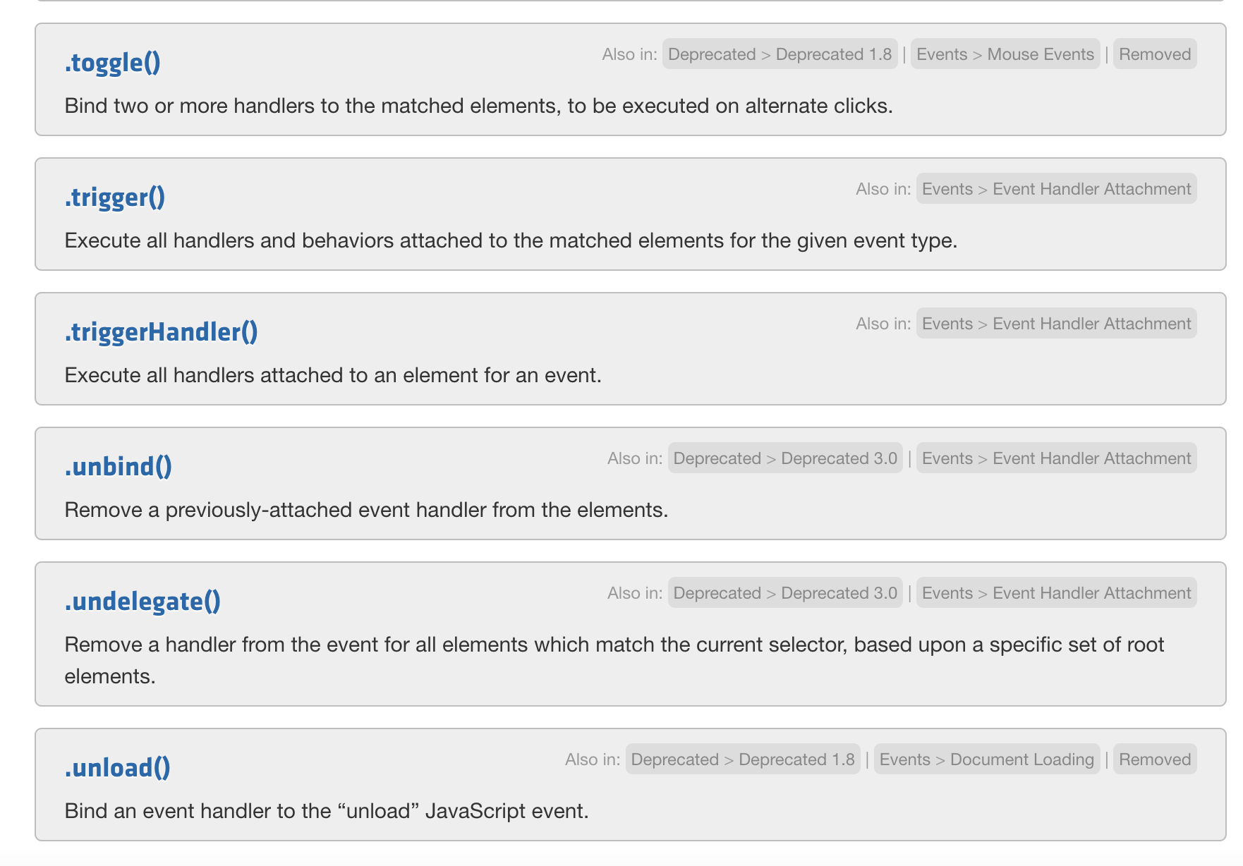
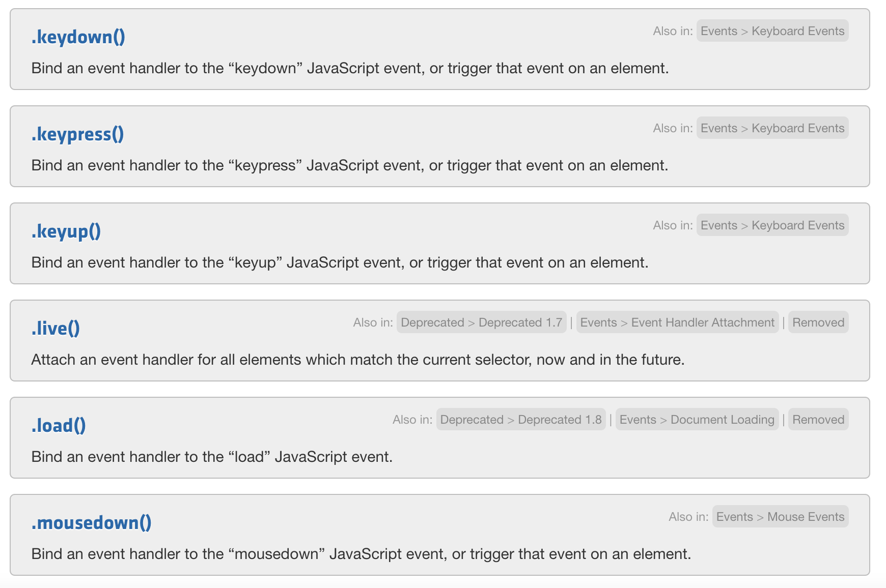
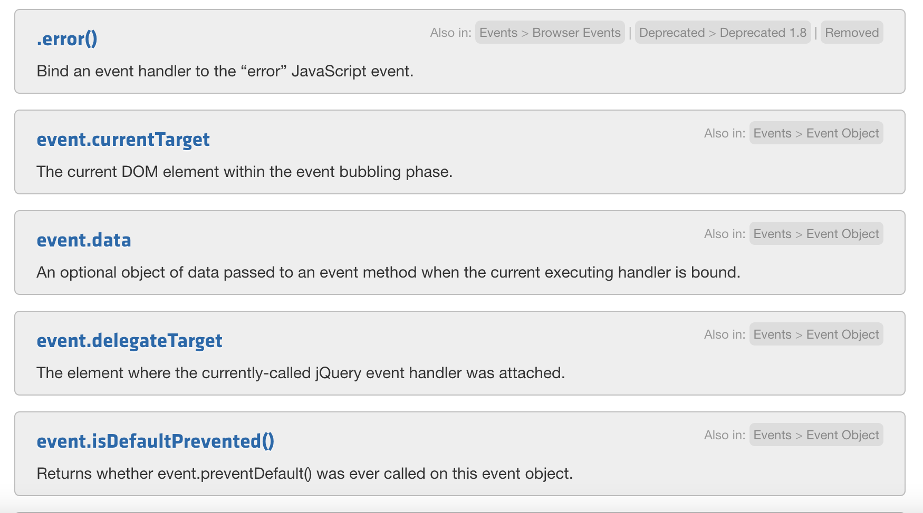
Other events

Slide 7
Thank You

