Slide 1
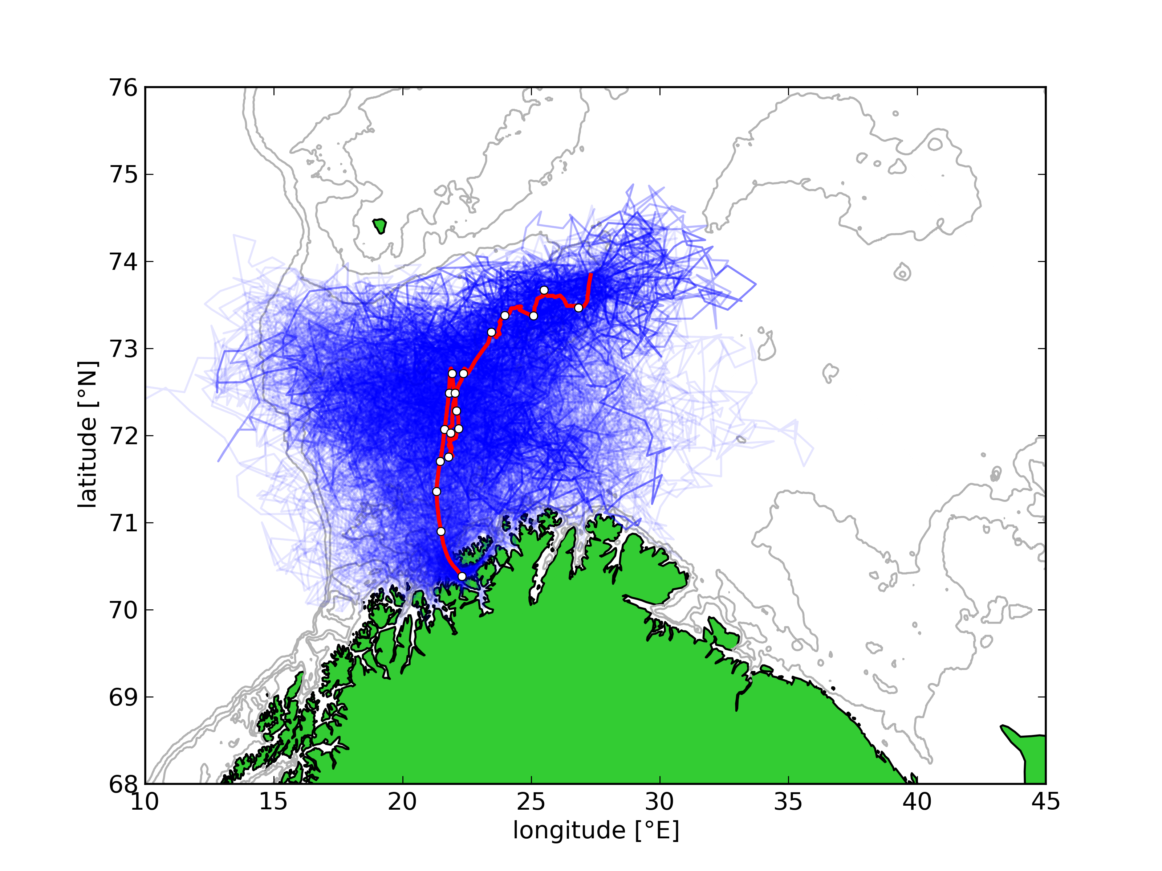
Spaghetti model for geolocation of salmon
University of Tromsø has tagged salmon with pop-up tags recording light, temperature and pressure.
A “spaghetti”-approach is used to find an ensemble of possible migrating routes consistent with bottom topography and sea surface temperature.
The results are validated against independent geolocation by light around the autumn equinox.
100 possible tracks (blue) and mean track (red)
white markers indicate 10 day intervals
C. Chittenden, B. Ådlandsvik, O.-P. Pedersen, D. Righton and A. Rikardsen, 2012
Testing a model to track ﬁsh migrations in polar regions using pop-up satellite archival tags
Fish. Oceanogr., doi:10.1111/fog.12000

