Slide 1
IoT Smart-Chair
Privacy-Preserving Posture Monitoring System
Internet of Things · Summer Term 2026
Presented by:
Michael Breyer · Sebghatullah Yarzada · Arturo Olivares · Reza Falahatkar · Atena Mahrooghi
Write Matrikelnummer here…

Slide 2
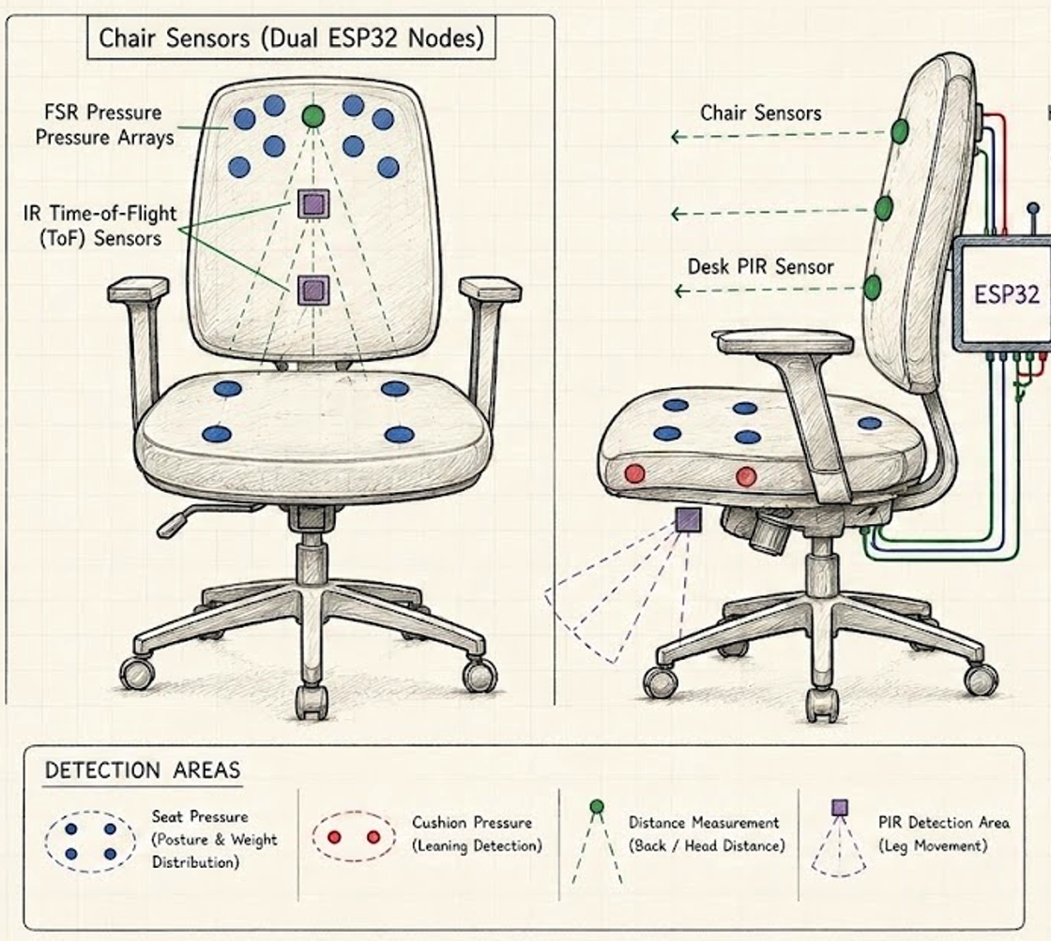
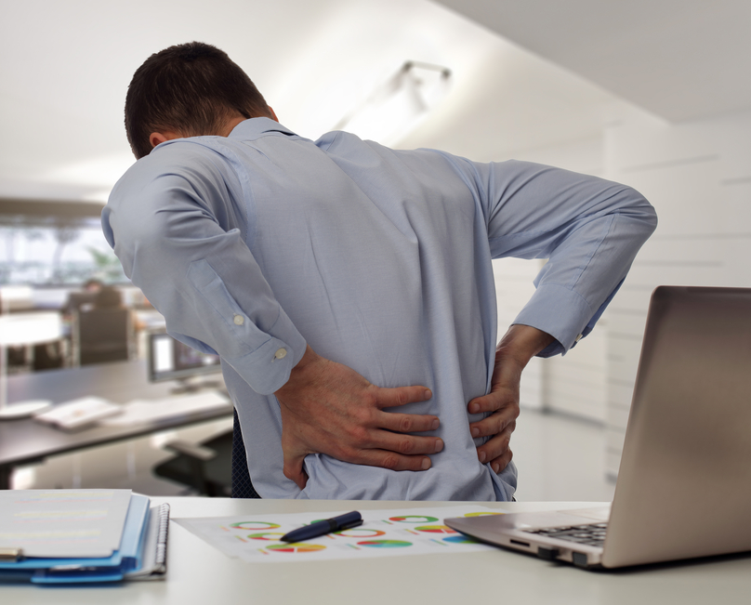


Why Does This Matter?
THE PROBLEM
OUR GOAL
Students and office workers sit 6–10 hours per day
Develop a low-cost, privacy-friendly posture monitoring system using embedded IoT sensors
Poor posture develops unconsciously over time
Long-term consequences: neck, shoulder & back pain
Camera-free & privacy-safe
Existing smart-chair solutions cost thousands of Euros
Affordable (~200 €)
Camera-based trackers compromise user privacy
Real-time feedback via buzzer
Long-term ergonomic analytics

Slide 3
Our Smart-Chair Solution
Weight Distribution
Slouch Detection
Multi-point FSR pressure sensors map pelvic balance and lean offsets across the seat cushion.
IR-based ToF distance sensors track upper-back and head positioning in real time via the backrest.
Activity Logging
Buzzer Alerts
PIR motion sensors detect user presence and inactivity throughout the day for activity patterns.
Instant, gentle audio warnings when bad sitting posture is detected for more than 5 minutes — no cameras.

Slide 4
System Overview & Architecture
Chair
Sensors
Buzzer
Alert
FSR · IR-ToF · PIR
Immediate feedback
Dual ESP32
Nodes
Python API
Dashboard
Local processing ·
ESP NOW
Desktop
Sensors
MQTT
Python · MQTT
Analysis · Timestamps
FSR · IR-ToF
Sensor data is collected and processed in real-time. If poor posture is detected for an extended period, a buzzer alert is activated and the event is logged for further analysis.
9 sensors collect pressure, distance & motion continuously
ESP32 processes raw data locally with threshold logic
Buzzer fires after sustained bad posture detected
MQTT protocol transmits structured JSON over WiFi
Python app analyses posture & manages alerts

Slide 5
Sensor System & Placement
CHAIR
DESKTOP / DESK
FSR Sensors
FSR Sensors
Pressure distribution · Weight shifting · Asymmetric sitting
4x seat area + 2x backrest area
Arm support position · Leaning on desk edge detection
2x desk area
ToF Sensors
ToF Sensors
Upper body position · Backrest distance
3x backrest area for back/head distance
Screen-to-user distance measurement · Head distance from monitor
1x desk area
PIR Sensor
Presence detection · Leg movement tracking
1x under-seat PIR sensor

Slide 6
Posture Detection Logic — IF / THEN
IF (Condition)
THEN (Response)
IF pelvic pressure distribution is uneven (leaning sideways/forward)
Activate buzzer — immediate audio alert
IF head/upper-back distance from backrest is unhealthy (slouching)
Activate buzzer — immediate audio alert
IF User sits too long without any movement detected (sedentary state)
Log event with timestamp & sensor values
IF combined sensor data indicates poor posture
Send MQTT notification to computer &
Generate posture warning on screen
Trigger: Bad posture sustained for prolonged period of time! (e.g. more than 10 minutes)

Slide 7


Data Flow & Analytics
Sensors
ESP32 Nodes
Data Aggregation
Analysis Engine
Web Dashboard
COLLECTED DATA
ANALYTICS
Movement sensor readings
Posture classification status
Pressure sensor values
Total sitting duration
Screen distance readings
Warning frequency trends
Timestamps
Posture improvement over time
Alert events

Slide 8

Expected User Interface
Dashboard Preview
DASHBOARD FEATURES
✓ Current Status: GOOD
Live posture status (Good / Warning / Bad)
Current screen distance in cm
5h 12min
4
Daily sitting time statistics
Today's Sitting Time
Bad Posture Events
68 cm
82 / 100
Screen Distance
Posture Score

Slide 9
Roadmap & Phase Plan
Phase 1
Phase 2
MVP — Core System
Improvement & Analysis
Build & test core sensor system
Python-based user monitoring dashboard
Calibrate FSR & IR-ToF sensors
Refine sensor filtering algorithms to minimize false-positive buzzer alerts
Implement local processing & ESP-NOW/MQTT
Implement data logging for short-term posture history
Local buzzer alert from ESP32 directly
App-based notifications & historical data tracking

Slide 10
Components & Budget
BUDGET
~200 €
Total Estimated Budget
Sensors (FSR + ToF) — 45%
Microcontrollers (ESP32) — 25%
Modules & Others — 20%
Accessories (e.g. adapters) — 10%

Slide 11
Team Roles & Responsibilities
Member
Project Focus Area
Key Deliverables
Atena Mahrooghi
Presentation & Communication
Academic slides, storyboarding, problem mapping
Michael Breyer
Posture Logic & Calibration
Algorithm design, thresholding, sensor calibration
Arturo Olivares
Network & MQTT Pipelines
MQTT messaging, networking, desktop Python API
Sebghatullah Yarzada
Hardware & Wiring
BOM sourcing, sensor mounting, circuit diagrams
Reza Falahatkar
Data analysis & Dashboard Design
Data analysis/ visualization, movement logging

Slide 12
Thank You!
Questions & Discussion
IoT Smart-Chair · Intelligent Posture Monitoring System · Summer Term 2026
Michael Breyer · Sebghatullah Yarzada · Arturo Olivares · Reza Falahatkar · Atena Mahrooghi

Slide 13
Hardware Components & BOM
# | Component | Model | Qty | Price (€) | Supplier
1 | High Chair | Bar stool | 1 | — | University
2 | FSR Pressure Sensor | Interlink 30-81794 | 12 | 56.23 | Digikey
3 | Active Buzzer | Iduino SE047 | 1 | 2.29 | Conrad
4 | ESP32 Dev Board | Joy-it SBC-NodeMCU-ESP32-C | 2 | 19.98 | Conrad
5 | PIR Motion Sensor | Joy-it SEN-HC-SR501 | 1 | 3.99 | Conrad
6 | ToF Distance Sensor | STEMMA QT VL53L4CD | 6 | 76.26 | Digikey
7 | Resistor Set | TRU Components assortment | 1 | 12.60 | Conrad
8 | Breadboard | Joy-it 830-pin | 2 | 6.70 | Conrad
9 | Jumper Wires | 40-pin Dupont set 20cm | 1 | 4.49 | Conrad
10 | USB-C Cables | USB-A to USB-C data cable | 2 | 14.80 | Conrad
11 | Foam/Cushion (Opt.) | 590×390×10mm foam layer | 1 | 6.59 | Conrad
Total Cost:
203,93 EUR

Slide 14
Why IR-ToF Instead of Cameras?
Feature
Camera
IR-ToF Sensor
Privacy
❌ Captures images/video
✓ Distance values only
Processing
❌ Image recognition needed
✓ Simple threshold logic
Compute Load
❌ High — not ESP32-friendly
✓ Low — runs on ESP32
Data Volume
❌ Large (MB per frame)
✓ Lightweight (bytes)
Integration
❌ Bulky, external device
✓ Compact, embeds in furniture
Result: Reliable posture estimation without collecting any visual data — fully privacy-preserving.

