Slide 1


IOD – Mini Project 1
Sebastian Giunta 2022

Slide 2


Overview
Analysis of reported crime incidents in Sydney LGA between Jan 2013 and Mar 2016.
All incidents occurred at an outdoor or public place.
Source: https://data.nsw.gov.au/data/dataset/non-domestic-assaults-sydney-lga

Slide 3
Analysis Focus
What is the most common type of offence and offence?
Which age group and sex commit the greatest number of offences?
How do offences change based on day of week?
Which hour has the greatest number of offences?
What is the trend for offences over this time period?
Which suburb had the highest number of offences?

Slide 4
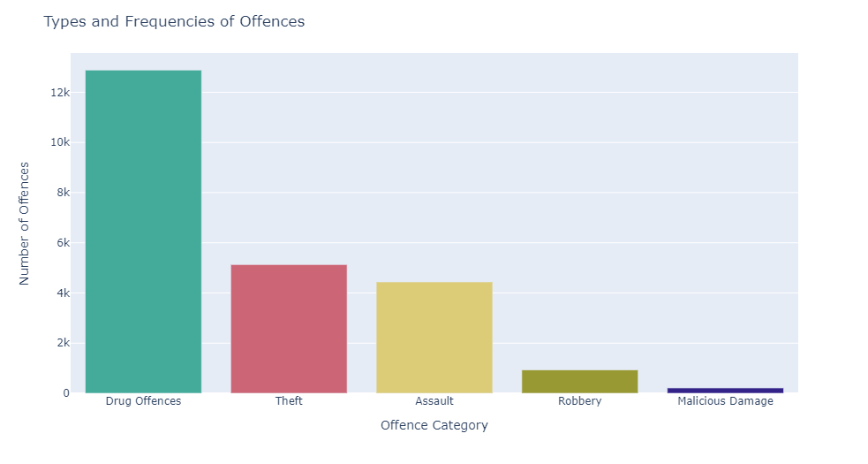
X% of offences committed are Drug Offences

Slide 5
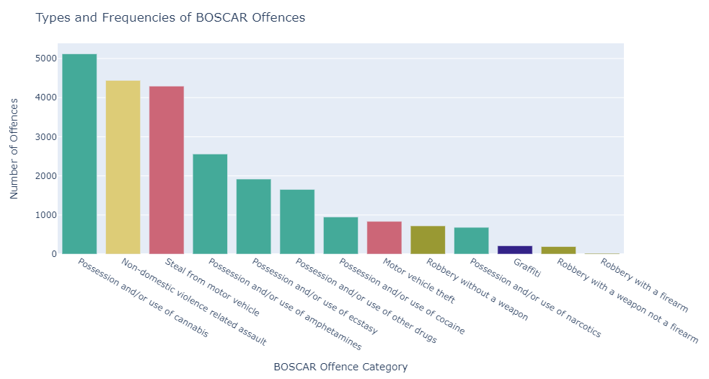
Cannabis, Assault & Stealing from car are the most common sub offences

Slide 6
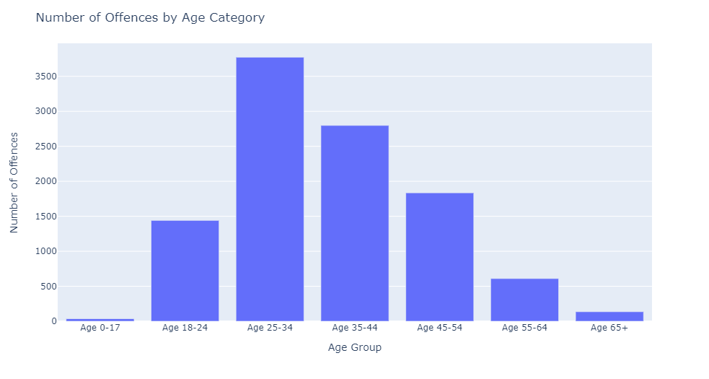
25 to 34 years are the most likely to commit an offence

Slide 7
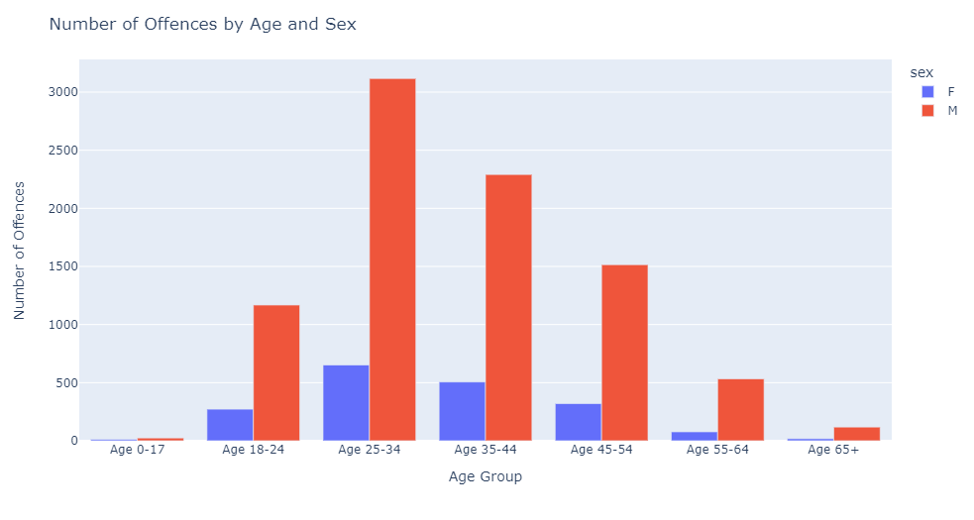
Males commit on average 5-6x more offences than Females

Slide 8
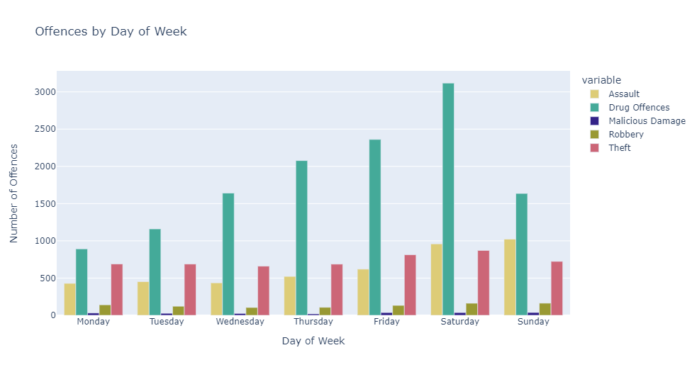
Drug Offences spike on Saturdays

Slide 9
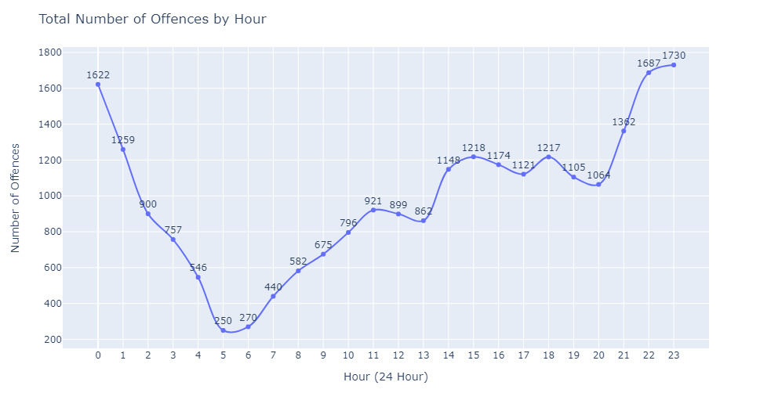
An offence is least likely to be committed in the early hours of the morning

Slide 10
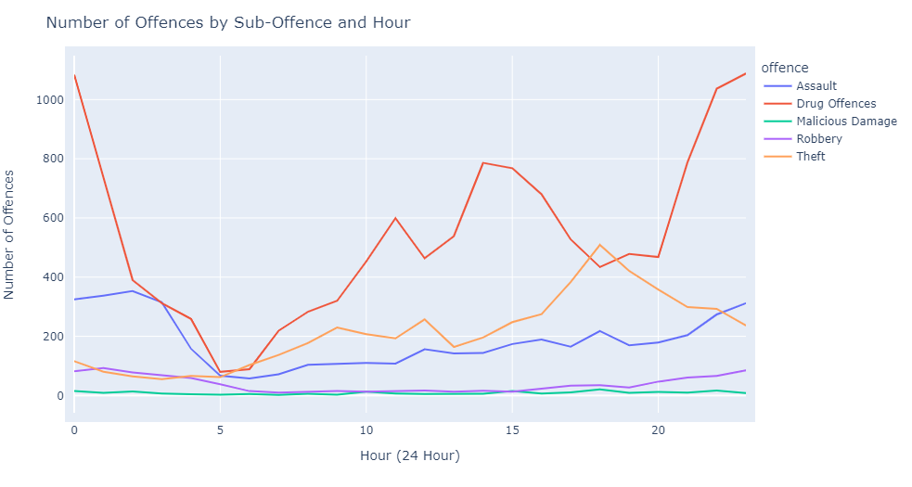
Assaults are most common between 11pm-3am

Slide 11
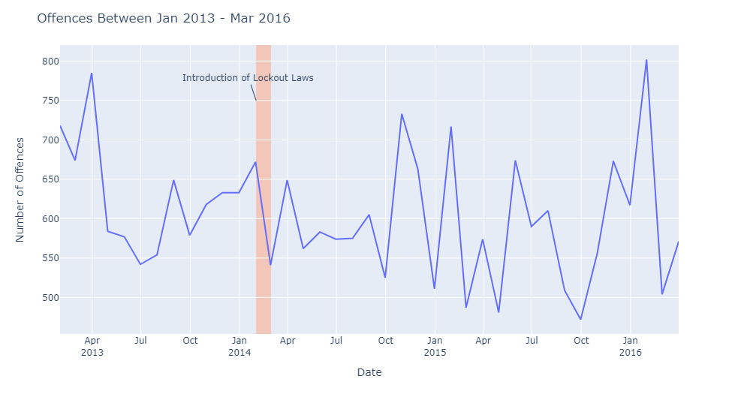
Offences can vary greatly month to month

Slide 12
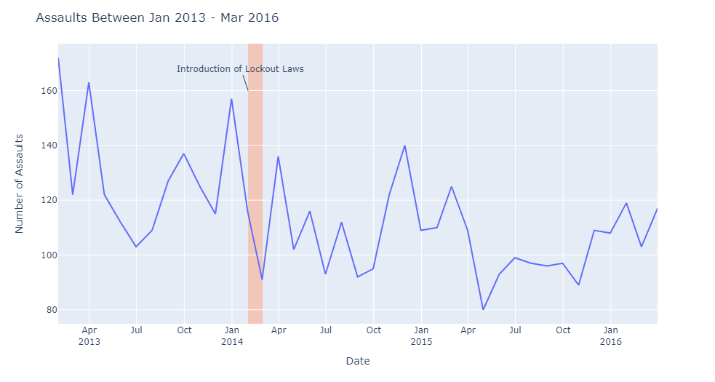
Introduction of the lockout laws appears to have decreased overall number of assaults

Slide 13
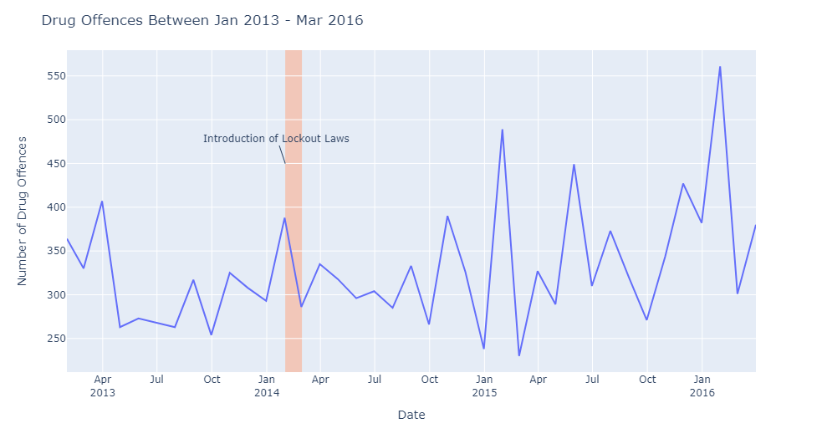
Drug offences appear to have increased after the introduction of the lockout laws

Slide 14
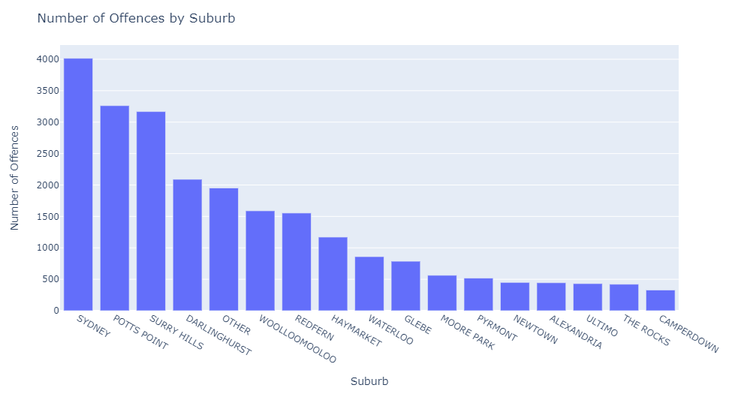
Sydney CBD and Inner Suburbs have the highest number of offences

Slide 15
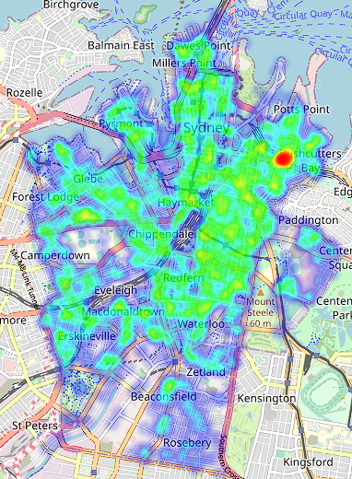
Kings Cross has a much larger density of offences, compared to surrounding areas

