Slide 1
Quantum Cascade Lasers: Well-timed next avenue for lightsource R&D?
Sebastian Gorgon
NanoDTC, University of Cambridge
sg911@cam.ac.uk
github.com/sebgorgon/patents
Notes:
OK

Slide 2
Quantum Cascade Lasers: Patent Landscape
Scope of report
Established laser manufacturer with no history of QCL manufacture
Assess if should launch R&D for a QCL-based platform
Main focus on IP conditions and timing
github.com/sebgorgon/patents
Notes:
OK

Slide 3
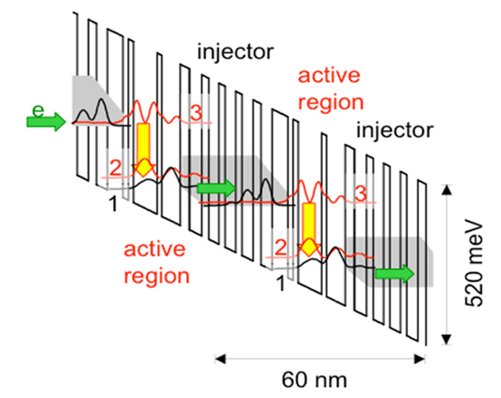
Quantum Cascade Lasers: Patent Landscape
Working principle
Unipolar
Multiple photons from single electron
Complicated layer stack
Intense infrared emission
Applications:
ultrasensitive sensing
medical diagnostics
industrial quality control
github.com/sebgorgon/patents
Notes:
OK

Slide 4
Quantum Cascade Lasers: Patent Landscape
History
1994 – QCL invented by Capasso and team at Bell Labs
1995 – Expiry of patent US3982207A covering Quantum Well Lasers
1997 – Patent US5936989A covers core QCL design
2006 – Patent US7535656B2 covers multiple wavelength emission
2017 – Expiry of original QCL patent
github.com/sebgorgon/patents
Notes:
OK

Slide 5
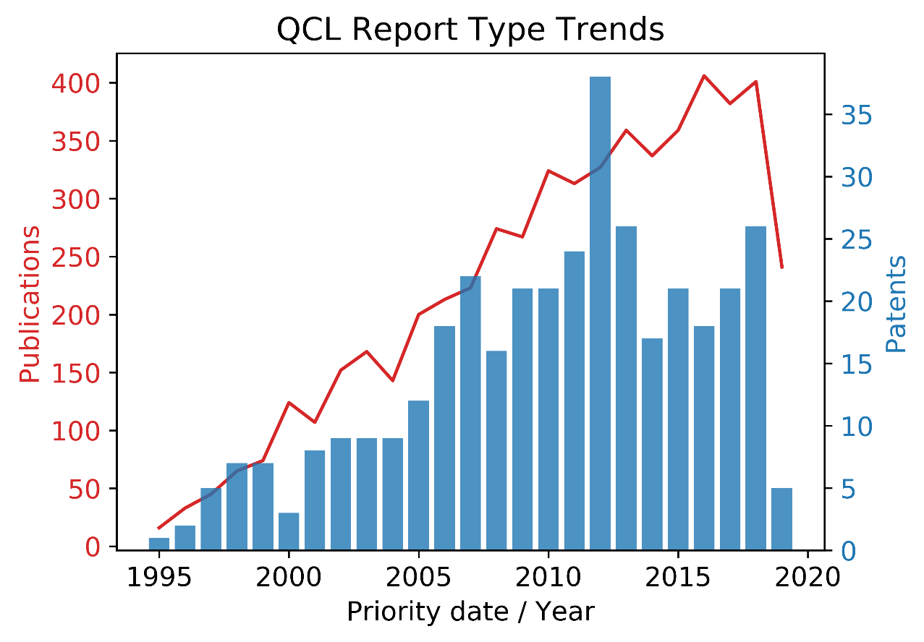
Quantum Cascade Lasers: Patent Landscape
Patent trends
Total of 366 patents on QCL-platform development
github.com/sebgorgon/patents
Notes:
OK

Slide 6
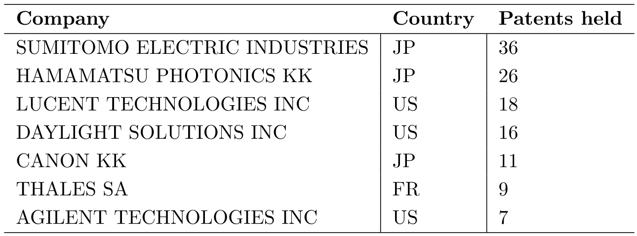
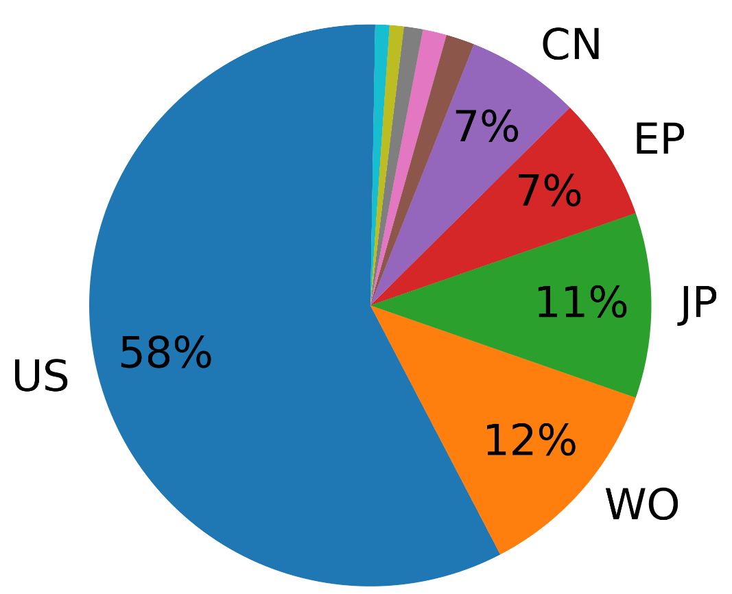
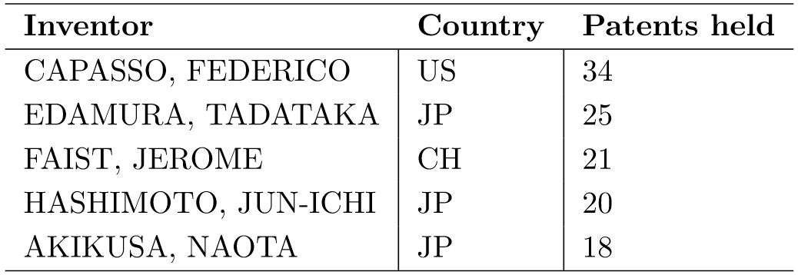
Quantum Cascade Lasers: Patent Landscape
Key players
github.com/sebgorgon/patents
Notes:
OK

Slide 7
Quantum Cascade Lasers: Patent Landscape
Recommendations
Original QCL patent expired in April 2017
Similar situation to QCL inventors in 1990s with recently expired Quantum Well Laser patent
Bulk of innovation covers layer optimisation
Can be achieved by relatively cheap simulation
IP landscape recently opened up – best time to enter is now
github.com/sebgorgon/patents
Notes:
OK

