Slide 1
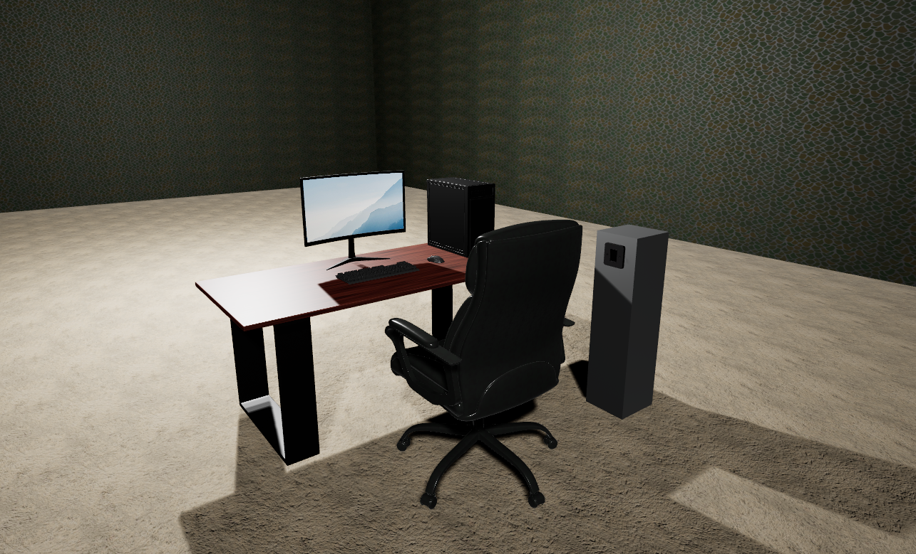
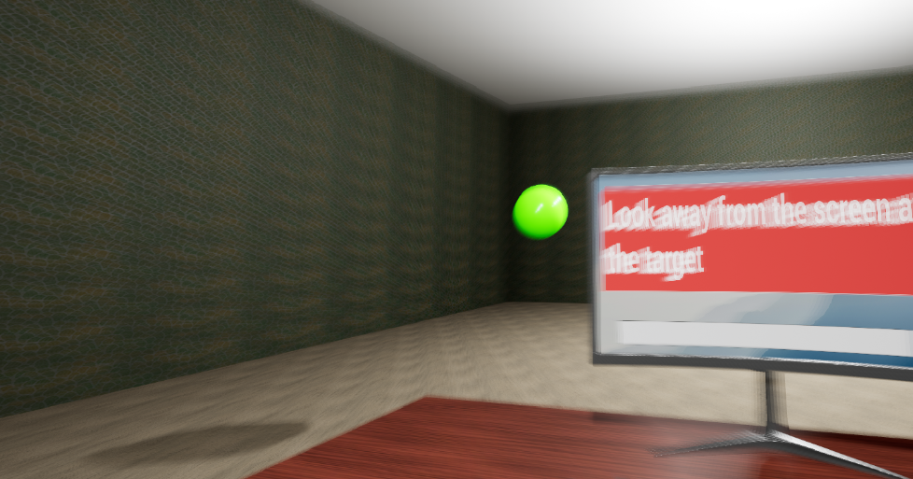
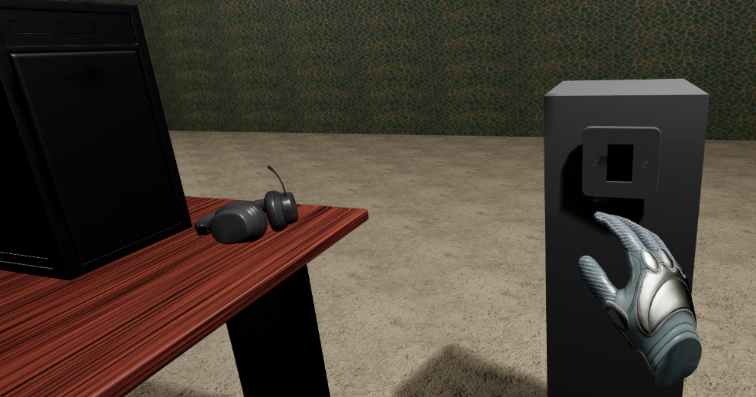
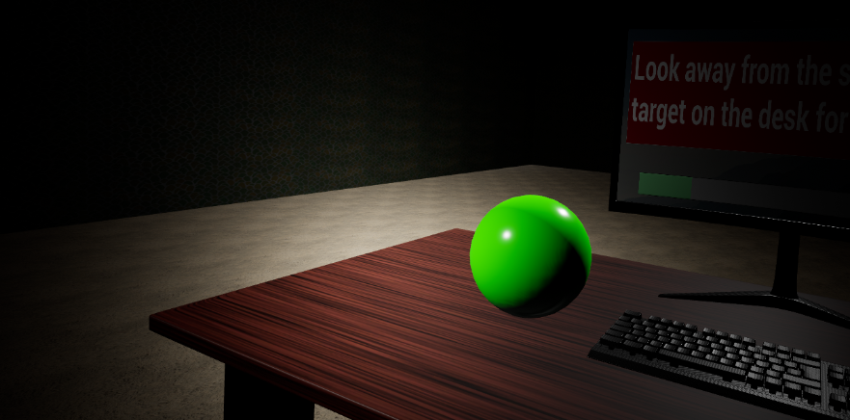
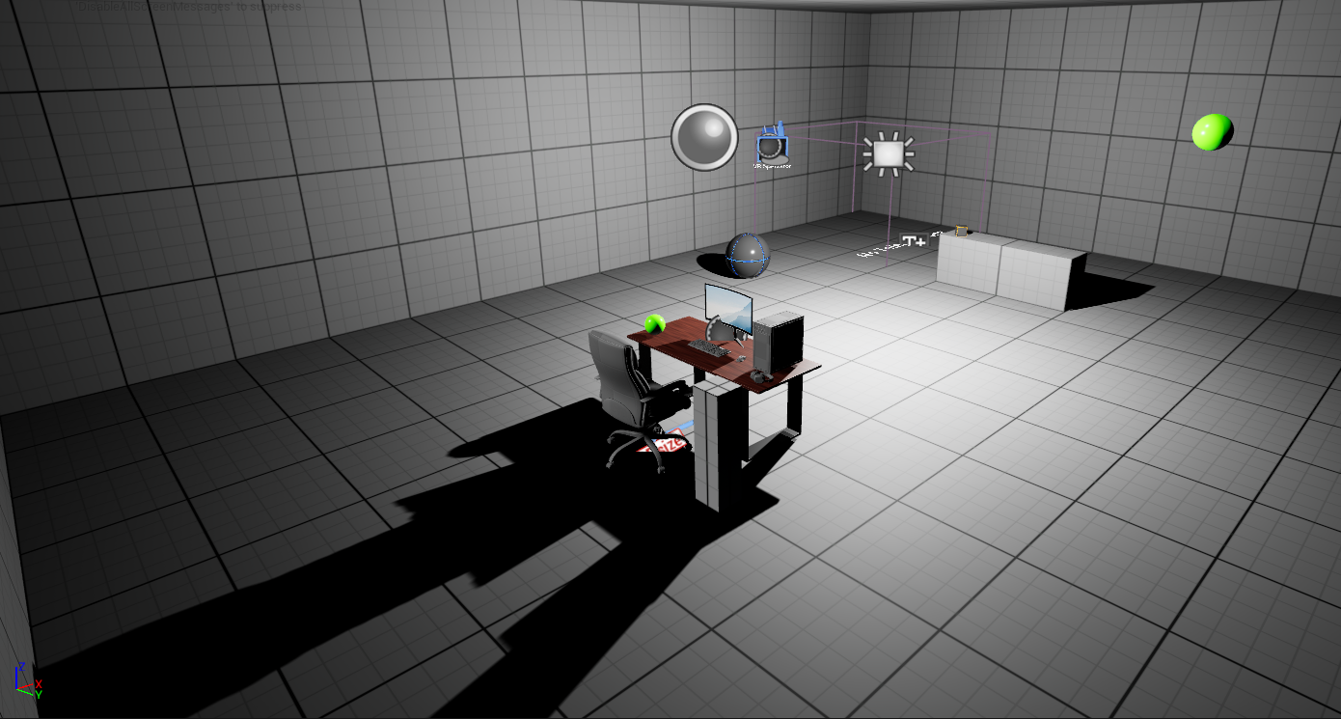
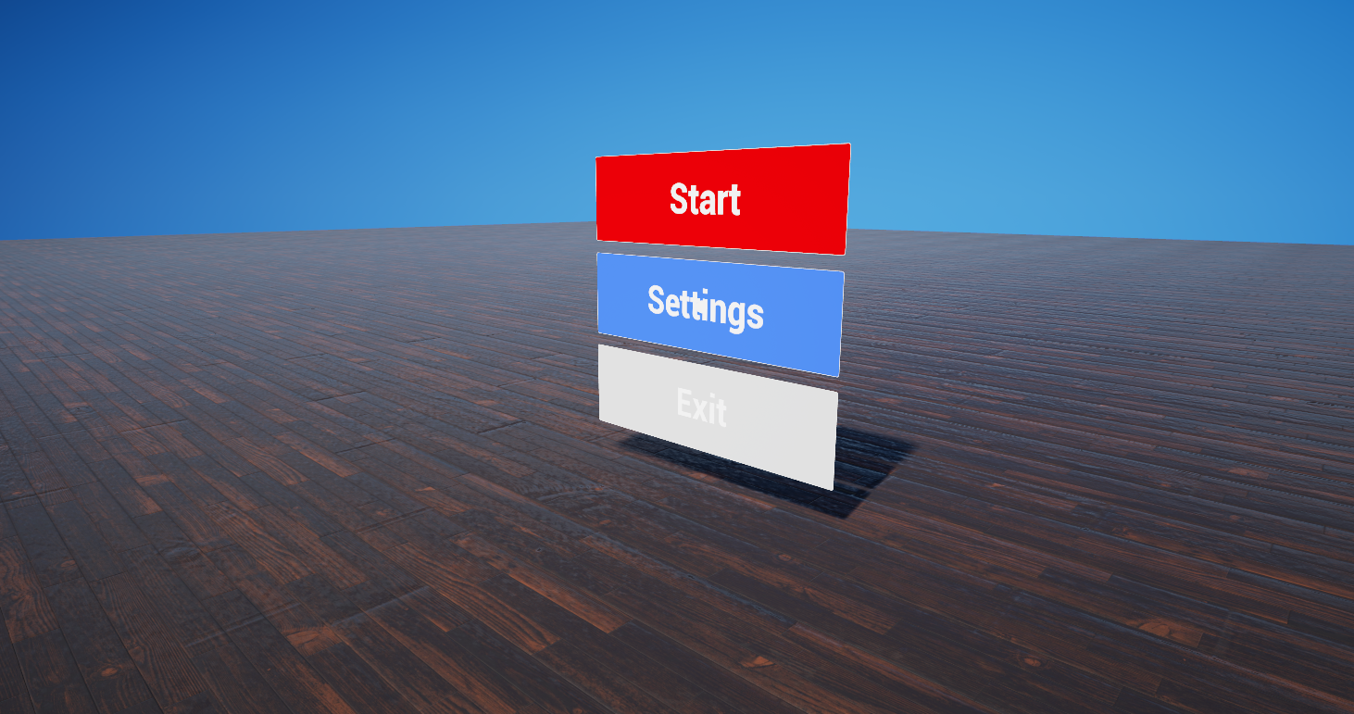

An Educational Virtual Reality Approach to Raising Awareness of Digital Eye Strain
Supervisor – Alun King Sebastian Ha 30077548@students.southwales.ac.uk
Problem
Digital Eye Strain (DES) is caused by prolonged screen use with symptoms including eye fatigue, light sensitivity, focus strain and headaches. However, awareness of preventative habits remains low. Sheppard and Wolffsohn, (2018) found the 2016 DES report showed 65% of participants experienced symptoms.
Aim
Raise awareness of DES by incorporating Virtual Reality (VR) to immerse and engage users with educational material relating to ocular health.
Objectives
Research preventative methods for DES and identify educational content appropriate for the VR experience.
Review existing medical VR applications to identify design and interaction strategies.
Develop a VR experience that simulates DES symptoms and teaches preventative techniques.
Conduct user testing to discover issues to improve the experience.
Results
User testing found usability issues within the prototype with the gaze detection accuracy and the light switch interactions.
Iterative improvements reduced interaction complexity while increasing the detection area for the gaze interaction. This resulted in smoother objective progression and reduced frustration.
Feedback showed simulated symptoms helped improve user understanding and recognition of the causes, symptoms and preventative measures of DES.
Final testing confirmed the experience effectively demonstrated symptoms and preventative measures, increasing awareness of DES.
Conclusion
Wu et al., (2020) found using VR as an immersive educational tool is more effective than non-immersive learning approaches. topics. The experience successfully demonstrated the symptoms and preventative measures of DES. Iterative user testing improved usability and interaction features, which resulted in a more intuitive experience. This shows immersive VR can be used as an effective educational tool for raising awareness of medical health.
Figure 1: Focus strain symptom simulation with gaze interaction as active objective
Figure 2: Desk setup with light switch interaction
Figure 3: Eye fatigue simulation with green sphere target for objective progression
Development Process
The project was developed using Unreal Engine 5.3.2 with blueprinting and tested with a Meta Quest 3 VR headset.
The development process followed a User Centred Design (UCD) approach. Gibson Kimutai and Förster, (2024) examined how UCD plays a critical role in product development, by using user feedback to refine the product throughout development.
Objective based progression gamified the experience. Deterding et al., (2011) defined
gamification as using game design elements in non-game contexts to increase retention and motivation of users. The environment was designed to replicate real-world desk environments where DES commonly occurs.
Post-processing effects were used to simulate DES symptoms.
Vignette → Eye Fatigue
Bloom → Light Sensitivity
Blur → Focus Strain
Workflow followed iterative development. Genov, (2005) described iterative usability testing as a form of continuous feedback that guides design. A prototype was created and tested by users. Feedback collected was used to improve interactions and usability of the experience. This resulted in the final version implementing improved interaction and gaze detection.
Research → Prototype → User Testing → Improvements → Final Version
Future Work
Narration within the experience
Accessibility settings
Changing gaze detection to use eye Tracking
Additional environments
More intuitive light switch interaction
Figure 4: Start menu environment
References
Deterding, S., Dixon, D., Khaled, R. and Nacke, L. (2011) ‘From Game Design Elements to gamefulness: Defining “gamification”’. Proceedings of the 15th International Academic MindTrek Conference on Envisioning Future Media Environments - MindTrek ’11 11, pp. 9–15. doi: https://doi.org/10.1145/2181037.2181040.
Genov, A. (2005) ‘Iterative usability testing as continuous feedback: a control systems perspective’. J. Usability Studies 1(1), pp. 18–27. doi: https://dl.acm.org/doi/abs/10.5555/2835525.2835528.
Gibson Kimutai and Förster, A. (2024) ‘A User-Centred Interaction Design: A Holistic Approach’., pp. 468–475. doi: https://doi.org/10.1109/ghtc62424.2024.10771531.
Sheppard, A.L. and Wolffsohn, J.S. (2018) ‘Digital eye strain: prevalence, measurement and amelioration’. BMJ Open Ophthalmology 3(1), p. e000146. Available at: https://bmjophth.bmj.com/content/3/1/e000146.
Wu, B., Yu, X. and Gu, X. (2020) ‘Effectiveness of immersive virtual reality using head‐mounted displays on learning performance: A meta‐analysis’. British Journal of Educational Technology 51(6), pp. 1991–2005. doi: https://doi.org/10.1111/bjet.13023.

