Slide 1



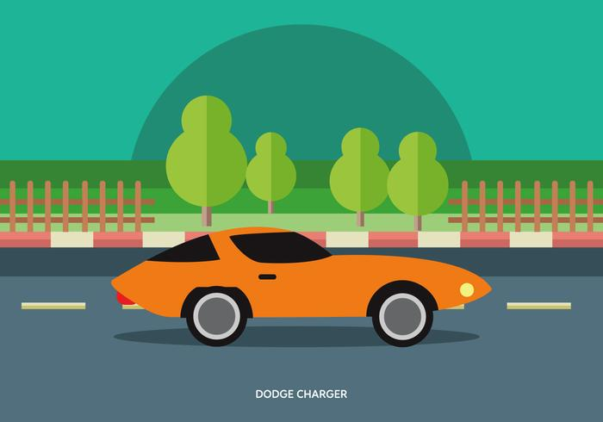
autobook
PRIMĂRIA
CLUJ-NAPOCA
It’s about cars

Slide 2
help us build a smart city
PRIMĂRIA
CLUJ-NAPOCA

Slide 3
turn your car into a smart-car
PRIMĂRIA
CLUJ-NAPOCA

Slide 4
connect your smart-car to the city
PRIMĂRIA
CLUJ-NAPOCA

Slide 5
we can show you how
PRIMĂRIA
CLUJ-NAPOCA

Slide 6
you can understand why
PRIMĂRIA
CLUJ-NAPOCA

Slide 7
imagine
PRIMĂRIA
CLUJ-NAPOCA

Slide 8
you can change decisions on the fly
PRIMĂRIA
CLUJ-NAPOCA

Slide 9
you can have an impact to your city
PRIMĂRIA
CLUJ-NAPOCA

Slide 10
get together
PRIMĂRIA
CLUJ-NAPOCA

Slide 11
stay connected
PRIMĂRIA
CLUJ-NAPOCA

Slide 12
we wrote a book
PRIMĂRIA
CLUJ-NAPOCA

Slide 13
with the story
PRIMĂRIA
CLUJ-NAPOCA

Slide 14
about your car
PRIMĂRIA
CLUJ-NAPOCA

Slide 15
then, the other story
PRIMĂRIA
CLUJ-NAPOCA

Slide 16
about… the other car
PRIMĂRIA
CLUJ-NAPOCA

Slide 17
and … we launched it into SPACE
PRIMĂRIA
CLUJ-NAPOCA

Slide 18
the book is autobook
PRIMĂRIA
CLUJ-NAPOCA

Slide 19

PRIMĂRIA
CLUJ-NAPOCA

Slide 20
demo

Slide 21
how… you access this service ?
PRIMĂRIA
CLUJ-NAPOCA

Slide 22

PRIMĂRIA
CLUJ-NAPOCA
GSM, data, GPS
smart device

Slide 23
how… to turn any car into a smart-car ?
PRIMĂRIA
CLUJ-NAPOCA

Slide 24

PRIMĂRIA
CLUJ-NAPOCA
attach a smart device to it

Slide 25
autobook.SPACE is ready for you now
PRIMĂRIA
CLUJ-NAPOCA

Slide 26
autobook.SPACE is storing data
PRIMĂRIA
CLUJ-NAPOCA

Slide 27
autobook.SPACE is ready to share the data
PRIMĂRIA
CLUJ-NAPOCA

Slide 28
do you allow us to share the data through
PRIMĂRIA
CLUJ-NAPOCA
?

Slide 29
we can make it better together
PRIMĂRIA
CLUJ-NAPOCA

Slide 30
we want to build a mobile app
PRIMĂRIA
CLUJ-NAPOCA

Slide 31
do you want to help us ?
PRIMĂRIA
CLUJ-NAPOCA

Slide 32
thank you for your patience
PRIMĂRIA
CLUJ-NAPOCA

Slide 33
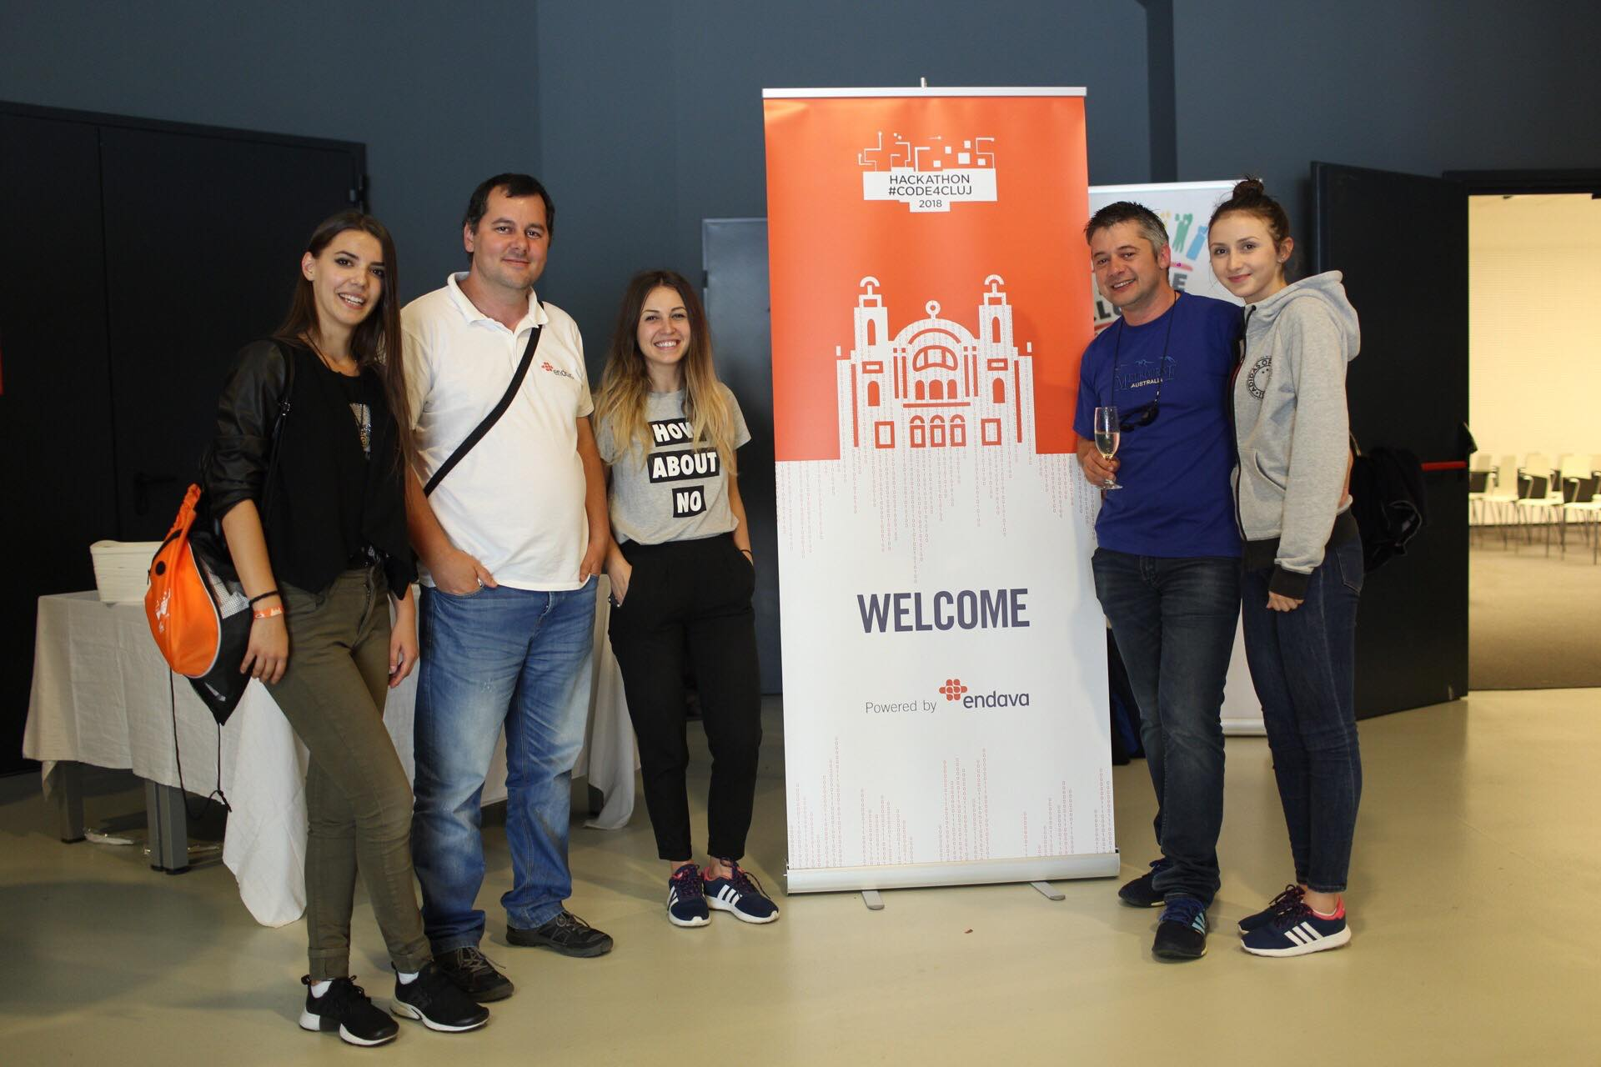
ANGEL team
PRIMĂRIA
CLUJ-NAPOCA

