Slide 1
SPATIAL BIG DATA · PROJECT PRESENTATION
Urban Expansion and Green Space Loss Using Spatial Big Data Analytics
A Case Study of Thiruvananthapuram, Kerala, 2000-2025
Presented by: Sebin George (Roll No. 253309)
M.Sc. Semester 3 · Digital University Kerala
Land cover · green · built-up · water
Notes:
How much green space did Thiruvananthapuram lose to buildings between 2000 and 2025? Where did this loss happen, why did it happen there, and which wards should be prioritised for protection?

Slide 2
In 25 years the city traded 12 km² of green for buildings
74.2%
22.9%
12.2 km²
+1.6 °C
Green cover in 2025
(77.7% in 2000)
Built-up in 2025
(15.6% in 2000)
Green converted to built-up, 2000-2025
Extra surface warming on converted land
Clustered, not scattered. One belt from Pettah and Chakkai to Sreevaraham and Kalippankulam holds 4.5 km² of the conversion (Getis-Ord Gi*).
Infill and roads drive it. Green pockets already ringed by buildings convert at 3.7× the city rate; 12.5% of green within 100 m of a main road was lost, 3.6% beyond 500 m.
Clear places to act. A ward priority index names 20 wards to protect first; Sreevaraham ranks first under every weighting tested.
Notes:
Headline numbers for the corporation (101 wards, 214 km2). Green is tree cover plus other vegetation. The 1.6 degree figure compares Landsat land surface temperature change on converted pixels with pixels that stayed green.

Slide 3
Why this study, and what it set out to do
The problem
1
Measure
Map land cover 2000-2025 from Landsat and Sentinel-2 and quantify green lost per ward
Technopark, Vizhinjam port and capital-region growth push the city outward
Home-garden canopy, paddy and wetland are lost plot by plot
Less green means more runoff, flooding and heat
No ward-level evidence of how much is gone, where, or why
2
Locate
Find where loss clusters: hotspot analysis on hexagons and construction clusters
3
Explain
Find what makes green land likely to be built over: roads, infill, terrain
214 km²
101
25 years
4
Scale and act
study area
wards
2000-2025
Run the analysis on big-data engines and turn it into a ward priority index and dashboard
Notes:
Thiruvananthapuram's green is mostly private home gardens under coconut and mixed tree canopy, not parks, so it disappears plot by plot without any single decision. The Corporation has no ward-level record of how much has gone, where, or why. The four objectives map onto the seven pipeline steps on the next slides.

Slide 4
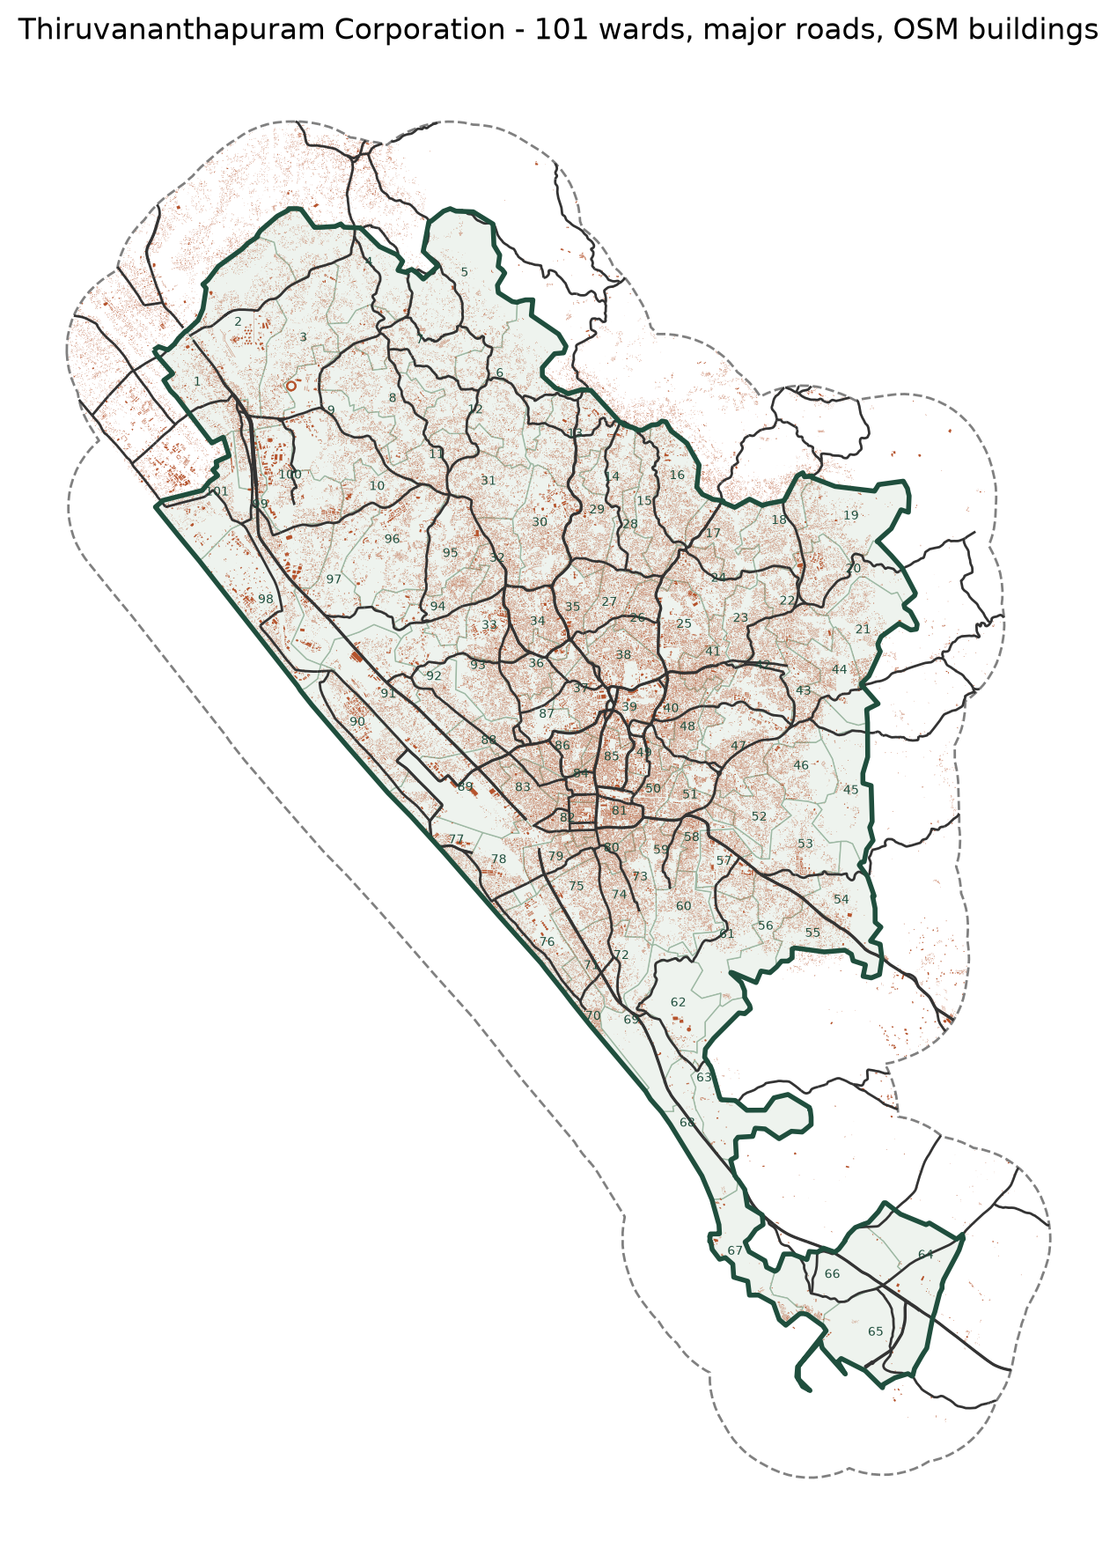
Study area and data
Layer | Source | Used for
Landsat 5/7/8/9, 30 m | Earth Engine dry-season medians: 2000, 2010, 2017, 2025 | Land cover over 25 years
Sentinel-2 L2A, 10 m | Earth Engine, Cloud Score+ mask: 2019, 2025 | Detailed recent map
WorldCover, Dynamic World | ESA, Google | Training labels where both agree
101 ward boundaries | K-SMART 2024 delimitation | Ward statistics
Roads, buildings, land use | OpenStreetMap (Geofabrik) | Drivers and checks
Population, 100 m | WorldPop | Density, green per person
DEM, HAND, LST, radar | Copernicus GLO-30, MERIT Hydro, MODIS, Sentinel-1 | Terrain, heat, floods
Notes:
All imagery was processed in Google Earth Engine and exported on one 30 m UTM 43N grid (and 10 m for Sentinel-2). Census 2011 wards do not match the 2024 delimitation, so population comes from gridded WorldPop aggregated to wards.

Slide 5
Seven steps from satellite pixels to ward decisions
1
Base data
2
Composites
3
Classify
4
Detect change
Wards, OSM roads and buildings, WorldPop
Cloud-masked dry-season medians, NDVI / NDBI / MNDWI
Random Forest, 5 classes, 10 k samples per map
Backdated series, transition matrices
GeoPandas
Earth Engine
scikit-learn
Rasterio
5
Big data engine
6
Analytics
7
Dashboard
4 M pixel points, spatial joins, partitions
Gi*, DBSCAN, FP-Growth, priority index
Maps, drill-down, live spatial queries
Sedona on Spark, PostGIS
PySAL, Spark MLlib
Streamlit, Folium
Notes:
We first collected and prepared geographical data. Then we downloaded satellite imagery and created cloud-free composites. We classified the images into different land-cover categories using Random Forest. After classification, we detected changes between 2000 and 2025. We then converted the raster pixels into spatial point data and processed them using Sedona and PostGIS. Finally, we conducted spatial and machine-learning analytics and presented the results through an interactive dashboard.

Slide 6
The tools, in plain words
Google Earth Engine
Python libraries
PostgreSQL + PostGIS
Cloud platform that filters and composites 25 years of Landsat and Sentinel-2 scenes
Rasterio reads satellite bands, GeoPandas handles ward and road shapes, scikit-learn trains the Random Forest
A free database with spatial SQL: clip, buffer and measure; GiST indexes make spatial queries fast
Apache Spark
Apache Sedona
PySAL, Streamlit, Folium, Plotly
Splits big data across many cores or machines; its MLlib library runs the FP-Growth rules
Spatial add-on for Spark: geometry, spatial indexes and partitioned joins over millions of pixels
Hotspot statistics, and the web dashboard with interactive maps and charts
How they fit: Earth Engine prepares imagery → Python classifies → PostGIS stores and queries → Sedona scales joins → Streamlit shows results
Notes:
For a non-specialist audience: what each tool is and what it did in this project. Earth Engine prepares the imagery, Python classifies it, PostGIS stores and queries the results, Spark and Sedona scale the heavy joins, and Streamlit shows everything in the browser.

Slide 7
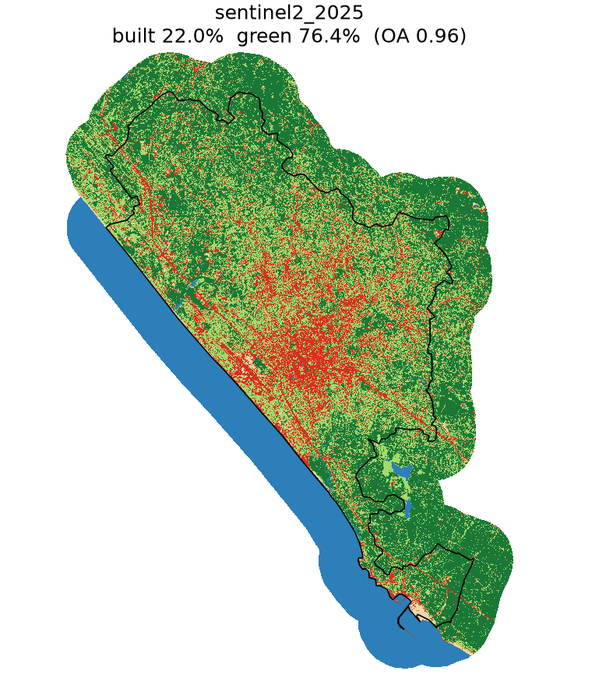
Machine learning models used
Model | Type | Used for | Result
Random Forest | Supervised ML (classification) | Land cover, 5 classes, from bands + indices | Accuracy 0.96 (Sentinel-2), 0.71-0.82 (Landsat)
DBSCAN | Unsupervised ML (clustering) | Groups converted pixels into construction sites | 250 clusters, 58% of conversion
FP-Growth | Unsupervised ML (association rules) | Finds conditions that predict green → built-up | Top rule 5.3× the city rate
Getis-Ord Gi*, Moran's I | Spatial statistics (not ML) | Tests where loss clusters | 262 hot hexagons, I = 0.49
Built-up
Tree
Other veg.
Deep learning: none trained. Two pre-trained Google deep-learning products are used as inputs only: Dynamic World (training labels) and Cloud Score+ (cloud masking).
Water
Bare
Random Forest map, Sentinel-2 2025
Notes:
Random Forest (scikit-learn, 200 trees, sqrt features) classifies each pixel from its spectral bands and the NDVI, NDBI and MNDWI indices into 5 classes. Accuracy is measured on held-out spatial blocks the model never saw (about 3,200 pixels per Sentinel-2 map). Training labels are pixels where ESA WorldCover and Google Dynamic World agree: WorldCover calls most of the city trees (coconut-canopy home gardens) while Dynamic World calls 80% built. Landsat accuracy is lower because its labels come from the 10 m map aggregated to 30 m and the older sensors are noisier. Tree vs other vegetation is unreliable at 30 m, so results use total green. No deep learning model was trained; Dynamic World (a convolutional neural network) and Cloud Score+ (a deep-learning cloud detector) are pre-trained Google products used only as inputs. Gi* and Moran's I are spatial statistics, not machine learning.

Slide 8
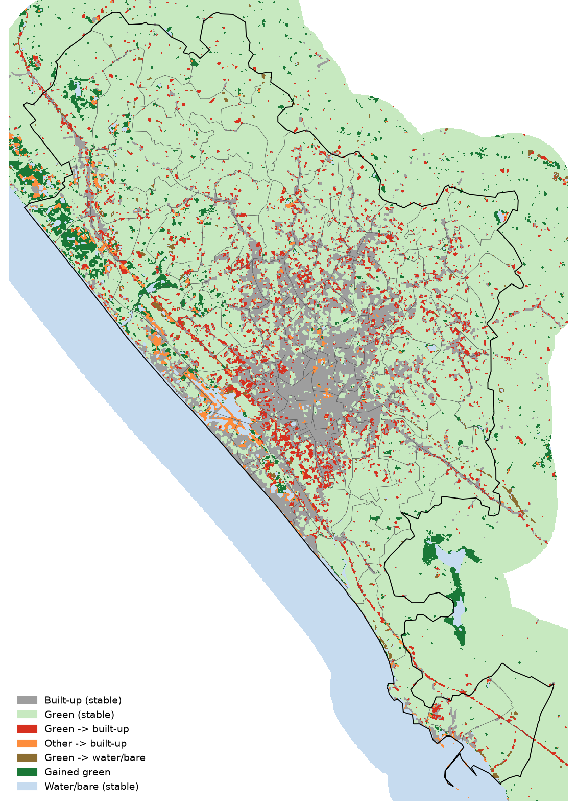
Built-up grew from 15.6% to 22.9% of the city
Green lost per year (km²)
0.71
0.62
0.52
2000-2010
2010-2017
2017-2025
Notes:
Independent Landsat maps per year gave a flat built-up trend, so the series was backdated from 2025 with change-vector detection; the threshold k = 0.25 was chosen so the trend follows the independent GHSL built-up surface. Loss is slowing: 0.71 km2 a year in the 2000s, 0.52 since 2017.

Slide 9
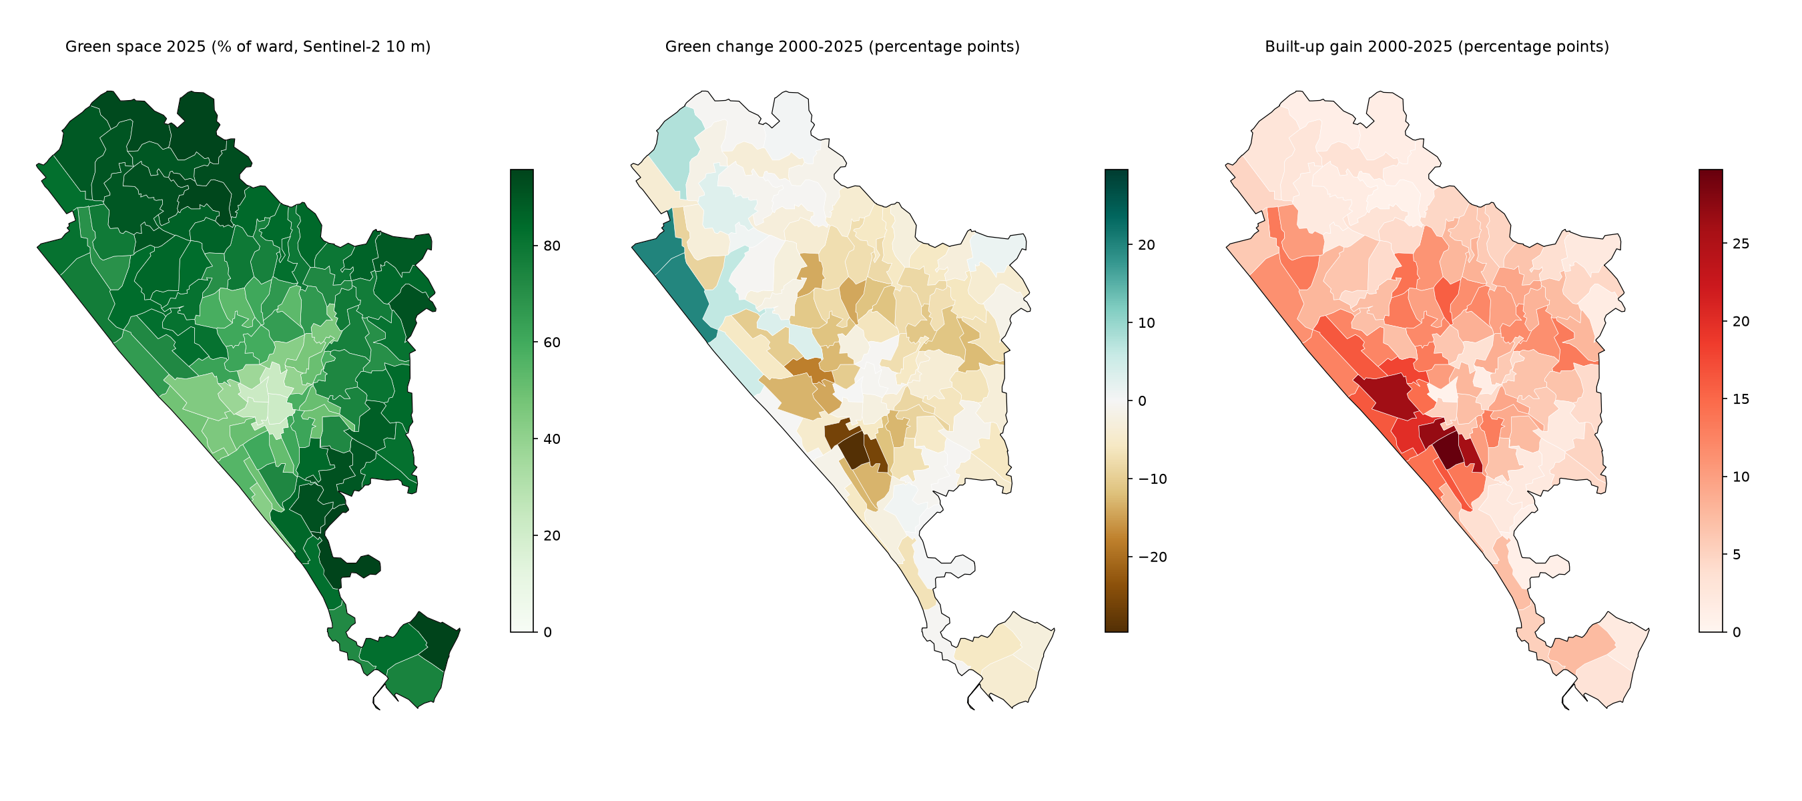
Six wards lost more than 14 points of green cover
Largest green loss, 2000-2025 (pp)
Kamaleswaram
-29.6
79 → 49%
Sreevaraham
-26.1
55 → 28%
Kalippankulam
-25.9
61 → 35%
Pettah
-18.0
62 → 44%
Kesavadasapuram
-14.3
The loss is concentrated in the southern and central wards around the old city. North-west coastal wards show apparent gains, partly because the 2000 map over-counts bare sand there.
62 → 47%
Perunthanni
-14.2
24 → 10%
Notes:
Ward maps of green share in 2000 and 2025 and the change. Gains in the north-west coastal wards (Pallithura, Powndukadavu) are partly an artefact: the 2000 map has too much bare/sand there.

Slide 10
A spatial index makes the 4 M-point join 64× faster
192 s → 3.0 s
Broadcast R-tree index join vs plain Spark nested loop at 4 M points
2× faster
Quadtree vs KDB-tree partitions: better load balance (variation 0.44 vs 1.79)
1.6 s
GeoPandas: 4 M points still fit one machine. Sedona wins when data outgrows it
Notes:
Benchmark: every Sentinel-2 pixel as a point joined to the 101 wards, best of three runs on local Spark with 12 threads. Without Sedona's spatial join planning Spark falls back to a nested loop that tests every point against every ward. At this size GeoPandas on one machine is still fastest; Sedona's value is that its indexed joins scale linearly and can run on a cluster.

Slide 11
PostGIS indexes cut queries up to 115×; all engines agree
Ward statistics as a MapReduce job
Map
pixel → ward (index join)
Combine
partial count per task
Shuffle
hash by (ward, class)
Reduce
count → km² per ward
Three engines agree
Sedona vs Rasterio: within 0.53 pp
PostGIS vs Sedona: identical counts
Pixel table vs raster: within 0.006 km²
Notes:
EXPLAIN ANALYZE timings in PostgreSQL 13 / PostGIS on the 451 k Landsat pixel table and OSM layers, with index scans enabled and disabled. The geohash LIST-partitioned pixel table lets the planner read 1 of 30 partitions for a local query. The Spark physical plan of the ward-by-class count is a MapReduce job: partial counts inside each task act as the combiner, the Exchange is the shuffle, and the final HashAggregate is the reduce. The same ward statistics were computed three independent ways and agree: Sedona vs Rasterio within 0.53 pp, PostGIS vs Sedona identical building and road counts, PostGIS pixel table vs raster within 0.006 km2.

Slide 12
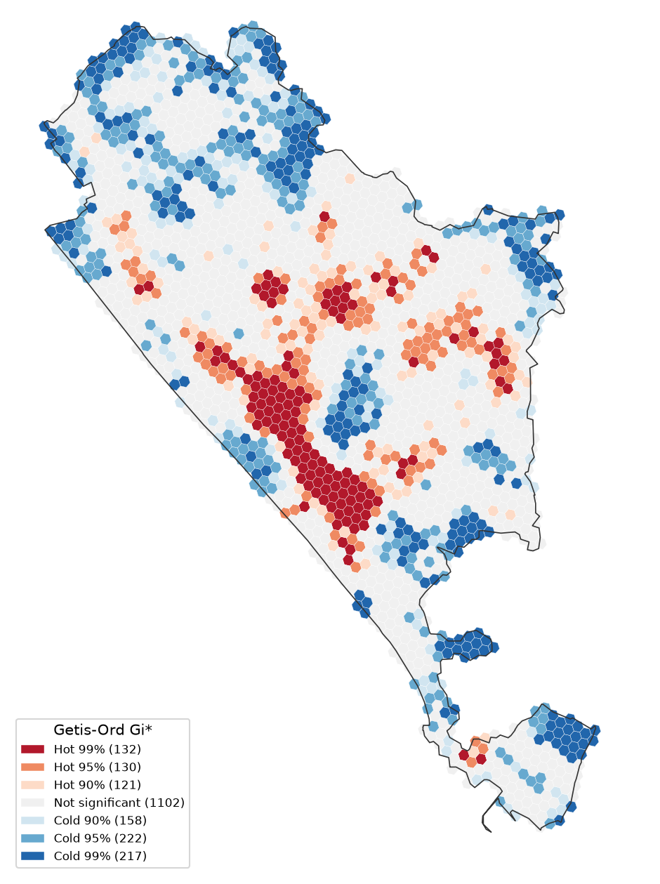
Conversion is concentrated in one central-southern belt
0.49
262
Moran's I of conversion across hexagons (p = 0.001)
Hot hexagons at 95% (115 survive the false-discovery correction)
4.5 km²
250
of the 12.2 km² conversion lies in those hot hexagons
DBSCAN clusters holding 58% of converted pixels
Largest clusters: Sreevaraham 0.44 km², Kalippankulam 0.40 km², Chakkai 0.28 km², Karikkakam 0.18 km²
Notes:
Getis-Ord Gi* on 2,082 H3 hexagons (resolution 9, about 0.1 km2) with 6-nearest-neighbour weights and 999 permutations. Red = significant clusters of green-to-built conversion, blue = significant clusters of little conversion. DBSCAN (eps 100 m, 12 pixels) finds the compact construction clusters inside them.

Slide 13
Infill near the centre and along roads drives conversion
Reading: green pockets already surrounded by buildings in 2000, on flat land within 3 km of the centre, converted at 39%, 5.3× the city rate. Green within 100 m of a main road converted 3.5× as often as green beyond 500 m.
Notes:
FP-Growth (Spark MLlib) on 182,192 green-2000 pixels with 11 location attributes each; 112 k frequent itemsets at minimum support 0.3%. Lift is the conversion rate of the rule divided by the city-wide rate of 7.4%. Near Technopark conversion is below average (5.1% within 2 km) because the campus area was already built by 2000.

Slide 14
Converted land runs hotter; green per person falls
Floods
People
7.8%
139 → 132
of low-lying green land converted (upland 7.2%)
m² of green per person, 2017 → 2025
2.95 km²
23 → 27
of floodplain-belt green lost to buildings
wards below 50 m² of green per person
2018 radar flood signal in the city was small (0.32 km²)
Same WorldPop release for both years
Heat: converted pixels warmed 1.6 °C more than green that stayed
Notes:
Heat: Landsat dry-season LST on the 76% of the corporation with data in both years; MODIS (complete coverage) shows greener wards are cooler, Spearman rho -0.77. Floods: low-lying land is height above nearest drainage of 5 m or less. The Sentinel-1 change detection found only 0.32 km2 of open-water flooding in August 2018 inside the corporation, so the flood overlay is weak for this city. Population is compared only within one WorldPop release.

Slide 15
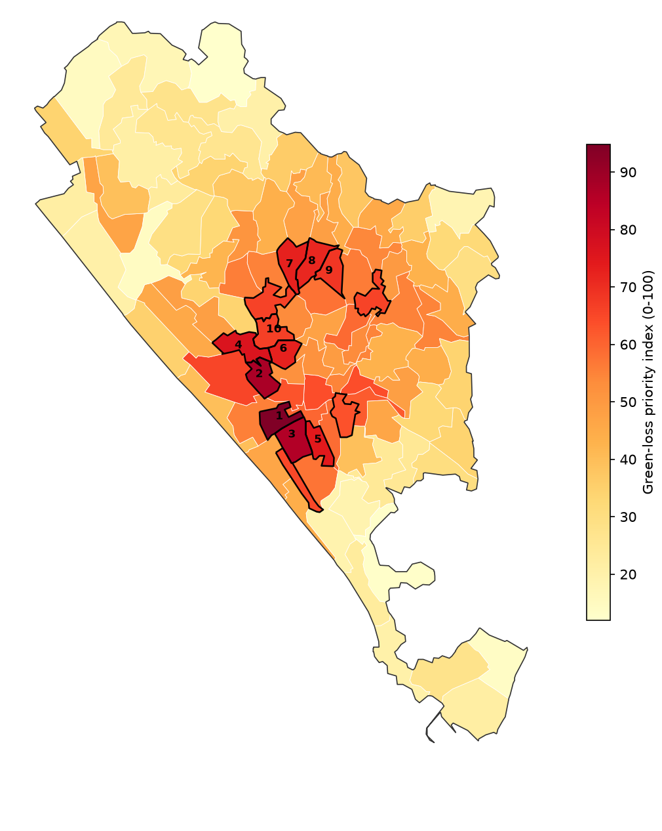
Twenty wards to protect first
Rank | Ward | Index | Rank range
1 | Sreevaraham | 95 | 1-1
2 | Perunthanni | 88 | 2-4
3 | Kamaleswaram | 86 | 2-3
4 | Pettah | 77 | 3-13
5 | Kalippankulam | 74 | 5-19
6 | Vanchiyoor | 73 | 4-13
7 | Kesavadasapuram | 73 | 6-11
8 | Muttada | 71 | 7-9
Robust: rankings under four weighting schemes agree (ρ ≥ 0.97); Sreevaraham is first in all of them.
Notes:
Priority index: seven indicators scaled 0 to 1 (green loss 2000-2025 and 2017-2025, share of ward in Gi* hotspots, share of low-lying green converted, dry-season LST, green per person, population density), equal weights. Re-ranked under loss-pressure, climate-risk and people-first weightings: Spearman rho at least 0.97 and 16 to 19 of the top 20 shared. Rank range shows the best and worst rank across the four schemes.

Slide 16
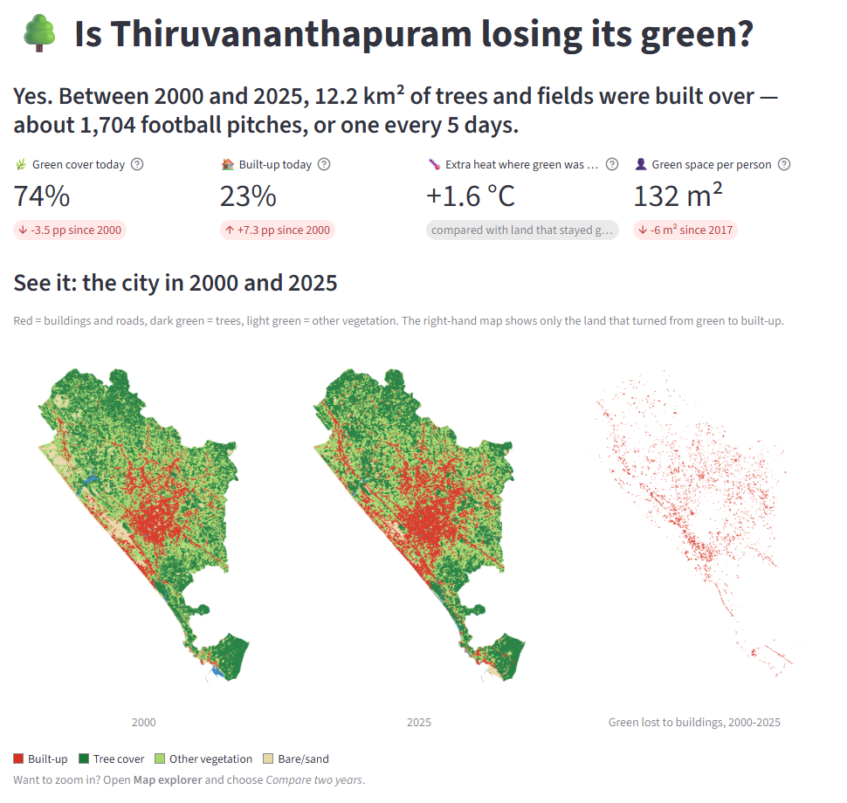
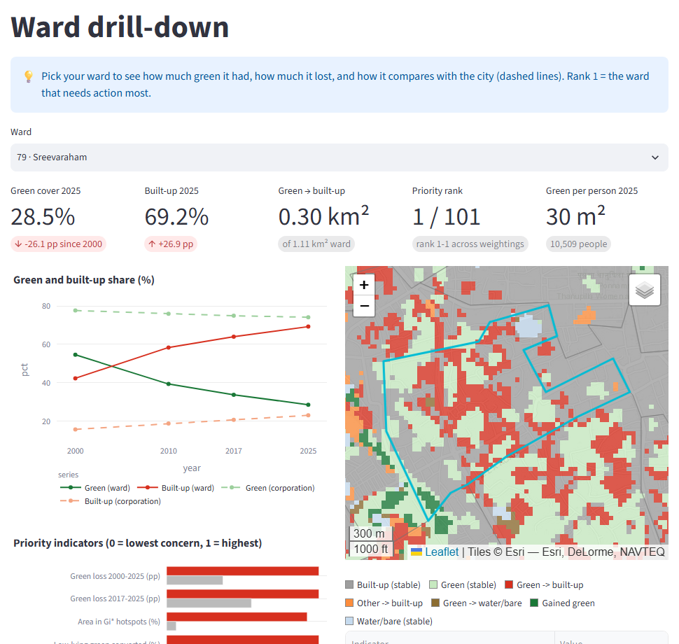
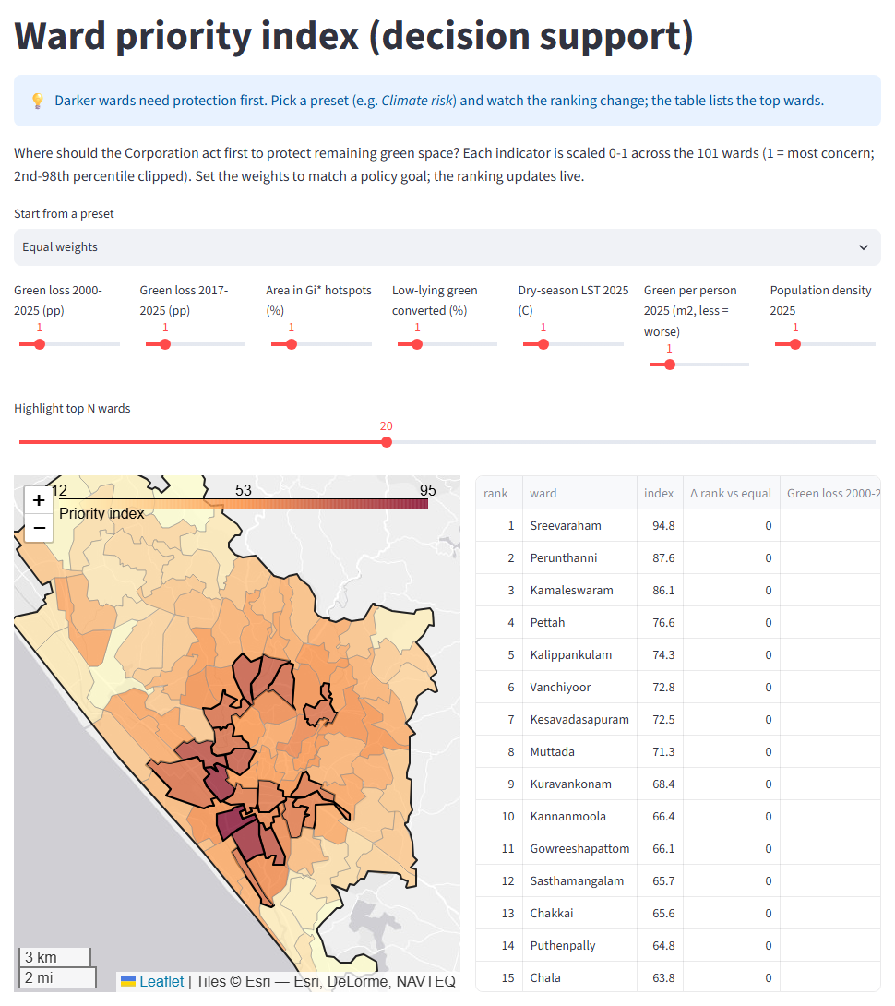
A dashboard puts the results in planners' hands
Overview: the answer in one line, then maps and charts
Ward drill-down: trend, indicators, map
Priority: set the weights, the ranking updates
Year slider and compare
Click a ward to drill down
Gi* and DBSCAN layers
Live PostGIS spatial query
Adjustable priority weights
CSV and GeoJSON export
Notes:
Streamlit app with seven pages. The overview tells the story in plain language: a one-line answer, four headline numbers with explanations, 2000 and 2025 maps side by side, and charts whose titles state the finding. Other pages: map explorer (year slider, side-by-side compare, layer control), ward drill-down, hotspots and rules, spatial query (draw a polygon or buffer a point, answered live by PostGIS SQL or locally), priority index with adjustable weights, and the big-data benchmarks. Every view exports CSV or GeoJSON. Run with: streamlit run dashboard/app.py

Slide 17
Every syllabus module is covered by working results
Module | Topic | Delivered | Status
1 | MapReduce; Spark vs Sedona | Pixel-to-ward join timed 5 ways; MapReduce read from the Spark plan | Done
2 | Cleaning; partitioning; Postgres | Cloud masks, ST_MakeValid; KDB-tree / Quadtree; GiST, geohash partitions | Done
3 | Classification and clustering | Random Forest (OA 0.96); Gi* and DBSCAN hotspots | Done
3 | Association rules; DSS | FP-Growth on 182 k pixels; ward priority index with sensitivity test | Done
3 | Visualisation | Streamlit dashboard with live PostGIS queries | Done
4 | Case studies: environment, society, disasters | Surface heat, green per person, low-lying land and 2018 floods | Done
Notes:
Status of the syllabus mapping proposed in v3; every row is now implemented and has outputs in data/processed and outputs/maps.

Slide 18
Limitations, next steps and who benefits
Limitations
Next steps
Who benefits
Landsat 2000 accuracy is 0.71; bare/sand inflates NW coastal "gains"
Tree vs other vegetation not separable at 30 m
Landsat LST missing over the NW 20%
Two WorldPop releases cannot be compared
Validate with high-resolution imagery and field points
Annual Sentinel-2 maps 2019-2025
Run Sedona on a multi-node cluster
Host the dashboard; overlay zoning and wetlands
Planners: evidence for master plan and zoning
Disaster agencies: target greening and flood action
Citizens and NGOs: see their ward's green cover
Researchers: a reusable open workflow
Notes:
The limitations are stated so the numbers are read correctly. The next steps would turn the prototype into a tool the Corporation could use. Beneficiaries (from the proposal): the Corporation and planners get evidence for the master plan and zoning; environment and disaster agencies can target greening, wetland and flood-risk action; citizens and NGOs get a transparent view of their ward; researchers get a reusable open workflow.

Slide 19
CONCLUSION
Protect the green that is left where the pressure is highest
12.2 km²
5.3×
20 wards
of green became built-up in 25 years, mostly as infill in one central-southern belt
the city's conversion rate where green pockets sit inside built-up areas near the centre
stand out under every weighting, led by Sreevaraham, Perunthanni and Kamaleswaram
Thank you · Questions?
Notes:
Close on the three numbers: how much, why, and where to act. The dashboard can be opened live for questions.

