Slide 1

Yoga Master – AI-Enhanced Online Yoga Learning Platform
SUBMITED BY
AGNIVESH R
SEBIN BABU

Slide 2

Introduction
Yoga Master – AI-enhanced online yoga learning & wellness platform
Built on MERN Stack (MongoDB, Express.js, React.js, Node.js)
Connects users with certified instructors for interactive online yoga learning
Users can browse, purchase, enroll in, and download yoga classes
Smart features: AI chatbot, personalized yoga plans, calendar-based recommendations, photo-based fitness assessment, private 1-to-1 sessions, appointment scheduling

Slide 3
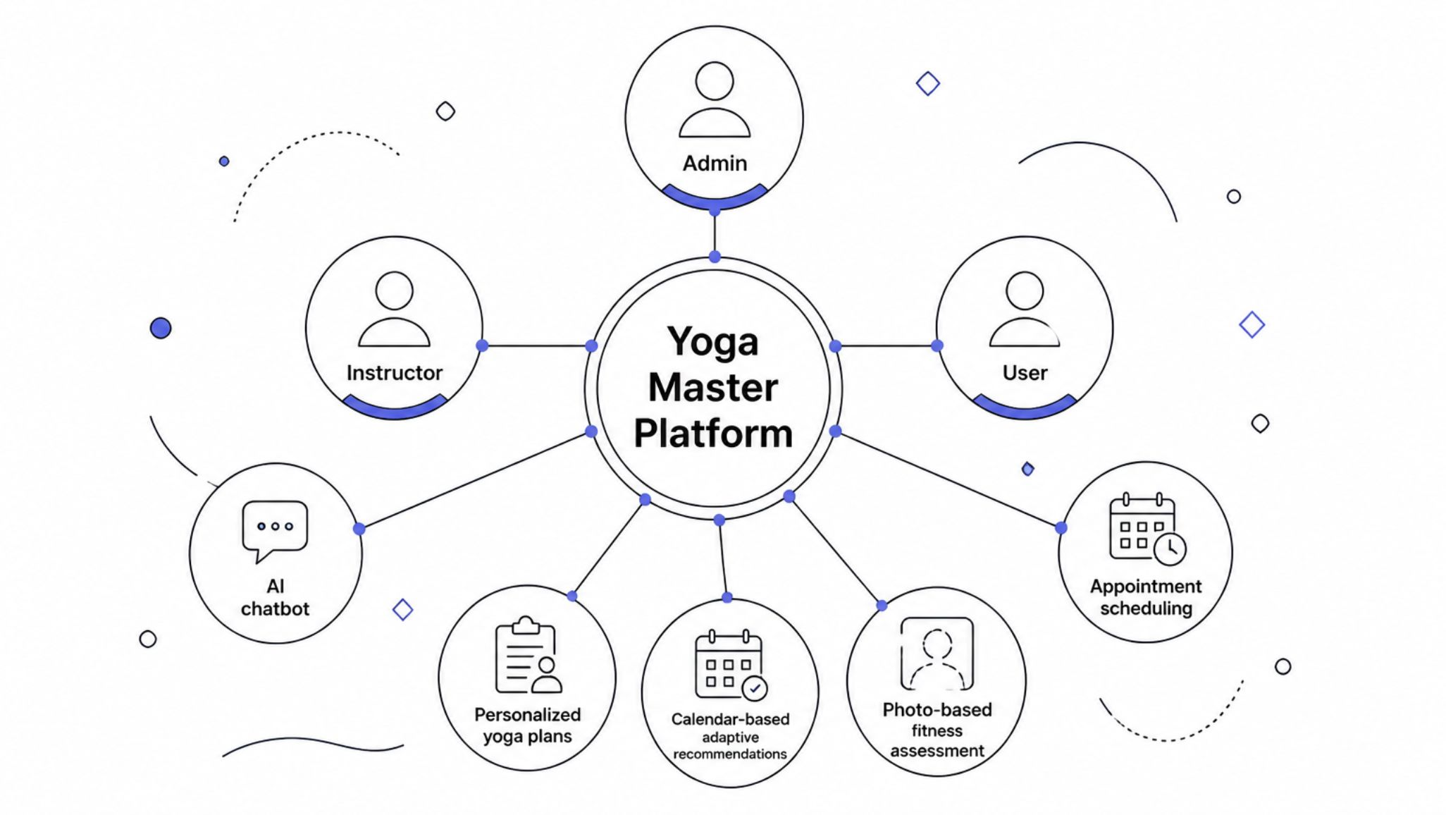
Proposed System
Centralized intelligent yoga platform addressing gaps in existing platforms:
Limited personalization
No AI recommendations
No private sessions
Poor progress tracking
Built using MERN Stack with MongoDB Atlas
Three integrated modules: Admin, Instructor, User
Key additions:
  AI chat-bot support
  Personalized yoga plans
  Calendar-based adaptive recommendations
  Photo-based fitness assessment
  Appointment scheduling
Benefits:
  Secure authentication & payments
  Scalable cloud database
  AI-powered wellness support

Slide 4




System Modules
Here are the three main modules that constitute the Yoga Master platform, each designed to cater to specific user roles and functionalities.
User Module
Instructor Module
Admin Module
Register and manage profile
Browse and search yoga classes
Purchase premium content
Enroll in classes
Download videos for offline access
Receive personalized recommendations
Book private 1-to-1 sessions
Schedule and manage appointments
Publish and manage yoga classes
Customize learning content
Conduct private 1-to-1 sessions
Manage student appointments
Track student progress
Manage user accounts
Review and approve instructor applications
Oversee all classes and content
Monitor payments and transactions

Slide 5

Use Case Diagram

Slide 6
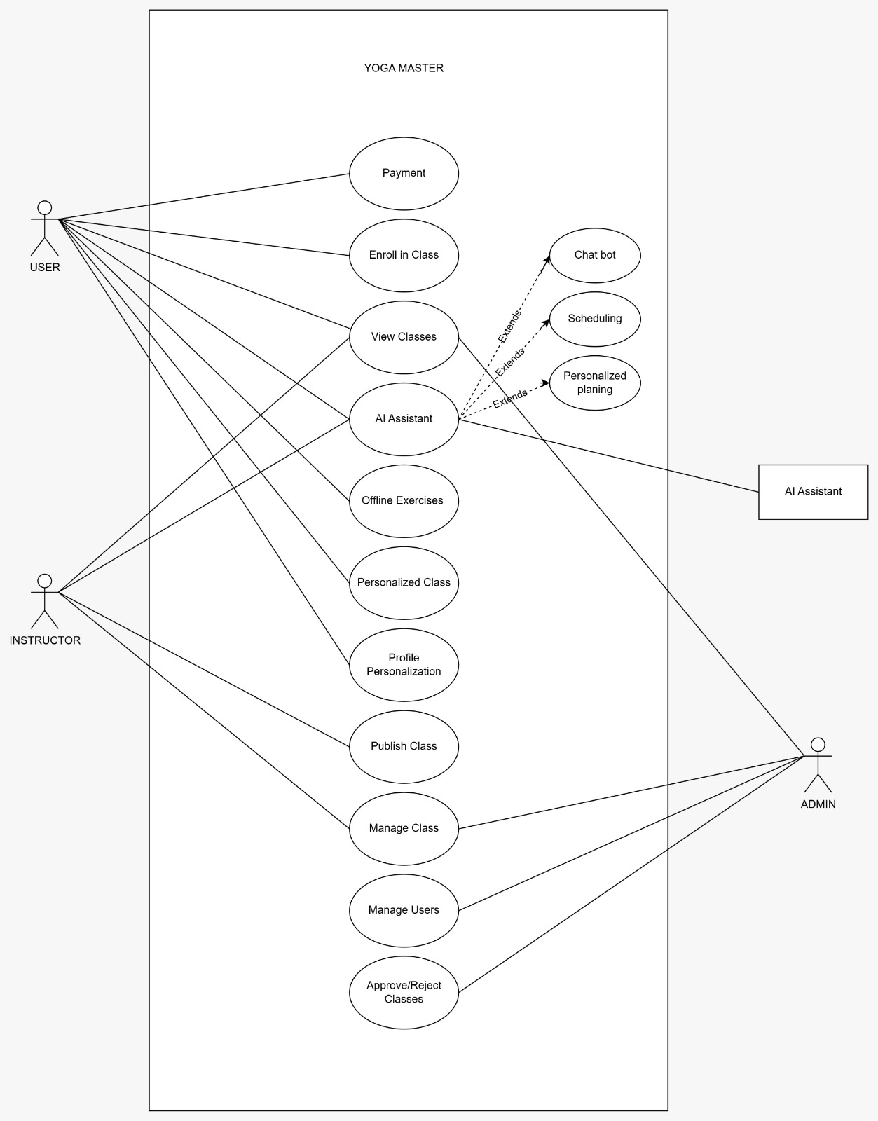

Slide 7

Activity Diagram

Slide 8
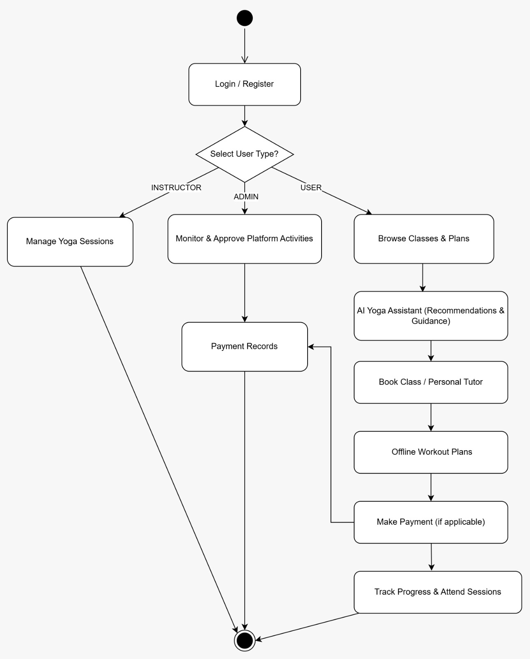

Slide 9
Sequence Diagram

Slide 10
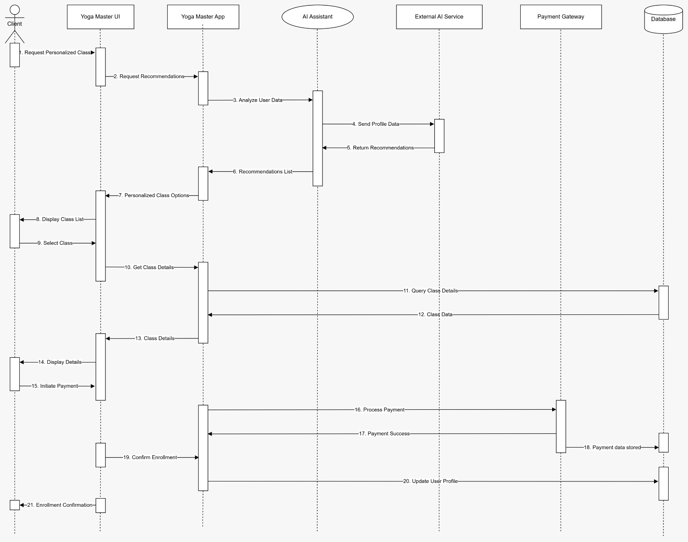

Slide 11
Thank You
We appreciate your time and interest in Yoga Master. We are confident that this AI-enhanced online yoga platform will transform wellness and learning experiences for users worldwide

