Slide 1


Slide 2
Intro
HTML5 Is newest version of html
HTML5 Is cooperation between w3c and WHATWG(Web Hypertext Application Technology Working Group)
In 2006 they decided to create new version of HTML

Slide 3
Features
HTML5
Elements Multimedia Web Apps Graphics
1)Semantic Elements 1)video 1)Web storage 1)Canvas
2)Web forms 2)audio 2)App cache 2)SVG
3)Web worker 3)CSS3 2D/3D
4)Geolocations
5)Drag/Drop

Slide 4
Semantic Elements
<article> – this tag defines an article, a user comment or a post, so an independent item of content
<aside> – the aside tag marks content aside from the page content, which for example could be a lateral sidebar
<header>, <footer> – you won’t need to manually name IDs for headers and footers, as now you have a pre-defined tag for them
<nav> – the navigation can now be placed in the markup in between the nav tags, which will automatically make your lists act like navigation
<section> – this is another important new syntax, as it can define any kind of sections in your document. It works pretty much like a div which separates different sections.
<audio>, <video> – these two obviously mark sound or video content, which will now be easier to run by devices.
<embed> – this new tag defines a container for interactive content (plugin) or external application
<canvas> – the canvas tag is quite exciting, as it allows drawing graphics via scripting (mostly JavaScript, but some others can be employed as well)

Slide 5
Web forms
New attributes for <form>:
Autocomplete
novalidate
New attributes for <input>:
Autocomplete
Autofocus,
Formnovalidate
min and max
Placeholder
Required
type=“text, search, url, tel, email, password,datepickers, range, and color”

Slide 6
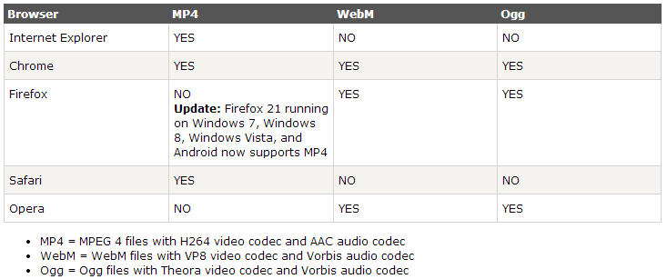
Videos
Snippet:
<video width="320" height="240" controls> <source src="movie.mp4" type="video/mp4"> <source src="movie.ogg" type="video/ogg"> Your browser does not support the video tag.
</video
Video Formats and Browser Support

Slide 7
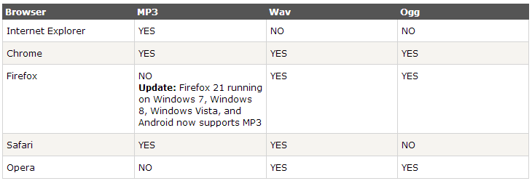
Audio
Snippet:
<audio controls> <source src="horse.ogg" type="audio/ogg"> <source src="horse.mp3" type="audio/mpeg"> Your browser does not support the audio element.
</audio>

Slide 8
Web storage
Advanced version of cookies(more secure, faster, can store larger data)
Stored as key/value pair.
Always stored as strings.
store data locally within the user's browser.
Two types of web storage
localStorage - stores data with no expiration date
web pages can store data locally within the user's browser.
sessionStorage - stores data for one session

Slide 9
Using Web Storage
if(typeof(Storage)!=="undefined"){ localStorage.firstname=“sample";// Adding value
alert(localStorage.firstname); //retriveing
}
else{
alert(‘Sorry! No web storage support..’);
}
Replace localStorage with sessionStorage to create session Storage

Slide 10
App Cache
App Cache is very useful to create offline website.
Very speed loading
Reduce server load
Internet Explorer 10, Firefox, Chrome, Safari and Opera support Application cache.

Slide 11
Using appcache
<!DOCTYPE HTML>
<html manifest=“myapp.appcache">
<body> The content of the document......
</body>
</html>
myapp.appcache
#comments
CACHE MANIFEST /theme.css /logo.gif /main.js
NETWORK: login.asp
FALLBACK: /html/ /offline.html

Slide 12
Server Sent Events
With the help of SSE we will get the updates from server with out sending any request to the server.
Snippet:
if(typeof(EventSource)!=="undefined"){ var source=new EventSource("demo_sse.php"); source.onmessage=function(event) { alert(event.data); };
}else{ alert(‘Sorry! No server-sent events support..’);
}

Slide 13
Web Workers
We use web workers to run our JavaScript code with out effecting the performance of the page.
Using Web workers
if(typeof(Worker)!=="undefined"){
var w=new Worker("demoWorkers.js");
w.onmessage=function(event){
alert(event.data);
};
}
else{
alert('Sorry! No Web Worker support..');
}

Slide 14
demoWorkers.js
var i=0;
(function(){
i=i+1;
postMessage(i);//Post Message back to html page
setTimeout("timedCount()",500);
})();

Slide 15
Geolocation
HTML5 Geolocation is used to locate a user's position
Snippet
function getLocation(){
if (navigator.geolocation) navigator.geolocation.getCurrentPosition(showPosition); } else{
alert(“Geolocation is not supported by this browser.”);
}
}
function showPosition(position) { alert("Latitude: " + position.coords.latitude + "<br>Longitude: " + position.coords.longitude);
}

Slide 16
Drag/Drop
<!DOCTYPE HTML>
<html>
<head>
<script>
function allowDrop(ev){
ev.preventDefault();
}
function drag(ev){
ev.dataTransfer.setData("Text",ev.target.id);
}
function drop(ev){
ev.preventDefault();
var data=ev.dataTransfer.getData("Text");
ev.target.appendChild(document.getElementById(data));
}
</script>
</head>

Slide 17
<body>
<div id="div1" ondrop="drop(event)"
ondragover="allowDrop(event)"></div>
<div id="drag1" src="img_logo.gif" draggable="true"
ondragstart="drag(event)" width="336" height="69">Please drag Message</div>
</body>
</html>

Slide 18
Canvas
The <canvas> element is used to draw graphics, on the fly, on a web page.
We can draw a rectangle, a gradient, a multicolor, and some multicolor text onto the canvas
Canvas will be very useful to create online game.

Slide 19
JS code for writing on canvas
<canvas id=“myCanvas”></canvas>
<script> var c=document.getElementById("myCanvas"); var ctx=c.getContext("2d"); ctx.fillStyle="#FF0000"; ctx.fillRect(0,0,150,75);
</script>

Slide 20
SVG
What is SVG?
SVG stands for Scalable Vector Graphics
SVG is used to define vector-based graphics for the Web
SVG defines the graphics in XML format
SVG graphics do NOT lose any quality if they are zoomed or resized
Every element and every attribute in SVG files can be animated
SVG is a W3C recommendation
SVG Advantages
SVG images can be created and edited with any text editor
SVG images can be searched, indexed, scripted, and compressed
SVG images are scalable
SVG images can be printed with high quality at any resolution
SVG images are zoomable (and the image can be zoomed without degradation)

Slide 21
Example
<!DOCTYPE html>
<html>
<body>
<svg id="svgelem" height="200" xmlns="http://www.w3.org/2000/svg">
<circle id="redcircle" cx="50" cy="50" r="50" fill="red" />
</svg></body>
</html>

Slide 22
Reference
https://developer.mozilla.org/en-US
http://diveintohtml5.info/‎
http://www.html5rocks.com/
http://www.tutorialspoint.com/
http://www.htmldog.com/

Slide 23
Thank you

