Slide 1

Ansible
29.11.2023
ESDE-Workshop

Slide 2
Contents
Introduction into Ansible
Why use Ansible?
How does Ansible work?
Key terms
Comparison
Advantages and Disadvantages
Example
Practical

Slide 3
What is Ansible?

Slide 4
What is Ansible?
open-source automation
YAML-based syntax
Utilizes Playbooks to define tasks and configurations
Playbooks configure systems and deploy applications

Slide 5
Why Ansible?

Slide 6

Why Ansible?
Advantage 1.
Simplicity and user-friendliness
Advantage 2.
Human-readable YAML syntax in Playbooks
Advantage 3.
Agentless design
Advantage 4.
High scalability
Advantage 5.
Seamless integration with existing tools and processes

Slide 7
How does Ansible work?

Slide 8
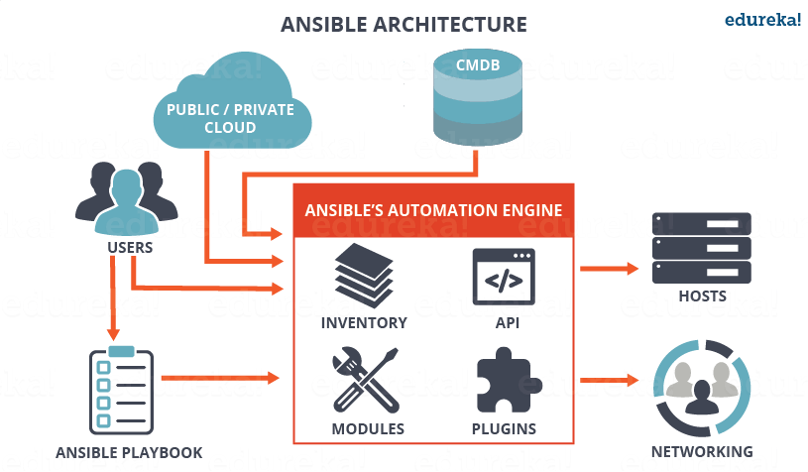
How does Ansible work?
Playbooks define tasks and configurations.
Inventory lists managed systems.
Modules: Reusable automation actions.
Communication via SSH or WinRM

Slide 9
Key terms

Slide 10
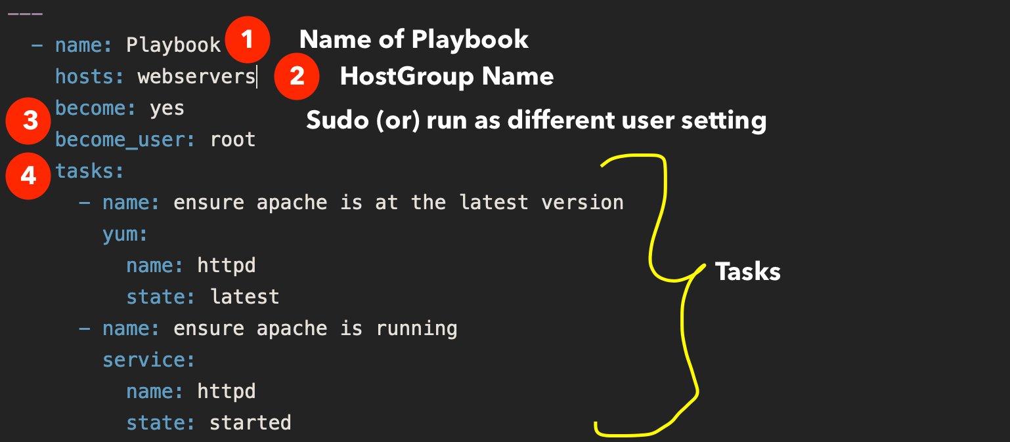
Terms
Playbooks: YAML files for tasks and configurations.
Tasks: Individual tasks within Playbooks.
Roles: Reusable units for organization.
Inventory: List of managed systems

Slide 11
Comparison

Slide 12
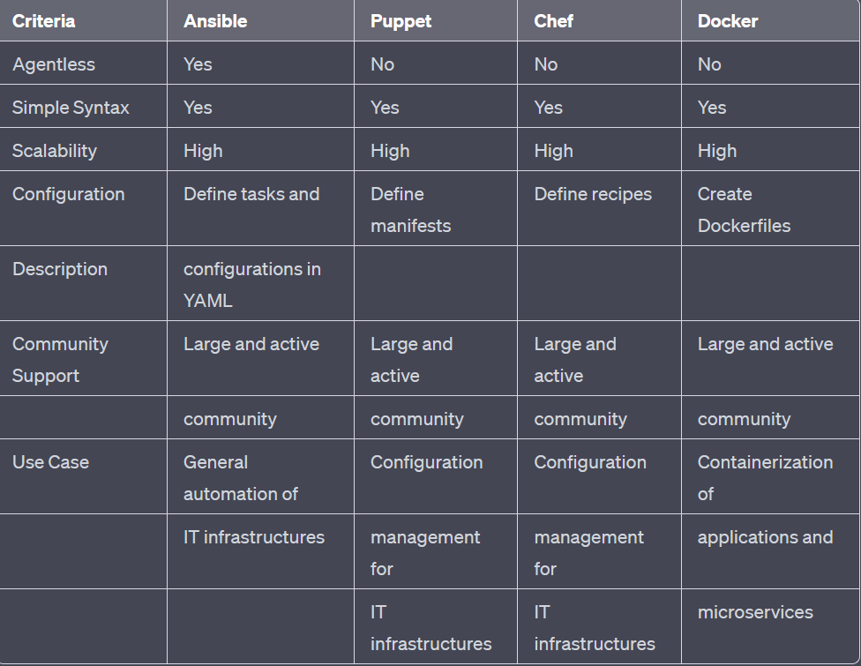
Comparison

Slide 13
Advantages and Disadvantages

Slide 14
Advantages and Disadvantages
Advantages
Disadvantages
Simplicity
Agentlessness
Scalability
Learning curve
SSH-based communication

Slide 15
Example

Slide 16
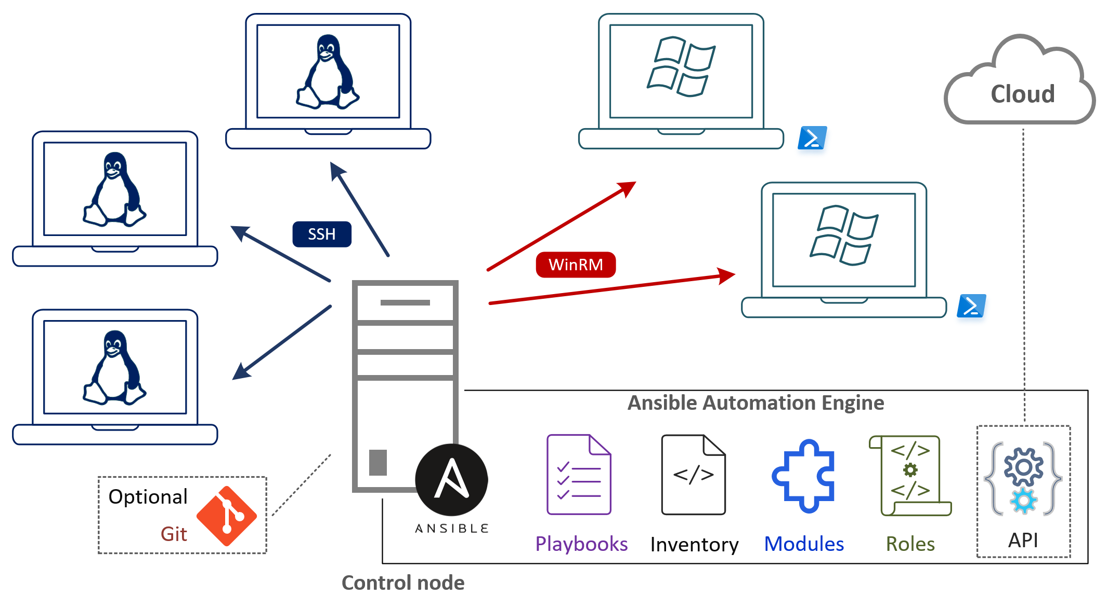
Example

Slide 17

Thank You!
.

