Slide 1

Kubernetes Workshop
By: Daniel, Patrick, Michiel and Timo

Slide 2

What is Containerization
Containerization is a software deployment process that bundles an application’s code with all the files and libraries it needs to run on any infrastructure into lightweight, isolated units.
Benefit of containerization is that one can create a single software package, or container, that reliably runs on and can be moved between all types of devices and operating systems

Slide 3
What is Kubernetes (K8s)
Kubernetes is an open-source container orchestration system.
Originally developed by Google, now maintained by the Cloud Native Computing Foundation.
Initially released on the 9th September 2014
Nowadays Kubernetes is the most popular container orchestration platform and most leading public cloud providers (such as AWS, GCP, IBM Cloud and Azure) offer managed Kubernetes services.
Kubernetes works with many container engines, such as Docker, but also any container system that conforms to the OCI standards.

Slide 4
Key Kubernetes Components
Control plane: The collection of processes that control Kubernetes nodes.
Node: These machines perform the requested tasks assigned by the control plane.
Master Node: Main node that performs all the tasks, starting point for all administrative tasks and responsible for managing the Kubernetes cluster architecture
Pod: A group of one or more containers deployed to a single node.
Service: Used to get service requests to the right pod, no matter where it moves in the cluster, even if it has been replaced. Exposes applications and enables external access to them.

Slide 5
Benefits of Kubernetes
Agility (rapid application development and enhancement)
Speed (lightweight containers, no overhead)
Fault Isolation (failure of one container does not affect other containers)
Efficiency (shares OS kernel, thus more efficient than a VM)
Security (isolation of containers prevents malicious code from spreading to other containers or host)
Ease of Management (automation of installation, scaling and management of containerized workloads and services)

Slide 6
Some Functional Advantages
Load Balancing & Service Discovery (automatic assigning of IPs & load balancing traffic within cluster through Services)
Self-Healing (automatic restart of containers that fail during execution, killing containers that don‘t respond to health checks)
Horizontal Scaling (requires only a single command to scale up (or down) containers
Automatic Rollbacks & Rollouts (Kubernetes can progressively roll out updates and changes. If something goes wrong Kubernetes can and will roll back the change)

Slide 7
Kubernetes compared to Docker Swarm
Kubernetes
Docker Swarm
Scalability: Kubernetes can handle a larger number of nodes compared to Swarm
More Features: Kubernetes offers a broader range of functionalities and extensions
Flexibility: Highly customizable, not restricted to any engines
Simplicity: Docker Swarm is easier to set up and use
Integrated with Docker: No additional installation required if Docker is already in use
Fast Deployment: Services can be deployed faster than in Kubernetes

Slide 8
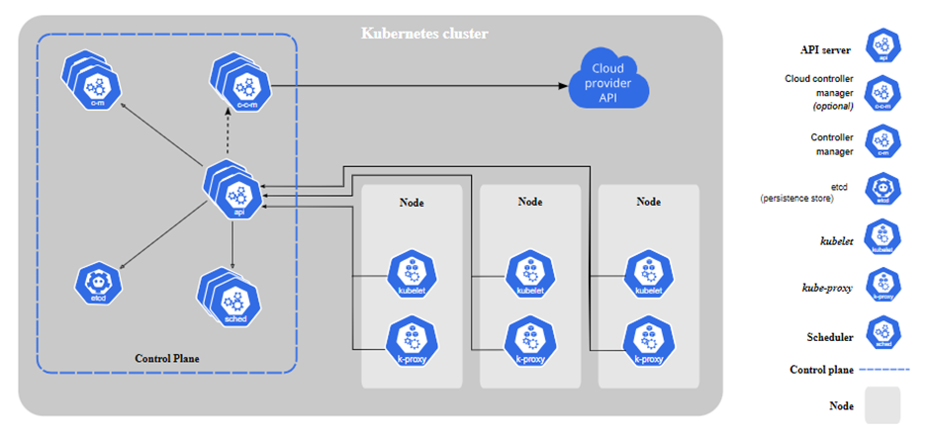
What is a K8s cluster?
Set of nodes that run containerized applications.
More lightweight and flexible than virtual machines.
Easier development, movement, and management of applications across various environments.

Slide 9
Core Components of the K8s cluster

Slide 10
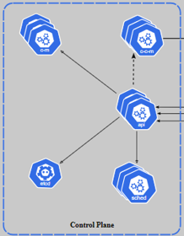
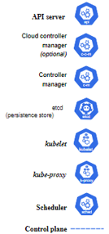
Master Node
Controls the state of the cluster
Coordinates processes like scheduling and scaling applications, maintaining the cluster’s state, and implementing updates.
Core components: API Server, Scheduler, etcd, Controller manager

Slide 11

Worker Node
Perform tasks assigned by the master node and can be virtual machines or physical computers.
Core components: Kubelet, Kube-proxy

Slide 12
Namespaces
A mechanism to divide cluster resources between multiple users, applications, or phases of a project.
It provides a scope for names, allowing you to organize resources into isolated units.
Namespaces are a way to divide cluster resources and can be used to enable patterns like microservices or multi-tenancy.

Slide 13
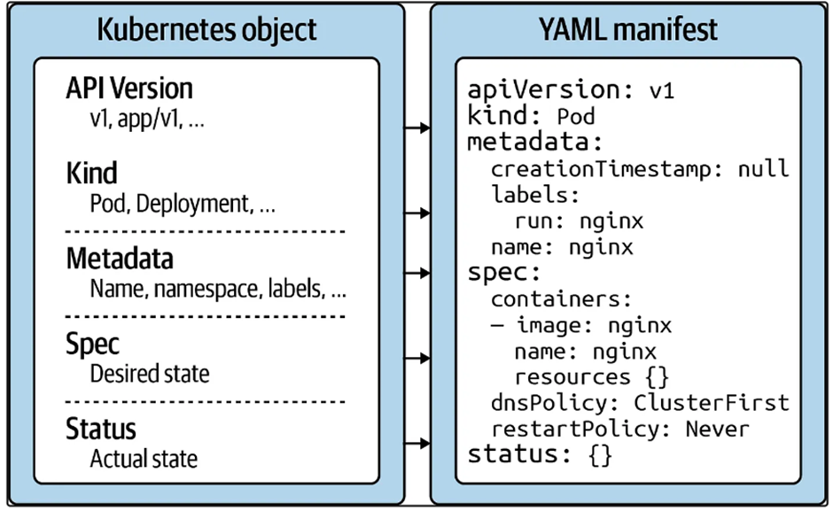
Desired State
Represents the user’s intent for the system.
It is defined using YAML or JSON configuration files, which describe how applications should run, the resources they should use, and how they should behave at runtime.
Defines various aspects, such as the number of pod replicas, network settings, and storage resources.

Slide 14
How is the Desired State achieved?
What is the Reconciliation Loop?
How does the Reconciliation Loop work?
Why is it important?

Slide 15
Automation and Management
Automated Deployment
Self-Healing
Rolling Updates & Rollbacks
Load Balancing
Scaling
Resource Management

Slide 16
Cloud-based vs Local K8 clusters
Cloud-based Clusters: These are Kubernetes clusters that are hosted on a cloud platform, such as AWS, Google Cloud, or Azure. They provide scalability, high availability, and a pay-as-you-go pricing model.
Local Clusters: These are Kubernetes clusters set up in a local environment, such as a personal computer or an on-premises data center. They are suitable for development, testing, and small-scale deployment.

Slide 17
Introduction to Minikube
Minikube is a free and open-source tool designed to set up a single-node Kubernetes cluster on a local machine.
Key Features of Minikube:
Isolation: Minikube provides an isolated environment to learn and test Kubernetes. Any operations you perform won't affect any other Kubernetes setup you might have.
Add-ons: Minikube supports various add-ons like dashboard, monitoring, logging, and more, which can enhance the local Kubernetes experience.
Driver Support: Minikube can run on various virtualization platforms like VirtualBox, VMware, Hyper-V, and even Docker.

Slide 18
Self-healing demonstration

Slide 19
Autoscaling demonstration

Slide 20
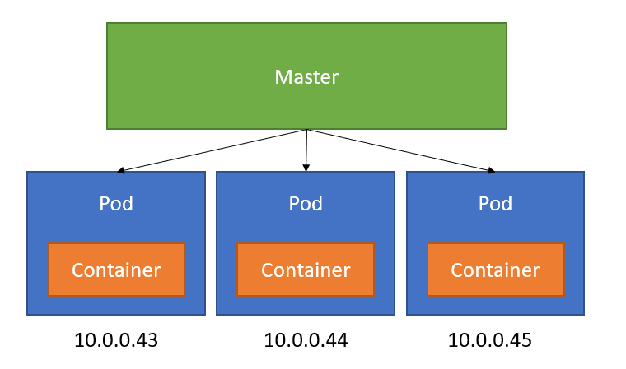
Deployments in Kubernetes
The smallest and simplest unit in the Kubernetes object model is a Pod
A Pod can contain one or multiple containers.
Containers within a Pod share the same IP, port space, and storage.

Slide 21
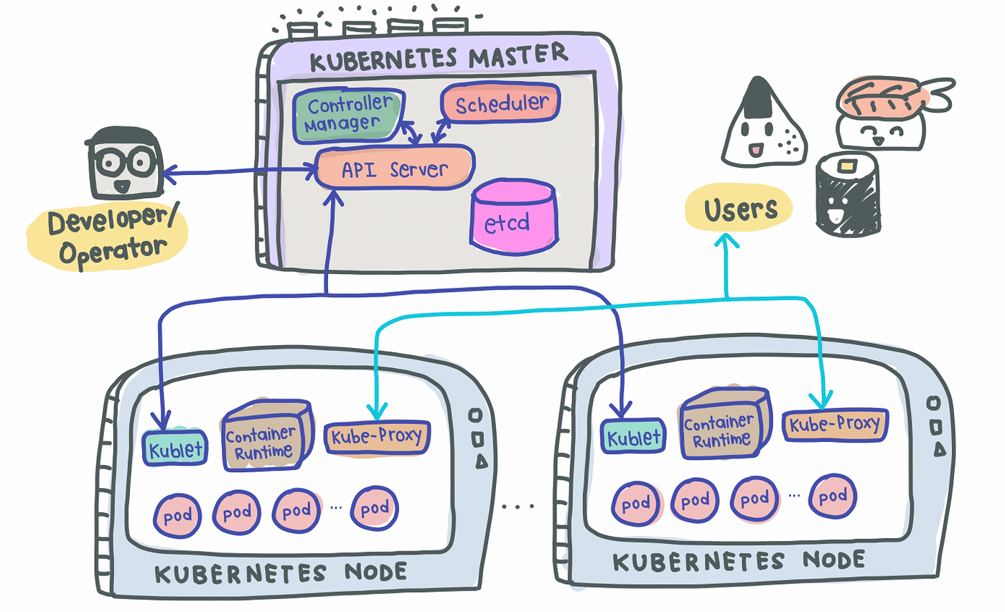

Slide 22
Pod Characteristics
Containers within the same Pod can easily communicate with each other.
Manage multi-container applications as a single entity.
Shared storage volumes allow data to persist beyond the life of containers.

Slide 23
Deployment Characteristics
Automatically scale based on the current load.
Deployments Gradually update, ensuring minimal downtime.
Deployments, together with services distribute traffic equally for optimal load balancing
Supports Desired State Management
If something goes wrong during an update, then you can rollback.
Manages the Pods within itself.

Slide 24
Deploying Applications
Typically done using Kubernetes manifests (YAML files).
These manifests define the desired state for your application.
Deploy using `kubectl` command-line tool.

Slide 25
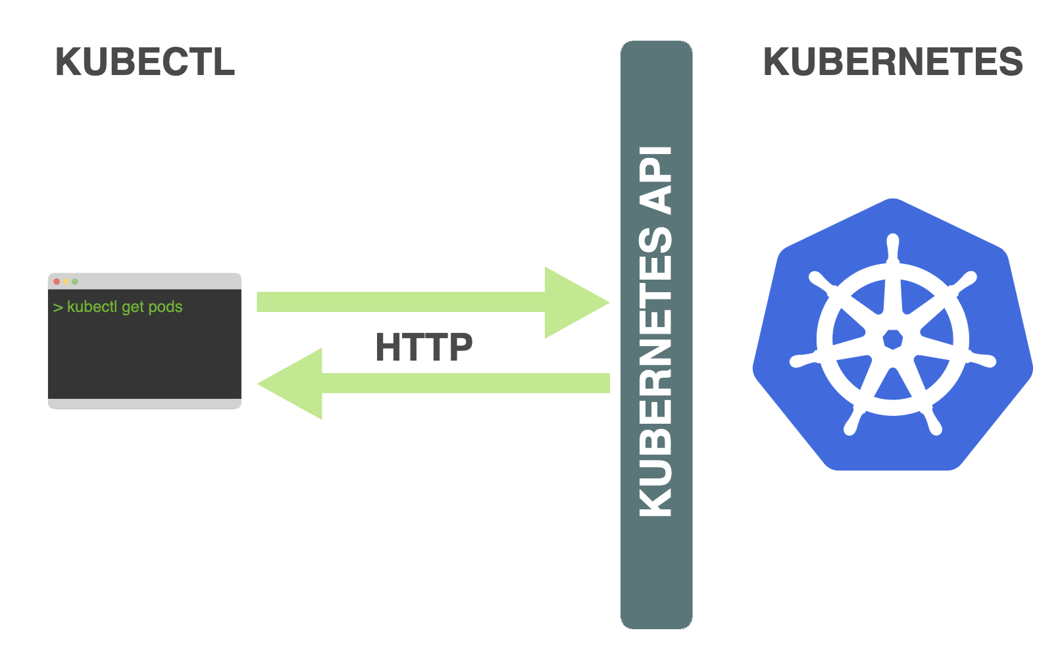
Using `kubectl` for Deployment Management
List deployments: `kubectl get deployments`
Describe pod details: `kubectl describe pod <pod-name>`
Delete a pod: `kubectl delete pod <pod-name>`

Slide 26
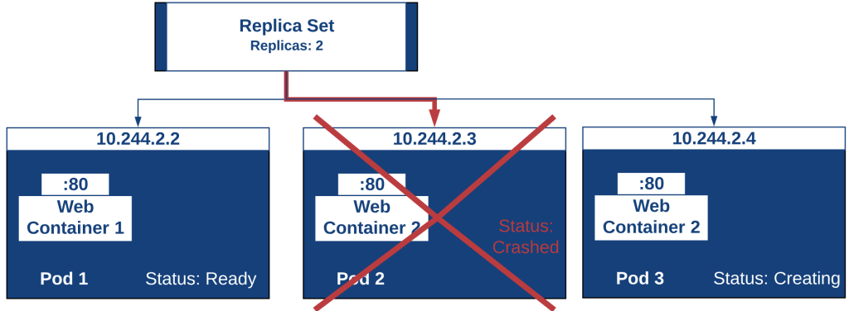
Advanced Operations
Scaling pods using ReplicaSets.
Accessing logs: `kubectl logs <pod-name>`
Executing commands inside a Pod: `kubectl exec -it <pod-name> -- /bin/sh` (or through port-forwarding!)

Slide 27
DEPLOYMENT DEMO

Slide 28
Key Takeaways
Kubernetes Deployments are fundamental units for deploying applications.
Pods allow for efficient communication and resource sharing among containers.
`kubectl` is the primary tool for managing Pod lifecycle.

Slide 29
Services

Slide 30
Importance of services in Kubernetes.
Pods and their own IP addresses
Pods are destroyed frequently
Great for balancing the load
Notes:
With the recreation of a pod they will get a new IP address. A service prevent this. (Explain why).
Services are a good abstraction for loose coupling and for communication within the cluster.
a service is a sort of pointer towards the pods based on the use of labels.

Slide 31
Service Types in Kubernetes
ClusterIP
NodePort
LoadBalancer
ExternalName
Notes:
With the recreation of a pod they will get a new IP address. A service prevent this. (Explain why).
Services are a good abstraction for loose coupling and for communication within the cluster.
a service is a sort of pointer towards the pods based on the use of labels.

Slide 32
ClusterIP
Common type to expose a service IP
Assigns an IP address from a pool of IP addresses in that cluster
Specifying your own cluster IP address
valid IPv4 or IPv6 address

Slide 33
NodePort
Exposes the Service on each Node's IP
Gives you the freedom to set up your own load balancing
Self-configuration

Slide 34
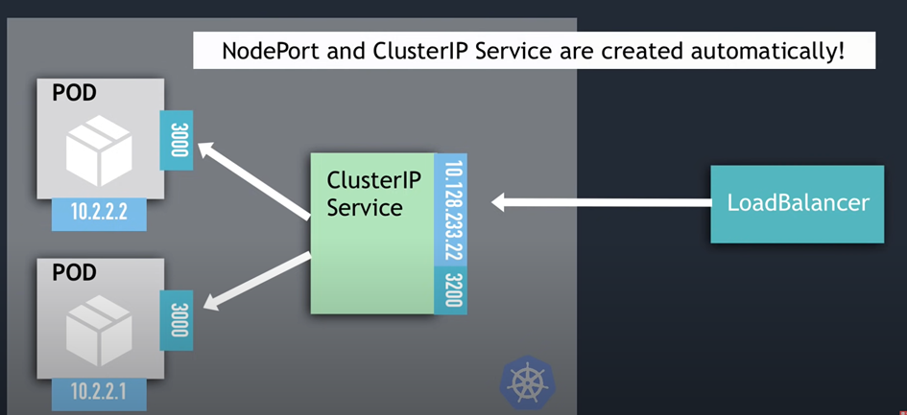
LoadBalancer
Exposes the Service externally by using an external load balancer
Own native load balancer implementation
The LoadBalancer is an extension of the node port.

Slide 35
ExternalName
Maps the Service to the contents of the externalName field
Crucial difference as other service types.

Slide 36
Key takeaways
Unique IP Addresses for Pods.
The Role of Services in Kubernetes.
Four Different Types of Services.

Slide 37

Questions?
No? Good.
Yes? Ehh… go to: Kubernetes Documentation | Kubernetes
You can ask some questions

Slide 38
Resources
Official Kubernetes documentation.
Kubernetes community forums and blogs.
https://aws.amazon.com/what-is/containerization/
https://en.wikipedia.org/wiki/Kubernetes
https://www.ibm.com/topics/container-orchestration
https://www.ibm.com/topics/containerization
https://www.clickittech.com/devops/kubernetes-architecture-diagram/
https://medium.com/@cuemby/main-components-of-kubernetes-82c024ceea69
https://www.redhat.com/en/topics/containers/what-is-kubernetes#speak-kubernetes

Slide 39
Resources /2
https://learn.microsoft.com/en-us/training/modules/intro-to-kubernetes/2-what-is-kubernetes
https://learn.microsoft.com/en-us/training/modules/intro-to-kubernetes/3-how-kubernetes-works
https://learn.microsoft.com/en-us/training/modules/intro-to-kubernetes/4-how-app-deployments-work

Slide 40
Resources /3
Kubernetes (n.d.). Minikube. Retrieved from https://kubernetes.io/docs/setup/learning-environment/minikube/
Google Cloud (n.d.). Google Kubernetes Engine. Retrieved from https://cloud.google.com/kubernetes-engine
AWS (n.d.). Amazon Elastic Kubernetes Service. Retrieved from https://aws.amazon.com/eks/
VirtualBox (n.d.). VirtualBox. Retrieved from https://www.virtualbox.org/
Chocolatey (n.d.). Chocolatey Software. Retrieved from https://chocolatey.org/
Kubernetes official documentation on Pods https://minikube.sigs.k8s.io/docs/drivers/hyperv/
Kubernetes official documentation for kubectl https://kubernetes.io/docs/reference/kubectl/

