Slide 1

ESD Spring Data Rest Workshop
By Nils Theres, Luc Lehmkuhl, Alex Böning and Carl Rix

Slide 2
Structure
Overview of Spring Data Rest
Why & When?
How does it compare to other frameworks?
Core Concepts
Practical Applications
Workshop

Slide 3
Overview of Spring Data REST
Web Framework that is part of the Spring Data Project
Simplifies building RESTful APIs
Key features include
Automatic API Endpoint Generation
HATEOAS and HAL Support
Pagination, Sorting and Filtering
JSON Serialization

Slide 4
Why & When should you use Spring Data REST?
Rapid API development
Reducing Boilerplate Code
Data-Centric Applications
Consistency with Spring Ecosystem
Notes:
When to Use: When you need to quickly expose CRUD operations on data models without manual controller code.
Why: Spring Data REST automates RESTful endpoint creation, allowing faster development with minimal boilerplate.
Reducing Boilerplate Code:
When to Use: When you want to minimize manual setup and maintenance of RESTful APIs.
Why: Spring Data REST eliminates the need for explicit controller code, reducing development effort and improving code maintainability.
Data-Centric Applications:
When to Use: For applications focused on data storage and retrieval.
Why: Spring Data REST seamlessly integrates with Spring Data repositories, making it well-suited for data-centric applications.
Resource Discoverability and HATEOAS:
When to Use: When API discoverability and adherence to HATEOAS principles are crucial.
Why: Spring Data REST includes hyperlinks in responses, enabling dynamic resource navigation for clients.
Consistency with Spring Ecosystem:
When to Use: When maintaining consistency within the Spring ecosystem is essential.
Why: Spring Data REST integrates seamlessly with other Spring projects, ensuring a cohesive development experience for Spring developers.

Slide 5
How does it compare to other frameworks?
Framework | Spring | Django | Fast API
Language | Java, Kotlin | Python | Python
Ease of Use | Simplified, conventions-over-configurations, opinionated framework | Known for its "batteries-included" philosophy. | Known for its intuitive syntax and Pythonic nature.
Community | Strong and active community, robust documentation. | Extensive documentation, active community. | Growing community due to its recent surge in popularity.
REST API dev. | Easily exposes data models via REST. | Great flexibility in designing APIs. | Asynchronous support offers performance advantages.
Testing | Provides a strong testing framework, supporting various testing methodologies. | Offers a user-friendly testing framework. | Easy testing based on Python’s pytest.
Microservices Archi. | Aligns well with microservices architecture and is considered cloud-native. | Simpler to set up for smaller applications or microservices. | Lightweight nature makes it suitable for microservices. Easily containerized.
Notes:
Ultimately, the choice between frameworks depends on factors such as the programming language, existing technology stack, project requirements, and team expertise. Spring Data REST is a strong choice for Java developers working within the Spring ecosystem and seeking a streamlined approach to building RESTful APIs with minimal boilerplate code.

Slide 6

Core Concepts

Slide 7
Core Concepts – Annotations
Provide metadata and configuration
Control over various aspects of how API is exposed, and entities are handled
Common annotations include
@Entity: For domain entities
@Service: For services
@Component: For components
@Autowired: Automatic explicit injection of beans
Helpful packages can extend features of annotations
Lombok, Jakarta and more
Notes:
These annotations allow you to shape the behavior of Spring Data REST and customize how entities and repositories are exposed in the API. They provide a high level of flexibility in tailoring the API to your specific needs.

Slide 8
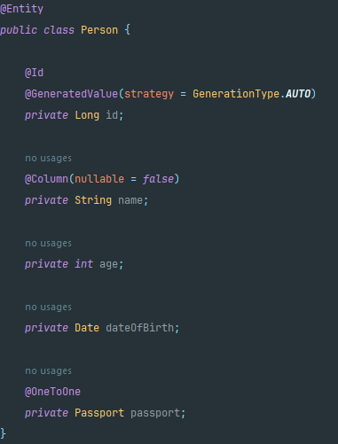
Core Concepts – Entity Modelling
Class Definition
@Entity
Java class
Primary Key
@Id
GenerationType
Relationships
@OneToMany, @ManyToOne, @OneToOne, @ManyToMany
Field Mappings
@Column
Data Types (String, int, Date, etc.)
Validation Constraints
@NotNull, @NotBlank, @Min, @Max

Slide 9
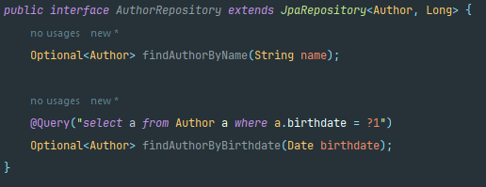
Core Concepts – Repositories & Querying
Used to export resources and automatically create endpoints
Different Repository Interfaces (Crud, Jpa, PagingAndSorting, etc.)
Dynamic Query Creation
Support for named queries
Interoperability with projections

Slide 10
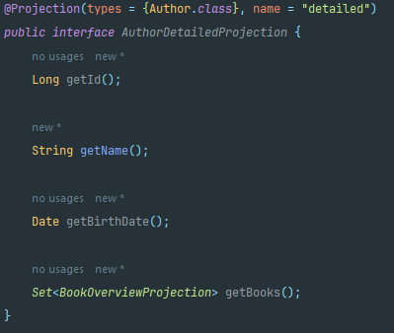
Core Concepts – Projections
Interface- or Class-based
Defined using the @Projection annotation
Support for selective Data Exposure
Nested Projections
Support for lazy loading and query optimization

Slide 11
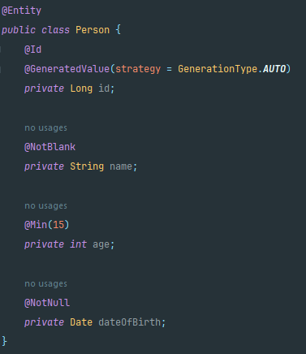
Core Concepts – Validation
Used to validate entities
Marker Annotation Support (@NotNull, @NotEmpty, etc.)
Support for cascade validation (@Valid)
Error handling with @ControllerAdvice

Slide 12
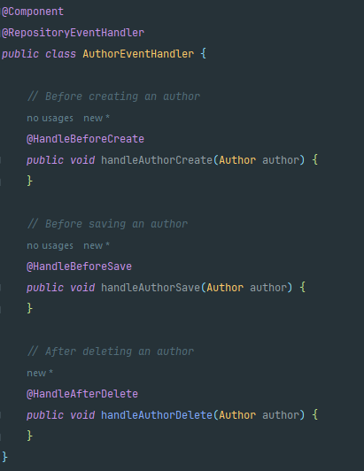
Core Concepts – Events
Entity Lifecycle Events (@PrePersist, @PostLoad)
Repository Events (@BeforeCreate, @AfterSave, etc.)
Annotation Driven with Event Classes
Support for conditional Events

Slide 13
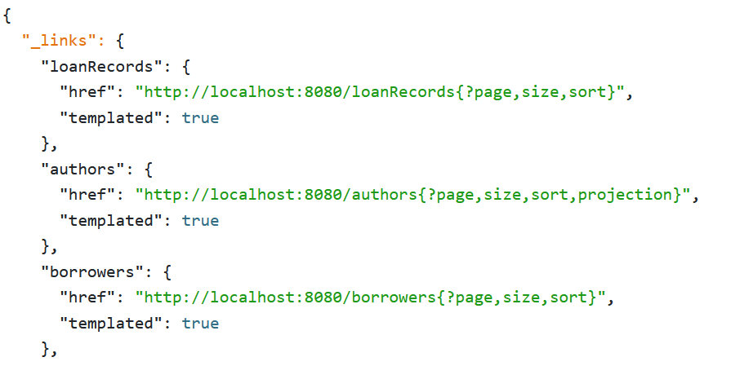
Core Concepts – HATEAOS
Resource Representation
Model Conversion
Dynamic Link Creation
Affordances
HAL Format compliant

Slide 14
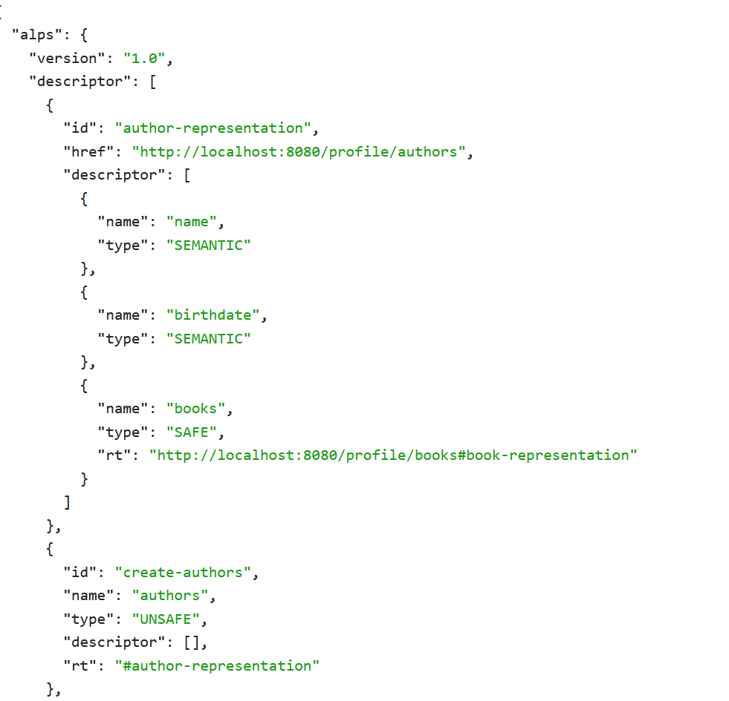
Core Concepts – ALPS
Semantic Descriptor Profiles
Support for Custom Types
Automatic Documentation Integration
Extendable

Slide 15
Practical Applications
E-Commerce Platforms
Banking and Financial Services
Healthcare Systems
Content Management Systems
Internet of Things

Slide 16

Questions

Slide 17

Quiz

Slide 18

Workshop

Slide 19
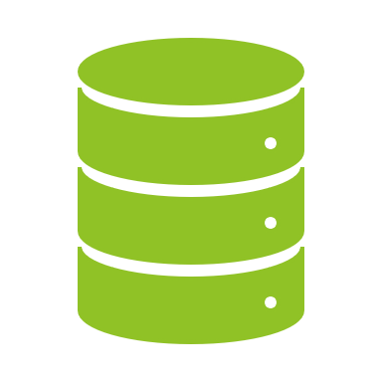
Assignment: Comprehensive Library Management API
Core Activities
Entity Modelling
Repository Creation
Service Layer Incorporation
Endpoint Generation
Learning Outcomes
Master Spring Data Rest Fundamentals
Gain practical Experience in building RESTful Services
Understand Entity Relationships
Learn about Error Handling and Validation

Slide 20
Next Steps
Clone the Repository
Load the Project in Your IDE
Explore the Project Structure
Read the Assignment Description
Test the Application with the provided sample Requests

Slide 21

Demo

