Slide 1
Vaadin Flow Workshop
Anatol, Fabian, Lawrence
Notes:
Anatol

Slide 2
Agenda
Introduction
What is Vaadin Flow?
Key Features
Vaadin compared to alternatives
Creating a Vaadin Flow application
Notes:
Anatol

Slide 3
What is Vaadin Flow?
Vaadin Flow helps you to quickly build web applications in pure Java — without writing any HTML or JavaScript
Notes:
Lawrence

Slide 4
Key Features
Server-Side Development
Seamless integration of existing Java libraries
Responsive Design
Theming and Styling
Notes:
Lawrence

Slide 5




Vaadin vs other Java Web Frameworks
Vaadin Flow
Google Web Toolkit
Jakarta Faces
Thymeleaf +
Spring Boot
100% development in Java
Works with components
Server-sided architecture
High abstraction -> easy to learn and use
Development in Java + XML
Works with components
Client-sided architecture
Low abstraction -> hard to learn and use
Development in Java + HTML
Works with HTML templates
Server-sided architecture
Medium abstraction -> easier to learn and use
Development in Java + HTML
Works with HTML templates
Server-sided architecture
Medium abstraction -> easier to learn and use
Notes:
Fabian
GWT: Has own XML type of files
Jakarta: Uses HTML Templates, but features very unique elements -> a lot to learn and understand
Thymeleaf: Same

Slide 6



Vaadin vs other Web Frameworks
Vaadin Flow
Vue
React
Angular
100% development in Java
Works with components
Server-sided architecture
High abstraction -> easy to learn and use
Development in JavaScript + HTML
Works with components
Client-sided architecture
Lightweight / Little overhead
Offers little room to expand to big applications
Development in JavaScript + HTML
Works with components
Client-sided architecture
Offers more control
More complex concepts (e.g. states)
Development in JavaScript + HTML
Works with components
Client-sided architecture
Offers a lot of functionality
Heavyweight
Notes:
Fabian
https://vaadin.com/comparison

Slide 7
Setting up a project
Requirements
JDK 17 or higher
Starter Project
Maven Archetype/ Gradle
https://start.vaadin.com/
Notes:
Anatol

Slide 8
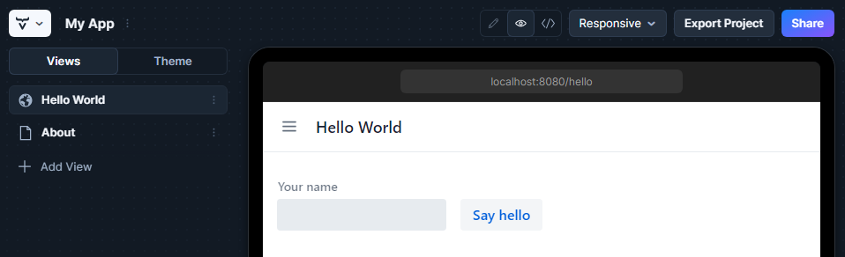
Vaadin Starter Project
Configure and download core of Vaadin project
Add several views
Selection of more than 15 templates
Add and modify JPA entities
Security and configure access control
Change look and feel
Add helpful project settings
Notes:
Anatol

Slide 9
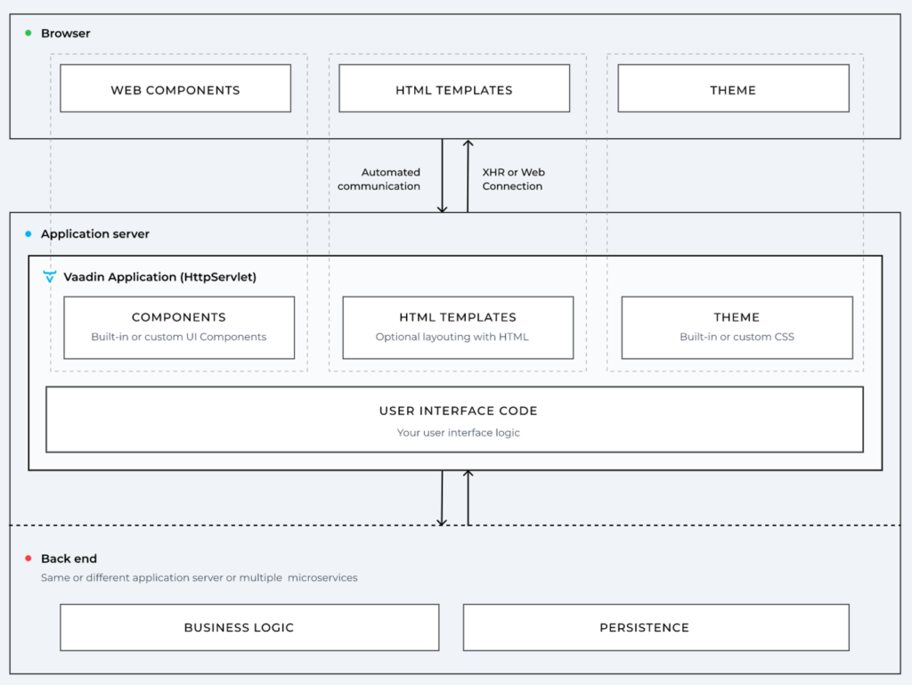
Architecture
Notes:
Fabian
https://72.services/en/vaadin-community-award/

Slide 10
Views

Slide 11
Views in Vaadin Flow
Represents a part or section of a web application
Help organize UI components with different layouts
Each view corresponds to a URL
Notes:
Anatol

Slide 12
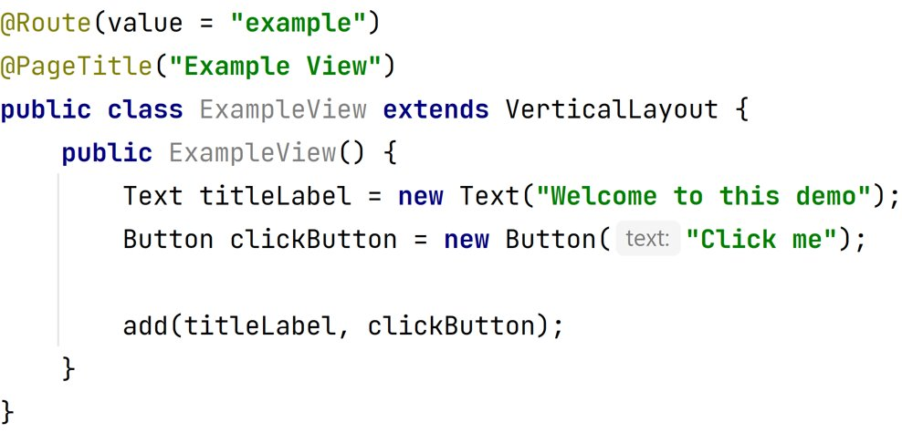
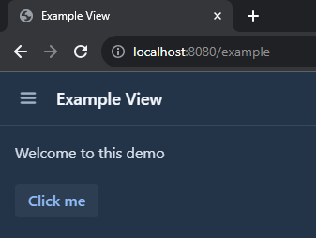
Creating a View
Notes:
Anatol

Slide 13
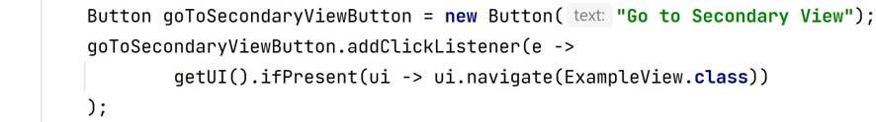
Navigating between Views
Using RouterLinks
Using UI
Notes:
Fabian

Slide 14
Components

Slide 15
Components in Vaadin Flow
Building blocks used to create visual interactive elements
Available pre-defined components
Notes:
Fabian

Slide 16
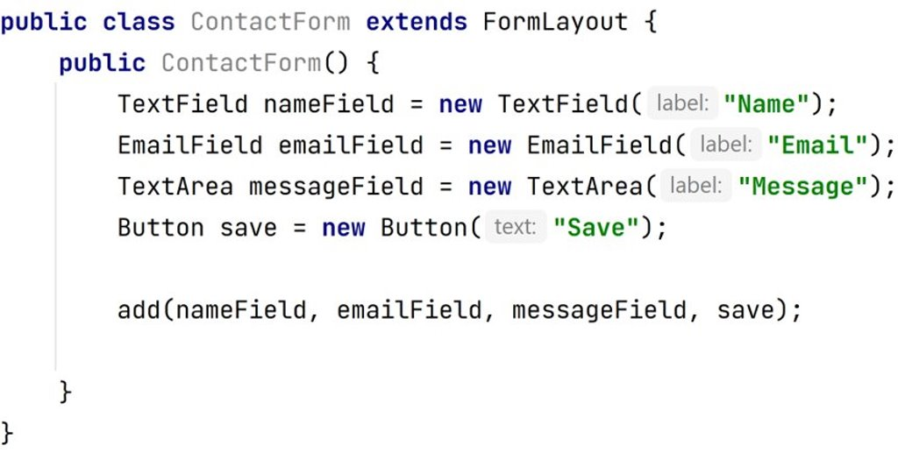
Creating a Component
Notes:
Fabian

Slide 17
Styling Components
Vaadin components come with built-in style variants (Lumo) that can be used to change the color, size, or other visual aspects
Default styling of Vaadin components is based on CSS style properties that can be customized
Notes:
Fabian

Slide 18
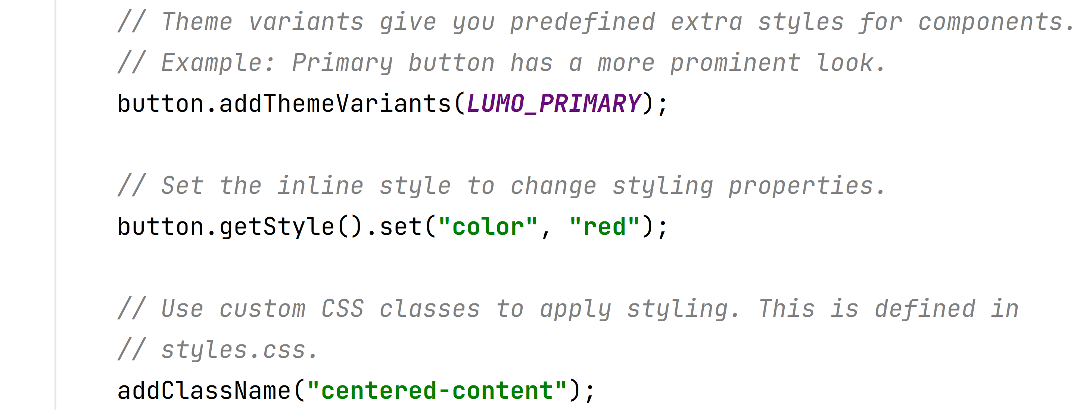
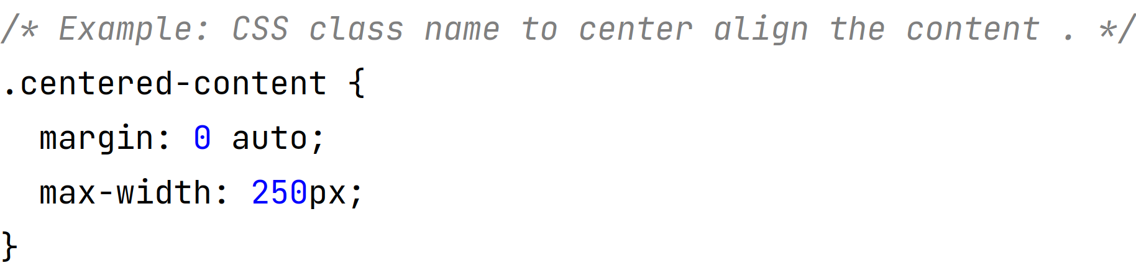
Styling Components
Theme
Inline
Styling
CSS Class
+ File
In styles.css
Notes:
Fabian

Slide 19
Database Access

Slide 20
Database with JPA - Entities
Represent Java objects that are mapped to database tables
Entities encapsulate data and behavior
Enables interaction with the database using object-oriented principles
Notes:
Lawrence

Slide 21
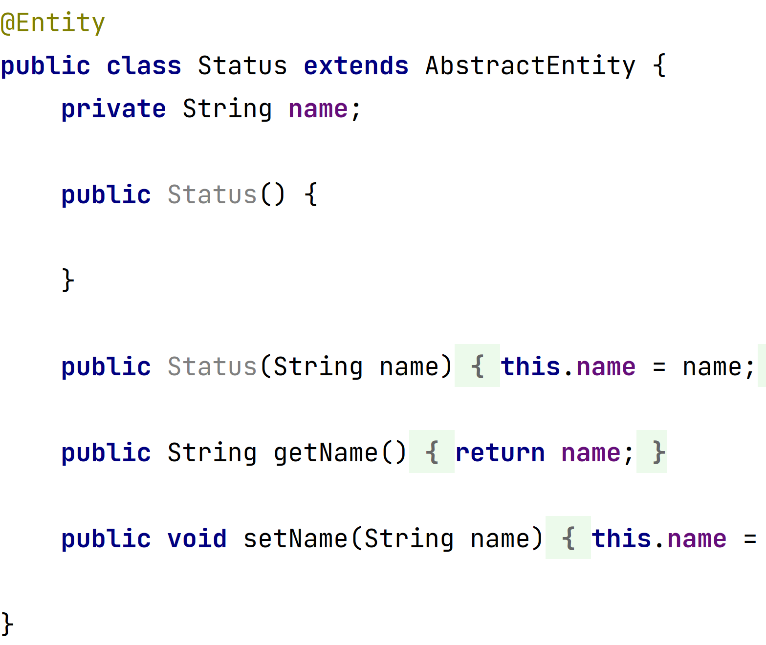
Creating Entities
Notes:
Lawrence

Slide 22
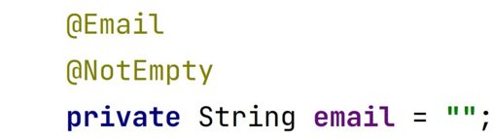
Validating data
Define data validation rules as Java Bean Validation annotations
E.g @NotNull, @Size, @Past
Notes:
Lawrence

Slide 23
Database with JPA - Repositories
Provides set of methods for performing common database operations on entities
Simplifies data access and reduces the amount of boilerplate code
Notes:
Lawrence

Slide 24
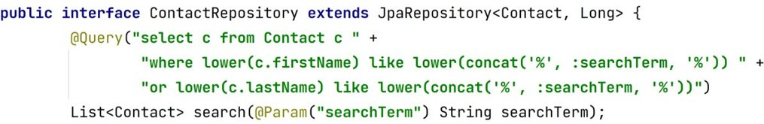
Creating Repositories
Notes:
Lawrence
JPQL or Plain SQL

Slide 25
Database with JPA - Services
Encapsulates business logic
Act as layer between data access layer and presentation layer
Notes:
Lawrence

Slide 26
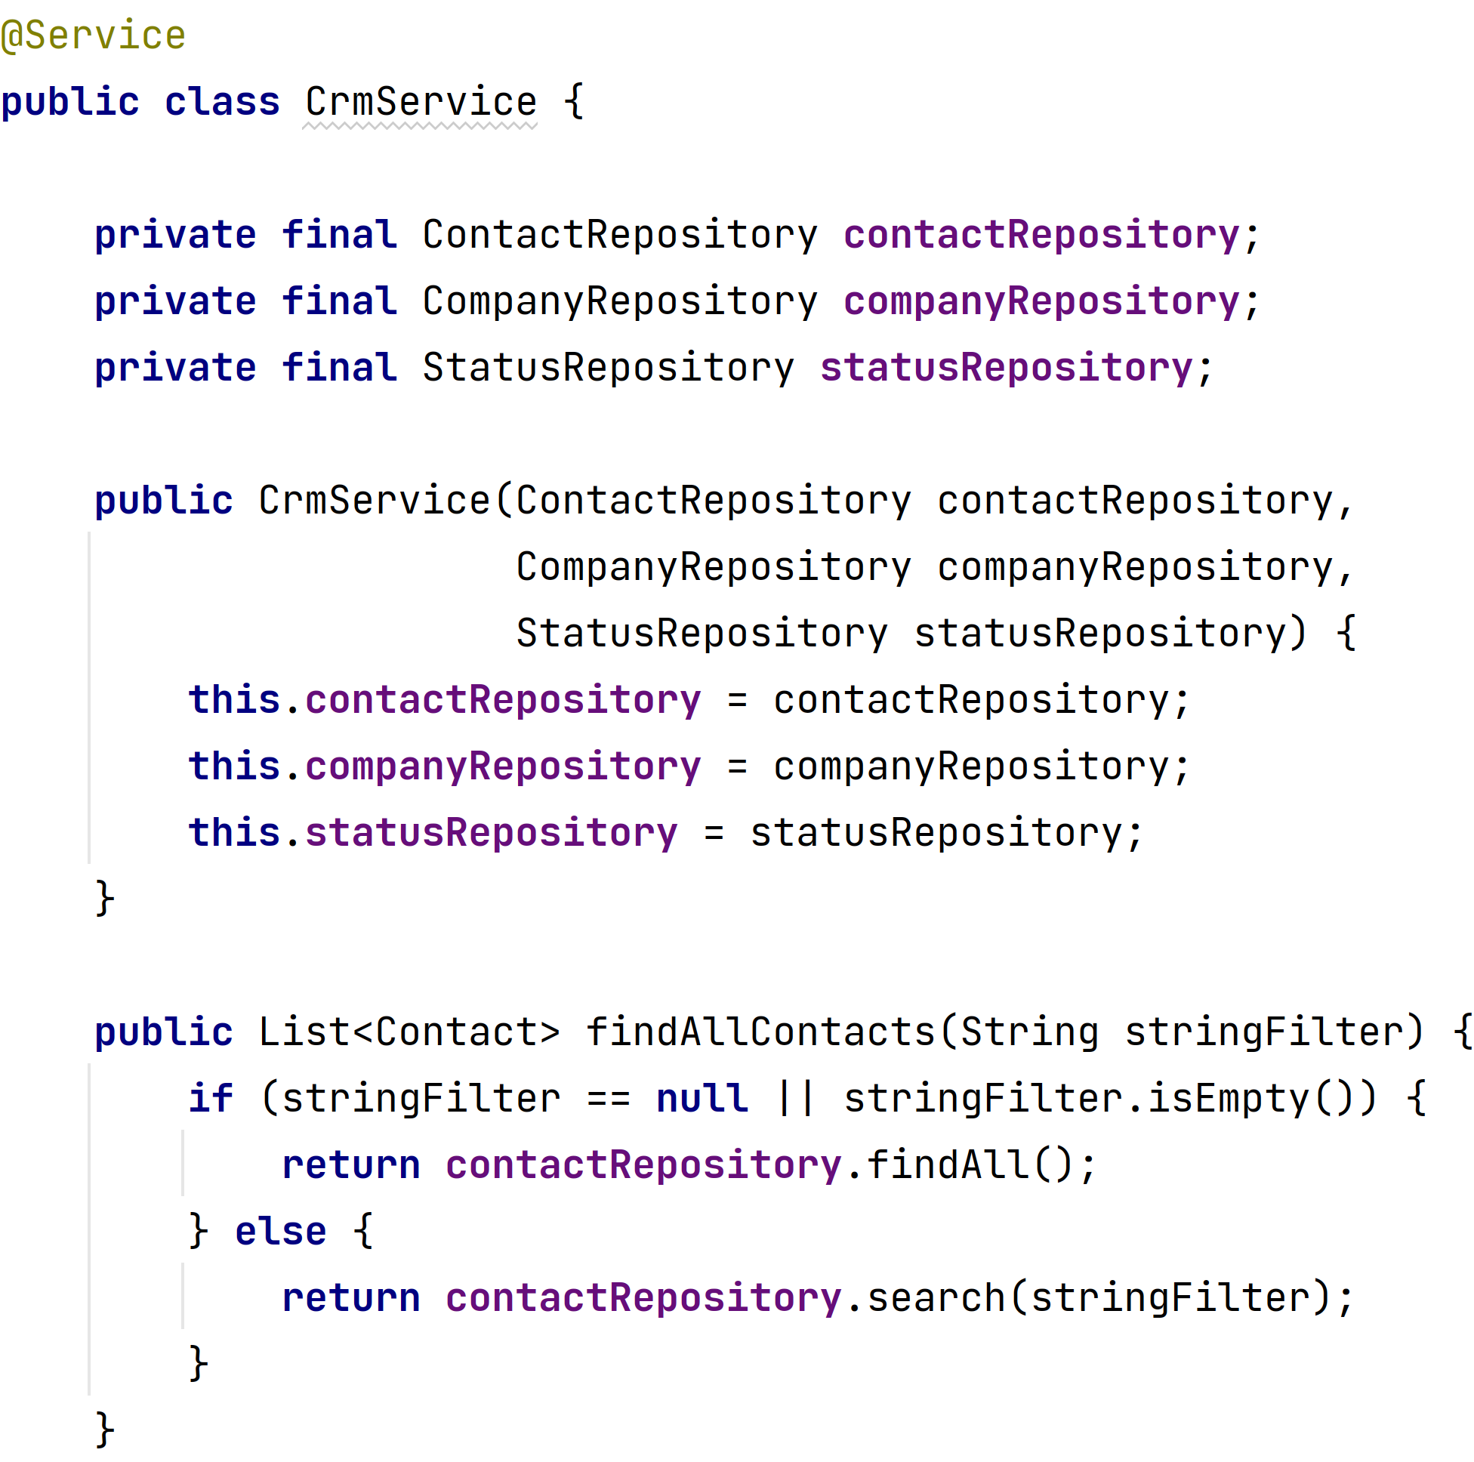
Creating Services
Service Annotation
Repository Declaration & Initialization
Logic
Notes:
Lawrence

Slide 27
Data Binding

Slide 28
Binding data objects to input
Binder class allows to define how the values in an object are bound to fields in the UI
Allows for seamless synchronization of data between the UI components and the backend
Notes:
Anatol

Slide 29
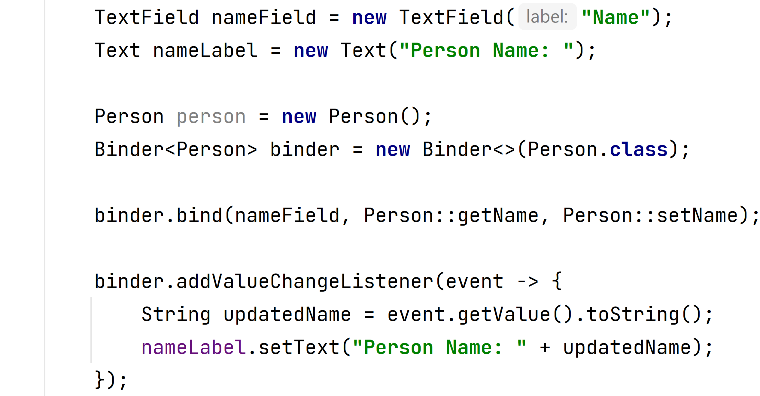
Binding data objects to input
UI Components
Our Java BEAN
Binding UI to BEAN
Notes:
Anatol

Slide 30
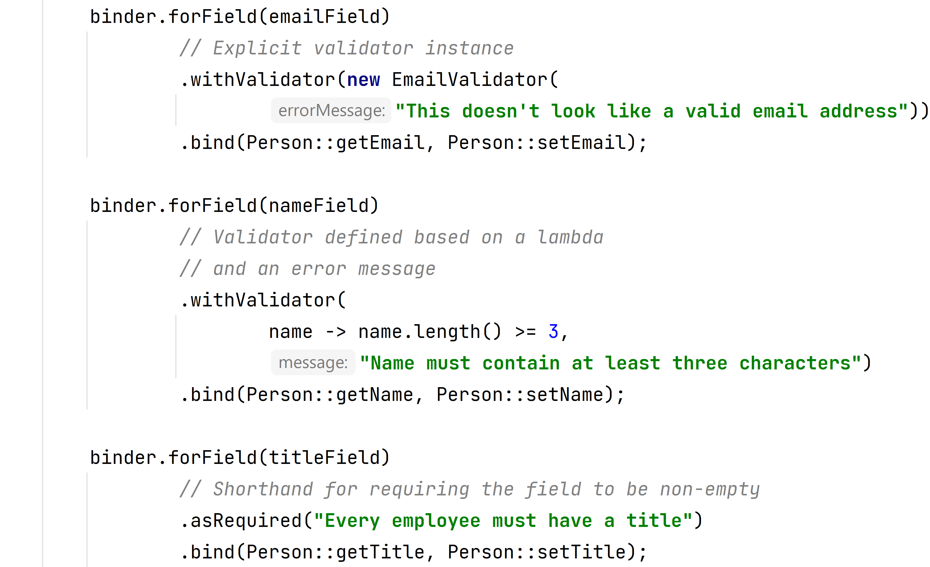
Validating input
Field to validate
Validator Class
Predefined Validator Class
BEAN Binding
Lambda
True = valid, False = invalid
Message if invalid
Required
Not-Null Check
Notes:
Anatol

Slide 31
Thanks for your attention
Notes:
Anatol

Slide 32
Sources
https://vaadin.com/docs/latest/overview
https://www.baeldung.com/vaadin
https://72.services/en/vaadin-community-award/
Comparison
https://www.gwtproject.org/doc/latest/DevGuide.html
https://blog.payara.fish/getting-started-with-jakarta-ee-9-jakarta-faces-jsf
https://www.thymeleaf.org/doc/tutorials/3.0/usingthymeleaf.html
https://vaadin.com/comparison

Slide 33
How to get started
Visit https://sebivenlo.github.io/ESD-2023-Vaadin-Flow/

