Slide 1

Glenn Jonkers & Sjong Leow
ESDE
Notes:
Sjong

Slide 2
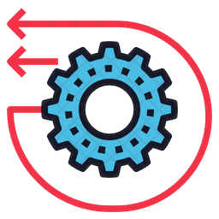
Summary
What is Ghidra
Rerverse Engineering
Compile and Decompile
NSA
FOSS
What can you do with Ghidra?
Practical uses of Ghidra
How to install
Workshop
https://cdn.iconscout.com/icon/premium/png-256-thumb/reverse-engineering-1524273-1290820.png
Notes:
Sjong

Slide 3

What is Ghidra
March 2017 Wikileaks
5th March 2019 released
June 2019 Coreboot
Open Source
NSA
JAVA Swing framework
Decompiler
IDE
https://en.wikipedia.org/wiki/Ghidra
Notes:
Sjong
Ghidra's existence was originally revealed to the public via WikiLeaks in March 2017, but the software itself remained unavailable until its declassification and official release two years later. In June 2019, Coreboot began to use Ghidra for its reverse engineering efforts on firmware-specific problems following the open source release of the Ghidra software suite. Ghidra can be used as a debugger since Ghidra 10.0. Ghidra's debugger supports debugging user-mode Windows programs via WinDbg, and Linux programs via GDB.
therefore usable in a stand-alone form. Ghidra plugins can be developed in Java or in Python (provided via Jython).
Ghidra is a free and open source reverse engineering tool developed by the National Security Agency (NSA) of the United States. The binaries were released at RSA Conference in March 2019; the sources were published one month later on GitHub. Ghidra is seen by many security researchers as a competitor to IDA Pro. The software is written in Java using the Swing framework for the GUI. The decompiler component is written in C++

Slide 4
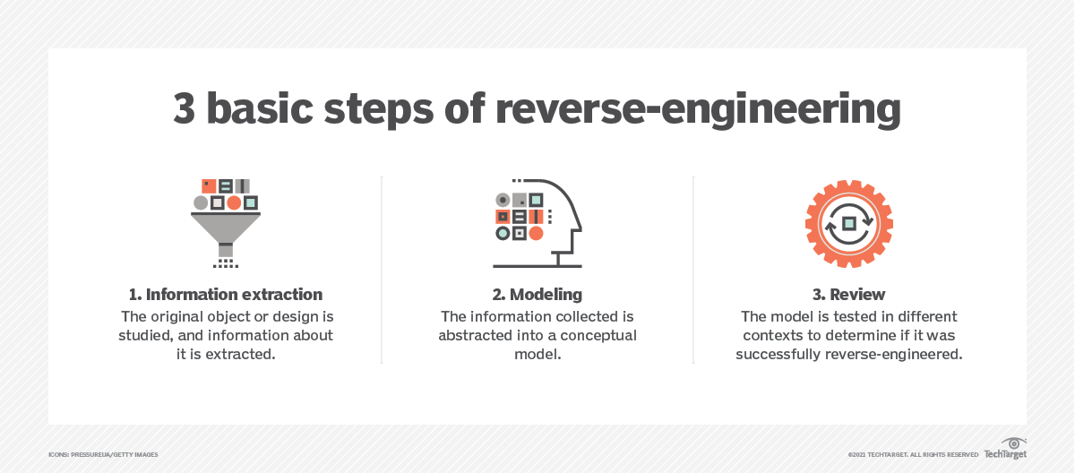
Reverse Engineering
Reverse-engineering is the act of dismantling an object to see how it works.
Compile is not the same as Decompile
What is Decompiling?
to convert executable or ready-to-run
program code “object code” into some form
of higher-level programming language
that humans can easily understand.
Examples?
Crack or remove copy protection
Find vulnerabilities in an OS
https://www.techtarget.com/searchsoftwarequality/definition/reverse-engineering
https://www.techtarget.com/whatis/definition/decompile#:~:text=What%20is%20a%20decompile%3F,opposite%20operations%20of%20a%20compiler.
Notes:
Glenn
Reverse-engineering is the act of dismantling an object to see how it works. As seen in the video in the next slide
This means you can disassemble something that is made by someone else.
What is decompiling? Anyone have an idea?
And any examples
Copy protection (Copy protection in data security is the process of protecting files and folders from being copied without proper authorization to any device in the same network. Unauthorized copying of data can lead to data leak, exposure, or even a breach.)(MFA/ physical control/ encrypting/ dlp solution(copy protection)
Finding vulnerabilities in an operating system.

Slide 5

Notes:
movie

Slide 6
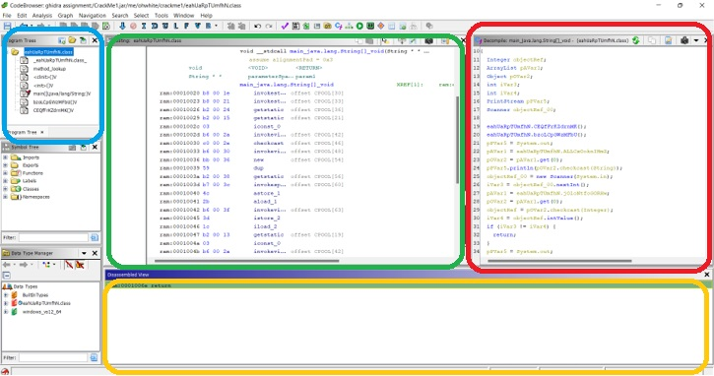
Blue: Program trees
Green: Listing window
Red: Decompiler!
Yellow: Disassembled View
Notes:
Glenn
Here you see how Ghidra is going to look like and how we can use ghidra to find the parts of the code we are looking for.
At the top right you see the program trees , this is like every other ide you probably use where the Jar file or project is divided into classes where you can look through them to look through the classes that you want.
Below that is the symol tree and the data type manager, which you probably wont use often but these show the types of functionality the code provides neatly ordered and what types of data is used in the code.
Next in the green outline is the listing window this shows you all locations of the code in the background and where these values are stored, this also shows what the code in the decompiler shows more indepth.
Next part is the red outlined window which is the Decompiler window, this is the most important one where you can see the code you have imported and it shows it in C++ where you can click on the variables to show what they are and this will show up in the listing window.
And last is the disassembled view where you can see indepth all the information about what the variable is linked to and what the functionality is of the variable you clicked on.

Slide 7
Compile and Decompile
Compiling:
Lexing
Parsing
Optimization
Translation
run
Decompiling
Translation
process
Notes:
Sjong
1. Lexing (breaking up the text into tokens)
2. Parsing (converting the tokens into parse tree)
3. Optimization (optimise the parse tree with actions as removing unused variables or evaluate constant expressions)
4. Translation (converting the parse tree into assembly code)
5. Run the code (the assembly code is translated into machine code)
Decompiling.
- It does the same as in translation compiling but it processes this into showing the functionality
The term decompiler is most commonly applied to a program which translates executable programs (the output from a compiler) into source code in a (relatively) high level language which, when compiled, will produce an executable whose behavior is the same as the original executable program. By comparison, a disassembler translates an executable program into assembly language (and an assembler could be used for assembling it back into an executable program).Decompilation is the act of using a decompiler, although the term can also refer to the output of a decompiler. It can be used for the recovery of lost source code, and is also useful in some cases for computer security, interoperability and error correction. The success of decompilation depends on the amount of information present in the code being decompiled and the sophistication of the analysis performed on it. The bytecode formats used by many virtual machines (such as the Java Virtual Machine or the .NET Framework Common Language Runtime) often include extensive metadata and high-level features that make decompilation quite feasible. The application of debug data, i.e. debug-symbols, may enable to reproduce the original names of variables and structures and even the line numbers. Machine language without such metadata or debug data is much harder to decompile.Some compilers and post-compilation tools produce obfuscated code (that is, they attempt to produce output that is very difficult to decompile, or that decompiles to confusing output). This is done to make it more difficult to reverse engineer the executable.While decompilers are normally used to (re-)create source code from binary executables, there are also decompilers to turn specific binary data files into human-readable and editable sources.

Slide 8
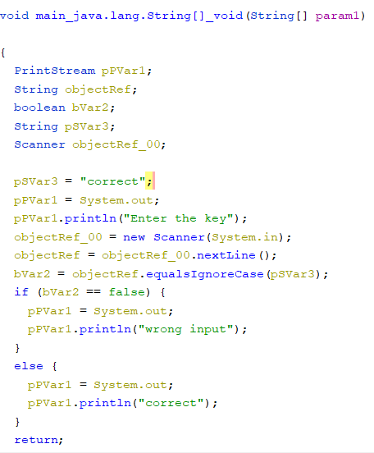
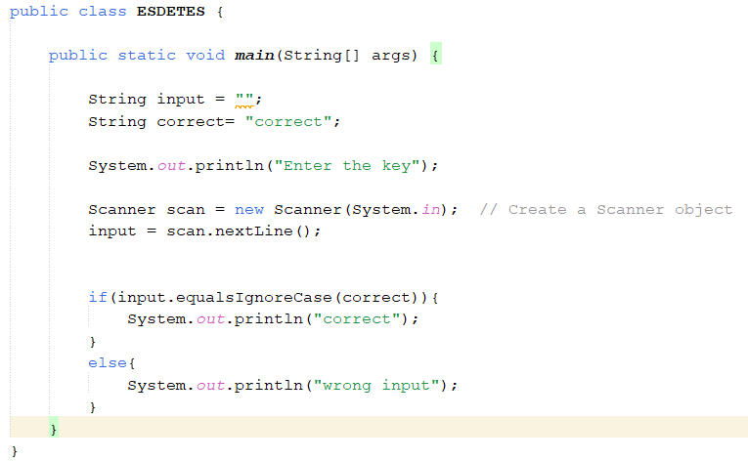
Decompiled
Original
Notes:
Sjong

Slide 9

NSA
What is the NSA
Mission
History
Digital Surveillance
Software
Usefulness of FOSS
Source: https://en.wikipedia.org/wiki/National_Security_Agency
Notes:
Glenn
The NSA is the National level intelligence Agency of the United States dep. Of defence. The NSA is responsible for monitoring, collecting and processing information and data for foreign and domestic intelligence, specializing in a discipline known as singals intelligence (SIGINT). The NSA is also tasked with protecting the US Communications networks and information systems. The NSA relies on a variety of measures to accomplish their mission which most of them are clandestine(secret).
The NSA’s existence was denied until 1975 and employs roughly 30000 employees.
History/formation:
The origins of the National Security Agency can be traced back to April 28, 1917, three weeks after the U.S. Congress declared war on Germany in World War I.
A code and cipher decryption unit was established as the Cable and Telegraph Section which was also known as the Cipher Bureau.
It was headquartered in Washington, D.C. and was part of the war effort under the executive branch without direct Congressional authorization.
During the course of the war, it was relocated in the army's organizational chart several times It absorbed the Navy's cryptanalysis functions in July 1918.
World War I ended on November 11, 1918, and the army cryptographic section of Military Intelligence (MI-8) moved to New York City on May 20, 1919,
where it continued intelligence activities as the Code Compilation Company.
Digital Surveillance:
The main task of the NSA entails the Digital Surveilance and protection of Domestic americans
The NSA also creates their own code to be used by them to support them in this goal whereas most are clandestine (secret) but many are also FOSS which stands for Free and open source Software
They have multiple reasons why they make them open source, but mainly to raise awareness of cyber security and to cut costs into making them.

Slide 10




FOSS
Free and Open Source Software
https://code.nsa.gov/
Notes:
Glenn
Some examples of open source software projects that the NSA has made and shared are to name a few:
SELinux( Security enhanced Linux) security architecture for admins to have more control.
Ghidra: which is what this presentation is about.
DataWave: is a Java-based ingest and query framework that leverages Apache accumulo to provide fast, secure access to your data
Qgis: QGIS is a free and open-source cross-platform desktop geographic information system (GIS) application that supports viewing, editing, printing, and analysis of geospatial data.
Timely: A secure time series database based on Accumulo and Grafana.
Grafana: multi platform open source analytics and interactive visualization web application.
Apache Accumulo: highly scalable sorted,distributed key value store based on google’s bigtable.

Slide 11
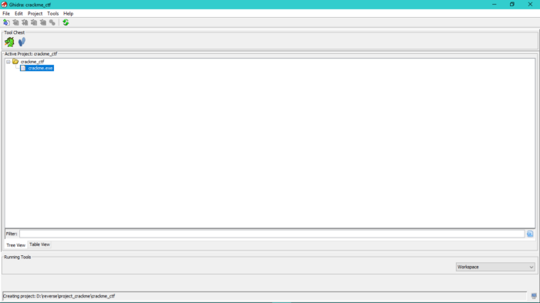
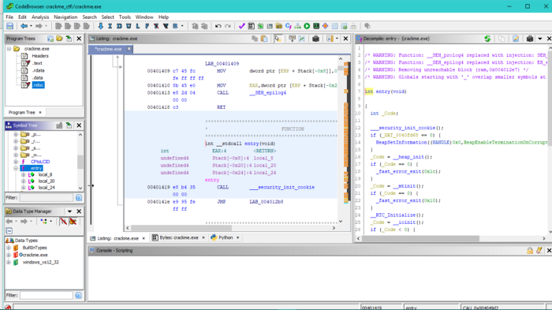
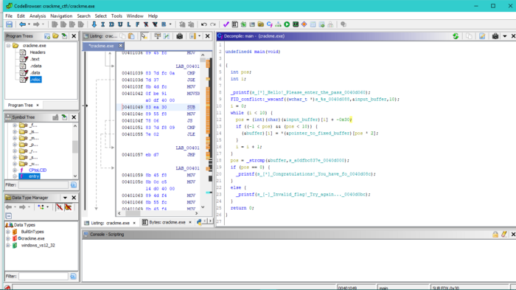
What can you do with Ghidra?
Notes:
Glenn
Import and open files like Jar and Executable files. To decompile them and see how they work.
First open ghidra and click on File -> New Project, choose Non shared project , pick a directory and the name for your project then click on finish. Also on File options pick Import File and then choose the PE file you want to reverse engineering, for this tutorial it is the PE file above, i won’t go into details each option because that is for advance tutorial so for the sake of this tutorial just choose ok. You will get the result like in this picture:
Now drag the crackme.exe into the dragon icon in Tool Chest. It will open the Code Browser window and ask you if you want to analyse it choose Yes of course. When the options window pop up, you will need to check and uncheck this options.

Slide 12
Practical examples of reverse engineering.
Analyse software
RAT File
WannaCry
File that contains the important algorithm
https://blogs.blackberry.com/en/2019/07/an-introduction-to-code-analysis-with-ghidra
Notes:
Sjong
Analyze all kinds of software (e.g. RAT – File (Remote Access Trojan, WannaCry, etc.)
RAT – File: Find out what it is doing. (Most commonly it tries to disable User Account Control (UAC) by modifying values in the registry)
WannaCry: Find the kill switch. (The program tried to reach a specific domain, if the domain is unassigned the program kept going, if assigned the program stopped immediately)
All you need is a file that contains the important algorithm (Binaries, Executables, …)

Slide 13
How to install Ghidra
Pull the Ghidra 2022 repository off github SEBIvenlo
JDK 17
Download Ghidra
Notes:
Install:
To install an official pre-built multi-platform Ghidra release:
Install JDK 17 64-bit
Download a Ghidra release file
Extract the Ghidra release file
Launch Ghidra: ./ghidraRun (or ghidraRun.bat for Windows)
For additional information and troubleshooting tips about installing and running a Ghidra release, please refer to docs/InstallationGuide.html which can be found in your extracted Ghidra release directory.
Build
to create the latest development build for your platform from this source repository:
Install build tools:
JDK 17 64-bit
Gradle 7.3+
make, gcc, and g++ (Linux/macOS-only)
Microsoft Visual Studio (Windows-only)
Download and extract the source:
Download from GitHub
$ unzip ghidra-master $ cd ghidra-master
NOTE: Instead of downloading the compressed source, you may instead want to clone the GitHub repository: git clone https://github.com/NationalSecurityAgency/ghidra.git
Download additional build dependencies into source repository:
$ gradle -I gradle/support/fetchDependencies.gradle init
Create development build:
$ gradle buildGhidra
The compressed development build will be located at build/dist/.
For more detailed information on building Ghidra, please read the Developer Guide.

Slide 14
Workshop
Importing Files
Starting with Decompiler.

Slide 15

Quizizz
Joinmyquiz.com

Slide 16

Questions?

