Slide 1

Glenn Jonkers & Sjong Leow
ESDE

Slide 2
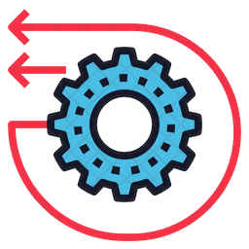
Summary
What is Ghidra
History of Ghidra
What can you do with Ghidra?
Demo
How to install
https://cdn.iconscout.com/icon/premium/png-256-thumb/reverse-engineering-1524273-1290820.png

Slide 3

What is Ghidra
March 2017 Wikileaks
June 2019 Coreboot
Open Source
NSA
JAVA Swing framework
Decompiler
Notes:
Ghidra's existence was originally revealed to the public via WikiLeaks in March 2017, but the software itself remained unavailable until its declassification and official release two years later. In June 2019, Coreboot began to use Ghidra for its reverse engineering efforts on firmware-specific problems following the open source release of the Ghidra software suite. Ghidra can be used as a debugger since Ghidra 10.0. Ghidra's debugger supports debugging user-mode Windows programs via WinDbg, and Linux programs via GDB.
therefore usable in a stand-alone form. Ghidra plugins can be developed in Java or in Python (provided via Jython).
Ghidra is a free and open source reverse engineering tool developed by the National Security Agency (NSA) of the United States. The binaries were released at RSA Conference in March 2019; the sources were published one month later on GitHub. Ghidra is seen by many security researchers as a competitor to IDA Pro. The software is written in Java using the Swing framework for the GUI. The decompiler component is written in C++, and is

Slide 4

NSA
History
Mission
Notes:
The National Security Agency (NSA) is a national-level intelligence agency of the United States Department of Defense, under the authority of the Director of National Intelligence (DNI). The NSA is responsible for global monitoring, collection, and processing of information and data for foreign and domestic intelligence and counterintelligence purposes, specializing in a discipline known as signals intelligence (SIGINT). The NSA is also tasked with the protection of U.S. communications networks and information systems.The NSA relies on a variety of measures to accomplish its mission, the majority of which are clandestine. The existence of the NSA was not revealed until 1975. The NSA has roughly 32,000 employees.
Formation:
The origins of the National Security Agency can be traced back to April 28, 1917, three weeks after the U.S. Congress declared war on Germany in World War I. A code and cipher decryption unit was established as the Cable and Telegraph Section which was also known as the Cipher Bureau. It was headquartered in Washington, D.C. and was part of the war effort under the executive branch without direct Congressional authorization. During the course of the war, it was relocated in the army's organizational chart several times. On July 5, 1917, Herbert O. Yardley was assigned to head the unit. At that point, the unit consisted of Yardley and two civilian clerks. It absorbed the Navy's cryptanalysis functions in July 1918. World War I ended on November 11, 1918, and the army cryptographic section of Military Intelligence (MI-8) moved to New York City on May 20, 1919, where it continued intelligence activities as the Code Compilation Company under the direction of Yardley.

Slide 5
Compile and Decompile
Notes:
The term decompiler is most commonly applied to a program which translates executable programs (the output from a compiler) into source code in a (relatively) high level language which, when compiled, will produce an executable whose behavior is the same as the original executable program. By comparison, a disassembler translates an executable program into assembly language (and an assembler could be used for assembling it back into an executable program).Decompilation is the act of using a decompiler, although the term can also refer to the output of a decompiler. It can be used for the recovery of lost source code, and is also useful in some cases for computer security, interoperability and error correction. The success of decompilation depends on the amount of information present in the code being decompiled and the sophistication of the analysis performed on it. The bytecode formats used by many virtual machines (such as the Java Virtual Machine or the .NET Framework Common Language Runtime) often include extensive metadata and high-level features that make decompilation quite feasible. The application of debug data, i.e. debug-symbols, may enable to reproduce the original names of variables and structures and even the line numbers. Machine language without such metadata or debug data is much harder to decompile.Some compilers and post-compilation tools produce obfuscated code (that is, they attempt to produce output that is very difficult to decompile, or that decompiles to confusing output). This is done to make it more difficult to reverse engineer the executable.While decompilers are normally used to (re-)create source code from binary executables, there are also decompilers to turn specific binary data files into human-readable and editable sources.

Slide 6
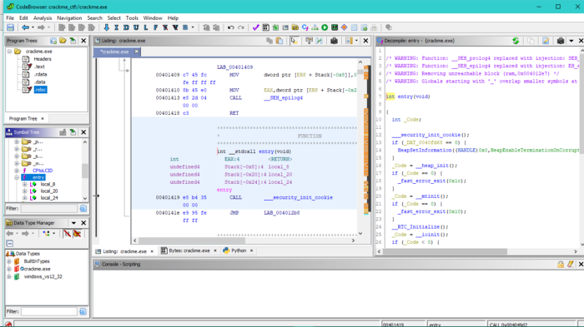
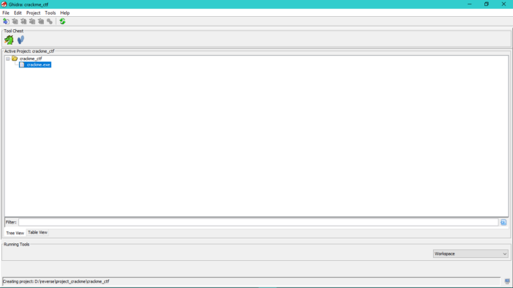
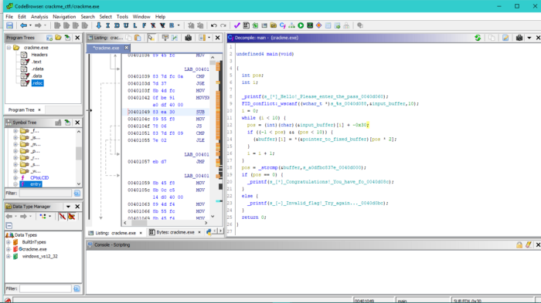
What can you do with Ghidra?
Notes:
First open ghidra and click on File -> New Project, choose Non shared project , pick a directory and the name for your project then click on finish. Also on File options pick Import File and then choose the PE file you want to reverse engineering, for this tutorial it is the PE file above, i won’t go into details each option because that is for advance tutorial so for the sake of this tutorial just choose ok. You will get the result like in this picture:
Now drag the crackme.exe into the dragon icon in Tool Chest. It will open the Code Browser window and ask you if you want to analyse it choose Yes of course. When the options window pop up, you will need to check and uncheck this options.

Slide 7
Ghidra Software Reverse Engineering Framework
Notes:
Ghidra is a software reverse engineering (SRE) framework created and maintained by the National Security Agency Research Directorate. This framework includes a suite of full-featured, high-end software analysis tools that enable users to analyze compiled code on a variety of platforms including Windows, macOS, and Linux. Capabilities include disassembly, assembly, decompilation, graphing, and scripting, along with hundreds of other features. Ghidra supports a wide variety of processor instruction sets and executable formats and can be run in both user-interactive and automated modes. Users may also develop their own Ghidra extension components and/or scripts using Java or Python.
In support of NSA's Cybersecurity mission, Ghidra was built to solve scaling and teaming problems on complex SRE efforts, and to provide a customizable and extensible SRE research platform. NSA has applied Ghidra SRE capabilities to a variety of problems that involve analyzing malicious code and generating deep insights for SRE analysts who seek a better understanding of potential vulnerabilities in networks and systems.

Slide 8

Demo
https://thumbs.dreamstime.com/b/demo-computer-key-to-download-version-software-trial-64543995.jpg

Slide 9
How to install Ghidra
Notes:
Install:
To install an official pre-built multi-platform Ghidra release:
Install JDK 17 64-bit
Download a Ghidra release file
Extract the Ghidra release file
Launch Ghidra: ./ghidraRun (or ghidraRun.bat for Windows)
For additional information and troubleshooting tips about installing and running a Ghidra release, please refer to docs/InstallationGuide.html which can be found in your extracted Ghidra release directory.
Build
to create the latest development build for your platform from this source repository:
Install build tools:
JDK 17 64-bit
Gradle 7.3+
make, gcc, and g++ (Linux/macOS-only)
Microsoft Visual Studio (Windows-only)
Download and extract the source:
Download from GitHub
$ unzip ghidra-master $ cd ghidra-master
NOTE: Instead of downloading the compressed source, you may instead want to clone the GitHub repository: git clone https://github.com/NationalSecurityAgency/ghidra.git
Download additional build dependencies into source repository:
$ gradle -I gradle/support/fetchDependencies.gradle init
Create development build:
$ gradle buildGhidra
The compressed development build will be located at build/dist/.
For more detailed information on building Ghidra, please read the Developer Guide.

Slide 10
Workshop
Importing Files
Starting with decompiler.

Slide 11

Questions?

