Slide 2
Disadvantages
Flexibility can be overwhelming when the chosen use case is not the default
Documentation is good however the info is not up-to date or info for specific use cases are difficult to be found
The website has decent documentation and snippets of code but they lack comprehensive examples/use cases
It needs to be tuned to get the benefit of speed and scalability
Lack of GUI controller like e.g. IBM MQ
source: The Uplink

Slide 3
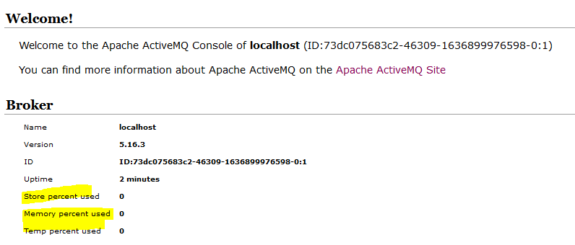
ActiveMQ storage
Store
% of assigned disk space that has been used up to store persistent messages (KahaDB)
Temp
Assigned of disk storage space %
Is used to store non-persistent messages
Memory
Amount of memory assigned to the broker to keep track of destinations.
Needs to be less than the JVM heap size
Source: DZone

Slide 4
What the columns mean
Pending messages – Number of currently messages waiting to be delivered
Enqueued messages – Number of messages waiting to be processed since the last reset.
Dequeued messages – Delivered messages to their consumers.
Equeued != Dequeued.
Source: stackoverflow

Slide 5
JMS Sessions Acknowledgment modes
AUTO_ACKNOWLEDGE
The session automatically acknowledges each message received by the application.
If messages are delivered synchronously to the application, the session acknowledges receipt of a message every time a Receive call completes successfully. If messages are delivered asynchronously, the session acknowledges receipt of a message every time a call to the onMessage() method of a message listener completes successfully.
If the application receives a message successfully, but a failure prevents acknowledgment from occurring, the message becomes available for delivery again. The application must therefore be able to handle a message that is re-delivered.
DUPS_OK_ACKNOWLEDGE
The session acknowledges the messages received by the application at times it selects.
Using this acknowledgment mode reduces the amount of work the session must do, but a failure that prevents message acknowledgment might result in more than one message becoming available for delivery again. The application must therefore be able to handle messages that are re-delivered.
CLIENT_ACKNOWLEDGE
The application acknowledges the messages it receives by calling the Acknowledge method of the Message class.
The application can acknowledge the receipt of each message individually, or it can receive a batch of messages and call the Acknowledge method only for the last message it receives. When the Acknowledge method is called all messages received since the last time the method was called are acknowledged.
Source: Ibm.com

Slide 6
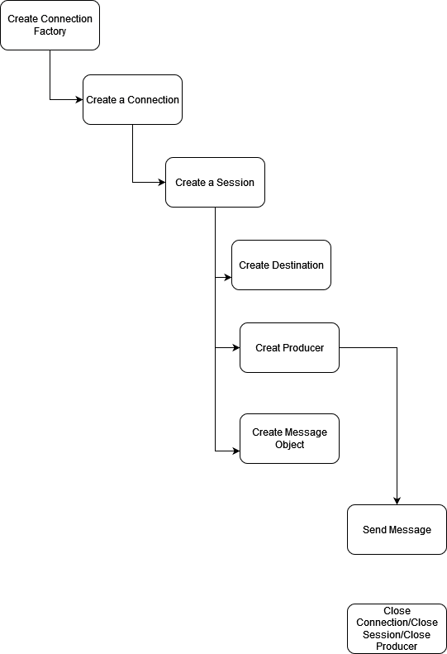
How to send a message with JMS

Slide 7
What happens when a message is Acknowledged?
Once the broker receives signal that a message has been acknowledged it removes it from the persistence storage unit (KahaDB)

Slide 8
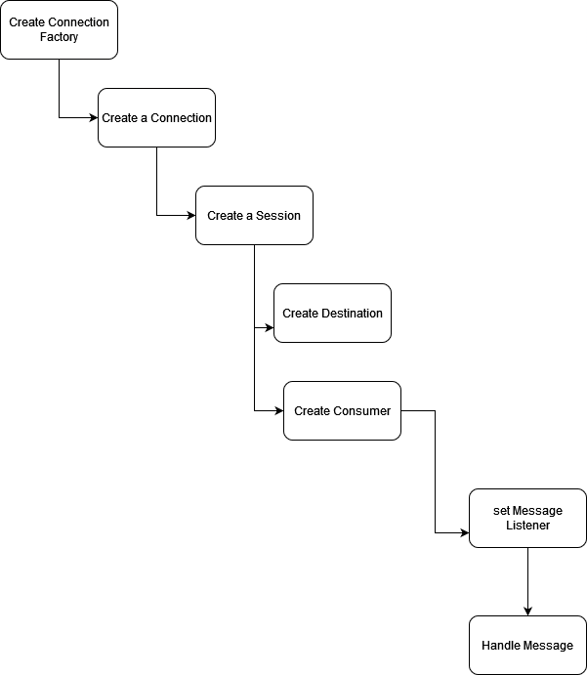
How to receive a message with JMS

Slide 9
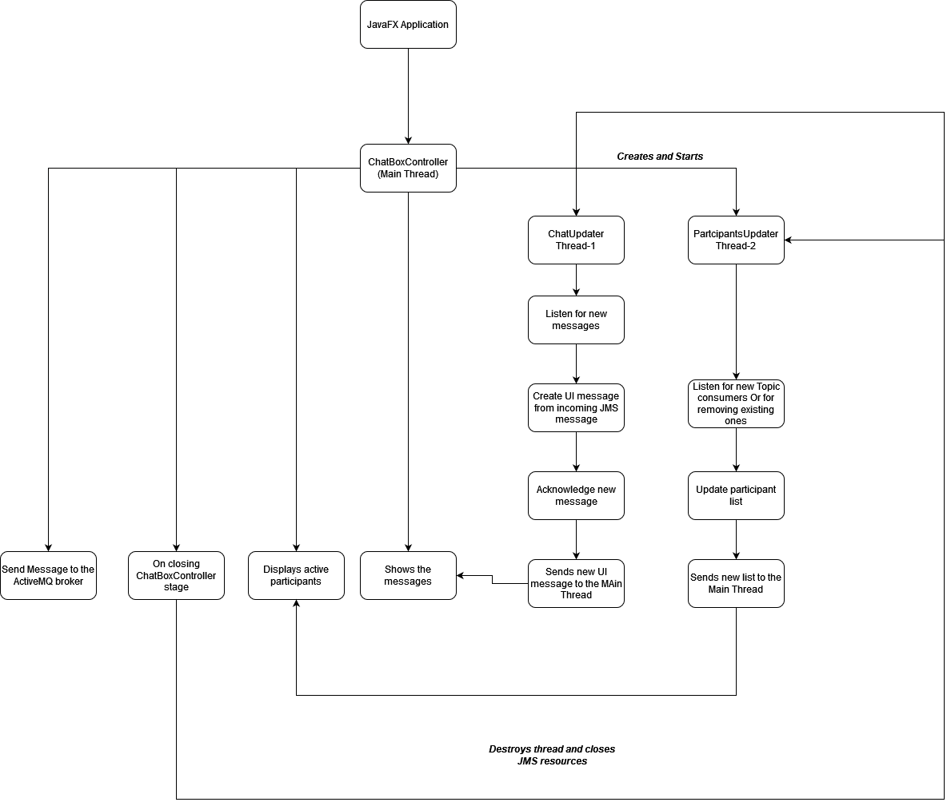
Main Functionality - ChatBoxController

Slide 10
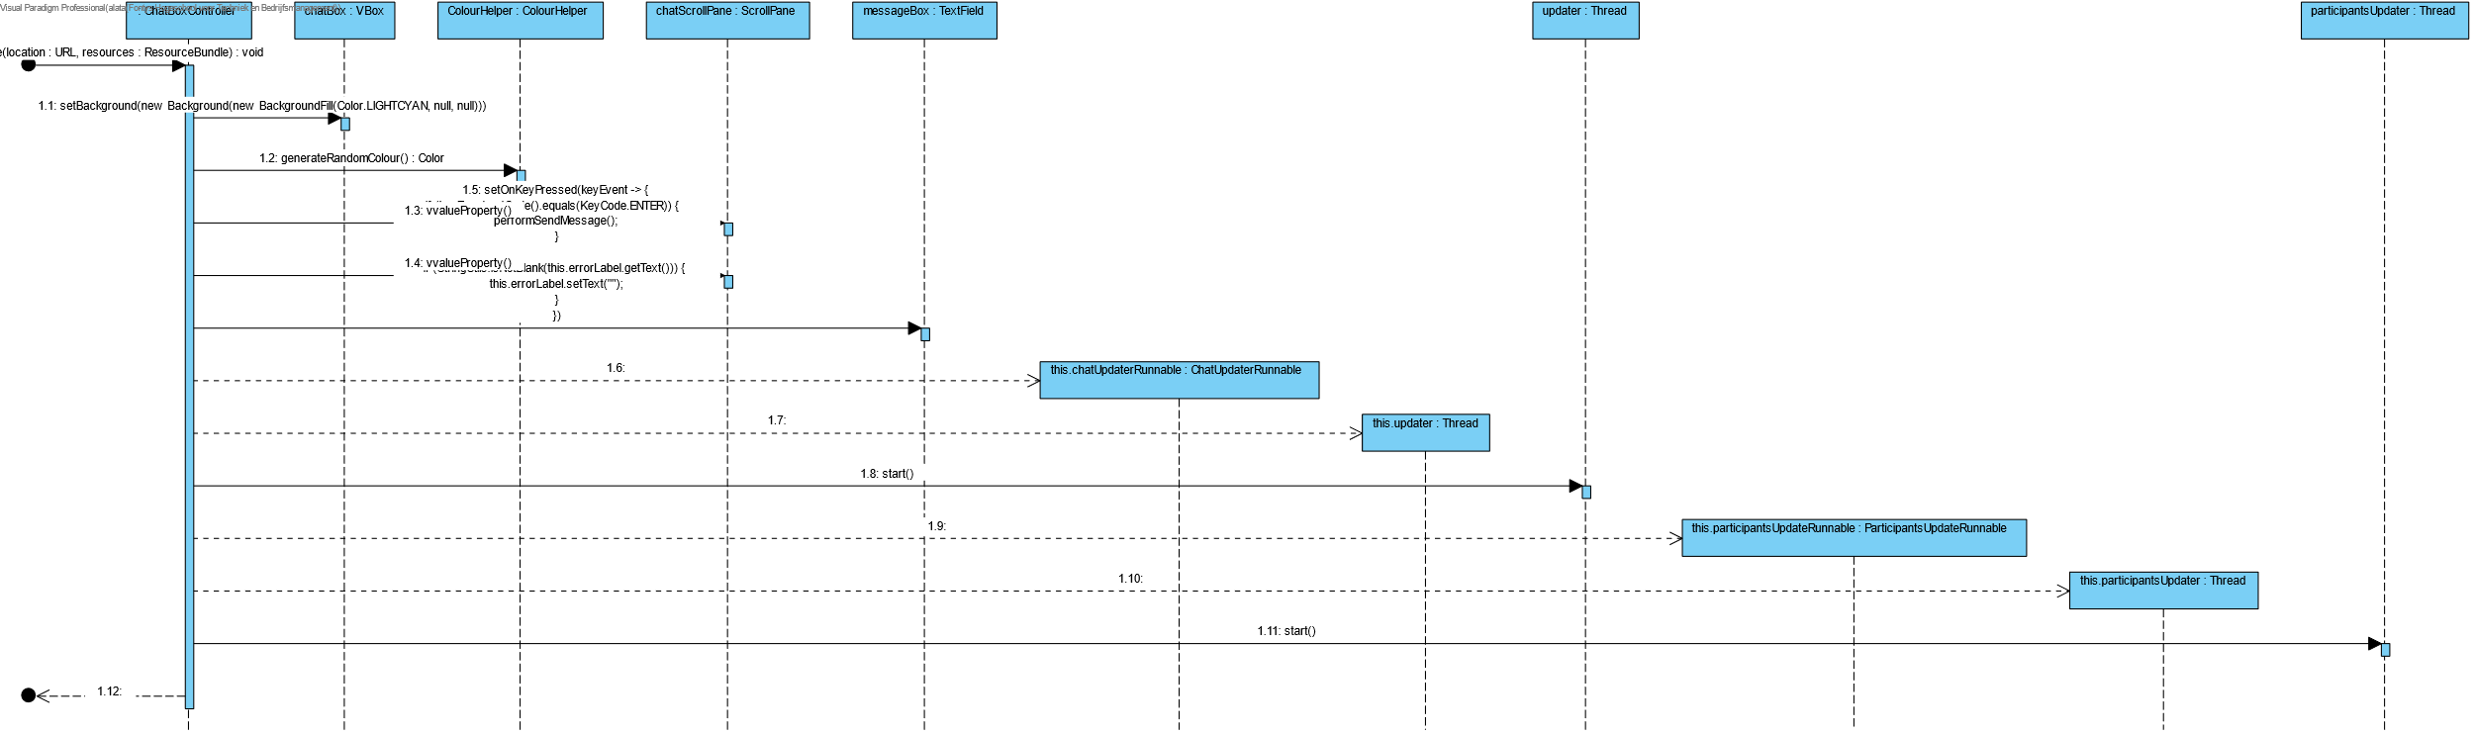
Thread creation

Slide 11
Exercises: Implement the code
Open the Chaty_Exercise project that exists in the git Repo
1st exercise open Class ActiveMQService and follow the instructions
2nd exercise open the ChatBoxController – line 143 and follow the instructions
3rd exercise open the ChatUpdaterRunnable and follow the instructions
4th exercise open the ActiveMQBrokerInfoRetrieverImpl class and follow the instructions
User the smaller examples that were provided before, your partner and don’t be afraid to ask questions

Slide 12
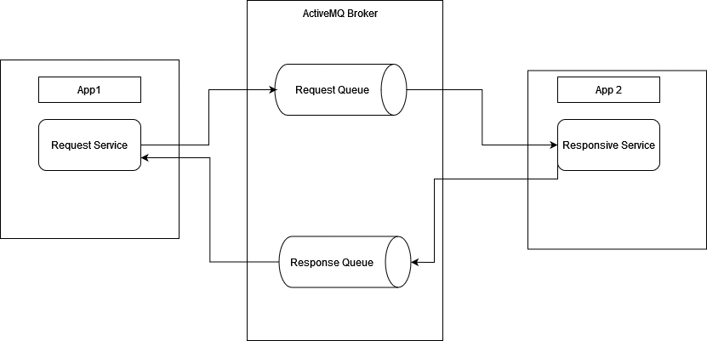
Request and Reply
Messaging Pattern
Really good for decentralized applications
Source: Enterprise Integration Patterns

Slide 13
Future of ActiveMQ
Current ActiveMQ 5.X
Will be replaced by ActiveMQ Artemis → ActiveMQ 6.X
ActiveMQ Artemis has more potential
source: activemq.apache.org

Slide 14
Useful links for self read
All inclusive ActiveMQ book: ActiveMQ in Action
How to Scale ActiveMQ: SlideShare
ActiveMQ Supported Protocols: Protocols

