Slide 1

Ansible
Guus Damen and Louisa Hereth
ESDE – Fontys University of Applied Sciences

Slide 2
Contents
What is Ansible?
Why use Ansible?
How does Ansible work?
Important terms
Comparable tools
Pros and Cons
Advanced use case
What next?

Slide 3








What is Ansible?
A tool to automate IT tasks
For almost all IT and system administration tasks:
OS level updates
Application deployment
Configuration management
Creating and managing DBs
Application orchestration
Cloud provisioning

Slide 4




Why use Ansible?
Less time consuming
More efficient
Less error prone

Slide 5
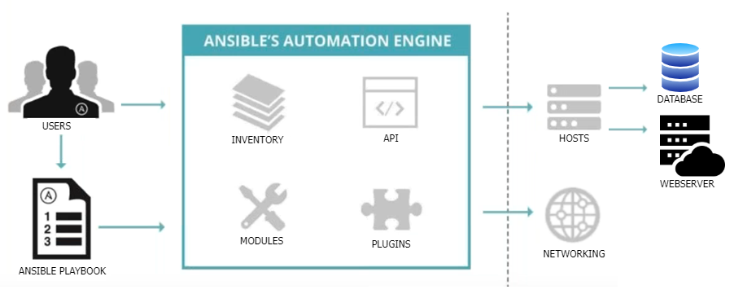
How does Ansible work?
YAML file

Slide 6
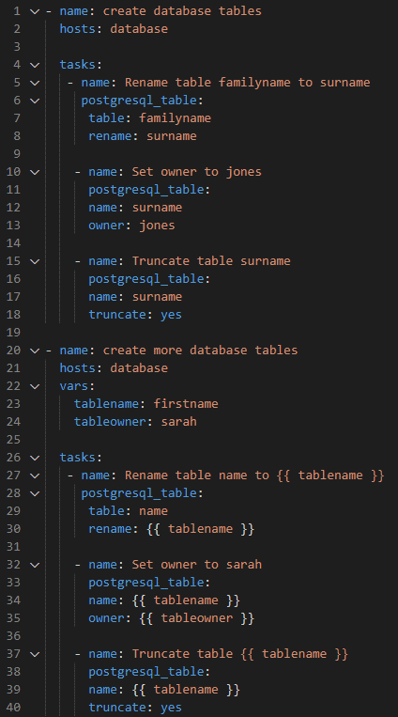
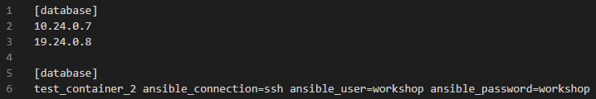
Important terms
Name of task
Task
Name of module
Arguments
Play
Playbook
Host definition & Inventory
Variable definition
Variable usage

Slide 7
Comparable tools
 | Ansible | Puppet | Chef
Founding year | 2012 | 2005 | 2009
Provider | Red Hat | Independent | Independent
Programming language of software | Python | Ruby | Ruby/ Erlang
Scripting language | YAML | Puppet DSL (based on Ruby) | Ruby DSL
Scalability | Well scalable and usable in large infrastructures
High availability | Identical: have a passive and an active instance
Implementation | Easy | Complex | Complex
Costs | From 100 target systems: 10 000$ | Per target system: 112$ | ?
Other | Many finished modules available
 | Modules can be written in any programming language | Good reporting functionality | Good integration with GitHub
 | Limited Windows Support

Slide 8
Pros and Cons
Pro
Con
Is open source
For every OS
For many different CLOUD providers
Is agentless
Uses YAML
Modules can be written in any programming language (answer in JSON format)
The GUI “Ansible Tower” is not cost-free
Limited Windows support
Relatively new to the market

Slide 9
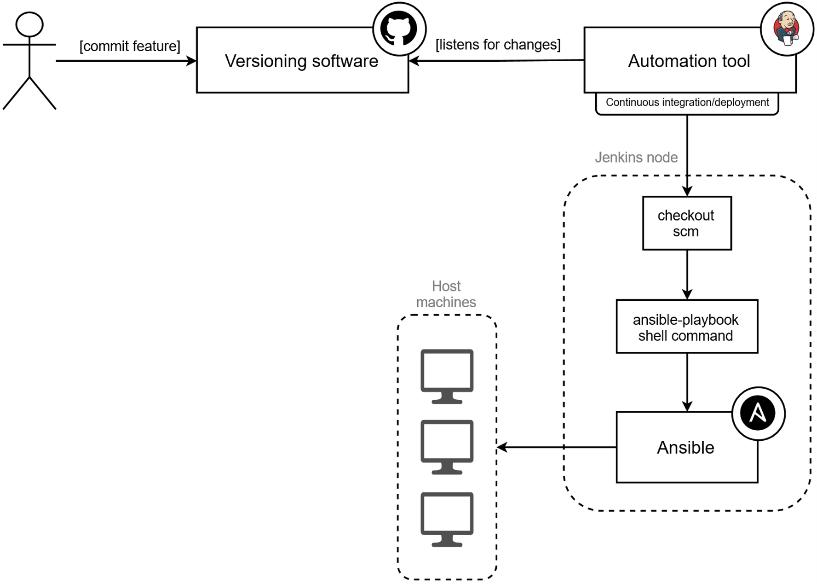
Advanced use case

Slide 10
What next?

Slide 11
What next?
Visit our Github page: https://sebivenlo.github.io/ESDE_G1_Ansible/ (you can find the link posted on in the chat on MS Teams)
Work on the exercises provided for you! (https://sebivenlo.github.io/ESDE_G1_Ansible/#unix-environment)
We will quickly show you the workflow with the first task.
P.S.: Don’t worry if you do not finish all tasks. If you are interested, you can finish them later on + we will upload the solutions as well!
We continue at 9:45!

Slide 12
Quizizz
Join the Quiz here: https://quizizz.com/pro/join
We will send the join code into the chat!

Slide 13
Sources
https://www.ansible.com/
https://www.youtube.com/watch?v=1id6ERvfozo&t=691s
https://www.kreyman.de/index.php/citrix/sonstige-citrix-komponenten/145-puppet-vs-chef-vs-ansible-vs-saltstack-vergleich
https://www.guruadvisor.net/en/server/1006-an-introduction-to-ansible
https://www.whizlabs.com/blog/ansible-advantages-and-disadvantages/

