Slide 1


By: Mark Sindram and Sam Claessen

Slide 2
Contents:
Introduction
What is Elastic Search?
What is Kibana?
Demo
Kahoot Quiz
Assignment

Slide 3
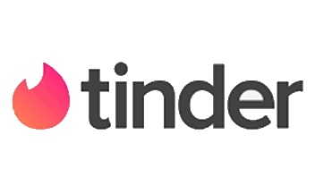



Introduction
Who uses Elastic Search?
Globally used, known brands:
And much more…

Slide 4
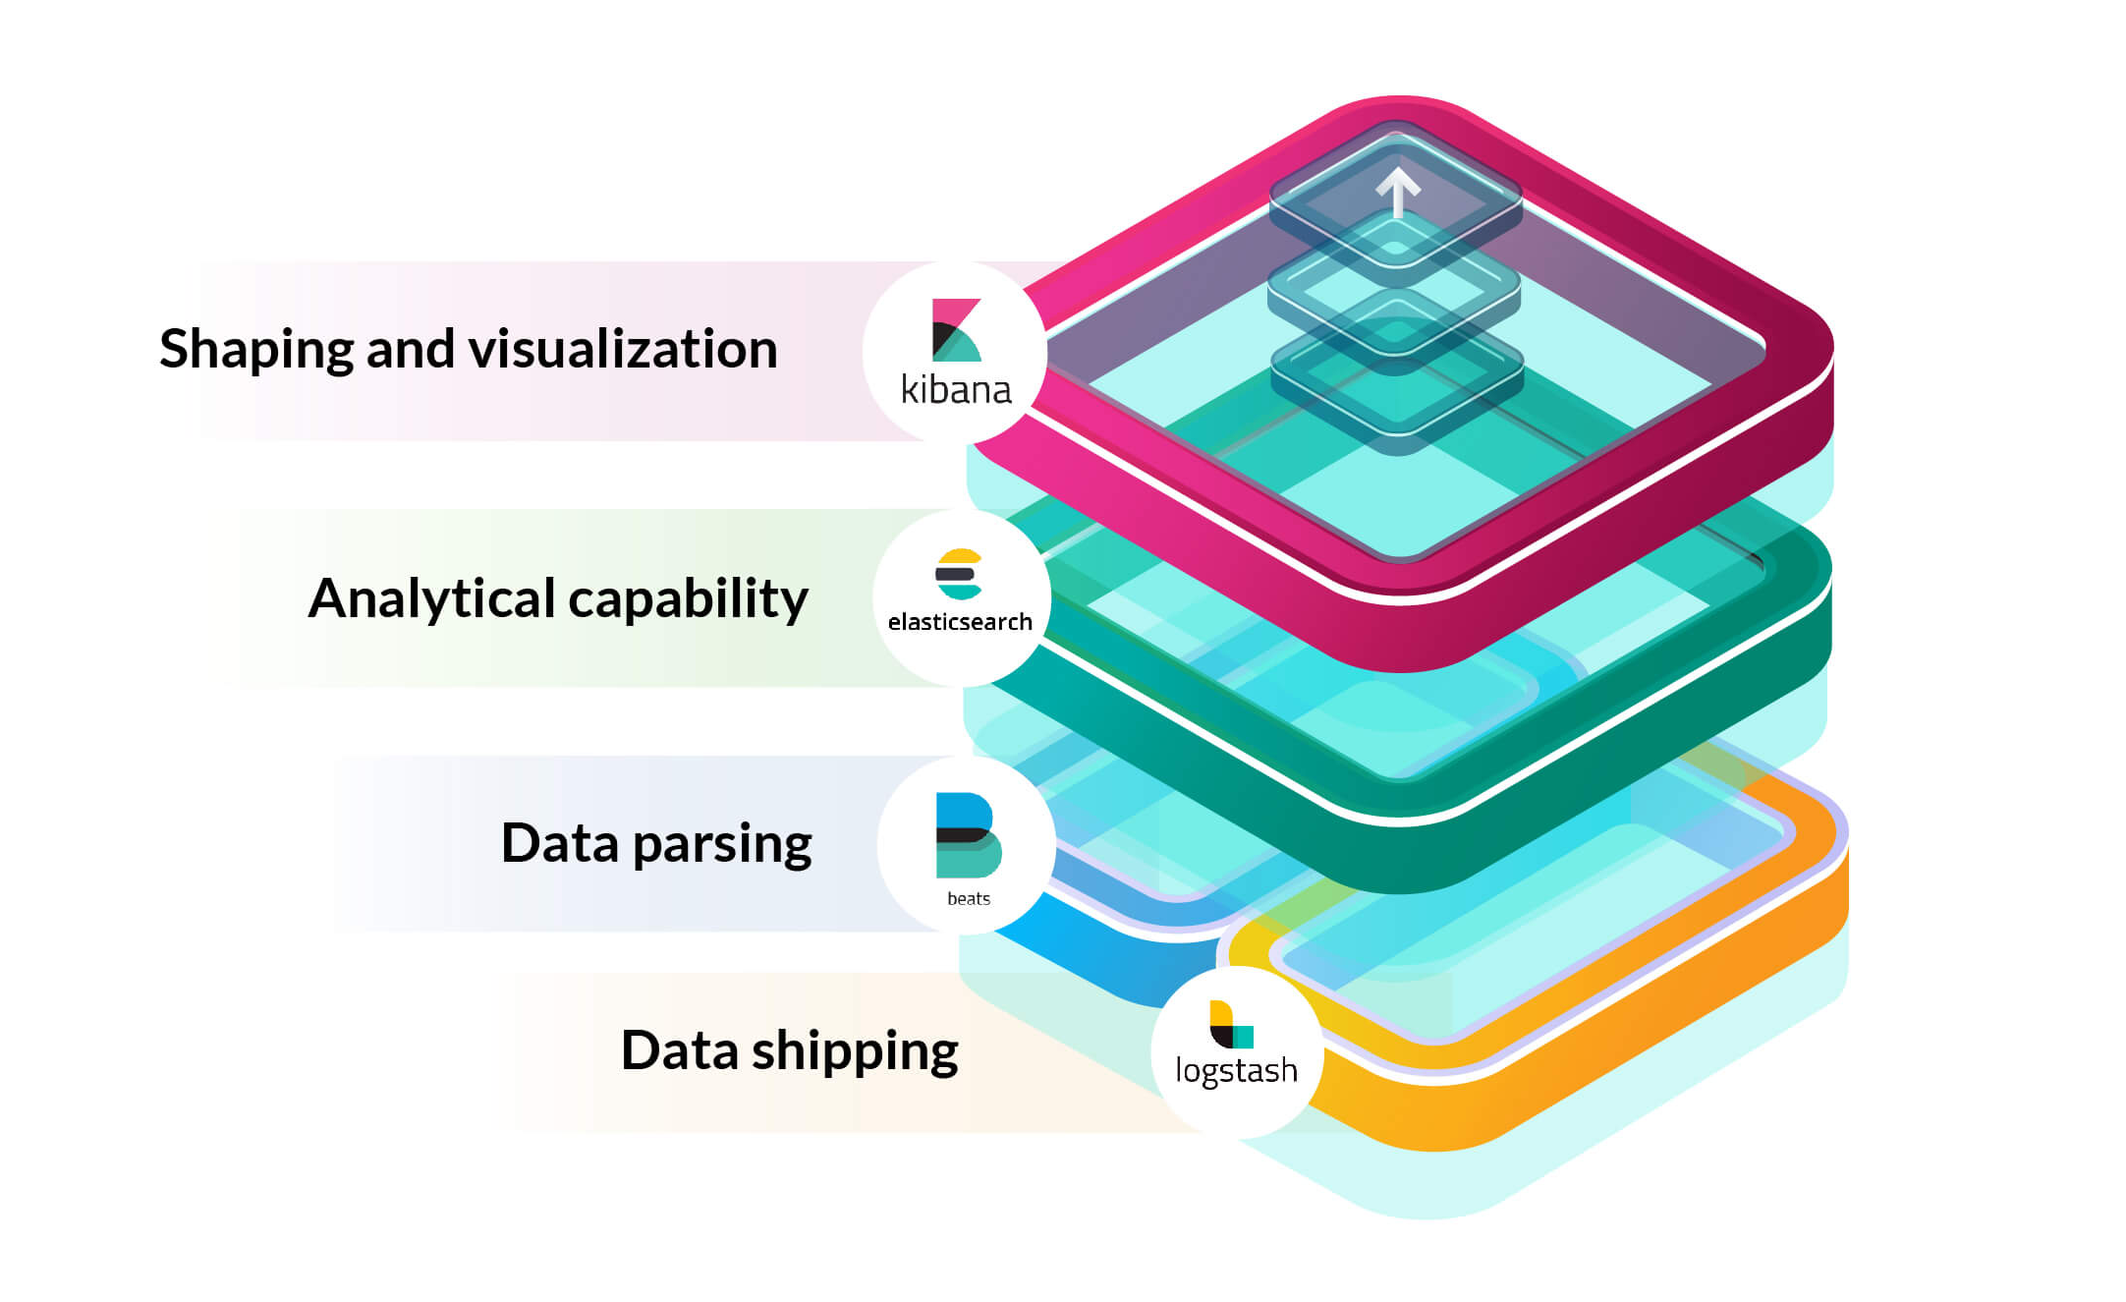
Introduction
What is Elastic Stack?
Relation between Elastic and Kibana
Components

Slide 5
What is Elastic Search?
Distributed, free and open search and analytics engine
Central component of elastic stack
All data types
Textual, numerical, geospatial, structured and unstructured
Document based
How does it work?
Data ingestion
Data enrichment
Data storage
Data analysis
Visualization

Slide 6
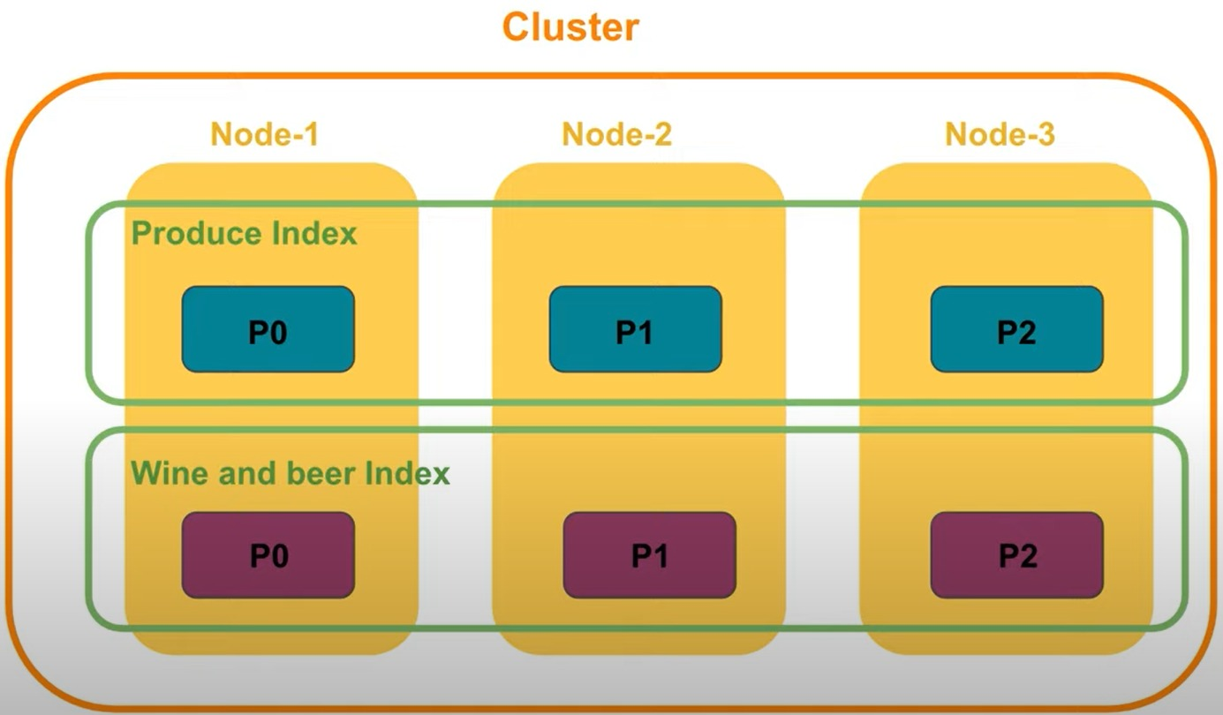
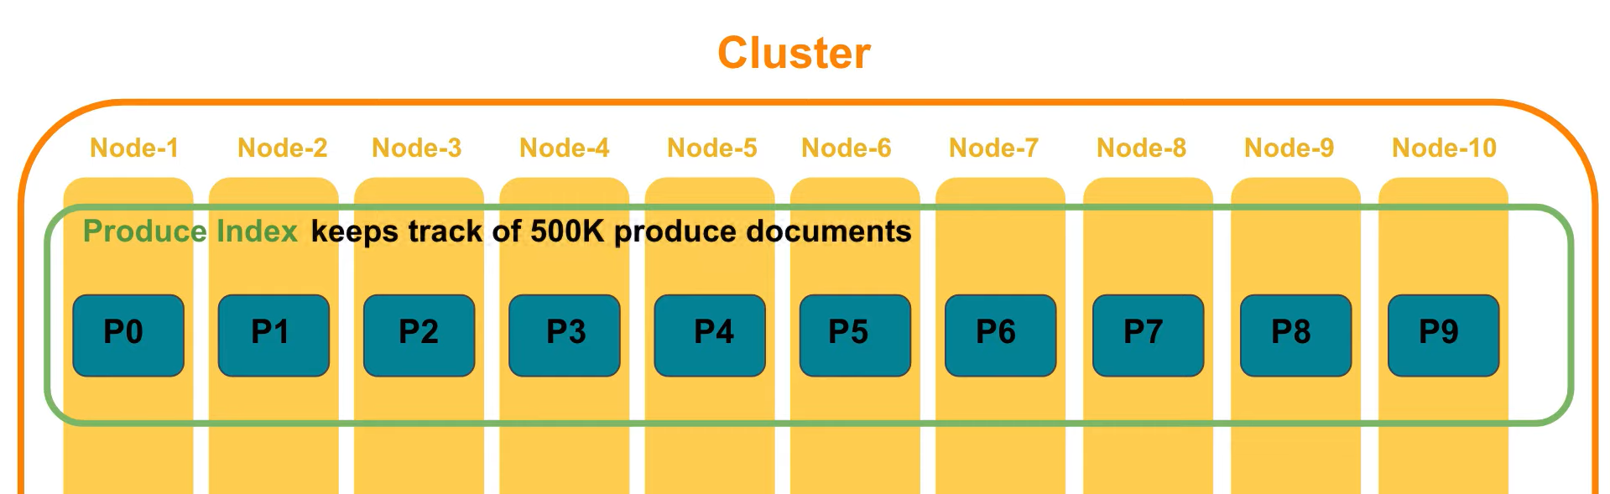
Elastic Search
Terminology:
Nodes
Search speed
Running instances
Documents
Actual data
Index
Inverted index
Clusters
Cooperating nodes (Container)
Shards
Not actually on disk
Replica Shard

Slide 7
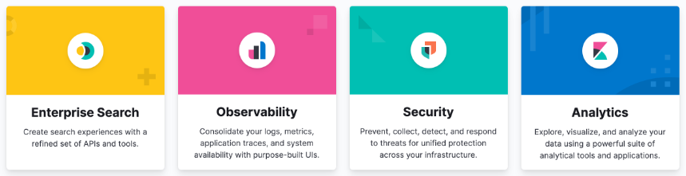
What is Kibana?
User interface
Monitoring, managing and securing
Search and data visualizations
Logging

Slide 8
Enterprise Search
Usecases:
App Search
Workplace Search

Slide 9
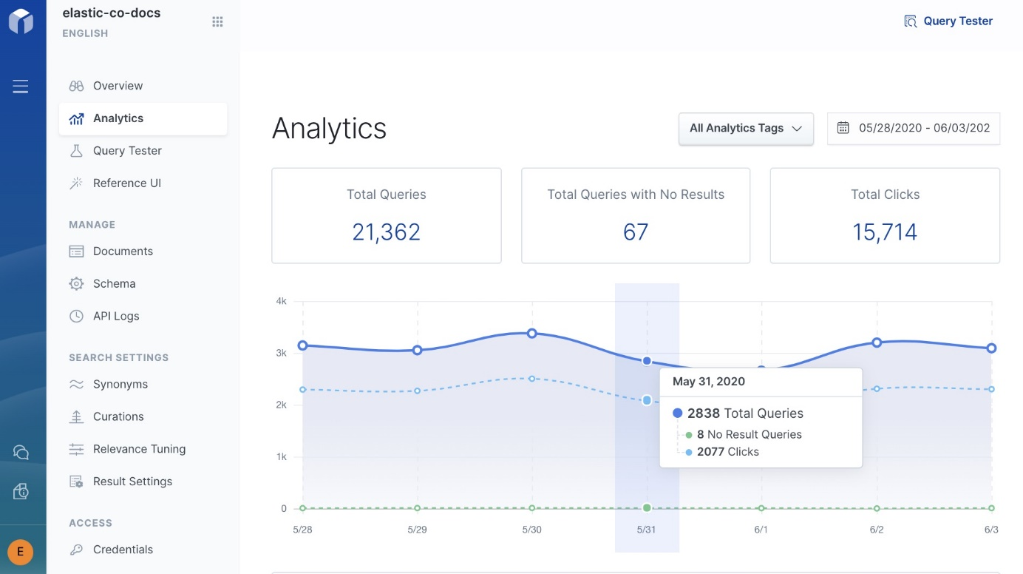
Enterprise Search

Slide 10
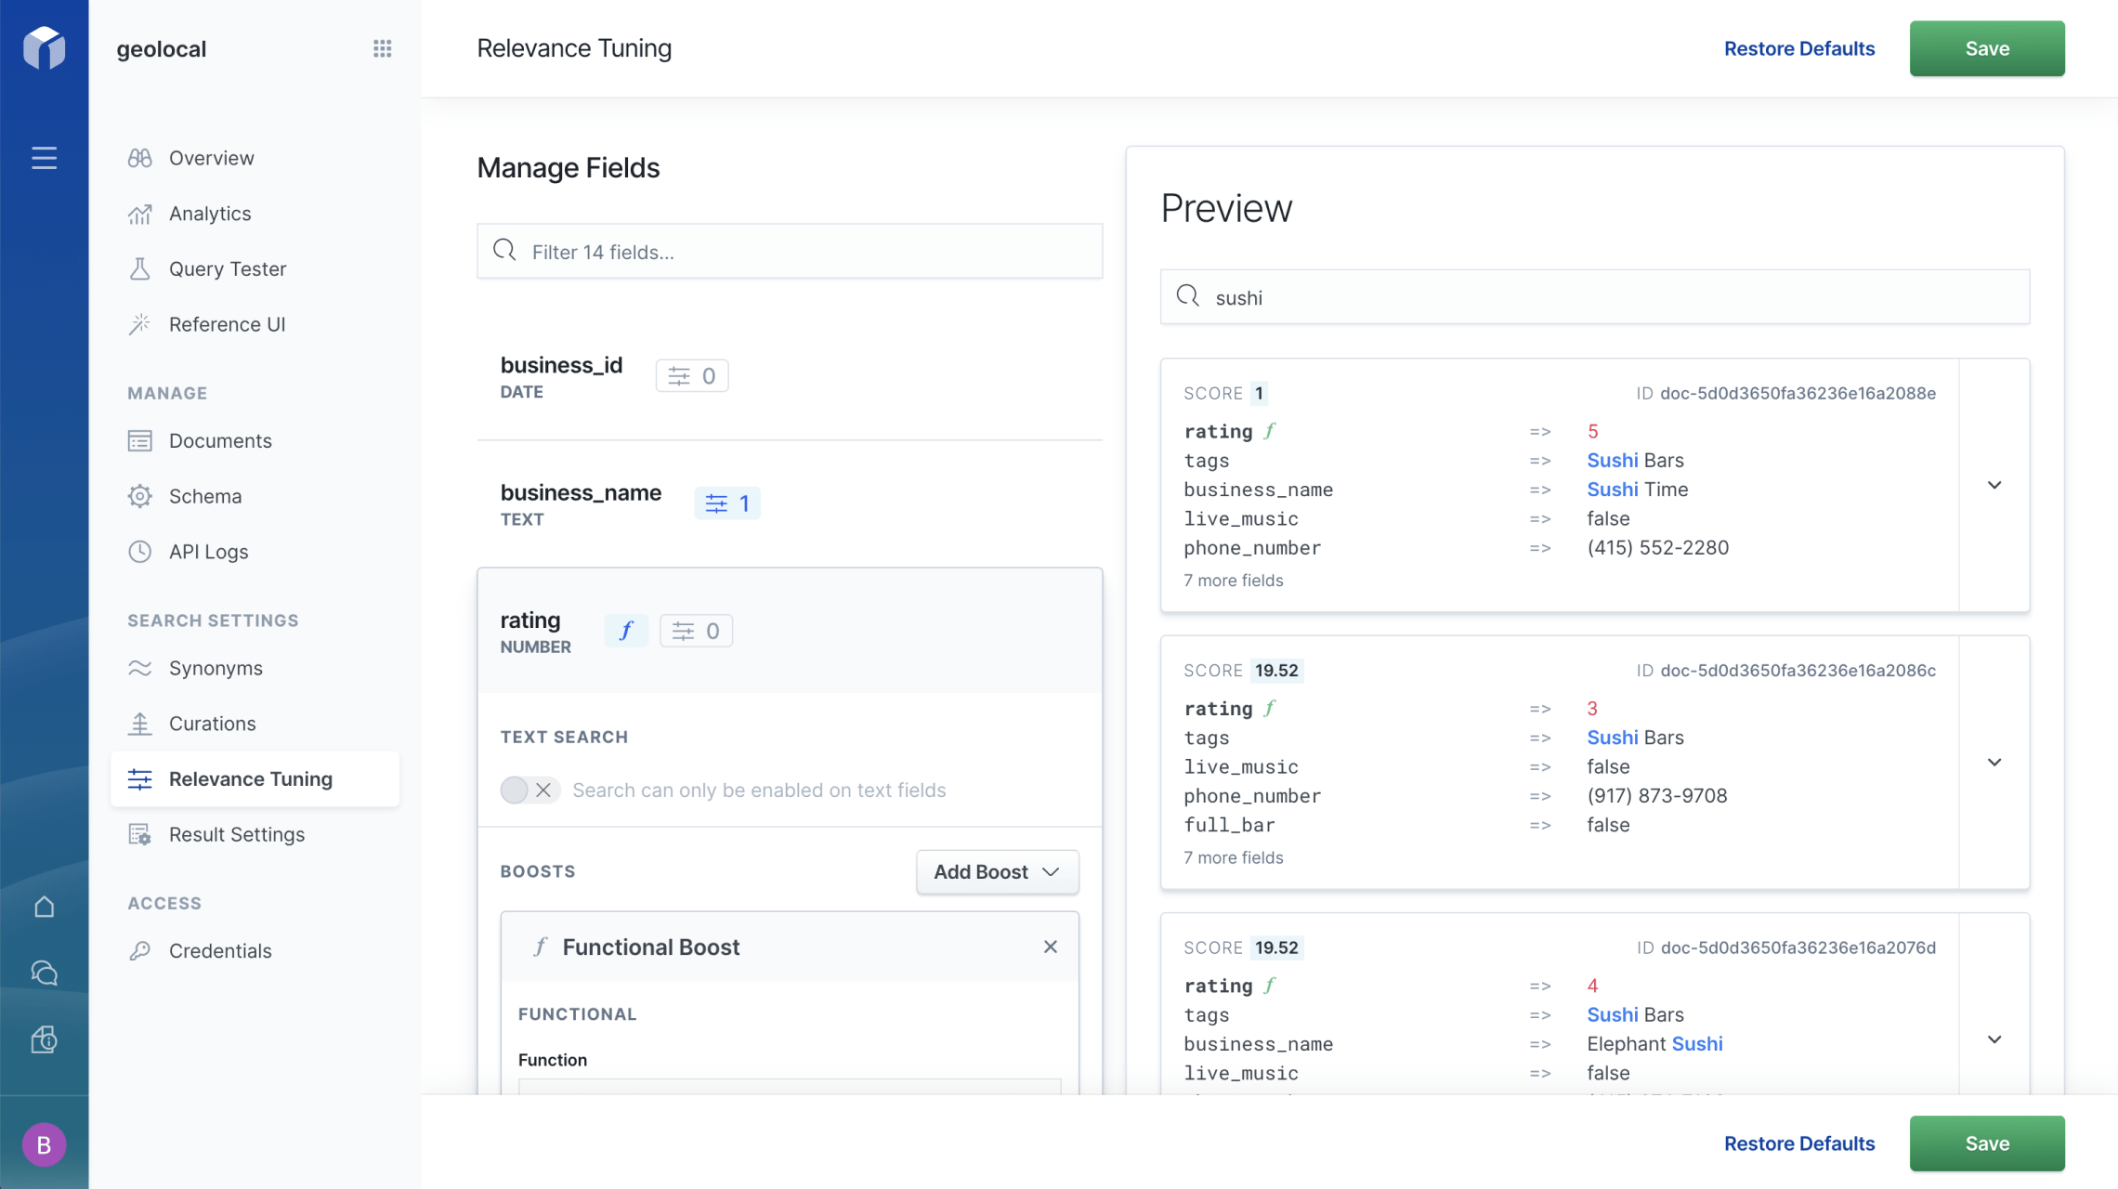
App Relevance

Slide 11
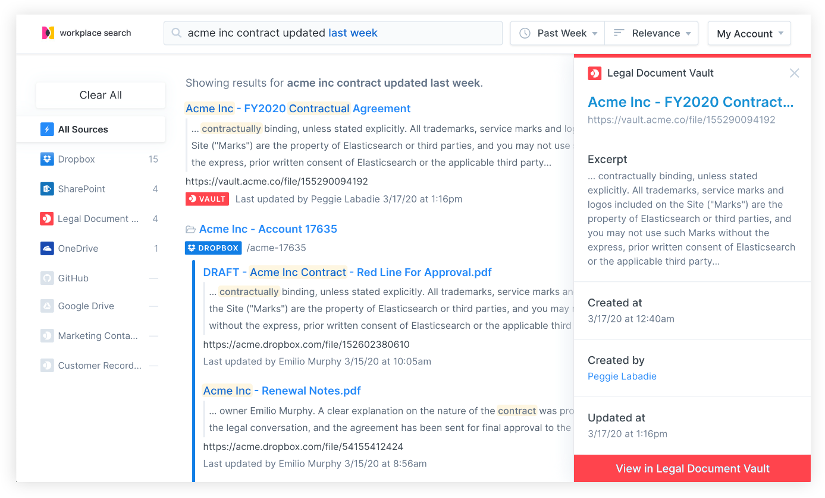
Workplace Search
One central source
Manage the sources easily
Group users in your company together. Employees of marketing don’t want to see github.

Slide 12
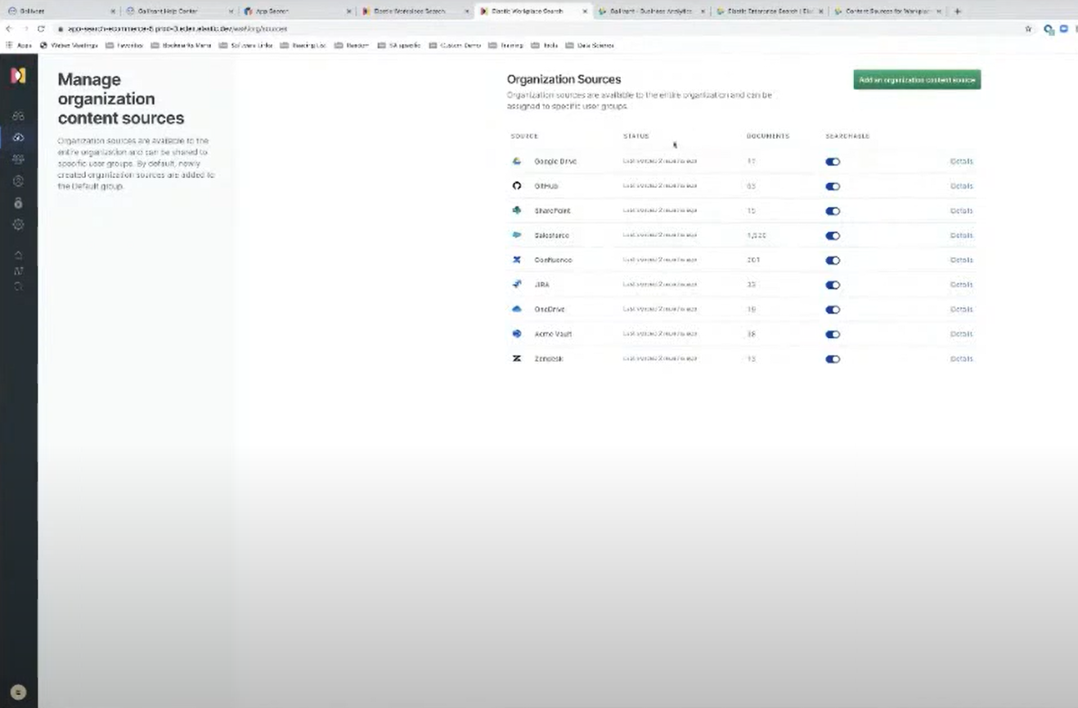
Adding an organizational Source

Slide 13
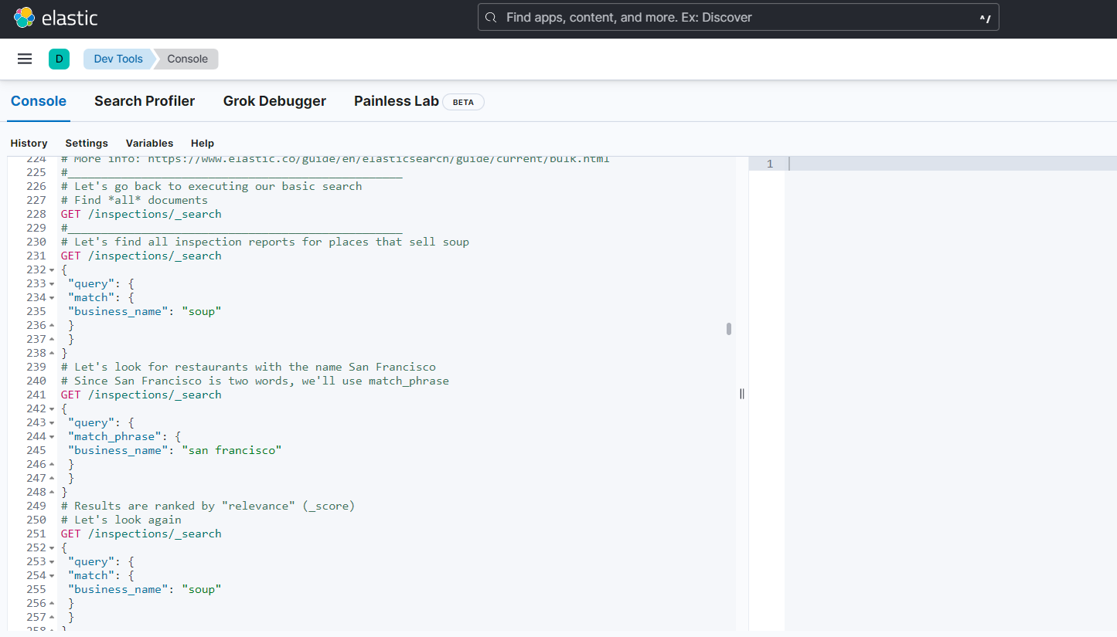
Elastic Search
Development Tools
Elastic Console
Data set
JSON objects
Functionalities

Slide 14
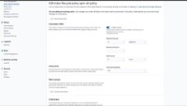
Observability

Slide 15

Security

Slide 16
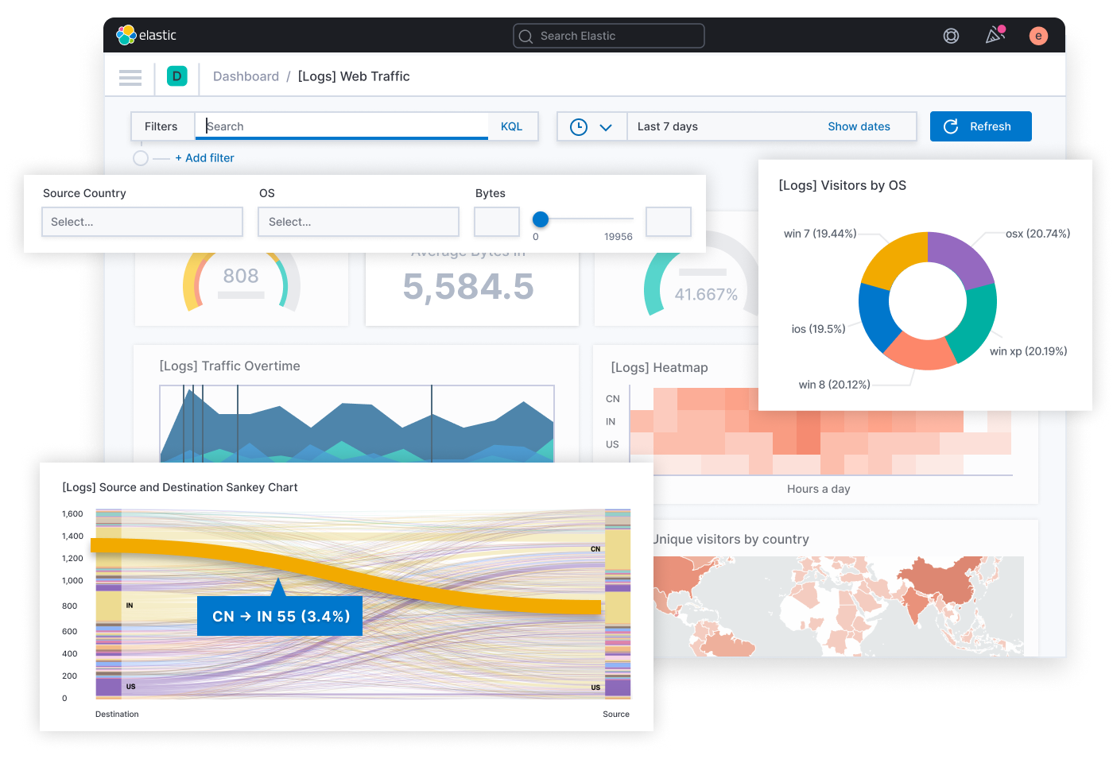
Kibana
Top layer of Elastic Stack
Business Intelligence tool
Data visualization
Charts
Filtering, querying, drill-trough

Slide 17
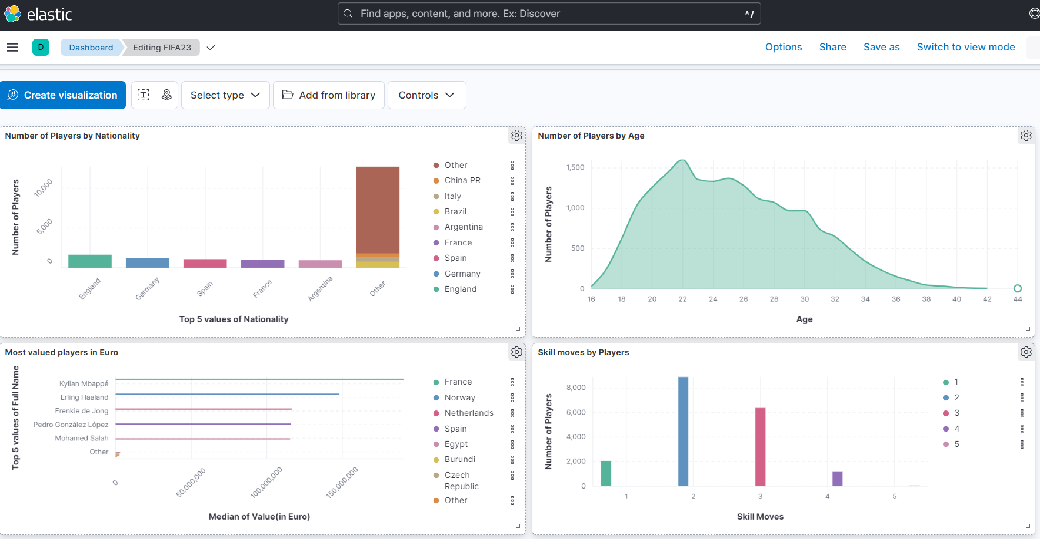
Analytics

Slide 18
Developing with Elastic Search
Assignment
Introduction of Development tools

Slide 19
Visualizing with Kibana
Assignment
Load the Fifa23_Dataset in Kibana by creating a new data view
Create a visualization that shows the number of players by country, how many players are originating from Argentina?
Create a visualization that shows the number of players by age, who is the oldest player in the game?
Create a visualization that shows the top 5 valued players, who is the most valuable player is in the game?
Create a visualization that shows the number of players by skill moves, who is the youngest player that has 5-star skill moves?
Introduction to dashboarding

Slide 20
Kahoot Quiz

Slide 21
Questions?
Thank you for listening

