Slide 1
Hibernate
Created by Andi Hermann & Yordan Baynov

Slide 2
Agenda

Slide 3
What is Hibernate?
Object-relational mapping tool created for Java
Maps Java classes to database tables
Provides data query and data retrieval

Slide 4

What it is good for ?
JPA & Hibernate (Explain JPA)
Hibernate vs EclipseLink (other JPA frameworks)
JPA features
ORM (Explanation given by Yordan)
JPQL (Explain)
Entity relations mapping (Explain)
Main benefits of Hibernate
Open source & Lightweight (Explain)
Fast performance (Explain)
Object-oriented SQL language (Explain)
Automatic table creation & Simplifies join (Explain)

Slide 5
Hibernate features
Extended support for natural IDs (Explain)
Support for multi-tenancy (Explain)
Loading multiple entities by their primary key (Explain)
Joining unassociated entities in queries (Explain)
Management of creation and update timestamps (Explain)

Slide 6

EclipseLink
EclipseLink also offers several proprietary features, like:
Handling of database change events (Explain)
Support for multi-tenancy (Explain, Already for Hibernate)
Composite persistence units ( to map entities to tables in multiple databases, further explain)

Slide 7
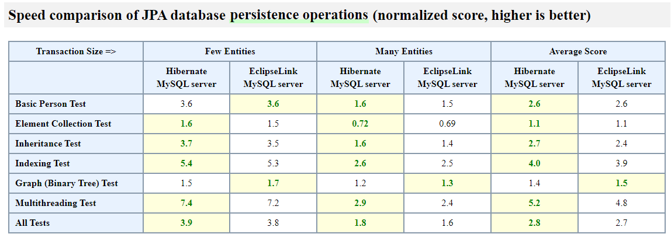
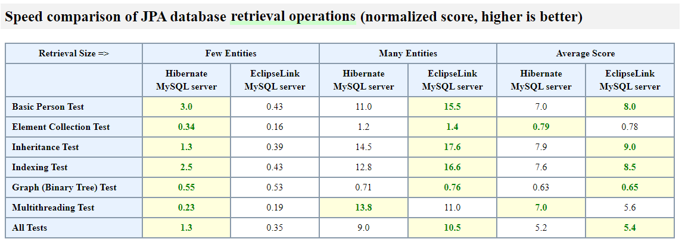
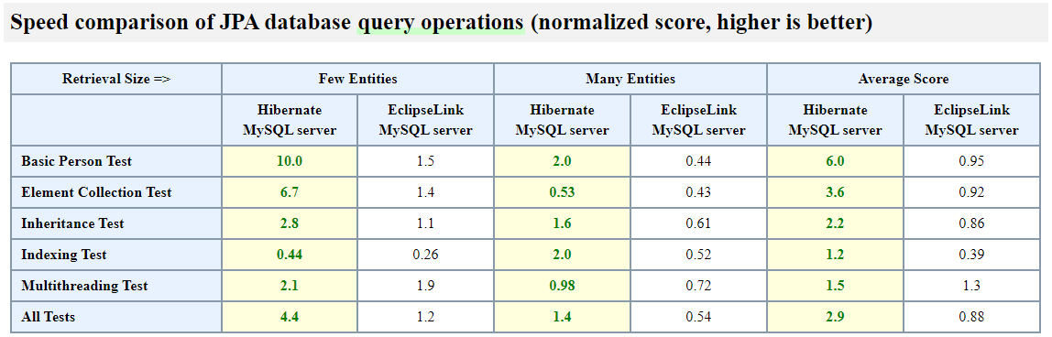
EclipseLink Vs Hibernate

Slide 8
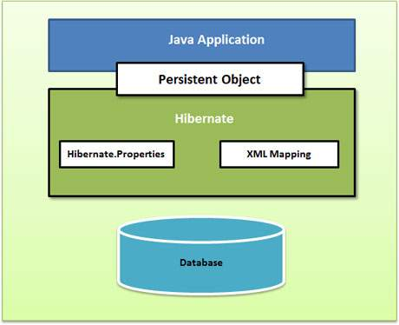
Overview of the architecture (Basic)
1. Java Application
2. Persistent Object = Row/Rows that interact within the database table
3. Hibernate Properties = A file used that contains connection criteria of a chosen database
4. Hibernate Mappings = ??
5. Database

Slide 9
Object Persistence
Saving objects into database
Rules for persistence:
Default constructor
ID attribute
Getter/setter methods
POJO (Plain Old Java Object)

Slide 10
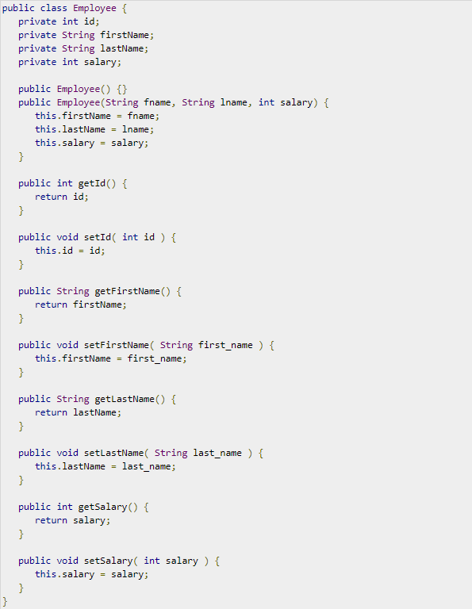
Example of Persistable POJO Class

Slide 11
Object Mapping
Class needs to be mapped to table
XML mapping / annotation mapping
XML mapping file needed

Slide 12
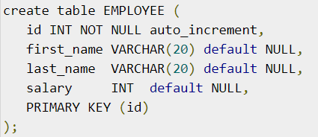

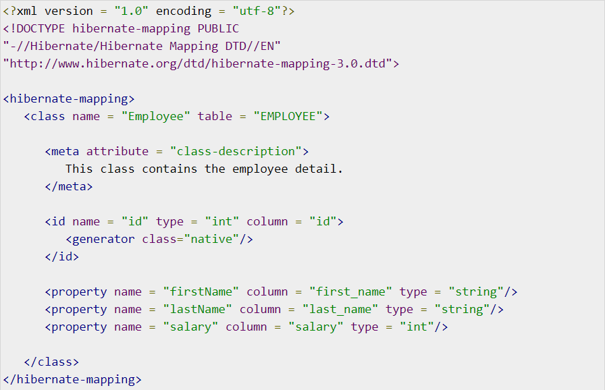

Slide 13
XML Elements
<hibernate-mapping> - root element
<class> - defines which class is mapped
<meta> - description
<id> - maps id
<generator> - generates id value
<property> - class attributes

Slide 14
Complex Use Cases
Mapping collections
List, Set, SortedSet, Map, SortedMap and Collection
Mapping associations between classes
Many-One, One-One, One-Many, Many-Many
Component mapping

Slide 15
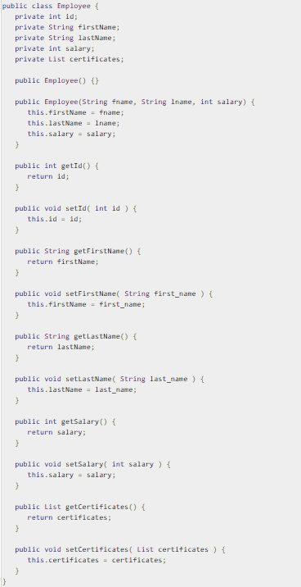
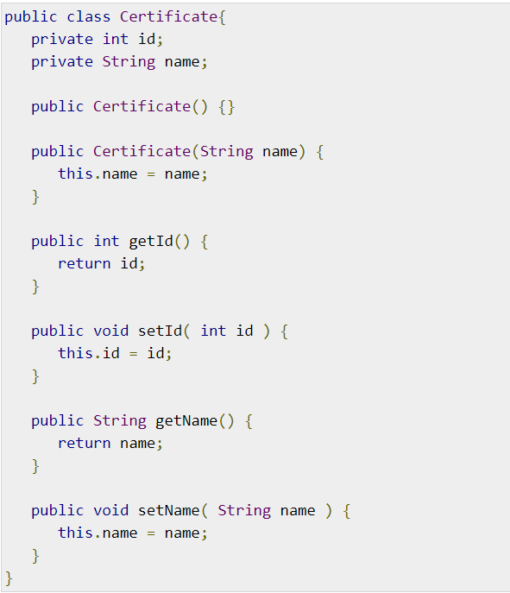
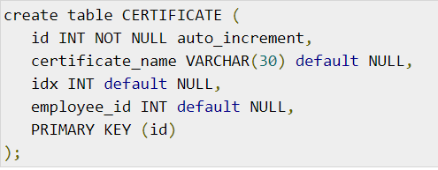
List Mapping

Slide 16
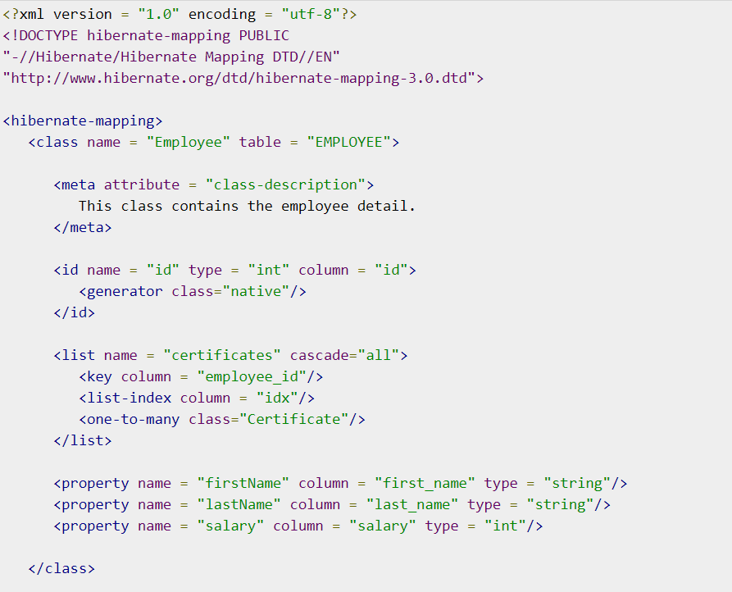
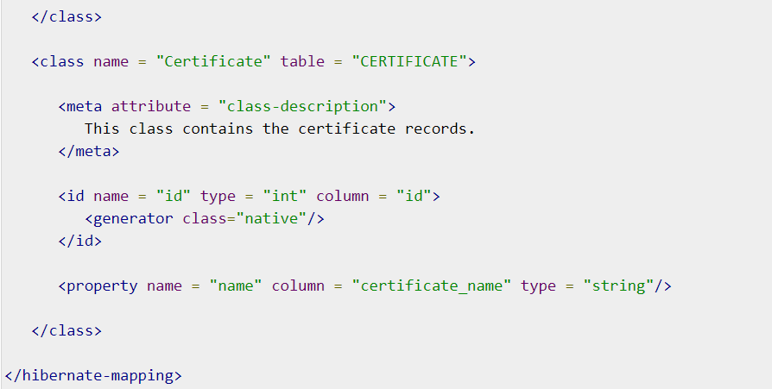
XML file for List
2.
1.

Slide 17
XML Elements for other Collections
<set> for Set and SortedSet
<map> for Map and SortedMap
<bag> for Collection

Slide 18
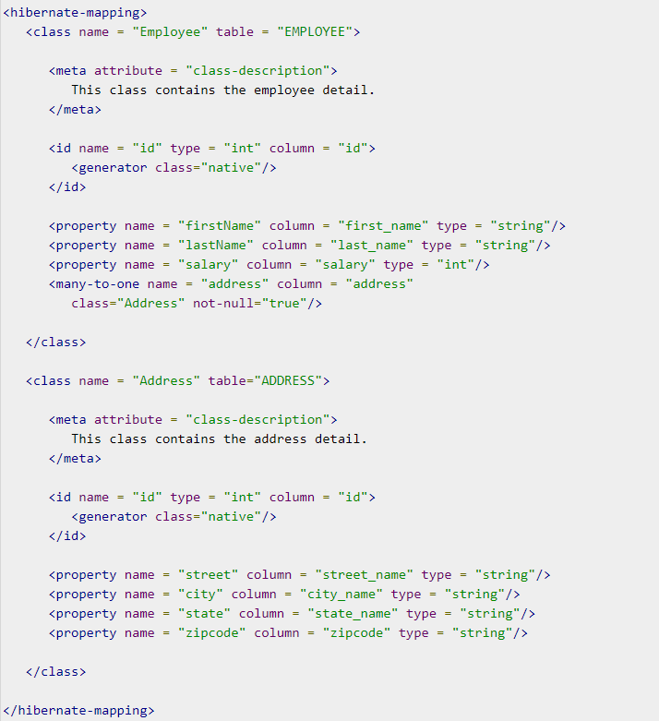
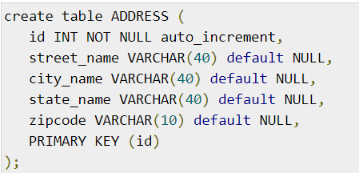
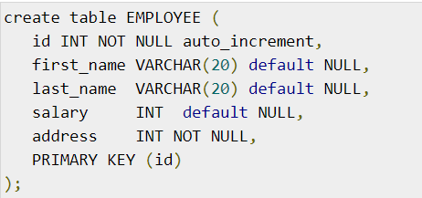
Many to One Relationship

Slide 19
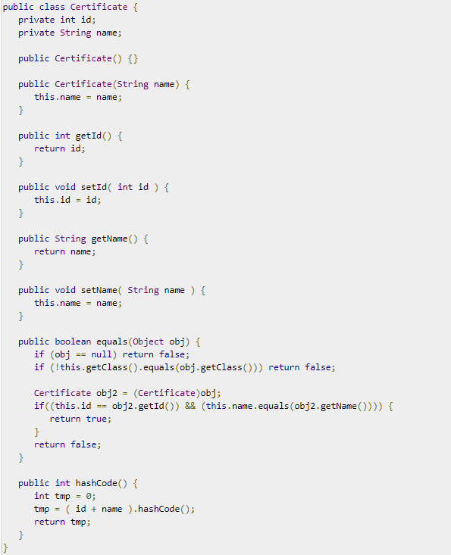
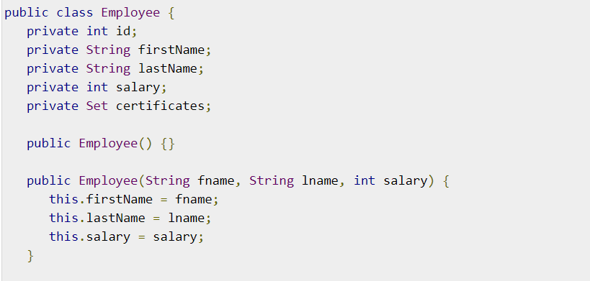
Many to Many Relationship

Slide 20
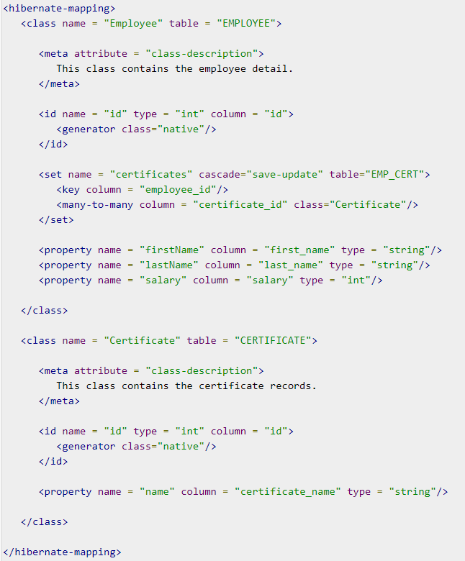
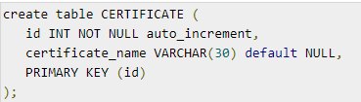
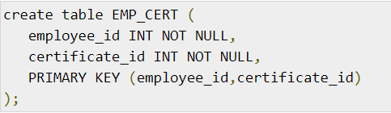
Many to Manny XML

Slide 21
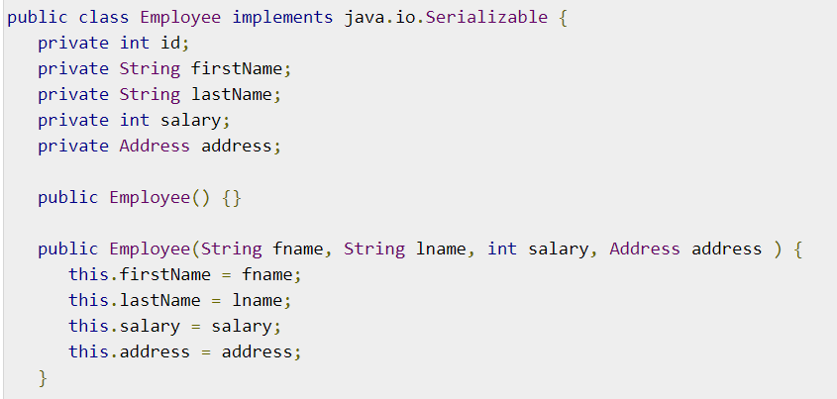
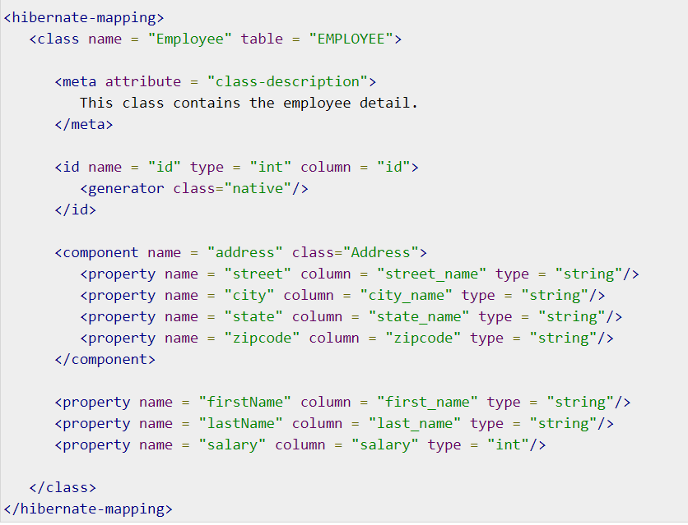
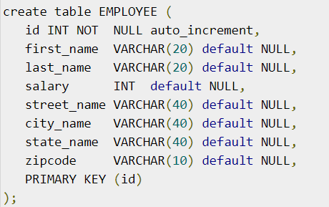
Component mapping

Slide 22
Final Notes for XML
Save file as <classname>.hbm.xml
Same directory as Configuration file
Generate XML with XDoclet, Middlegen and AndroMDA

Slide 23
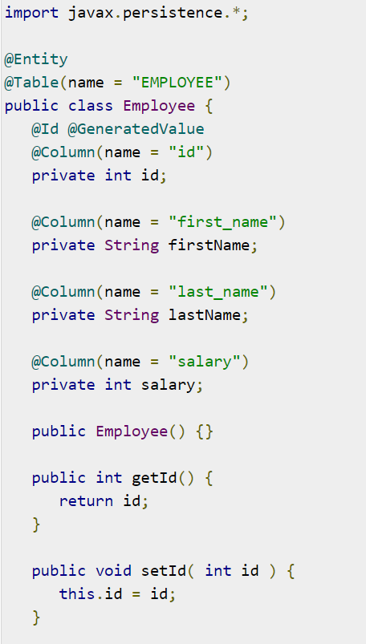

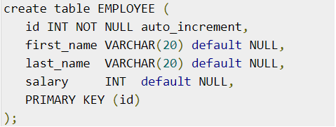
Annotation
Main Goal
No XML required
Cons
Less Flexibility

Slide 24
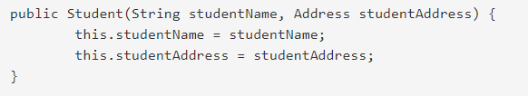
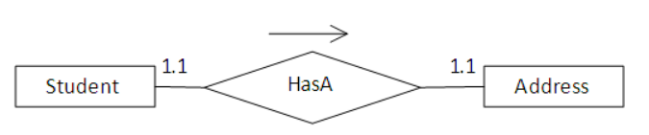
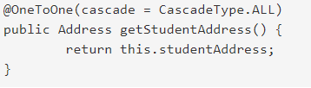
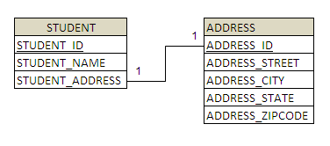
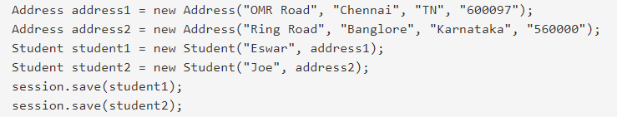
One-One ( Example)

Slide 25
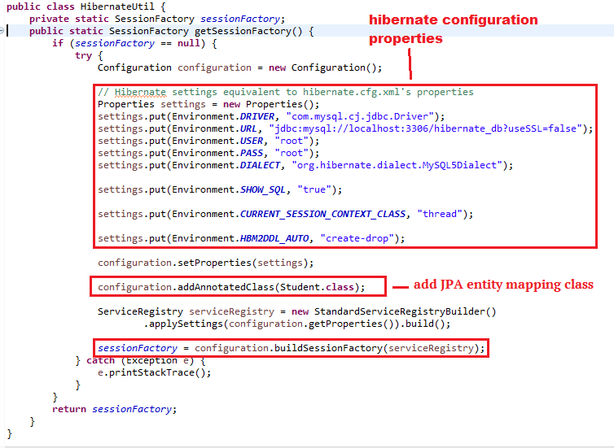
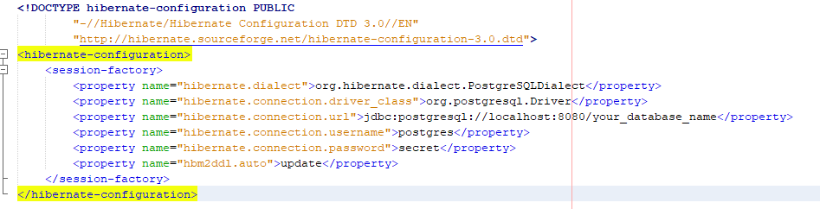
Configuration object
Usually the first hibernate object you create in the Hibernate application.
Created only once.
Contains configuration or properties file required by Hibernate.
Has 2 key components: (Kahoot)
Database connection (Explain)
Class Mapping Setup (Explain)

Slide 26
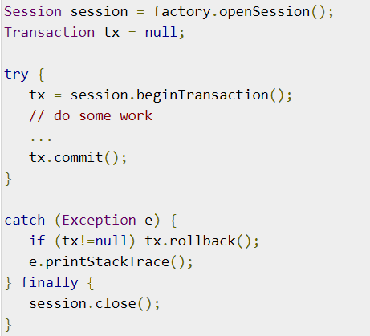
Session
Used to connect to the database
Main Session methods:
beginTransaction()
save(Object object)
get()
update()
delete()
close()

Slide 27
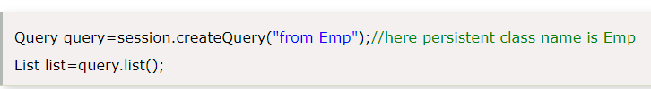
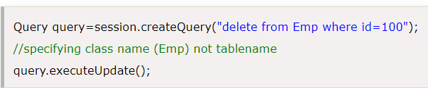
HQL - Query
Advantages:
database independent (explain)
supports polymorphic queries (explain)
Fast learning curve (explain)

Slide 28
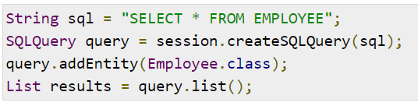
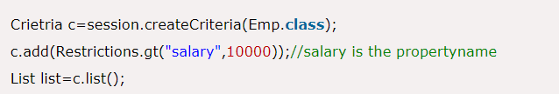
SQL Query & Criteria Query
You can use native SQL querying with Hibernate (Create, Update, Delete and Fetch)
The Hibernate Criteria Query Language (HCQL) is used to fetch the records based on the specific criteria. PROS: The HCQL provides methods to add criteria.

Slide 29
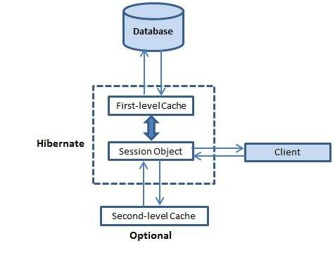
Cache
Caching used to improve performance. (Explain the figure)
Concurrency Strategies (Explain):
Transactional (Explain)
Read-write (Explain)
Nonstrict-read-write (Explain)
Read-only (Explain)

Slide 30
Thank you for your attention!

