Slide 1

Welcome to the Kafka workshop
Workshop by Bader Ammoun and Ian Sultanis

Slide 2
Workshop planning
Theory Session
Theory about Kafka
Practical and demo session
Set up the Development Environment
Some theory about Kafka API
Exercise
Show the solution

Slide 3
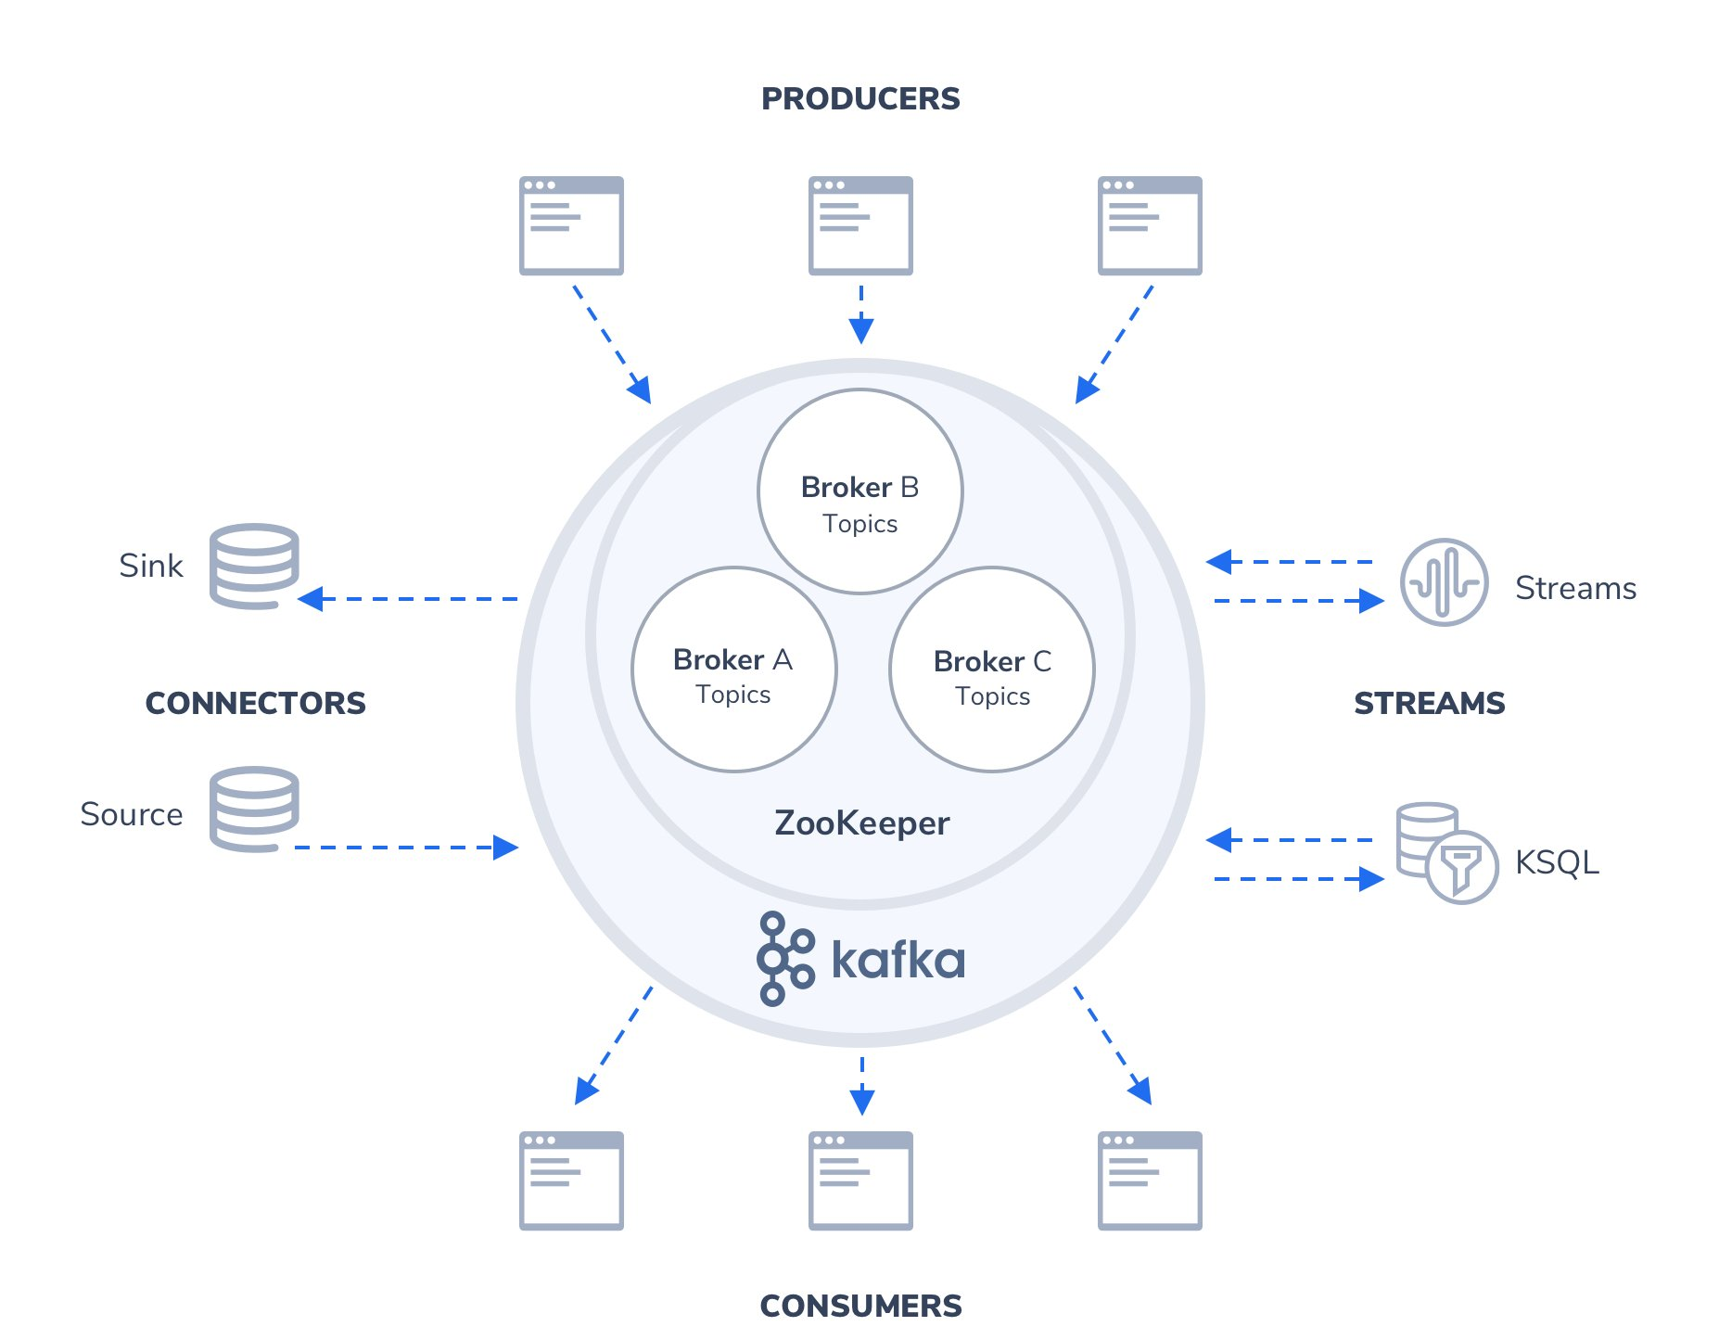
What is Kafka
Distributed streaming platform

Slide 4
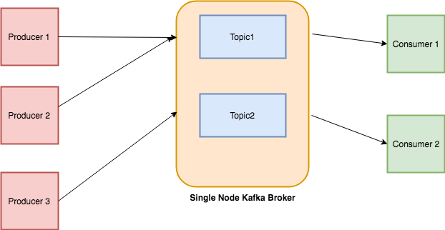
Core Concept
Producer
Consumer
Broker
Cluster
Topic
Partitions
Offset
Consumer groups

Slide 5
What is a Producer
An Application/ part of an application that send messages to the Kafka server.

Slide 6
What is the message
For us it could be any meaningful schema.
But for kafka it is a pure sequence of bytes.

Slide 7
Message Example
ID | Customer Name | Customer Address
1 | Customer 1 | Address 1
2 | Customer 2 | Address 2
3 | Customer 3 | Address 3
Message 1
Message 2
Message 3

Slide 8
Consumer
An Application that reads messages from the Kafka server
Producer 1
Kafka server
Consumer 1
Producer 2
Consumer 2

Slide 9
Broker
Kafka server
Producer 1
Kafka server
(Broker)
Consumer 1
Producer 2
Consumer 2

Slide 10
Cluster
A Group of brokers that work together for a common purpose
Producer 1
Consumer 1
Broker 1
Broker 2
Broker 3
Producer 2
Broker 4
Consumer 2

Slide 11


Topic
I’m collecting data from different producers which data do you want?
Can you give me the data
Consumer
Broker

Slide 12
Topic
Ab produces different type of records which one do you want ?
I want the data from producer Ab
Consumer
Broker

Slide 13
Topic
Okay, you want marketing data from producer ab. But there are two other producers producing marketing data
Give me marketing data
Consumer
Broker

Slide 14
Topic
Is an unique name for a Kafka stream
Producer 1
Consumer 1
Sales Topic
Producer 2
Producer 3
Marketing topic
Consumer 2

Slide 15
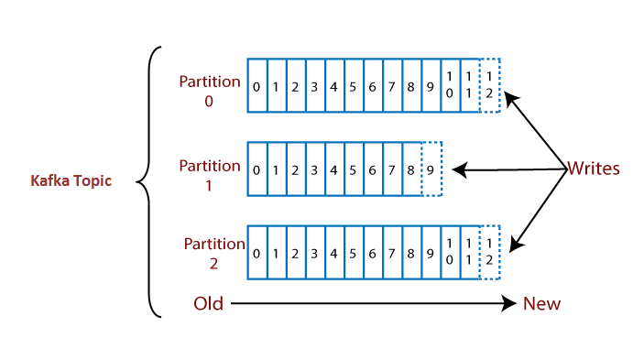
What is Partition

Slide 16
What is offset ?
A Sequence id given to messages as they arrive in a partition.
A Partition
M1
M2
M3
M4
M5
M6
0
1
2
3
4
5
Message writes
Offset

Slide 17
Global Unique identifier of a message
Topic Name Partition Number Offset

Slide 18

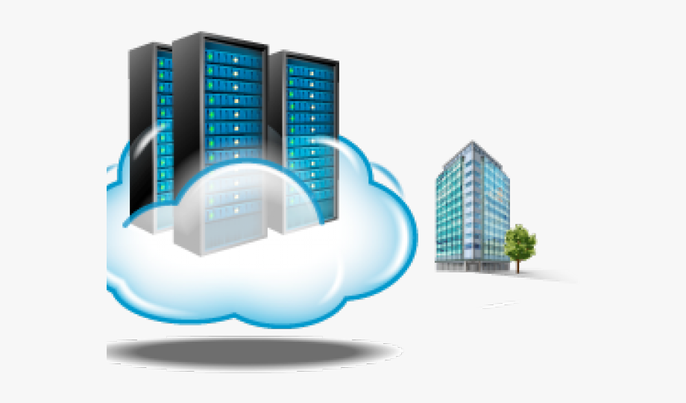
Group of Consumers
Retail Organization
Data Center

Slide 19

Retail Organization
Producer 1
Data Center
Producer 2
CONSUMER
Producer 3
Producer 4

Slide 20
Retail Organization
CLUSTER
Preducer 1
Data Center
Broker1
Preducer 2
Broker 2
CONSUMER
Preducer 3
Broker3
Preducer 4
ZooKeeper

Slide 21
Consumer Group
Retail Organization
CLUSTER
Preducer 1
CONSUMER
Data Center
Broker1
CONSUMER
Preducer 2
Broker 2
CONSUMER
Preducer 3
Broker3
CONSUMER
Preducer 4
ZooKeeper

Slide 22
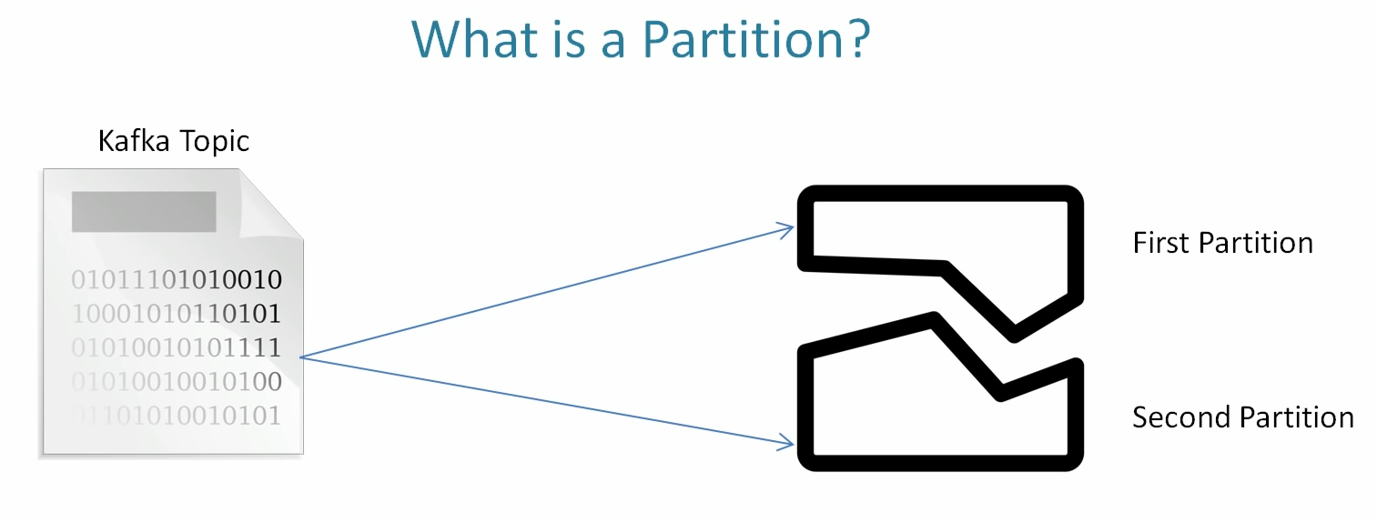
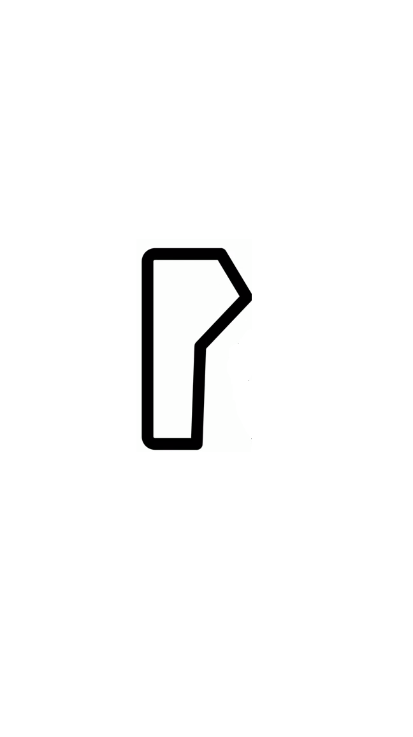


Fault Tolerance
p1
p2
p3
p4
P5
p6

Slide 23
What is the fault tolerance?
Enabling the system to continue work properly even
in the event of failure of some of its components

Slide 24
One Sample Solution
p1
p2
p6
p3
p4
P5
p3
p4
p4

Slide 25
What is Replication Factor?
The number of replication copies
p1
p1
p1

Slide 26
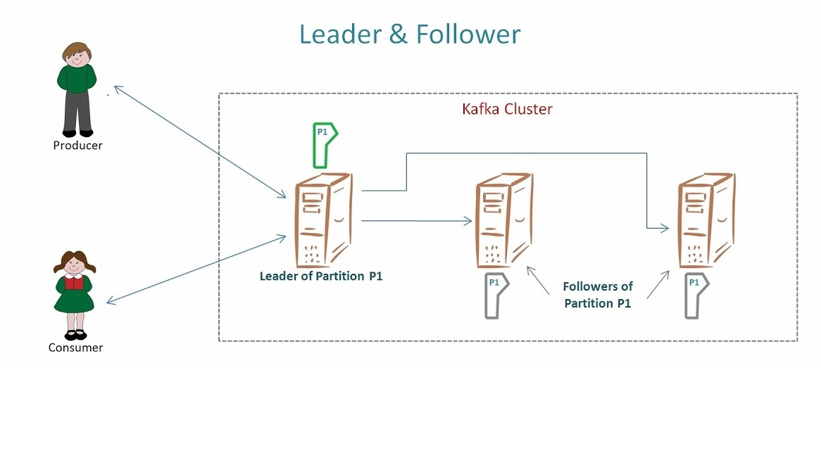
How does it work?

Slide 27
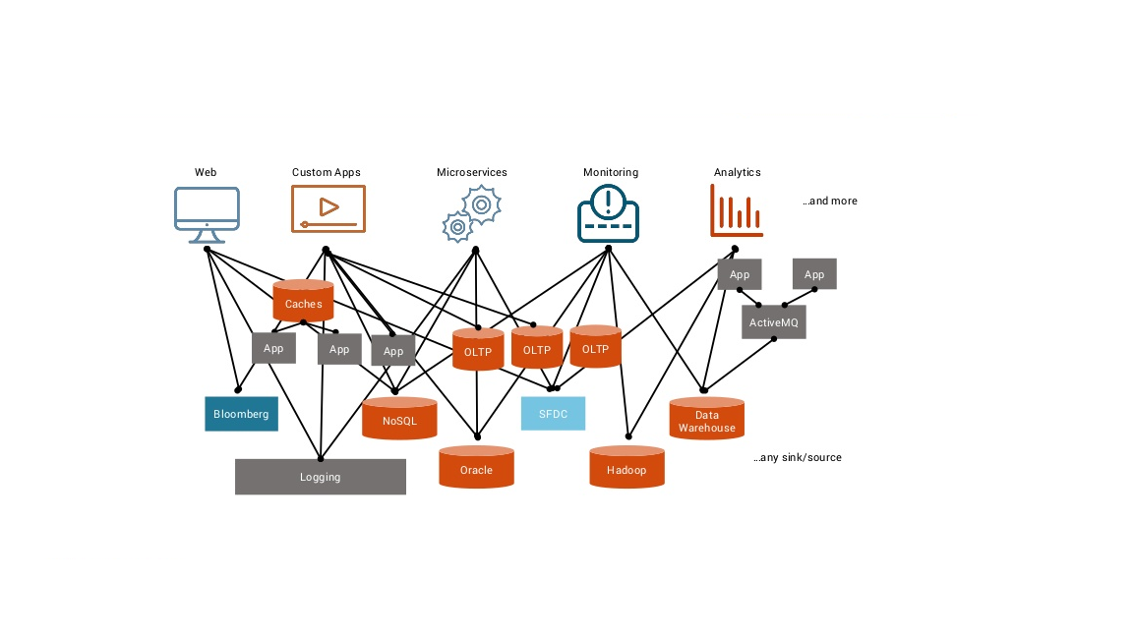
Streaming system without using Kafka

Slide 28
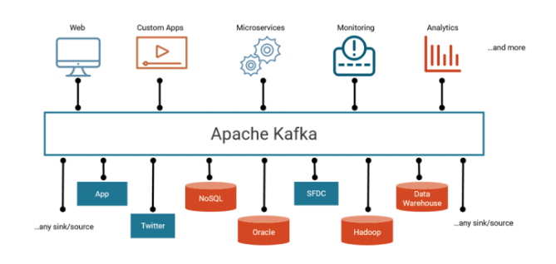
when kafka is used

Slide 29
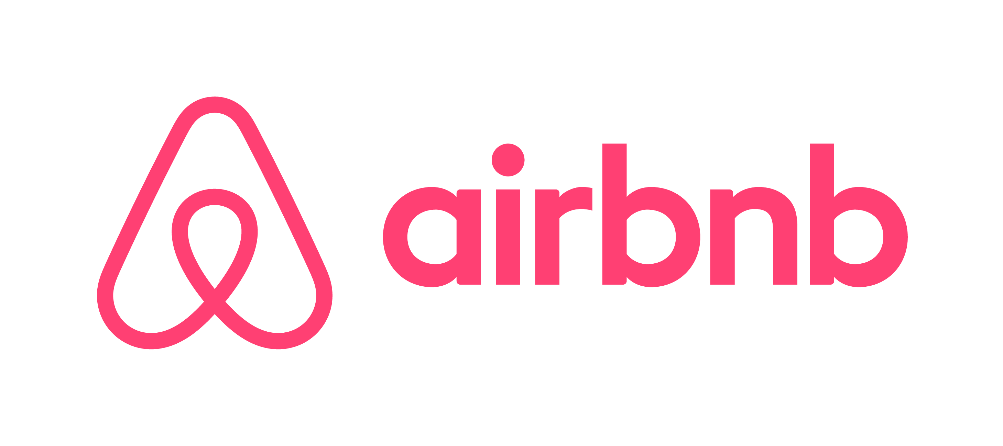

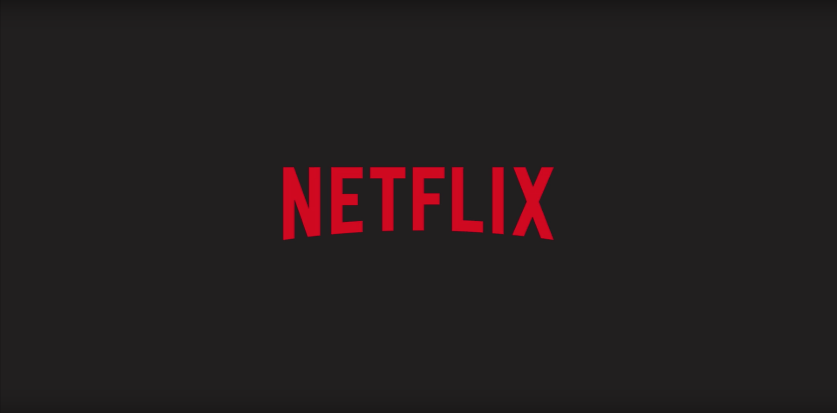
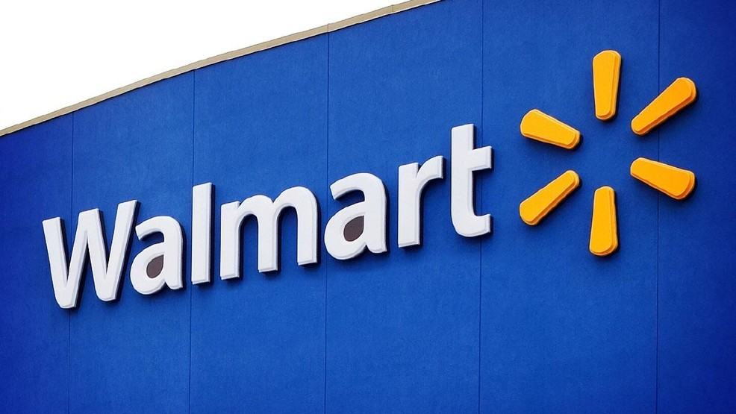
who is using kafka
Distributed, resilient architecture ,fault tolerant
Horizonal scalability:
Can scale to 100s of brokers
Can scale to million of messages pre second
High performance (latency of less than 10ms)-real time

Slide 30
Apache Kafka library
Producer/Consumer config.
Polling the consumer.
Record -> Key, value, topic.

Slide 31
Spring Kafka library
Producer/Consumer config.
Autowiring the KafkaTemplate to use as a producer.
Creating a KafkaListener method for the consumer.
Record -> Value, topic. The key is handled by Spring itself.

Slide 32
Practical session
Setup the development environment
Follow the installation instructions on the README file in the repository
Choose the assignment you are more interested in, so using either the Apache Kafka library or using Spring Kafka.
Don’t be afraid to ask for help if you are stuck!

