Slide 1


Slide 2
Table of content
What is Oauth2
Differences Oauth1 and Oauth2
Oauth2 Roles
Protocol types
Protocol flows
Token
Demo Registration
Workshop Client
Workshop Server

Slide 3

What is Oauth2
Authorization framework
HTTP service
All applications

Slide 4
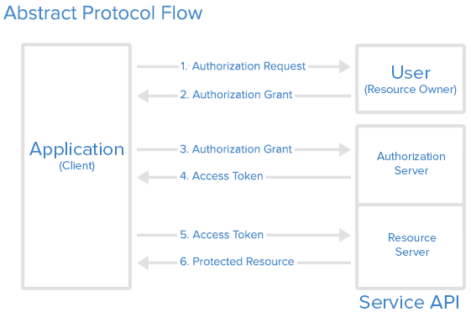
Abstract protocol flow

Slide 5
Differences Oauth1 and Oauth2
Security
Token life span
Flows
Roles

Slide 6
Oauth2 roles
Resource owner
Resource server
Client Application
Authorization Server
User Agent

Slide 7
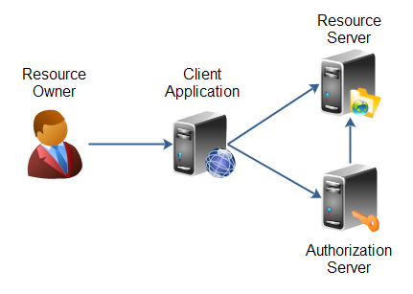
OAuth2 roles/structure
Resource owner(User)
Resource/Authorization Server: API
Client: Application

Slide 8

Authorization grant
Authorization code
Implicit
Resource Owner Password Credentials
Client credentials
Refresh token

Slide 9
Grant type: authorization code
Most common
Used for server side applications
5 steps
  Authorization code link
  User Authorizes application
  Application receives authorization code
  Application requests access token
  Application receives access token

Slide 10
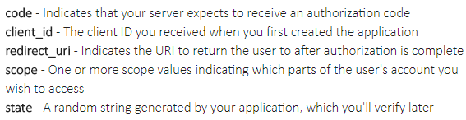
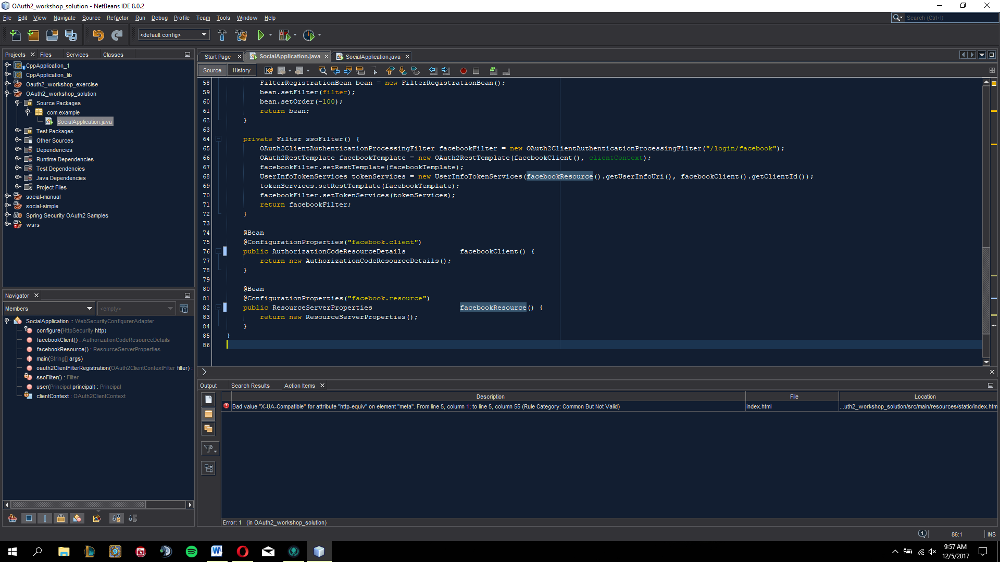
Grant type: authorization code
Link components

Slide 11
Implicit grant
Used for mobile/web applications
Running resource in browser
Simplicity

Slide 12
Grant type: Resource owner password credentials
Username and password
Only on authorization server
Depending on trust

Slide 13
Grant type: Client credentials
Own service accounts
Updating registered description
Access other data

Slide 14

Refreshing your token

Slide 15
Token
Request:
client_id =CLIENT_ID
client_secret =CLIENT_SECRET
grant_type =authorization_code
Code =AUTHORIZATION_CODE
redirect_uri =CALLBACK_URL
Receive:
access_token:"ACCESS_TOKEN“
token_type":"bearer“
expires_in":2592000
refresh_token":"REFRESH_TOKEN“
scope":"read“
uid":100101
info":{"name":"Mark E. Mark","email":"mark@thefunkybunch.com"}}

Slide 16
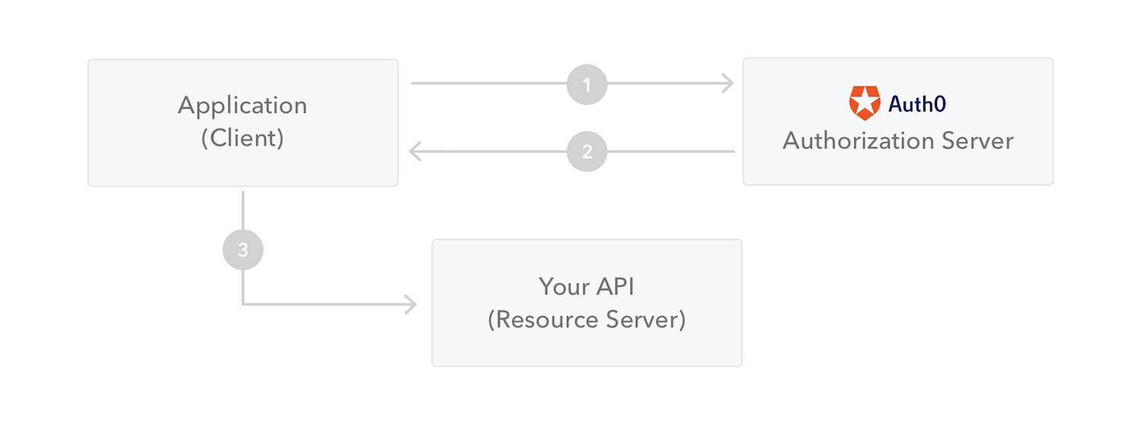
Client Credentials Grant

Slide 17
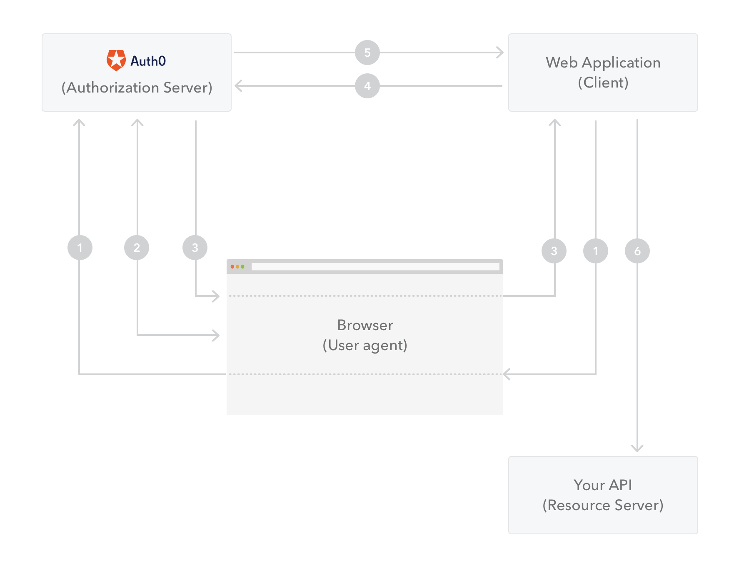
Authorization Code Grant

Slide 18
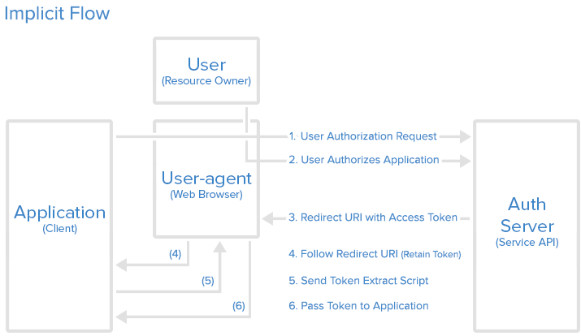
Implicit grant

Slide 19
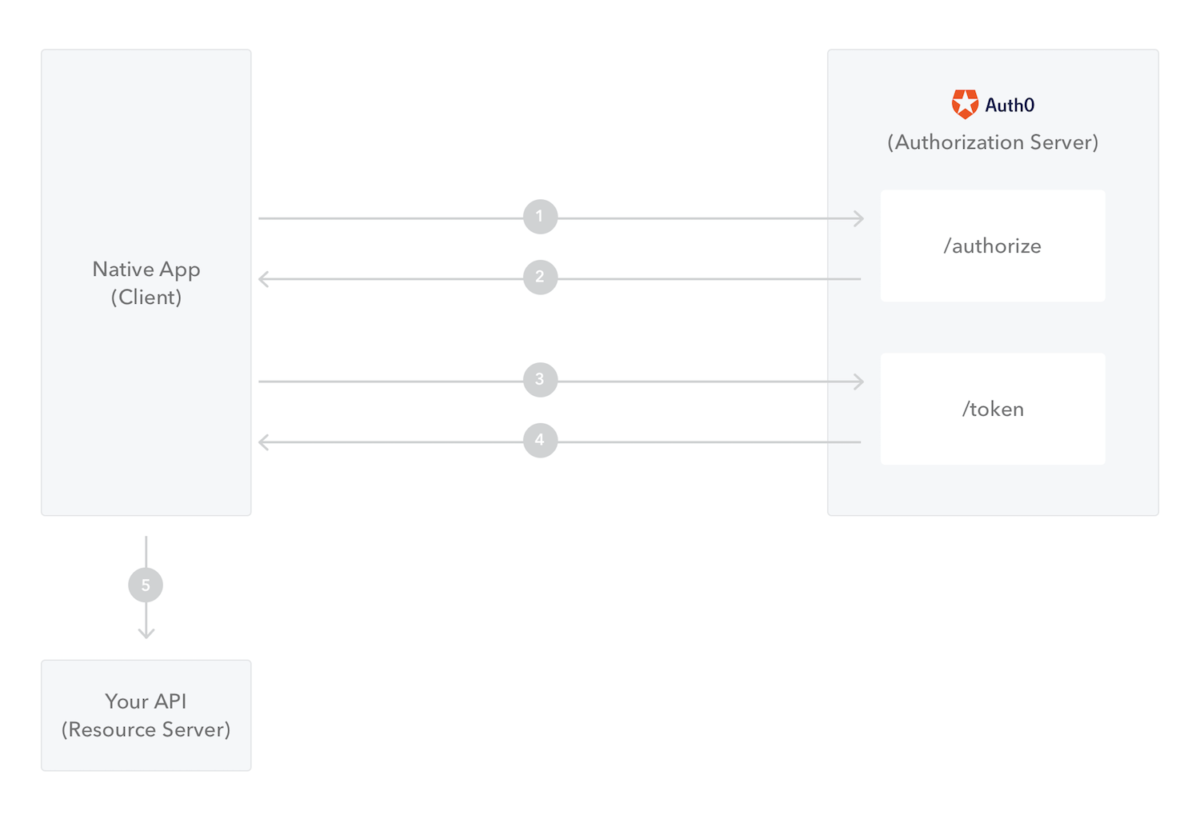
Authorization Code Grant (PKCE)

Slide 20
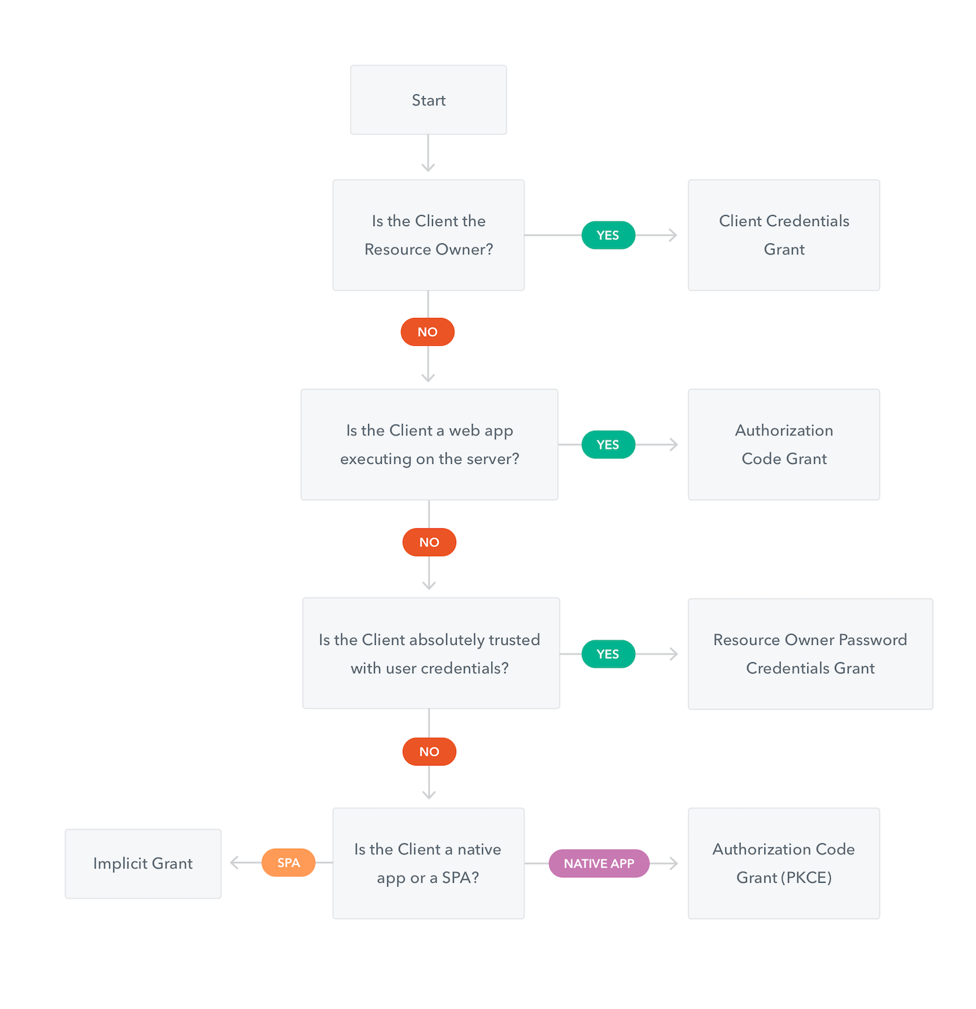

Slide 21
Workshop registration

Slide 22
Workshop client

Slide 23
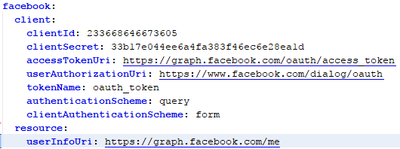
Workshop Client

Slide 24
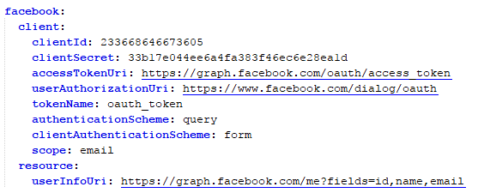
Workshop client

