Slide 1

ESD2019 – Eric Syberg

Slide 2
Before we Start
Download the Repository:
https://github.com/sebivenlo/PostgREST2019
Notes:
Standalone webserver that turns a PostgreSQL database into a RESTfull API

Slide 3


Before we Start
GitBash or Cygwin
Notes:
Standalone webserver that turns a PostgreSQL database into a RESTfull API

Slide 4


Before we Start
X
Notes:
Standalone webserver that turns a PostgreSQL database into a RESTfull API

Slide 5
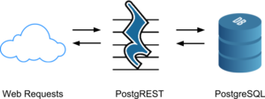
What is PostgREST?
Notes:
Standalone webserver that turns a PostgreSQL database into a RESTfull API

Slide 6
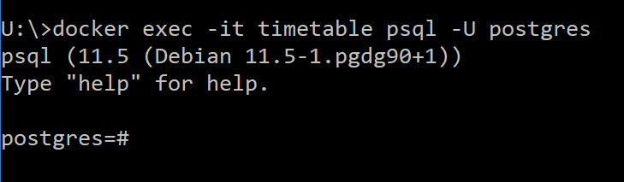
Creating a Database
Commands/01_Creating_A_Database > Step 1
Notes:
Standalone webserver that turns a PostgreSQL database into a RESTfull API

Slide 7
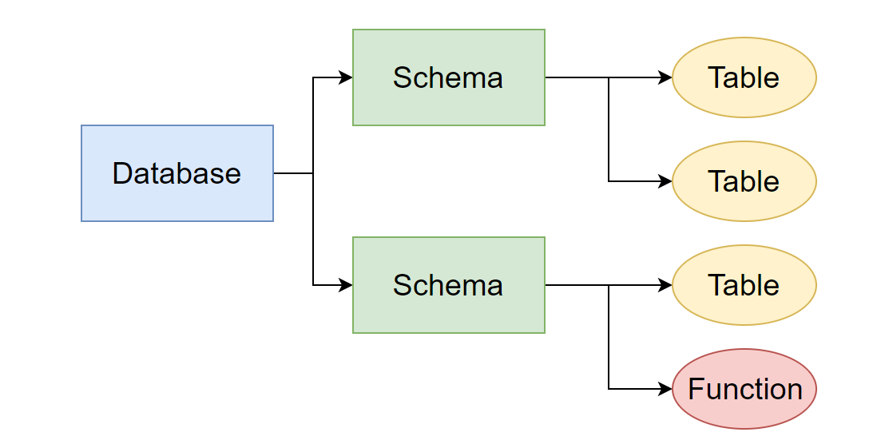

Creating a Database
Commands/01_Creating_A_Database > Step 2
Notes:
A database can contain one or multiple schemas which in turn can hold multiple tables. A user can be access these schemas and their content if he has access

Slide 8
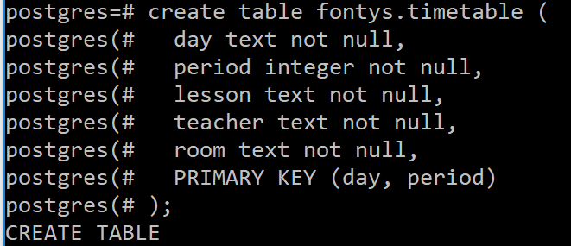
Creating a Database
Commands/01_Creating_A_Database > Step 3
Notes:
A database can contain one or multiple schemas which in turn can hold multiple tables. A user can be access these schemas and their content if he has access

Slide 9
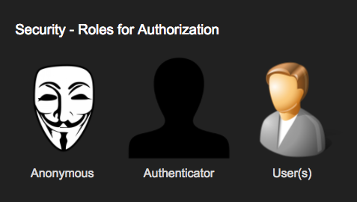
Authentication
Notes:
There are 3 Roles used by postgrest Anonymous: A user with no or invalid login User: A user with a role configured in the DB and valid login Authenticator: A role used by the server before authentication. Afterwards he becomes either a user or anonymous

Slide 10
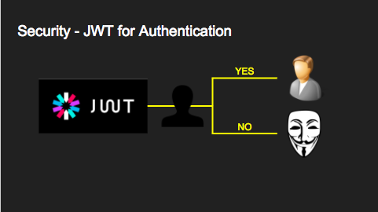
Authentication
Notes:
To allow the authenticator to switch to a role it needs to be configured by the datbase administrator

Slide 11
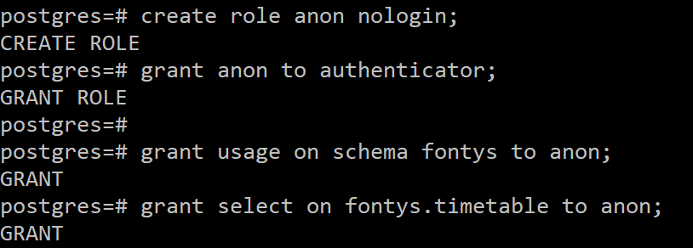
Authentication
Commands/02_Creating_Users > Step 1
Commands/02_Creating_Users > Step 2
Notes:
To allow the authenticator to switch to a role it needs to be configured by the datbase administrator

Slide 12
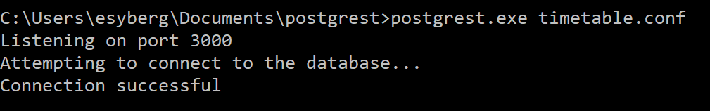
Run PostgREST
Commands/03_Creating_Users > Step 1
Open a new CMD window and start the postgrest.exe with the config
Try it out by connecting to http://localhost:3000/timetable
(Linux users write postgrest timetable.conf)
Notes:
To allow the authenticator to switch to a role it needs to be configured by the datbase administrator

Slide 13
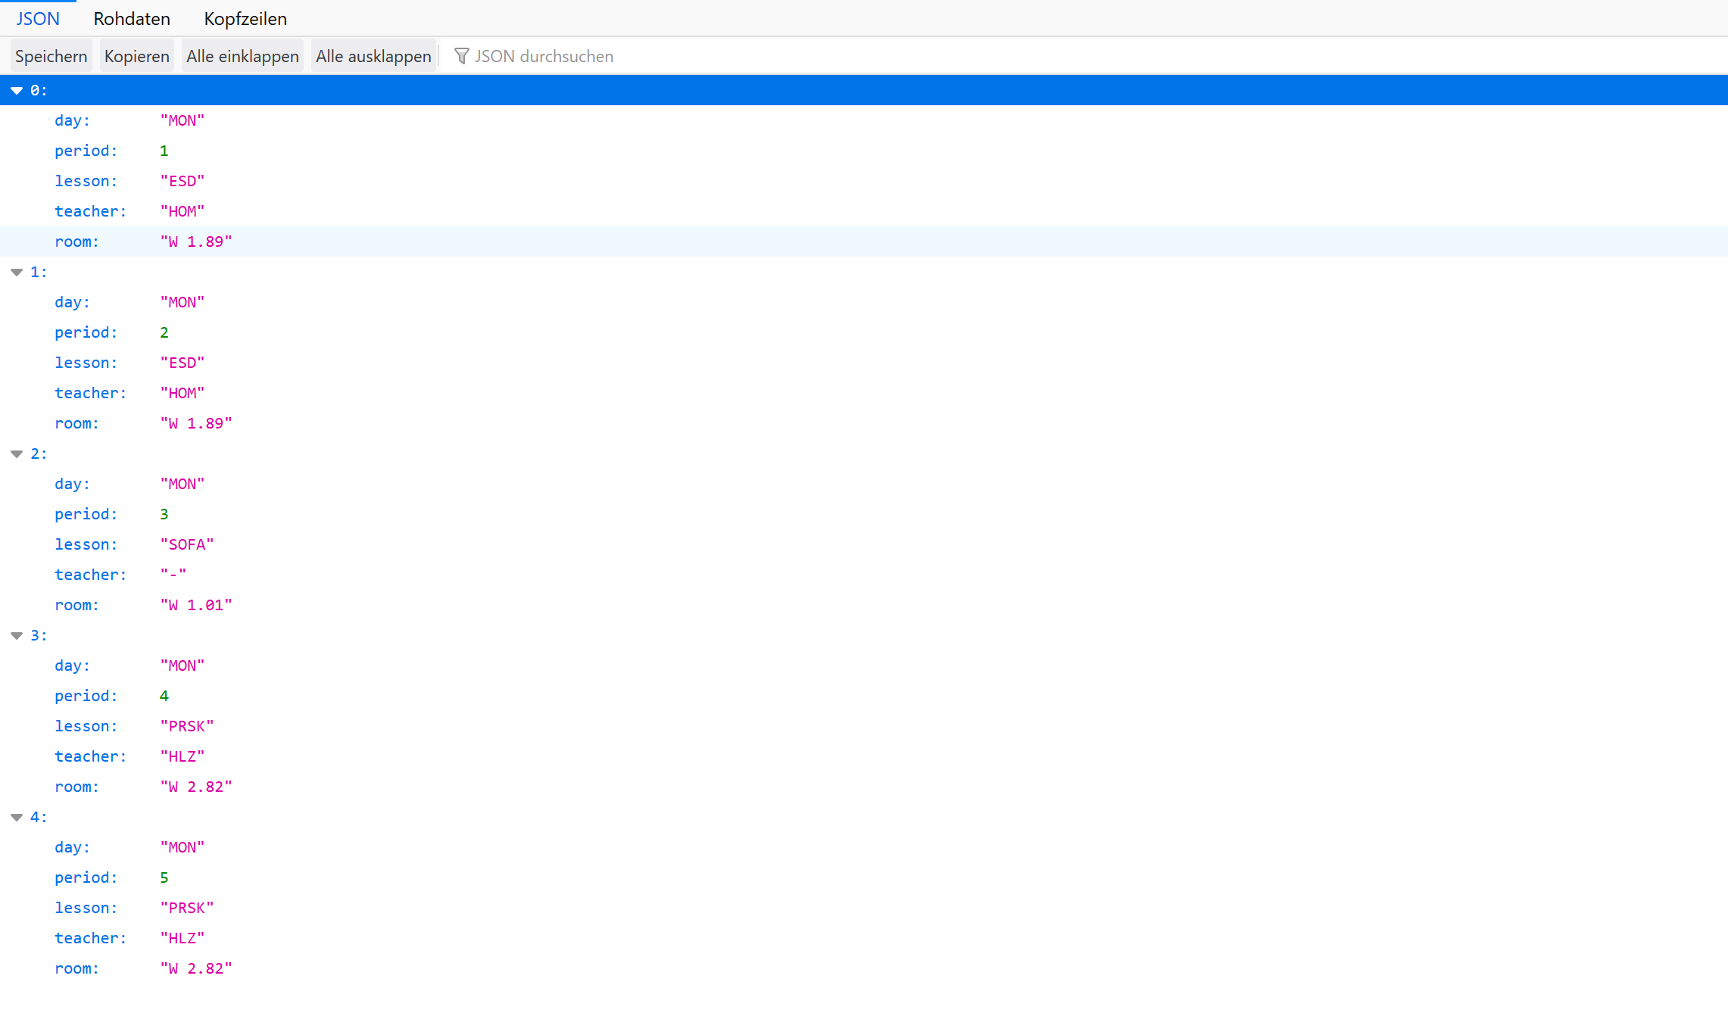
We have data
Notes:
To allow the authenticator to switch to a role it needs to be configured by the datbase administrator

Slide 14
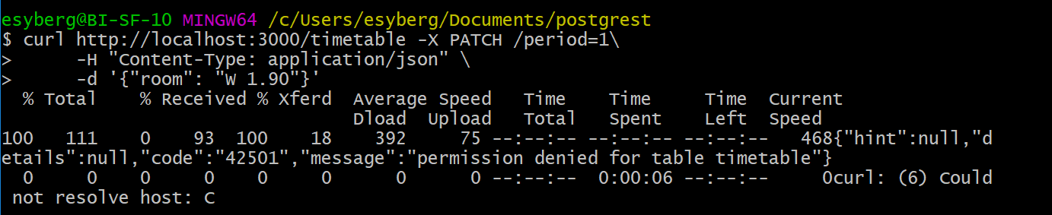
Now try changing something
Commands/04_Changes > Step 1
What went wrong?
Notes:
To allow the authenticator to switch to a role it needs to be configured by the datbase administrator

Slide 15
Permission Denied
Notes:
To allow the authenticator to switch to a role it needs to be configured by the datbase administrator

Slide 16
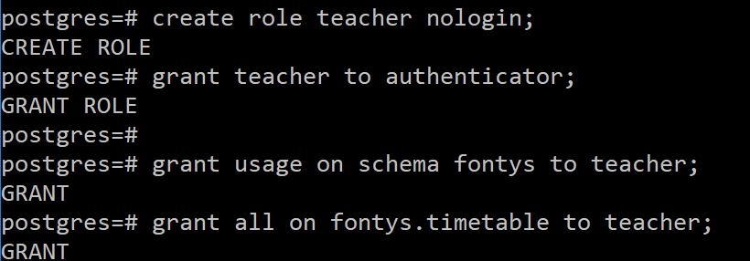
Lets make a new user
Commands/04_Changes > Step 2
Notes:
To allow the authenticator to switch to a role it needs to be configured by the datbase administrator

Slide 17
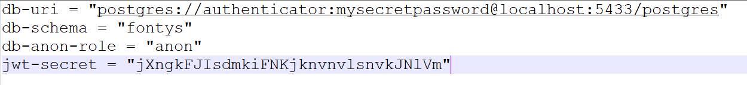
Now we need a Webtoken
Think of a 32 char password for example = jXngkFJIsdmkiFNKjknvnvlsnvkJNlVm
Now add jwt-secret = “<password>” to your timetable.conf
Restart postrgrest afterwards!
Notes:
To allow the authenticator to switch to a role it needs to be configured by the datbase administrator

Slide 18
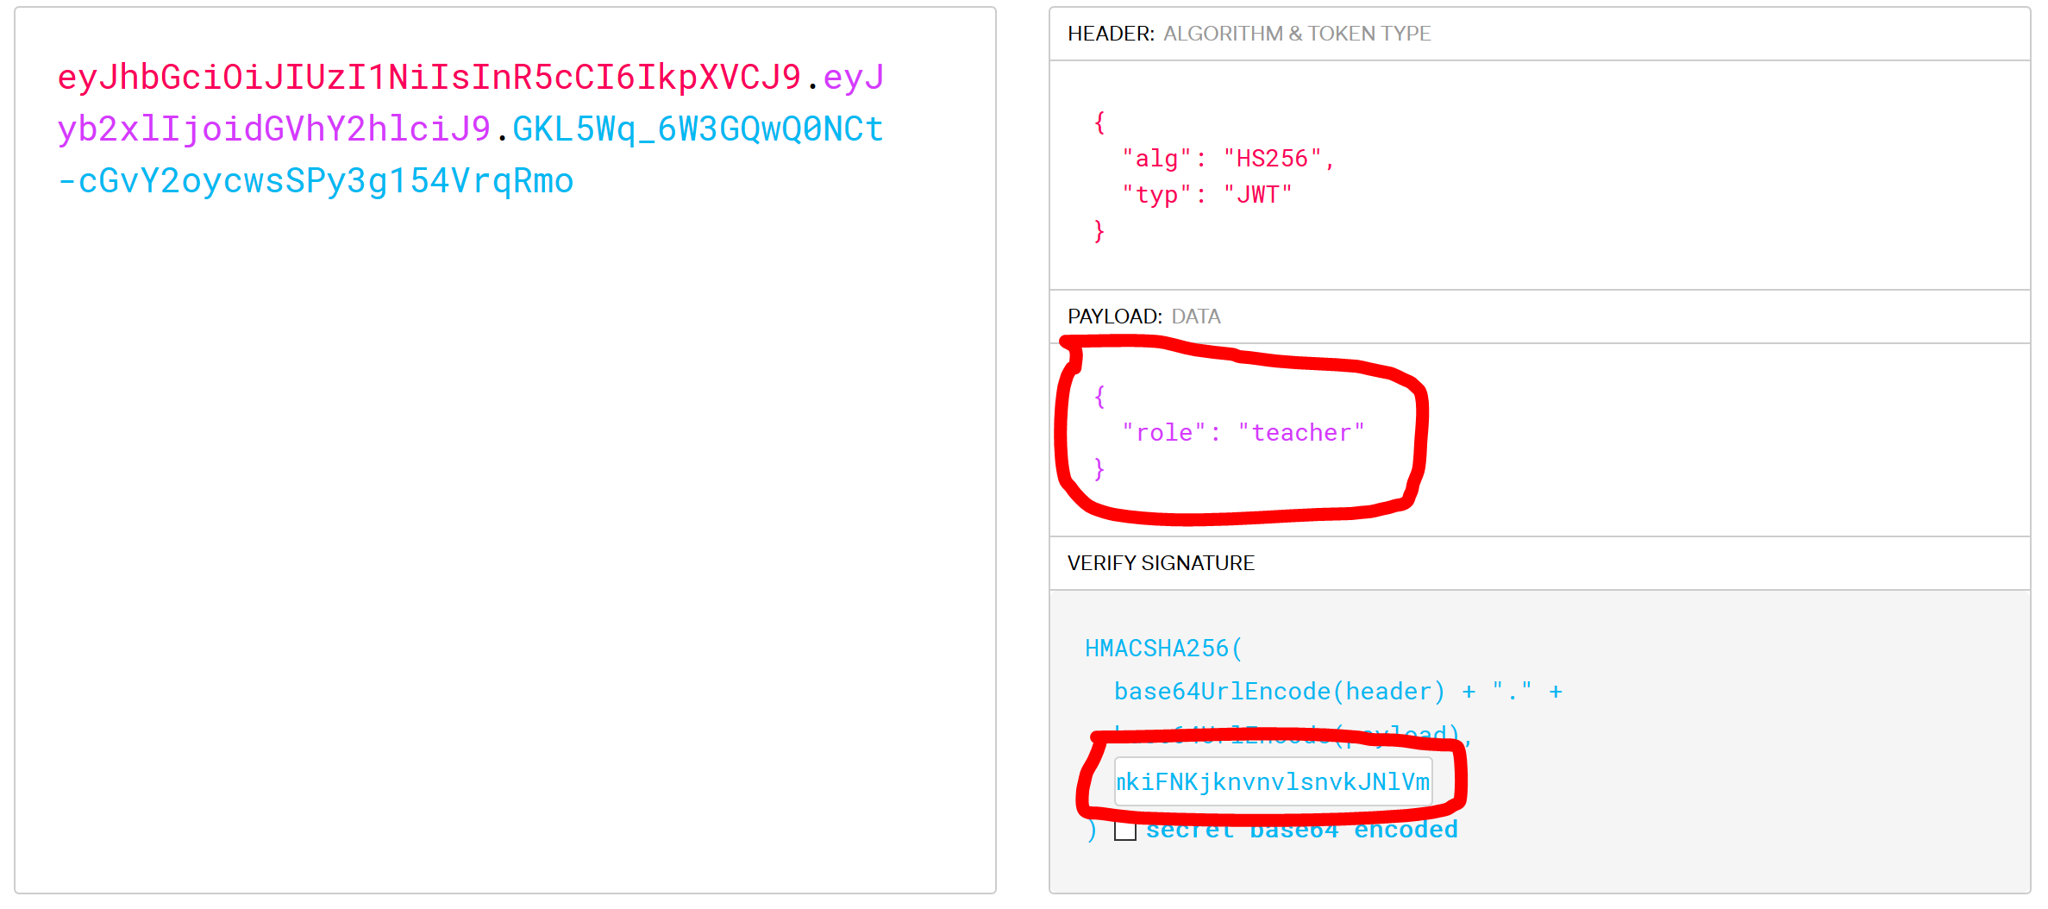
Generating a Webtoken
Open your browser and go to https://jwt.io/
Notes:
To allow the authenticator to switch to a role it needs to be configured by the datbase administrator

Slide 19
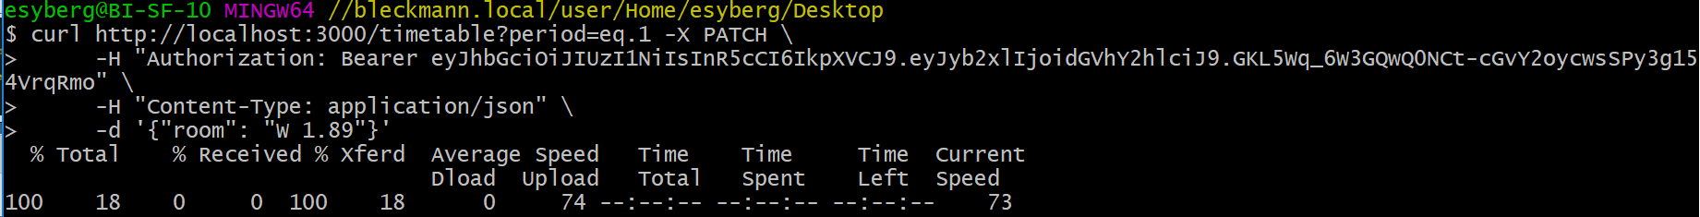
Now try changing something
Commands/04_Changes > Step 3
No errors this time!
Notes:
To allow the authenticator to switch to a role it needs to be configured by the datbase administrator

Slide 20
But now its not ordered anymore!
The postgREST API allows for table manipulation via the URL For example the ?period=eq.1 to look for the period that is 1 Try entering http://localhost:3000/timetable?order=period.asc
Notes:
To allow the authenticator to switch to a role it needs to be configured by the datbase administrator

Slide 21
Conclusion
Pros:
- Fast to develop
- Completely based on the data in the database
- No need to duplicate database structures in code
- No extra CRUD code or authentication needed
Cons:
- Only works with PostgrSQL
- It does one thing well but only that

