Slide 1

ESD2019 – Eric Syberg

Slide 2
Before we Start
Download the Repository:
https://github.com/sebivenlo/PostgREST2019
Notes:
Standalone webserver that turns a PostgreSQL database into a RESTfull API

Slide 3


Before we Start
GitBash or Cygwin
Notes:
Standalone webserver that turns a PostgreSQL database into a RESTfull API

Slide 4


Before we Start
X
Notes:
Standalone webserver that turns a PostgreSQL database into a RESTfull API

Slide 5
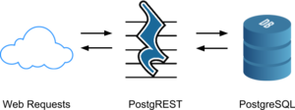
What is PostgREST?
Notes:
Standalone webserver that turns a PostgreSQL database into a RESTfull API

Slide 6
What is PostgREST?
Motivation:
- Alternative to CRUD programming
- Easier to let the database handle data access
- Creation of an API from scratch without programming
Notes:
Standalone webserver that turns a PostgreSQL database into a RESTfull API

Slide 7
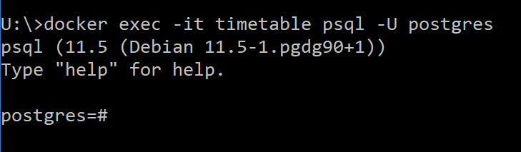
Creating a Database
Commands/01_Creating_A_Database > Step 1
Notes:
Standalone webserver that turns a PostgreSQL database into a RESTfull API

Slide 8
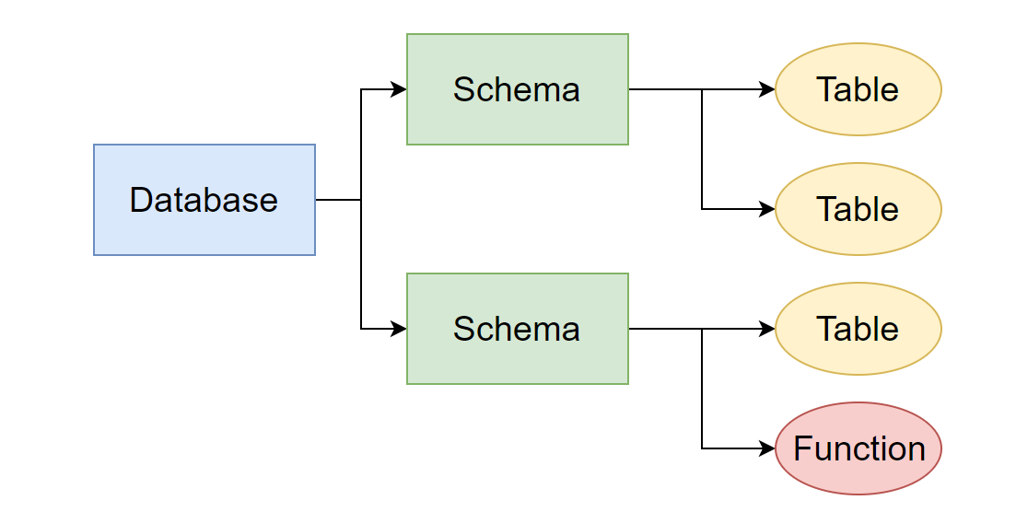

Creating a Database
Commands/01_Creating_A_Database > Step 2
Notes:
A database can contain one or multiple schemas which in turn can hold multiple tables. A user can be access these schemas and their content if he has access

Slide 9
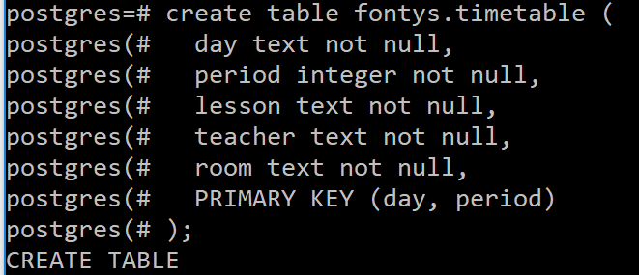
Creating a Database
Commands/01_Creating_A_Database > Step 3
Notes:
A database can contain one or multiple schemas which in turn can hold multiple tables. A user can be access these schemas and their content if he has access

Slide 10
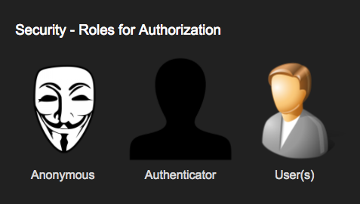
Authentication
Notes:
There are 3 Roles used by postgrest Anonymous: A user with no or invalid login User: A user with a role configured in the DB and valid login Authenticator: A role used by the server before authentication. Afterwards he becomes either a user or anonymous

Slide 11
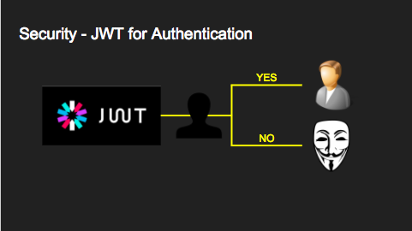
Authentication
Notes:
To allow the authenticator to switch to a role it needs to be configured by the datbase administrator

Slide 12
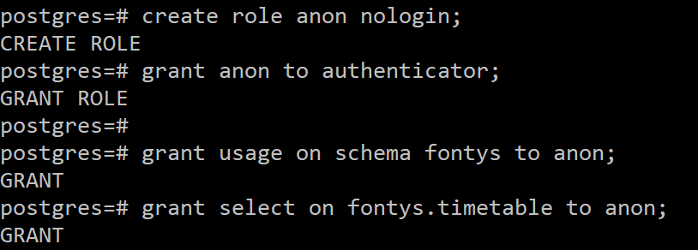
Authentication
Commands/02_Creating_Users > Step 1
Commands/02_Creating_Users > Step 2
Notes:
To allow the authenticator to switch to a role it needs to be configured by the datbase administrator

Slide 13
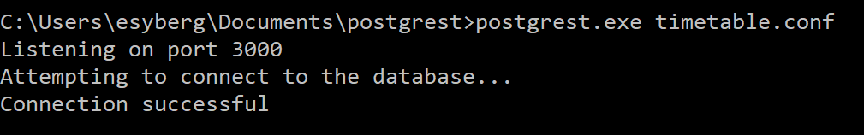
Run PostgREST
Commands/03_Creating_Users > Step 1
Open a new CMD window and start the postgrest.exe with the config
Try it out by connecting to http://localhost:3000/timetable
(Linux users write postgrest timetable.conf)
Notes:
To allow the authenticator to switch to a role it needs to be configured by the datbase administrator

Slide 14
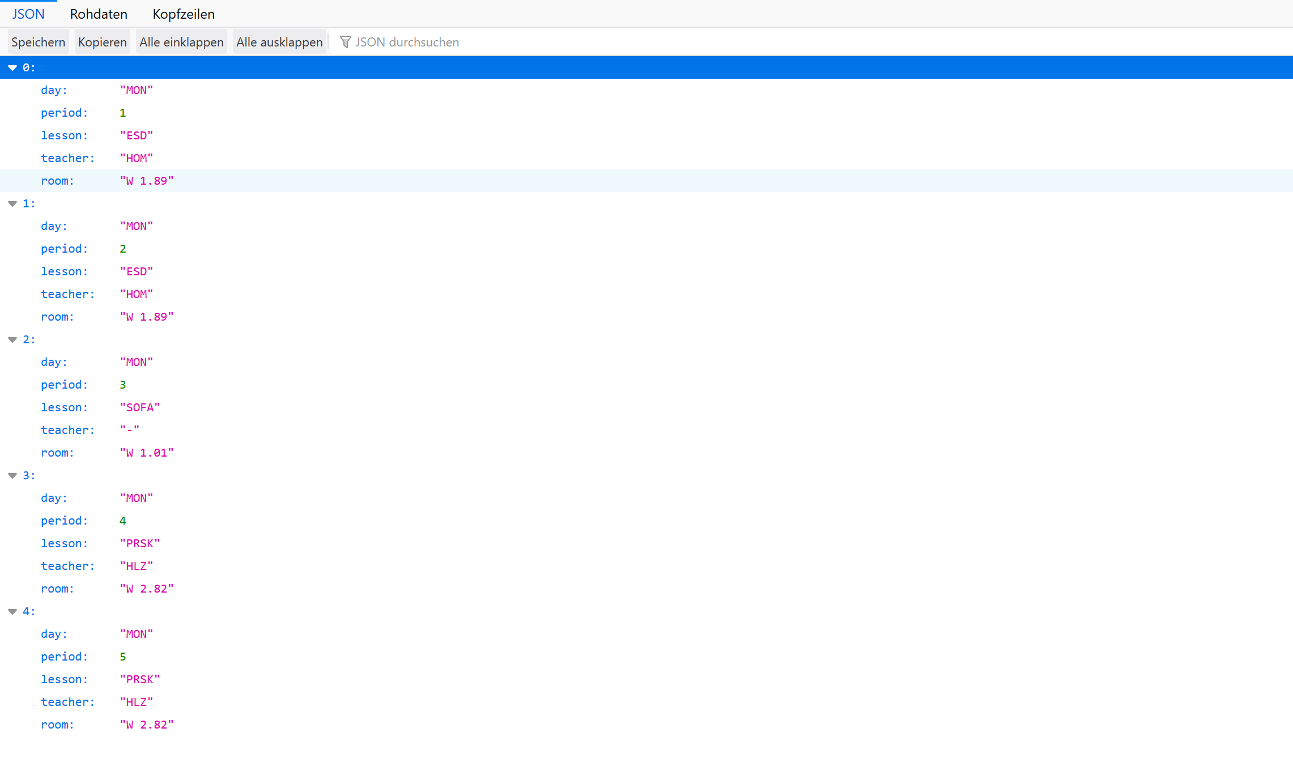
We have data
Notes:
To allow the authenticator to switch to a role it needs to be configured by the datbase administrator

Slide 15
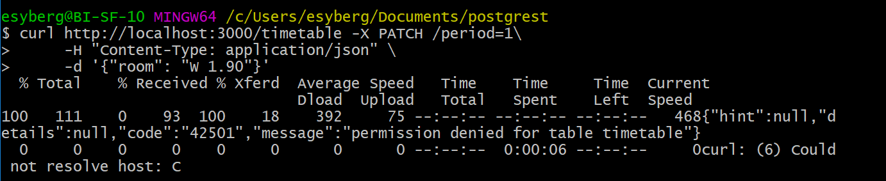
Now try changing something
Commands/04_Changes > Step 1
What went wrong?
Notes:
To allow the authenticator to switch to a role it needs to be configured by the datbase administrator

Slide 16
Permission Denied
Notes:
To allow the authenticator to switch to a role it needs to be configured by the datbase administrator

Slide 17
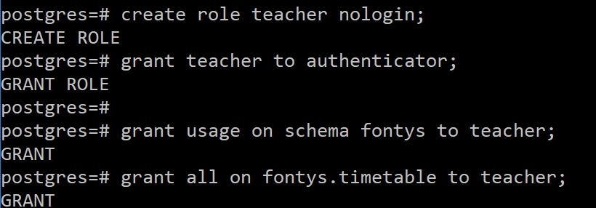
Lets make a new user
Commands/04_Changes > Step 2
Notes:
To allow the authenticator to switch to a role it needs to be configured by the datbase administrator

Slide 18
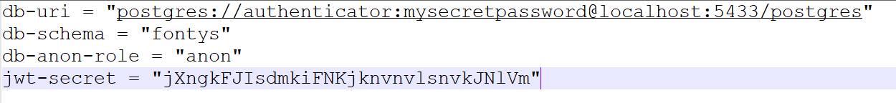
Now we need a Webtoken
Think of a 32 char password for example = jXngkFJIsdmkiFNKjknvnvlsnvkJNlVm
Now add jwt-secret = “<password>” to your timetable.conf
Restart postrgrest afterwards!
Notes:
To allow the authenticator to switch to a role it needs to be configured by the datbase administrator

Slide 19
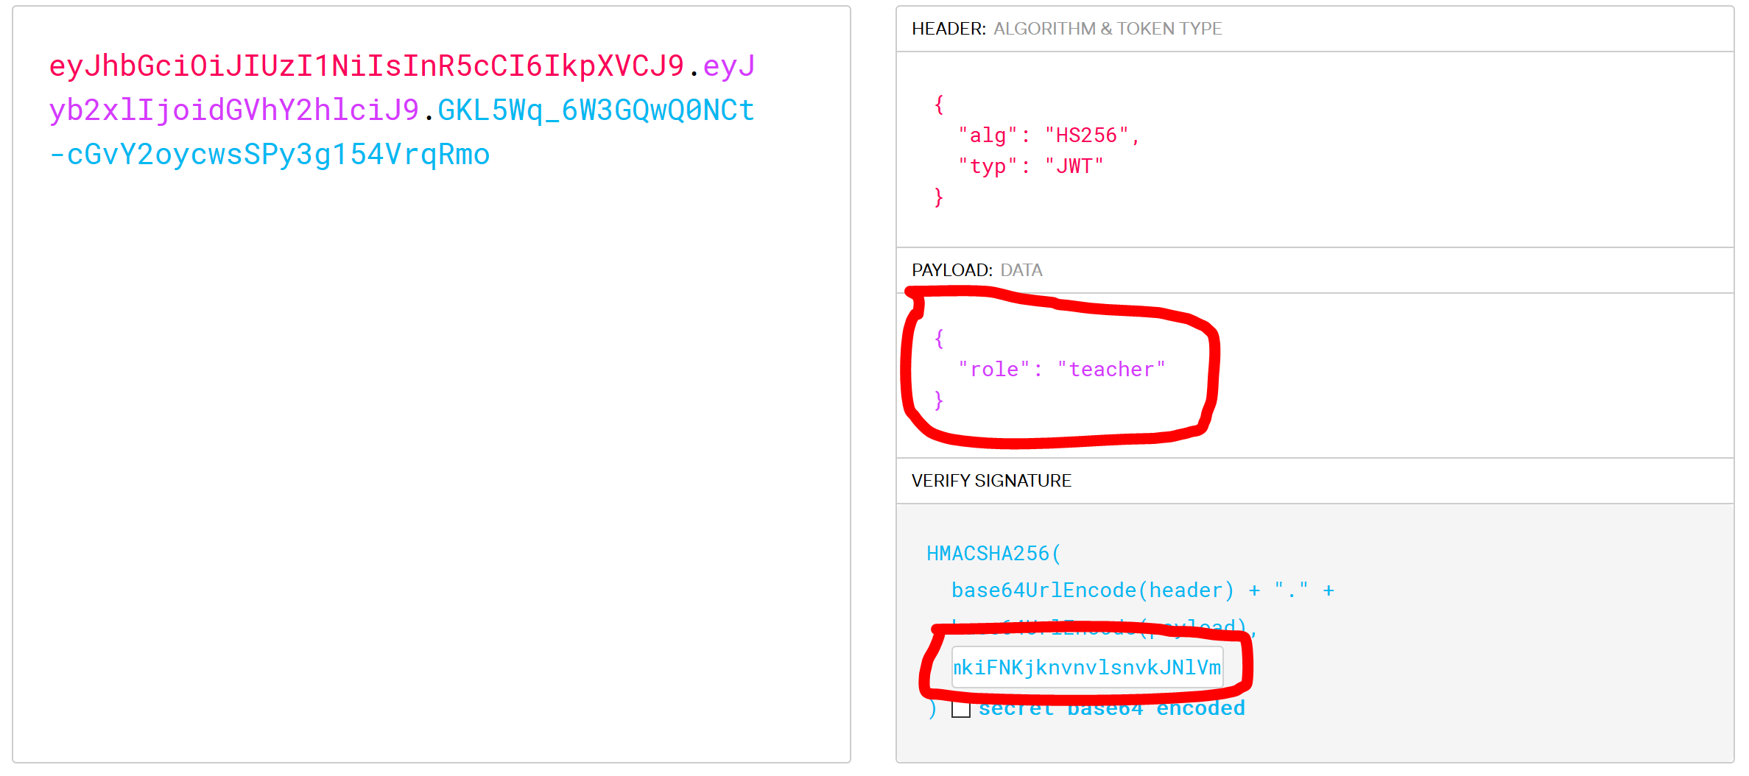
Generating a Webtoken
Open your browser and go to https://jwt.io/
Notes:
To allow the authenticator to switch to a role it needs to be configured by the datbase administrator

Slide 20
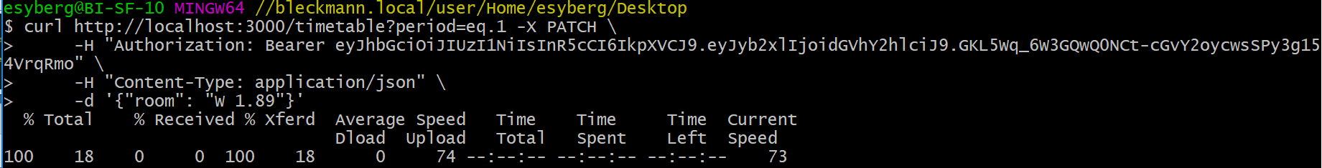
Now try changing something
Commands/04_Changes > Step 3
No errors this time!
Notes:
To allow the authenticator to switch to a role it needs to be configured by the datbase administrator

Slide 21
But now its not ordered anymore!
The postgREST API allows us to translate a HTTP request into SQL For example the ?period=eq.1 to filter based on the period is equal to Where period = 1 Try entering http://localhost:3000/timetable?order=period.asc
Notes:
To allow the authenticator to switch to a role it needs to be configured by the datbase administrator

Slide 22
Thats not all PostgREST can do ofcourse
- Querry data
- Call stored procedures via http requests
- Different ways to hand webtokens
- And much more…
Take a look yourself: http://postgrest.org/en/v6.0/index.html
Notes:
To allow the authenticator to switch to a role it needs to be configured by the datbase administrator

Slide 23
Conclusion
Pros:
- Totally free
- Fast to develop
- Completely based on the data in the database
- No need to duplicate database structures in code
- No extra CRUD code or authentication needed
Cons:
- Only works with PostgrSQL
- It does one thing well but only that

