Slide 1
Vaadin
I. Kouzak, T. Roodbeen

Slide 2
Table of content
Introduction
Framework
Components
Assignment 1
Vaadin designer
Form exercise
Pro’s & con’s
Demo

Slide 3
Introduction
Vaadin is an open source web framework that helps Java developers build great user experiences with minimal effort. Focus on creating apps that your users will
Vaadin makes it easy to build beautiful web apps in Java. The included library of UI components is designed to work well on both mobile and desktop. Your users will appreciate the attention to detail while you can focus on the functionality.

Slide 4
Exercise 1

Slide 5
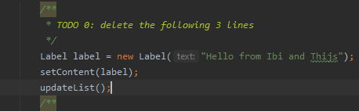


Exercise 1-1
Follow step 1 and 2 (present in the ‘ApplicationUI’)
  Adding a grid
  Adding a layout

Slide 6


Solutions 1-1
Step 1 and 2 (present in the ‘ApplicationUI’)
  Adding a grid
  Adding a layout

Slide 7


Exercise 1-2
Now follow step 3 and 4
  Setting the grid
  Adding the grid to the layout

Slide 8


Solutions 1-2
Step 3 and 4
  Setting the grid
  Adding the grid to the layout

Slide 9

Exercise 1-3
Now follow step 5 and 6
  Setting the columns
  Setting the content

Slide 10


Solutions 1-3
Now follow step 5 and 6
  Setting the columns
  Setting the content

Slide 11

Exercise 1-4
Now follow step 7
  Setting the items

Slide 12

Solutions 1-4
Now follow step 7
  Setting the items

Slide 13
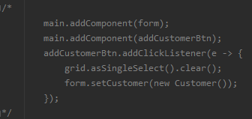
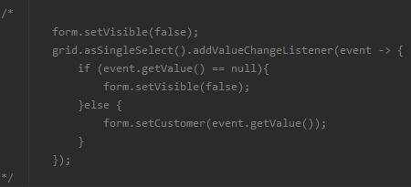
Exercise 1-5
Uncomment the following

Slide 14
Vaadin Designer

Slide 15
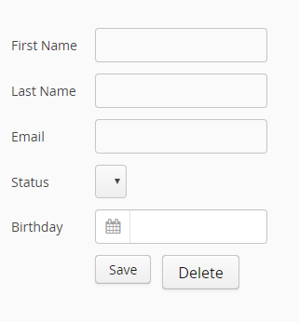
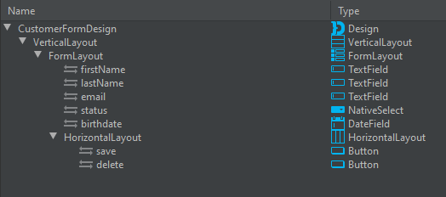
Picture 3 Vaadin Designer example

Slide 16
Designer
In the background the components are generated in HTML format
Focus on ease of use for the designer,
No worry about the syntax

Slide 17
Exercise 2

Slide 18


Exercise 2-1
Follow step 8 and 9 (present in the ‘Customerform’)
  Adding text fields
  Adding date fields

Slide 19


Solutions 2-1
Step 8 and 9 (present in the ‘Customerform’)
  Adding text fields
  Adding date fields

Slide 20
Exercise 2-2
Now follow step 10 and 11
  Create a binder
  Create a layout

Slide 21


Solutions 2-2
Step 10 and 11
  Create a binder
  Create a layout

Slide 22


Exercise 2-3
Now follow step 12 and 13
  Adding the fields
  Binding the fields and the class

Slide 23


Exercise 2-3
Now follow step 12 and 13
  Adding the fields
  Binding the fields and the class

Slide 24
Exercise 2-4
Now follow step 14 and 15
  Adding a listener
  Adding a listener

Slide 25


Solutions 2-4
Step 14 and 15
  Adding a listener
  Adding a listener

Slide 26
Exercise 2-5
Follow step 16

Slide 27
Pros and cons

Slide 28
Pros
Easy to use
No knowledge required for the design

Slide 29
cons
Looks less interactive
  Interactive backgrounds
  moving components

Slide 30
Conclusion

Slide 31
Conclusion
In which situation could it be used?
Would we use it?
What do you think?

