Slide 1


Slide 2
Overview
Introduction to drools
Passport / VISA Maven project overview
Exercises for this project

Slide 3
What is a Business rule engine?
Tool for executing business rules
e.g. when an employee is out sick for more than 5 days in a row and does not have a doctor’s note, then they need to be written up
Drools rules consists of a set of rules and a set of facts
Efficient for non-programmers

Slide 4
Example Visa application
VISA application, passport
VISA, rejection letter
Rule engine
Passport not expired
VISA has free pages

Slide 5
Drools Introduction
Business rule management system
Core: Business rule engine
Business rule engine – domain expert
Data
Domain expert
Rule 1
Rule 2
Decision

Slide 6
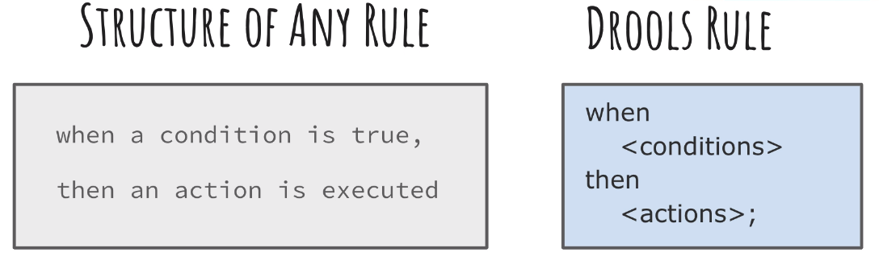
What does drools do?
drools is about writing rules without specifying their order
data goes to business rule, matching rules get fired, data gets changed

Slide 7
Comparison Java <-> Drools
Java: imperative programming
Might have lots of branches
Might be hard to change
Drools: declarative programming
No use of an ordered sequence like in Java
Specify what you want, not the steps of how to achieve it

Slide 8
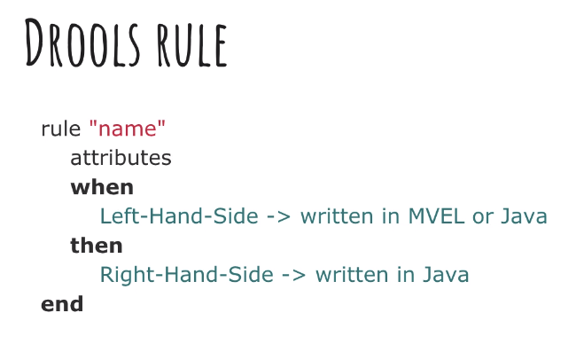
When to use Drools?
drools is useful in complex scenarios
don’t use drools when you want tight control over the execution flow

Slide 9
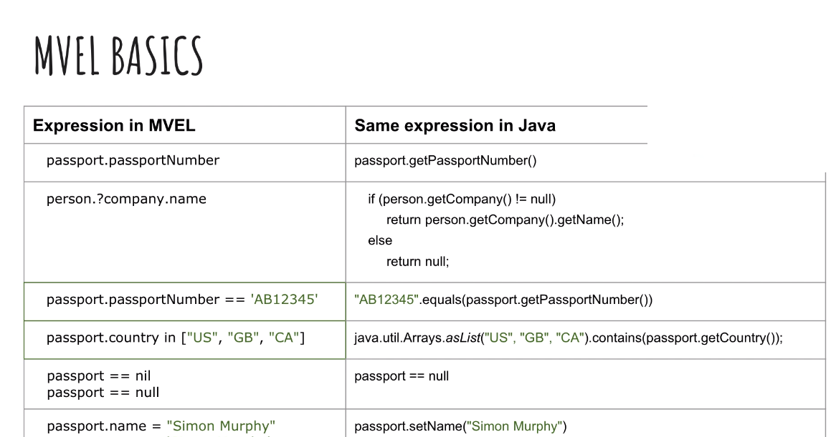

Slide 10
Printing content of the data
-$p: variable. Uses Passport.toString() in S.out.p. method
, and || or
rule "Valid passport"
dialect "mvel"
when
$p : Passport( !isExpired(), unusedVisaPages > 0 )
then
System.out.println($p+"This passport is CORRECT");
end

Slide 11
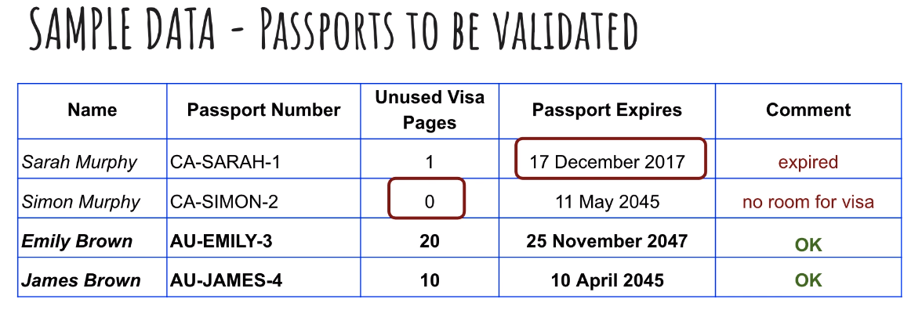

Slide 12
Introduction Project
Exercise Section 3, Step 1 (src-main-resources) – 5 minutes

Slide 13
Rules design principles
Rule independency: rule shouldnt depent on other rule
Rule atomicity: design rules as simple as possible. Split complicated rules into smaller rules until they cant be divided any more.
Its possible to determine order in which rules are checked, but this should remain an exception (salience ’10‘ – the higher the sooner)

Slide 14
Java methods vs Drools rules
Rules are executed by checking data against the rules
Rules can never be called directly
Depending on the data a rule can be fired once, several times or not at all

Slide 15
Exercise
Section 3, steps 2-4 – 10 min

Slide 16
Stateful <-> stateless session
kmodule.xml-> type “stateless”
Default-> stateful
stateless: drools session doesn’t get to know of state change during session, even if state of the object has changed. (“new StatelessKeySession”)
if you modify an object in a stateful session then all affected rules are automatically re-checked
in kmodule there is no specification for stateful Session needed

Slide 17
Problem with stateless Sessions
Showing .drl files of Section03, Step 5 vs. Step 6
Moving the Unknown rule from top to bottom

Slide 18
Inference
Building on top of previous knowledge. Meaning that you want to build on top of state changes.
see example with false passport validation
To be able to apply inference, use stateful sessions

Slide 19
Modify keyword & dispose
makes drools aware of state changes
Other rules are automatically re-checked
In body of modify you can run one or more methods
Dispose() method frees memory after the end of a Session

Slide 20
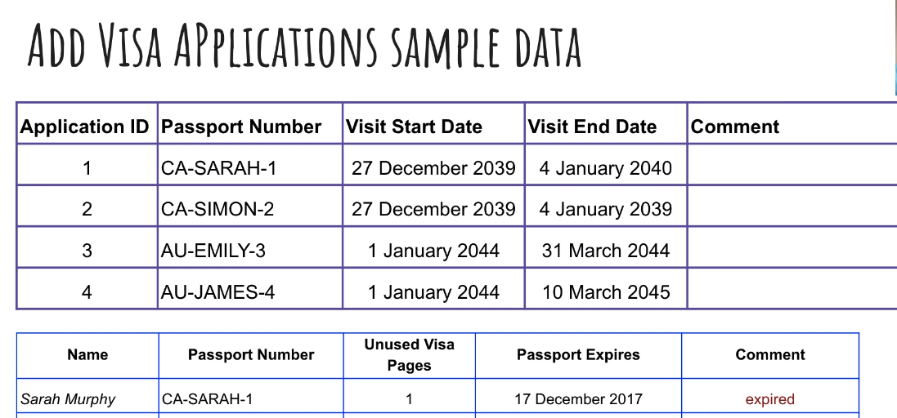
Cross validation / combine objects

Slide 21
Exercise
Section 4, step 2 and Section 5, step 1 - 15 min

