Slide 1

Workshop 16th October
Created by Mohamed Ismael and Glenn Verstraelen

Slide 2
Index
What is Avalonia UI?
A brief history
Competing products
What problems does it solve?
Visual Studio vs Vscode
Workshop
Pros/Cons
Notes:
Mohamed : Brief history, competing products, visual studio
Glenn : What is Avalonia, What problems does it solve, VsCode

Slide 3
What is Avalonia UI?
MVVM framework in .NET 8
Cross-platform

Slide 4
A brief history
When was Avalonia UI invented?

Slide 5
Competing products
Who are Avalonias competitors?
Avalonia challenges who?

Slide 6
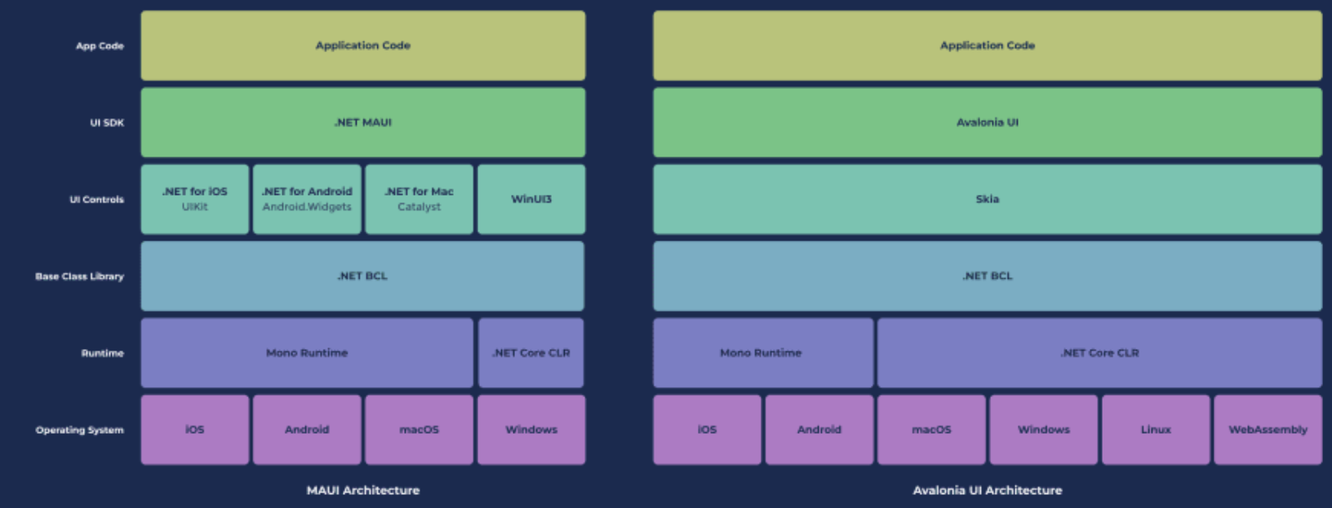
MAUI

Slide 7
What problems does it solve?

Slide 8
Visual Studio vs VScode
Both support C#
Visual Studio is most prominent (previewer)
Vscode extension is very early

Slide 9
Workshop
Character creator
Take a look at the project to study the environment
Challenge 1: Add the characters arms. (hint: Check the grids)
Challenge 2: Create height and width numerics, and bind them with the height and width of the character. ()
Challenge 3: Create a new class named Gamebreaker, which allows the user to manipulate all the stats, including height and width.

Slide 10
Pros/cons
Pros
sdfsdf
Cons
sdfsdf

Slide 11
Workshop 14th October
Thank you for your attention!

