Slide 1

Workshop 16th October
Created by Mohamed Ismael and Glenn Verstraelen

Slide 2
Index
What is Avalonia UI?
How does MVVM work?
Avalonia UI vs
MAUI
Electron
Flutter
WPF integration
What problems does it solve?
Visual Studio vs Vscode
Workshop
Pros/Cons
Notes:
Mohamed : Brief history, competing products, visual studio
Glenn : What is Avalonia, What problems does it solve, VsCode

Slide 3
What is Avalonia UI?
XAML-framework in .NET 8 (WPF successor)
Open source
Cross-platform (Win, macOS, Linux, Android, WebAssembly, embedded)
Usable in Visual Studio 2022, VScode and JetBrains Rider.
Last checked on 12th October:
Contributors - 435
Installs – 58,206,406

Slide 4
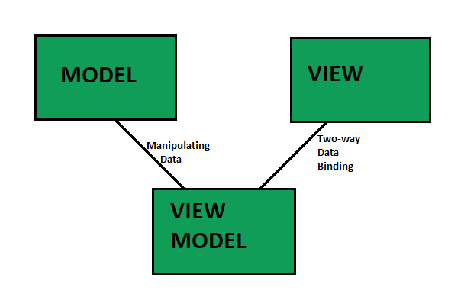
How does MVVM work?

Slide 5
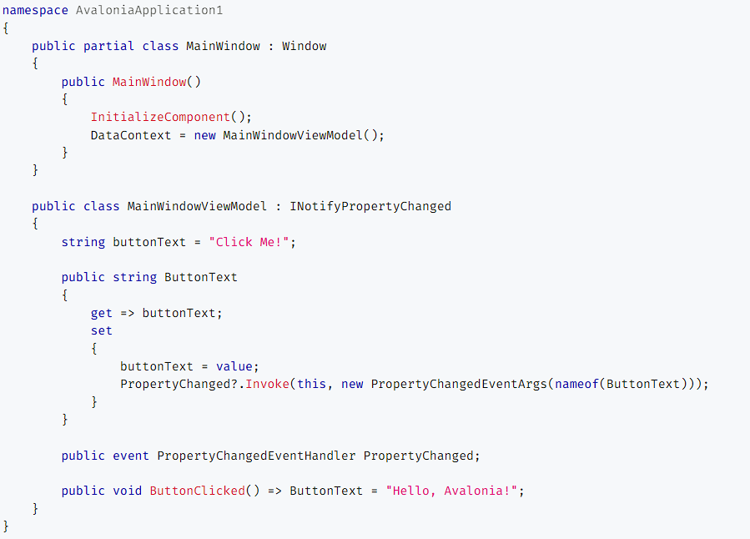
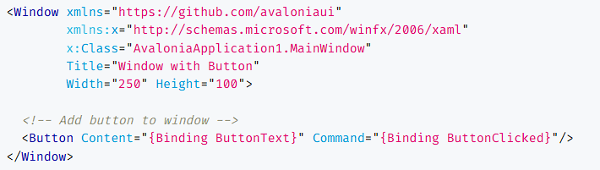
How does MVVM work?

Slide 6
Vs Maui
Avalonia
Maui
Custom rendering
Unique UI components
Easier to maintain and update
Supports older Windows (7) and MacOS versions
Supports Linux & WebAssembly
Native rendering
Native UI toolkits
May need to reimplement platform-specific features
Lacks Linux support & web development

Slide 7
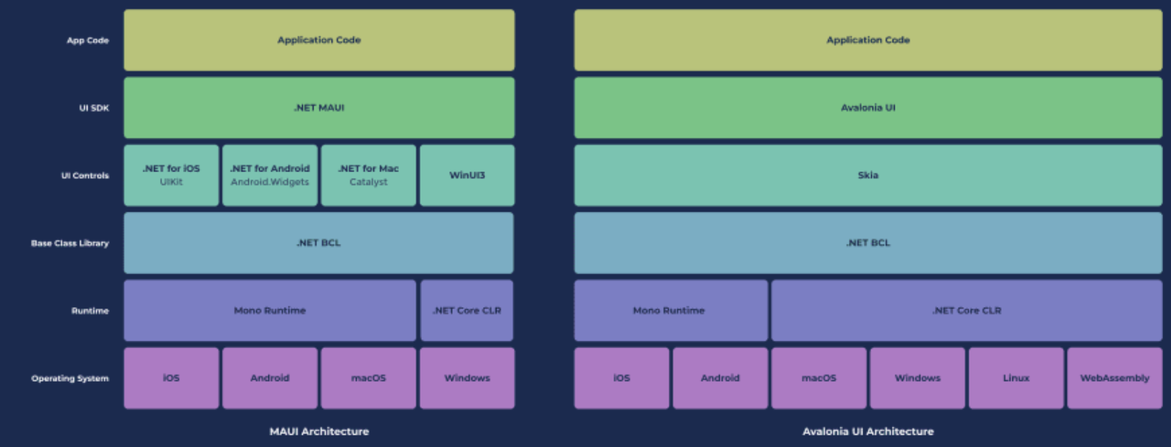
MAUI

Slide 8

Vs Electron
Avalonia
Electron
XAML-based framework
C#
Native hardware acceleration
Integrated debugging
Wide platform support
Easier for .NET developers to learn
Built on web technologies.
HTML, CSS, and JavaScript
More memory usage
DevTools for debugging
Primarly targets desktop (smaller focus on mobile)
Easier for web developers to learn

Slide 9

Vs Flutter
Avalonia
Flutter
C#
Tree-based approach
Both use Skia
Previewer
Growing community
Fewer specific resources and third-party libraries
Dart
Widget-based approach
Hot Reload
Larger active community
Wider range of third-party packages and plugins

Slide 10
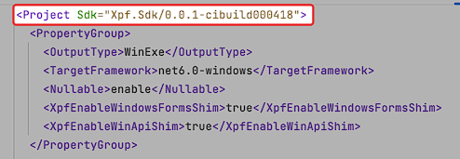
WPF intergration
Avalonia XPF
WPF applications on macOS, and Linux
Reuse existing WPF code
Preserve investments in third-party controls
Port WPF apps to new platforms

Slide 11





What problems does it solve?
Cross-platform
Dynamic UI development (previewer)
Active adoption
Supports mobile development, WPF doesn’t

Slide 12
Visual Studio vs VScode
Both support C#
Visual Studio (2022) works the best, thanks to the previewer
VScode extension works too, but poor previewer

Slide 13
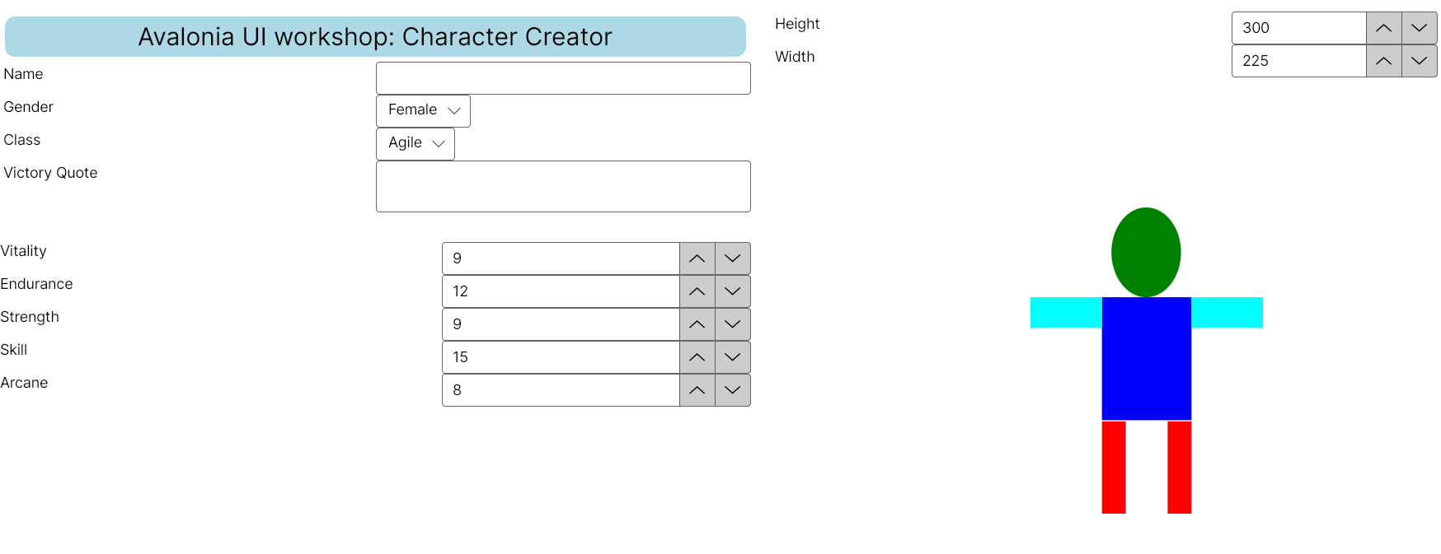
Workshop – Character Creator!

Slide 14

Workshop – Character Creator!
Challenge 1: Add “Name” and “Victory Quote” under the character. Make use of data binding.
Challenge 2: Create a new class named Gamebreaker, which can manipulate all the stats, including height and width. Make sure that the height and width dynamically change the character’s height and width as well.
Challenge 3: Add color input to customize character color per body part. Make use of data binding.
https://www.github.com/esd-2024-avaloniaui
Helpful recourses:
https://play.avaloniaui.net/
https://docs.avaloniaui.net/docs/basics/data/data-binding/
README for project build instructions
Otherwise, ask us!

Slide 15
Pros/cons
Pros
Easy to build UI
Easy to maintain code
Easy to test, without referencing UI
Cons
Lack of documentation
Overkill for single –page or very small apps.
Previewer support
Docker limitations

Slide 16
Thank you for your attention!

