Slide 1

Workshop 16th October
Created by Mohamed Ismael and Glenn Verstraelen

Slide 2
Index
What is Avalonia UI?
A brief history
Competing products
What problems does it solve?
Visual Studio vs Vscode
Workshop
Pros/Cons
Notes:
Mohamed : Brief history, competing products, visual studio
Glenn : What is Avalonia, What problems does it solve, VsCode

Slide 3
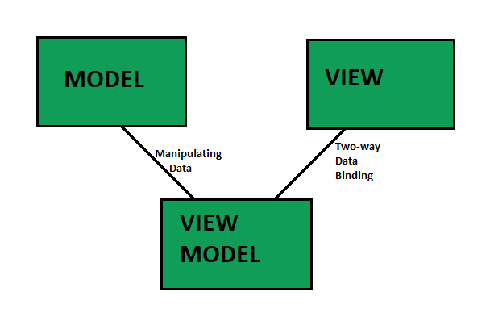
What is Avalonia UI?
MVVM framework in .NET 8
Open source
Cross-platform (Win, macOS, Linux, Android, WebAssembly, embedded)
Usable in Visual Studio 2022, VScode and JetBrains Rider.
Last checked on 12th October:
Contributors - 435
Installs – 58,206,406

Slide 4
A brief history
When was Avalonia UI invented?

Slide 5
Competing products
Who are Avalonias competitors?
Avalonia challenges who?

Slide 6
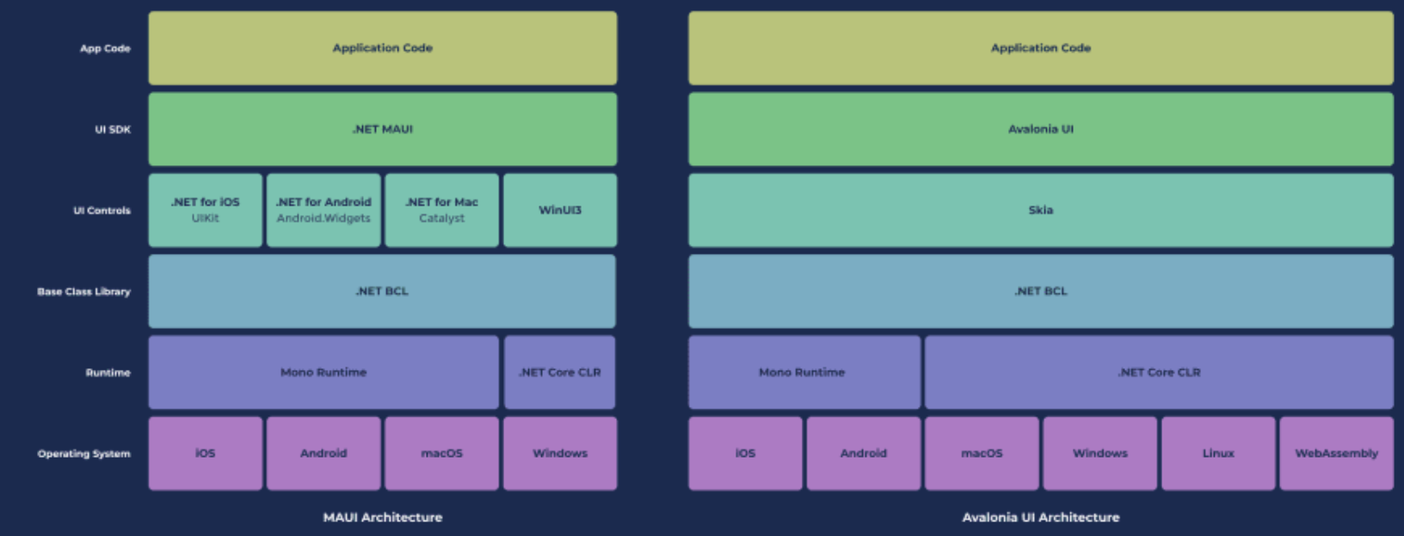
MAUI

Slide 7
What problems does it solve?
Cross-platform
Dynamic UI development
Active Adoption

Slide 8
Visual Studio vs VScode
Both support C#
Visual Studio (2022) works the best, because of the previewer
VScode extension works too, but poor previewer

Slide 9
Workshop – Character Creator
Challenge 1: Add “Name” and “Victory Quote” under the character. Make use of data binding.
Challenge 2: Add the characters arms in the character grid.
Challenge 3: Create a new class named Gamebreaker, which can manipulate all the stats, including height and width. Make sure that the height and width dynamically change the character’s height and width as well.
Challenge 4: Add color input to customize character color per body part. Make use of data binding.
Helpful recourses:
https://play.avaloniaui.net/
README for project build instructions
Otherwise, ask us!

Slide 10
Pros/cons
Pros
Easy to build modern UI
Easy to maintain code
Easy to test, without referencing UI
Cons
Lack of documentation
Overkill for single –page or very small apps.
Previewer support
Docker limitations

Slide 11
Thank you for your attention!

