Slide 1

Introduction to Rust
By Felix Berger Cipriano and Flemming Habets
Notes:
What is Rust [FELIX!]
Why Rust
What problem does Rust solve [FELIX!]
Competing Products -> C/RUST/GO [FLEMMING!]
Pros/Cons [FLEMMING!]
Rust Concepts
Common Programming Concepts – refresher // short intro & Immutability & Everything non-nullable by default > 1min [FLEMMING]
Cargo > 1min [FLEMMING]
You know maven/gradle/(npm) -> build tools/package manager not in language by default, cargo is integrated
If you want a crate (library) [crates.io] put it in cargo.toml and import in file
You can use a github repo as a library
Ownership > 7min [FELIX!]
Data is owned by a certain scope
Transferring ownership -> move
Why? Memory management (at compile time)
…
Borrowing: reference = pointer to data
Only one mutable reference, unlimited immutable references
No mutable reference as long as there is an immutable reference
Reason: promise that a reference is immutable, you wouldn't expect changes
Lifetimes/Borrow Checker > 5min [FELIX!]
[Borrow checker makes ownership usable -> ownership without borrow checker/references is hell]
Borrow checker prohibits you from accessing invalid references at compile time
Borrow checker enforces that there is only one mutable reference to a value [immutable & mutable: data race when writing and reading at the same time, multiple mutable: collision when writing at the same time
Borrow checker tracks the lifetimes of references
Ask them, if compiles…. Valid reference??? Do people see an issue in cpp code
LIFETIMES: add example code from rustbook
Reference returned needs to be related to returned lifetime
‘static
Struct/impl/option > 2min [FLEMMING!]
{Structs are product types (*)}
Option
Struct initialization
Pattern Matching/Enums > 1min [FELIX]
Java enums define constants, are namespaced constants
Rust enums define states
{Rust enums are sum types (+)}
Match keyword
Switch statement on steroids
Error handling > 2min [FLEMMING]
Smart pointers > 2min [FELIX!]
Rc immutability
box

Slide 2
What is Rust
What is Rust not
Performant (zero abstraction cost)
Typesafe
Functional
Rust is the first language to be used in the Linux Kernel apart from C and Assembly
Not fully object oriented (objects & interfaces exist, no inheritance)
Notes:
Performant (zero abstraction cost)
No performance hits from abstraction -> match, iterator, …
Typesafe
Also Functional, not purely
Rust is the first language to be used in the Linux Kernel apart from C and Assembly

Slide 3
What does Rust solve
Rust is memory safe, without a garbage collector
Memory safety: Ownership, Borrow Checker/Lifetimes
Provides high level language features, while writing low level code
Notes:
Rust is memory safe, without a garbage collector
Memory safety: Ownership, Borrow Checker/Lifetimes
Provides high level language features, while writing low level code

Slide 4
C vs Rust vs Go
Rust | C | Go
Safety and performance | Simplicity, control | Simplicity, productivity
RAII (automatic -> ownership) | Manual Memory Allocation | Garbage Collector
Zero Abstraction Cost | discourage Abstraction | Garbage collector overhead
Compile time checks through ownership | Manual concurrency with libraries | Goroutines
Steep learning curve | Simple syntax but deep concept understanding | Easy to learn and start
Notes:
No garbage collector: C: RAII (manual -> free), Rust: RAII (automatic -> Lifetimes); Garbage collector: Go
Dangling pointers: C YES, Go Garbage Collector, Rust Borrow Checker (Writing unsafe code -> Dangling pointers)
C malloc, Rust Box

Slide 5
Use Cases
Rust:
OS Kernels, embedded software, high performance applications, game programming, projects with need for high safety
C:
OS Kernels, Embedded Software, Game Programming
Go:
Short Time Scale Projects, Lots of new developers to onboard, high scale concurrent applications -> micro services

Slide 6
Cargo
Build Tool and Packet Manager
-> known build tools are maven/ gradle
TOML file to add libraries
GitHub Repositories can be libraries

Slide 7
Ownership
Notes:
Every programming language needs to manage memory, aka resources.
In Java/C#/Go/Python/JavaScript, when an object is created and put onto the heap; When does the object get freed again?
=> When it is no longer reference by the program (that is checked by the Garbage Collector)
Pros: You don’t have to think about memory management, which makes coding easier and faster and memory safe.
Cons: But you have a significant higher memory consumption

Slide 8
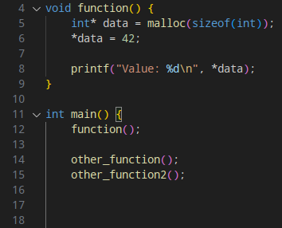
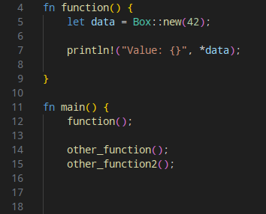
Ownership
C
Rust
Notes:
What is wrong with the C code?
In C/C++, when an object is created and put onto the heap; When does the object get freed again?
=> When the programmer says so (free function)
=> (by the Smart Pointer in C++) - not about smart pointer, but raw pointer
Why is it a problem? => sleep(5000) => (What happens when I call this function 500 times)
=> Memory leak
Memory leak causes undefined behaviour
To get you on the right track, what is better: runtime error or ub?
=> UB inconsistent, runtime error is traceable, consistent
Program can fill up memory
Rust:
Explain data pointer to heap
Go back into main, data is freed => because ownership
In Rust, when an object is created and put onto the heap, Ownership decides when the object gets freed again.
Ownership achieves low memory footprint while being memory safe. Freeing manually in C: Low memory footprint, but not memory safe.
And How does Ownership achieve this?
—-----------------------------------------------------------------------------------------------------
It is more complex than garbage collected languages, but not much complexer than C++.
Rust and C use the same memory management model (aka no GC), but Rust enforces correct memory management at compile time, C does not.
—---
Low memory footprint, but not memory safe.
Why is it not safe
- Undefined behavior when dereferencing invalid references or pointers
- Memory leaks when not freeing
- Double free errors

Slide 9
Ownership
Ownership Rules:
Each value in Rust has an owner
There can only be one owner at a time
When the owner goes out of scope, the value will be dropped
Notes:
By following three rules
Ownership Rules:
- Each value in Rust has an owner.
- There can only be one owner at a time. (To prevent double frees)
- When the owner goes out of scope, the value will be dropped. (To have only one free)
Checked on compile time

Slide 10
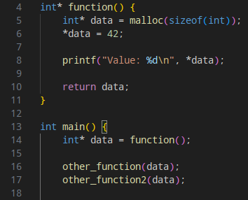
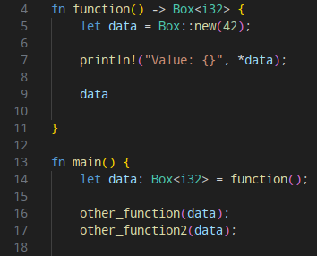
Ownership
C
Rust
Notes:
OWNERSHIP MOVING
C code:
Pointer returned now, …
Other_function and other_function2 could free data => double free error (heap corruption => undefined behaviour)
Not managing memory correctly can lead to security vulnerabilities too
Rust code:
Ownership rules don’t let the program compile
Move data in other_function, but not returned
But we want to pass data to both functions, how do we achieve this?
—---------
It is more complex than garbage collected languages, but not much complexer than C++.
Rust and C use the same memory management model (aka no GC), but Rust enforces correct memory management at compile time, C does not.
—------------------------------------------------------------
Low memory footprint, but not memory safe.
Why is it not safe
- Undefined behavior when dereferencing invalid references or pointers
- Memory leaks when not freeing
- Double free errors

Slide 11
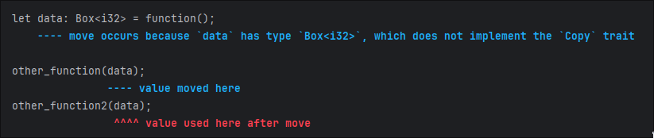
Ownership
Rust
Notes:
OWNERSHIP MOVING
C code:
Pointer returned now, …
Other_function and other_function2 could free data => double free error (heap corruption => undefined behaviour)
Not managing memory correctly can lead to security vulnerabilities too
Rust code:
Ownership rules don’t let the program compile
Move data in other_function, but not returned
But we want to pass data to both functions, how do we achieve this?
—---------
It is more complex than garbage collected languages, but not much complexer than C++.
Rust and C use the same memory management model (aka no GC), but Rust enforces correct memory management at compile time, C does not.
—------------------------------------------------------------
Low memory footprint, but not memory safe.
Why is it not safe
- Undefined behavior when dereferencing invalid references or pointers
- Memory leaks when not freeing
- Double free errors

Slide 12
References
Rule for references:
A value can only have one mutable reference or unlimited immutable references
No mixing of Immutable & Mutable
When you are promised, that a reference is immutable, you wouldn’t expect that its value changes!
Prohibits Data Races!
No multiple mutable
Prohibits data collisions!
Notes:
References are pointers, you all know pointers, points to value
Immutable by default &Type, mutable references &mut Type
Borrowing: reference = pointer to data
Rules checked by Borrow Checker at compile time
Borrow checker is the system in rust that checks if references are valid at compile time
A reference is valid when…
In case someone asks: Everything checked at compile time?
No, there are types like rc and refcell (rust borrowing rules at runtime) that are checked at runtime
—---------------
LATER:
Borrow checker prohibits you from accessing invalid references at compile time
Borrow checker enforces that there is only one mutable reference to a value [immutable & mutable: data race when writing and reading at the same time, multiple mutable: collision when writing at the same time
Borrow checker tracks the lifetimes of references

Slide 13
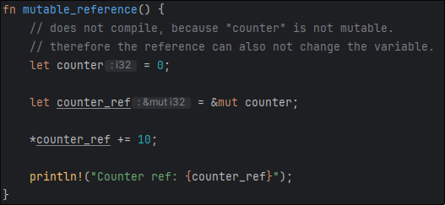
References
Notes:
A few examples:
When you want to have a mutable reference, the value must be mutable too

Slide 14
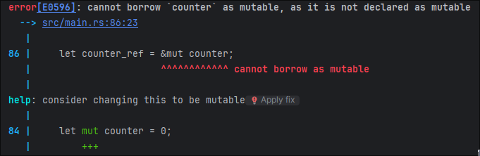
References
Notes:
A few examples:
When you want to have a mutable reference, the value must be mutable too

Slide 15
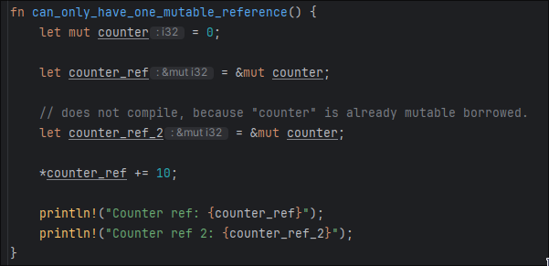
References
Notes:
Not two mutable variables

Slide 16
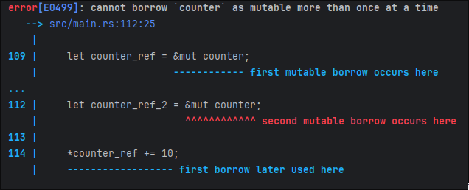
References
Notes:
Not two mutable variables

Slide 17
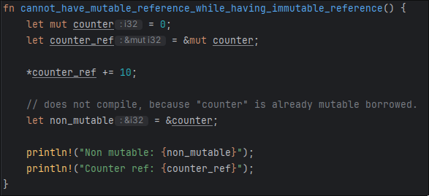
References
Notes:
No mutable & immutable

Slide 18
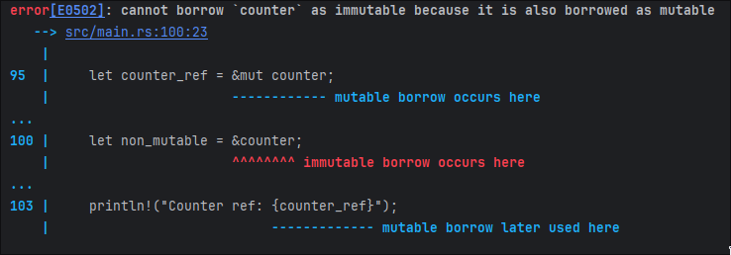
References
Notes:
No mutable & immutable

Slide 19
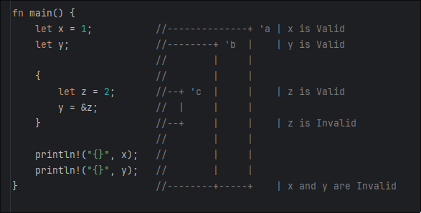
Lifetimes
Notes:
X lives at least as long as z, but z not as long as x
At compile time, lifetimes are statically checked by the borrow checker

Slide 20
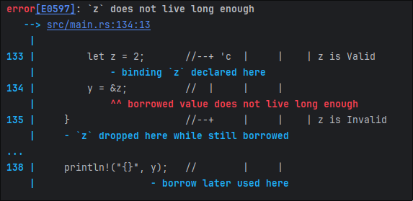
Lifetimes

Slide 21
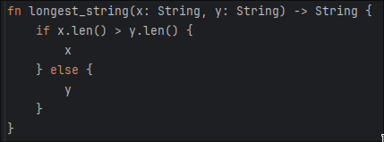
Lifetime Annotations
Notes:
‘A is a named lifetime
Names lifetime beschreibt relation between references
Lifetime annotations

Slide 22
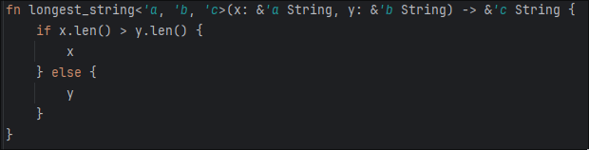
Lifetime Annotations
Notes:
At compile time, lifetimes are statically checked by the borrow checker
‘A is a named lifetime
Names lifetime describes relation between references

Slide 23
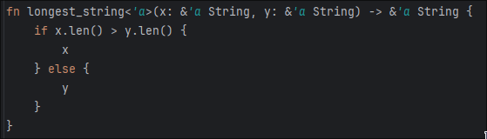
Lifetime Annotations
Notes:
At compile time, lifetimes are statically checked by the borrow checker
‘A is a named lifetime
Names lifetime beschreibt relation between references
Lifetime annotations
‘A is a shared lifetime

Slide 24
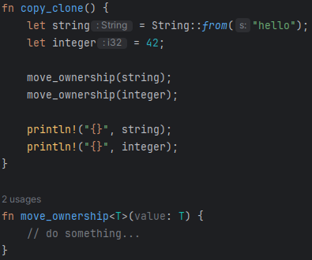
Copy & Clone Types

Slide 25
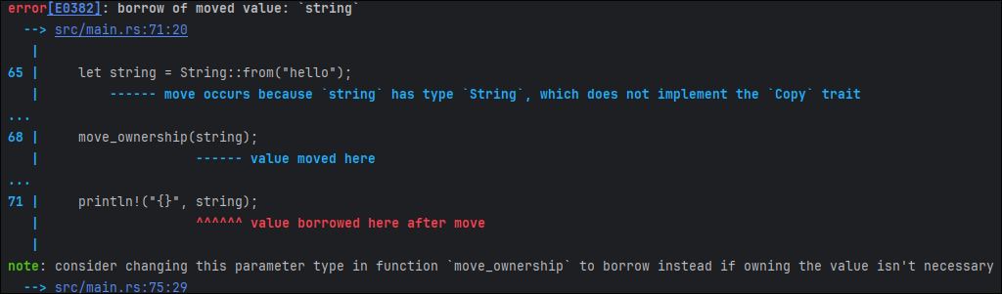
Copy & Clone Types

Slide 26
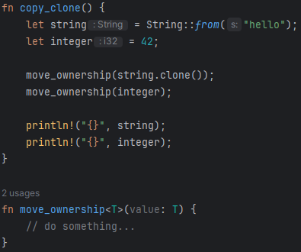

Copy & Clone Types
Notes:
Clone is maybe expensive
Copy is cheap/inexpensive

Slide 27
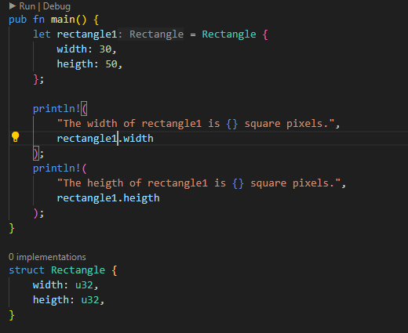
Struct
Notes:
Types to var assign

Slide 28
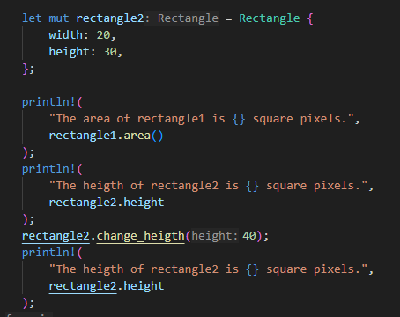
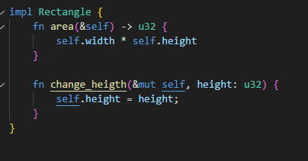
Impl

Slide 29
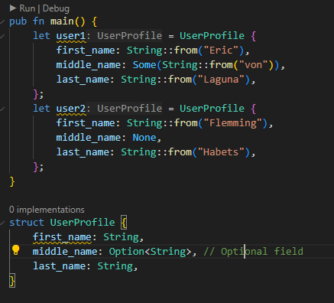
Option

Slide 30
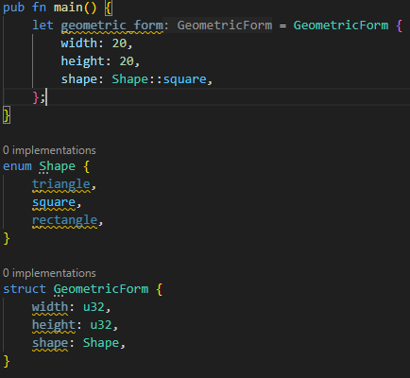
Enum

Slide 31
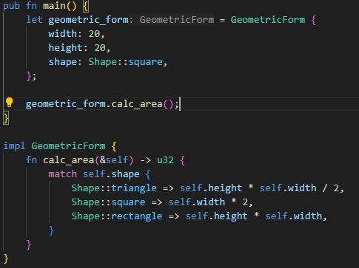
Match

Slide 32
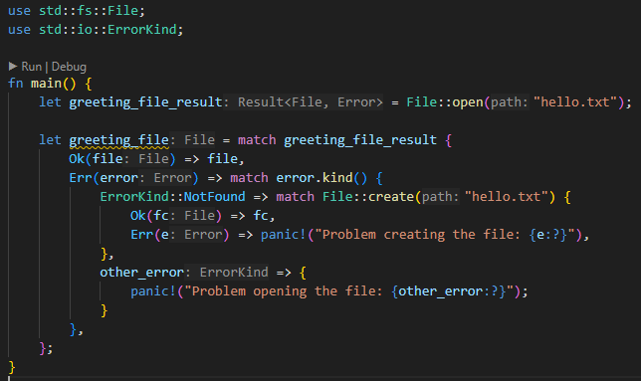
Error Handling
Result<T, E>
Program continues
Panic!
Program stops

Slide 33
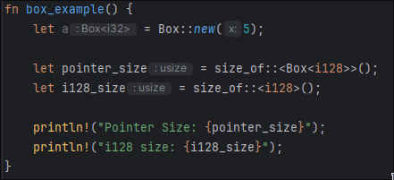

Smart Pointers
Output:
Notes:
Reference Counting

Slide 34
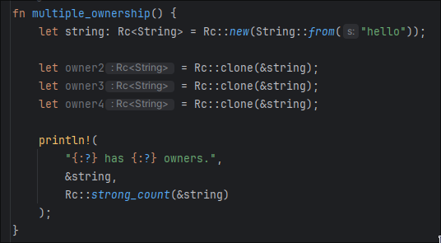
Smart Pointers
Output:
Notes:
Reference Counting
Last Reference frees

Slide 35
Any Questions?

Slide 36
Clone the GitHub repository: https://github.com/sebivenlo/esd-2024-rust
Follow the Setup and Getting started with Exercises steps
Work at your own pace!
Questions? Ask us!

Slide 37
Want to learn more about Rust?
Continue your journey with these suggested topics to become a true rustacean
Common Collections - https://doc.rust-lang.org/book/ch08-00-common-collections.html
Generics & Traits - https://doc.rust-lang.org/book/ch10-00-generics.html
Functional Language features - https://doc.rust-lang.org/book/ch13-00-functional-features.html
More Exercises: https://github.com/rust-lang/rustlings

