Slide 1
What is ThreeJS?
JavaScript library
First release in April 2010 by Ricardo Cabello
Open-source, large active community
Creating 3D graphics and animations in web browsers
Built-in support for common 3D elements
Scenes
Cameras
Lights
Materials
Geometries
Animation capabilities
Keyframe animation

Slide 2
ThreeJS and WebGL
Uses WebGL to render 3D graphics using the GPU
ThreeJS provides an easy-to-use abstraction layer on top of WebGel
-> making 3D graphics more accessible to web developers

Slide 3
Where are 3D models used in your daylie life?
Menti.com

Slide 4
What can ThreeJS create?
Simple/complex 3D models
Interactive visualizations
Games

Slide 5
Utilization

Slide 6
ThreeJS vs Babylon.js

Slide 7
Pros
Cons
Immersive 3D experiences run directly in the browser
No plugins or software installation required
Supports importing 3D models from popular 3D modeling software like Blender
Built-in support for virtual and augmented reality through the WebXR API
Instable API
Difficult to debug
Incomplete documentation

Slide 8
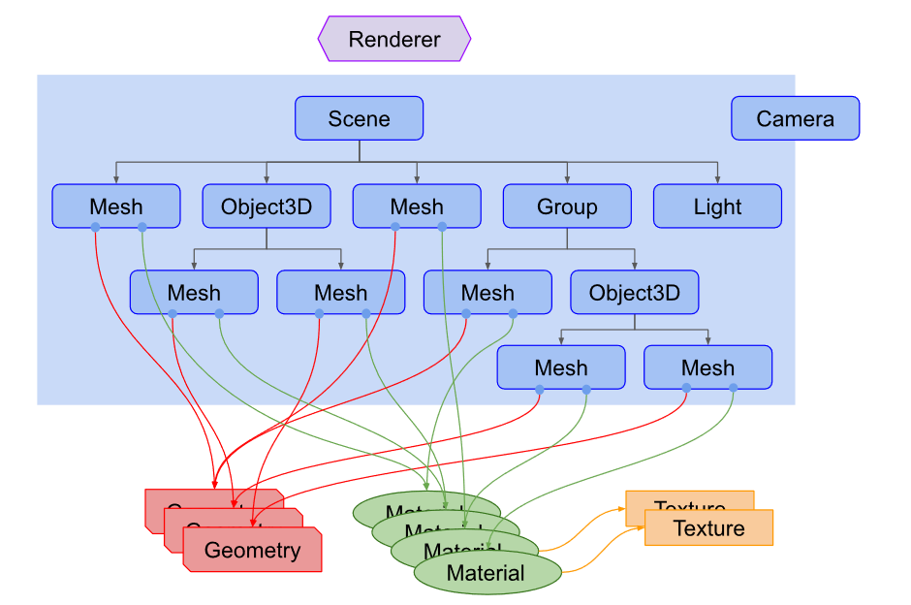
Structure

Slide 9
Aufgabe 1

Slide 10
Aufgabe 2

Slide 11
Aufgabe 3

Slide 12
Aufgabe 4

