Slide 1

Three.js

Slide 2
What is ThreeJS?
JavaScript library
First release in April 2010 by Ricardo Cabello
Open-source, large active community
Creating 3D graphics and animations in web browsers
Built-in support for common 3D elements
Scenes
Cameras
Lights
Materials
Geometries
Animation capabilities
Keyframe animation

Slide 3
ThreeJS and WebGL
Uses WebGL to render 3D graphics using the GPU
ThreeJS provides an easy-to-use abstraction layer on top of WebGel
-> making 3D graphics more accessible to web developers

Slide 4
Where are 3D models used in your daily life?
Menti.com

Slide 5
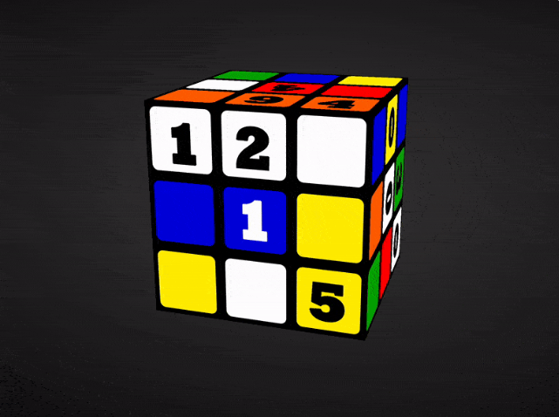
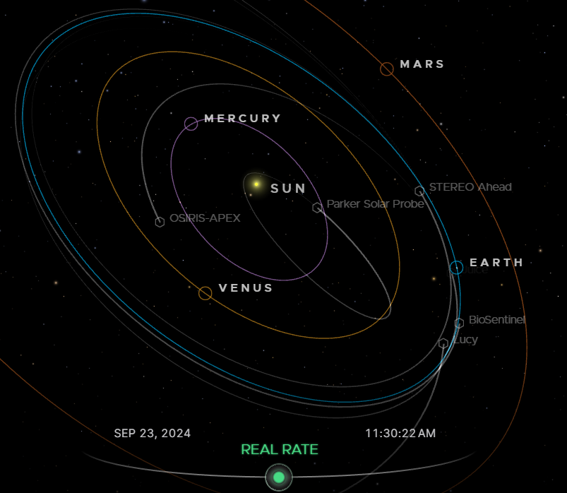
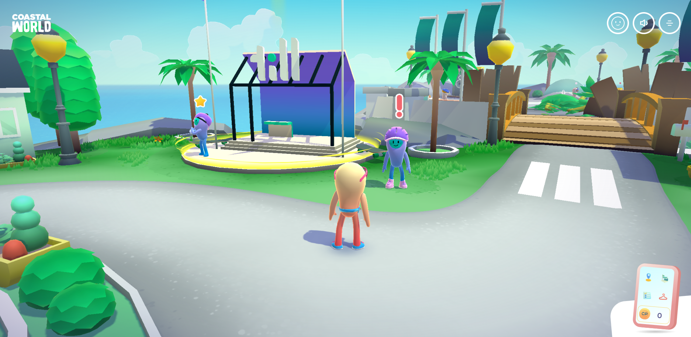
Utilization
3D Model
Interactive Visualization
Games

Slide 6
ThreeJS vs Babylon.js
ThreeJS
Babylon.js
Supports 3D model import
AR/VR features
Lower learning curve
Lightweight, fewer built-in features
Large community
High customizability, lower-lever access
Small/custom projects
Limited built-in tools
Creative web experience, data visualization
Supports 3D model import
AR/VR features
Complex
Heavier, comprehensive & feature-rich
Small community
More built-in abstractions, high-level
Large-scale apps
A lot tools (editor, sandbox, etc.)
3D games, WebXR, larger applications

Slide 7
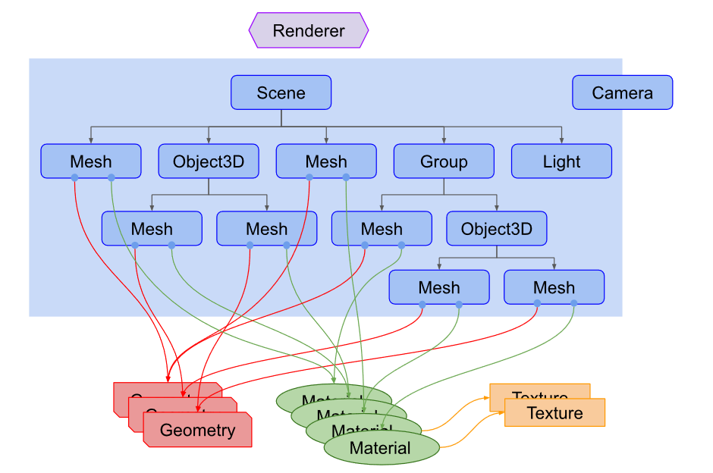
Scene Structure
https://www.researchgate.net/figure/Structure-of-a-typical-Threejs-scene-Image-source-threejsfundamentalsorg-c-Google_fig28_344339852
Notes:
Renderer: takes all information from scene, renders it into an image
Scene: top-level container
Camera: determines viewpoint
Mesh: combination of geometry and material
Object 3D: base class for any object that can exist in the 3D scene
Group: Container thatenables to group multiple objects together and manipulates them as one entity
Light: necessary for iluminating the scene and shading
Texture: images applied to materials to add detail/pattern

Slide 8
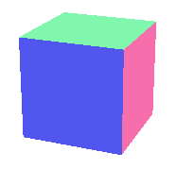
Task 1
Basic Elements

Slide 9

Task 2
Animation

Slide 10

Task 3
Load External Model

Slide 11
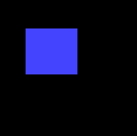
Task 4
Loading Screen

Slide 12
Thanks for your attention!

