Slide 1
KUBERNETES Config Management / Container Orchestration
Enterprise Software Development
Paul Renkel & Dorothee Schilling & Laura Baus

Slide 2
INTRO TO K8S
01
TABLE OF CONTENTS
05
WORKER NODE COMPONENTS
02
04
MASTER NODE COMPONENTS
K8S SECURITY
ASPECTS

Slide 3
INTRO TO K8S

Slide 4

WHAT IS KUBERNETES?
Open-source Container Orchestration Tool​ ​
Developed by Google and released 2014​
Assists to manage containerized applications
-> In different deployment environments
Runs under Apache License 2.0
Maintained by Cloud Native Computing Foundation (CNCF)
GitHub link: https://github.com/kubernetes/kubernetes
Official documentation: https://kubernetes.io/
Source [1], [2]
1

Slide 5
HISTORY
2013
Summer 2014
2016
Project Start with first prototype
First Product Release with main functionalities
Accepted to Cloud Native Computing Foundation
2014
2015
More developers joined the project
Release of version 1.0
Source [5]
2
Notes:
https://kubernetes.io/blog/2018/07/20/the-history-of-kubernetes-the-community-behind-it/

Slide 6



WHO USES K8s?
SPOTIFY
PINTEREST
ADIDAS
10 million requests per second on a service
Autoscaling: no need for manual service creation
Improved CPU usage
On-demand scaling
Failover policies
Simplified deployment and management of complex infrastructure
Reduced build times
Reduced loading time for the website
From monthly to weekly product releases
Source [6], [7], [8]
3

Slide 7
WHAT IS CONTAINER ORCHESTRATION?
WHAT IS CONTAINER ORCHESTRATION?
“Container orchestration automates the deployment, management, scaling, and networking of containers.” ¹ It “manages the entire lifecycle of individual containers […]”²
Task Automation and management
Resource allocation
Scaling and removing containers
Load balancing and traffic routing
Monitoring container health
Source: 1 https://www.redhat.com/en/topics/containers/what-is-container-orchestration , 2 https://www.jeremyjordan.me/kubernetes/, [9]
4
Notes:
https://www.jeremyjordan.me/kubernetes/

Slide 8
HORIZONTAL SCALABILITY
RUNS ANYWHERE
ZERO DOWNTIME DEPLOYMENT
KUBERNETES FEATURES
SELF HEALING
LOAD BALANCING
AUTOMATED ROLLOUTS
Source [10], [11], [12]
5
Notes:
Zero downtime deployment: rolling updates: keep at least some instances up and running at any point in time while performing updates to prevent any application downtime

Slide 9
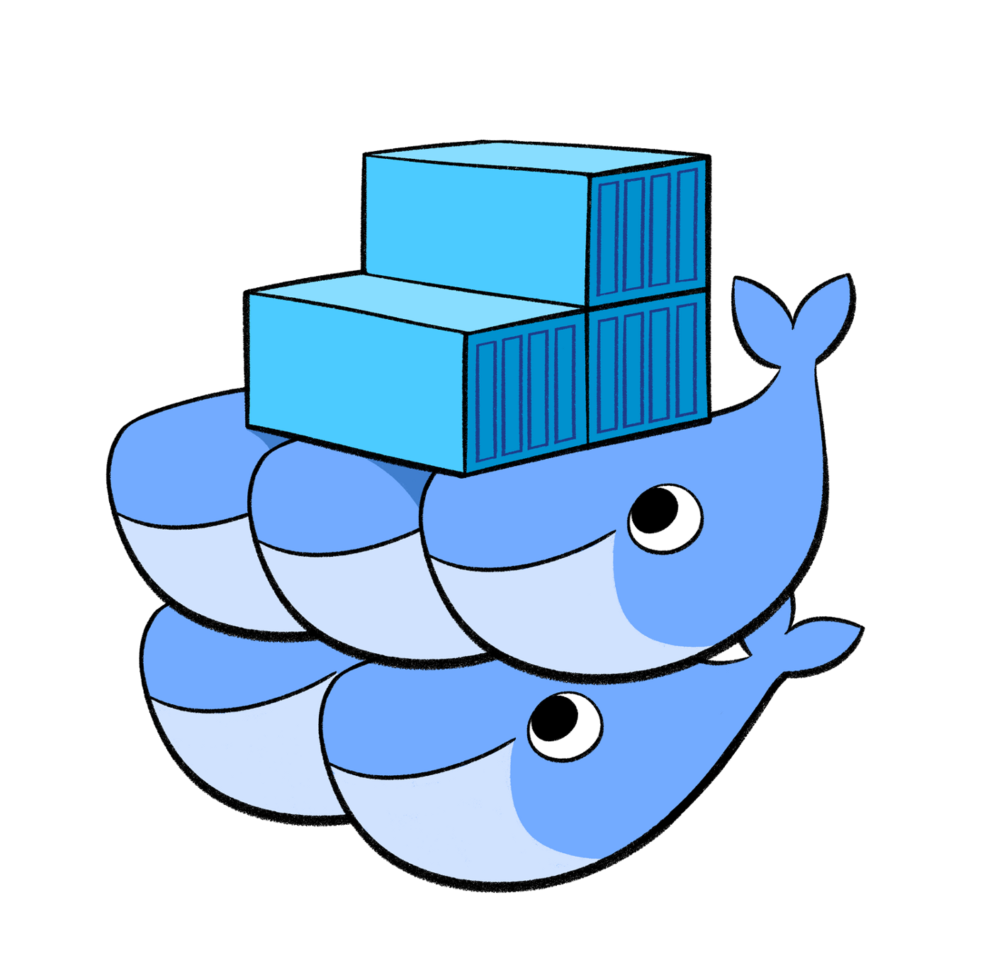
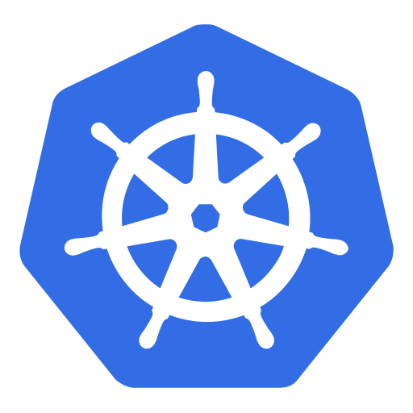
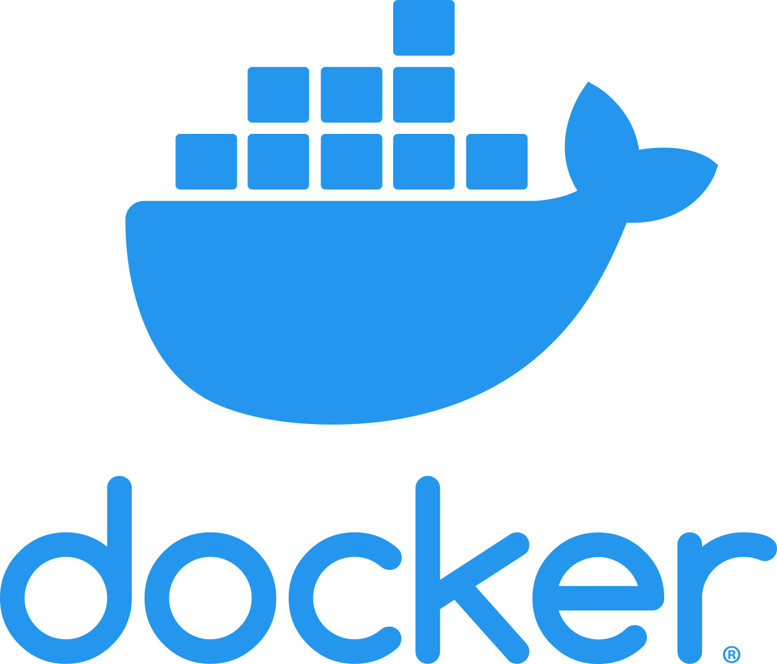
TECHNOLOGY COMPARISON
DOCKER
KUBERNETES
DOCKER SWARM
Create containerized apps​​
Run containers manually with docker runtime
OS independent
Docker‘s orchestration tool
To be used with docker engines
Easy to get started
Fewer functionalities / fewer automation options
Ideal for smaller applications
Container orchestration and management
Used after app is packaged into a container
More complex than Docker Swarm
Not suited for small and medium-sized apps
Requires expertise
More powerful and customizable
Source [13], [14]
6

Slide 10
WORKER NODE COMPONENTS

Slide 11
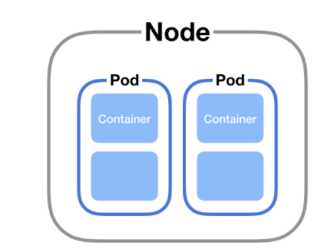
(WORKER) NODES
WORKER NODE COMPONENTS
PODS
Physical or virtual machine
Runs containerized application
Managed by control plane
Contain one or more containers
Optimize resource sharing: share networking resources
Ephemeral
Unique IP address
Source [2], [3], [15], [21]
7

Slide 12
SERVICE
Service name
Stable IP address
Enforces loose coupling
Internal services
External services
POD A.1
POD A.2
WORKER NODE COMPONENTS
Service A
Internal
(10.96.121.48)
CLIENT
Service B
External
(47.157.36.42)
POD B.1
NODE 1
NODE 2
Source [3]
8

Slide 13
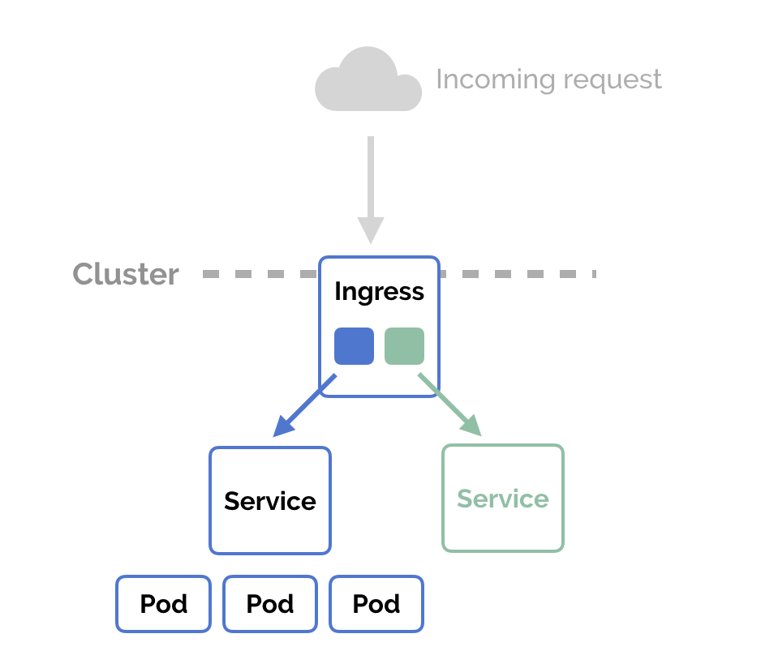
INGRESS
HTTP access to service
Customizable namespace
Avoid external IP's for services
WORKER NODE COMPONENTS
Source [3], [16]
9

Slide 14
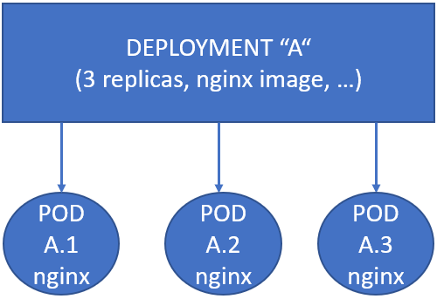
DEPLOYMENT
Blueprint for pods
Specifies pod contents
WORKER NODE COMPONENTS
STATEFULSET
Deployment with persistence
10

Slide 15
CONFIGMAP
Global key-value pairs
Non-confidential configuration data
Path to database
Deployment Flag
WORKER NODE COMPONENTS
SECRET
Sensitive data
Keys
Passwords
Encrypts data when deploying
Content must be base64 encoded
Source [17], [18]
11

Slide 16
VOLUMES
Directory
Containers in a pod can access volumes
Not possible to store data in a container
On-disk files in container are volatile
If container fails, data are lost
Ephemeral Volumes
Persistent Volumes
WORKER NODE COMPONENTS
Source [3], [19]
12
Notes:
https://cloud.netapp.com/blog/cvo-blg-5-types-of-kubernetes-volumes-and-how-to-work-with-them#h_h1

Slide 17
KUBELET
KUBE - PROXY
CONTAINER RUNTIME
WORKER NODE COMPONENTS
Manage nodes and containers
Restarts failed containers with clean state and based on desired state stored in etcd
Start pods
Network proxy
Establish cluster network rules for internal and external communication between and to pods
Runs containers
Integration of external container runtimes possible
Source [3], [20]
13
Notes:
https://yannalbou.medium.com/kubernetes-desired-state-4c5c4e873743
https://en.wikipedia.org/wiki/Kubernetes
https://www.youtube.com/watch?v=X48VuDVv0do&t=814s

Slide 18
MASTER NODE COMPONENTS

Slide 19
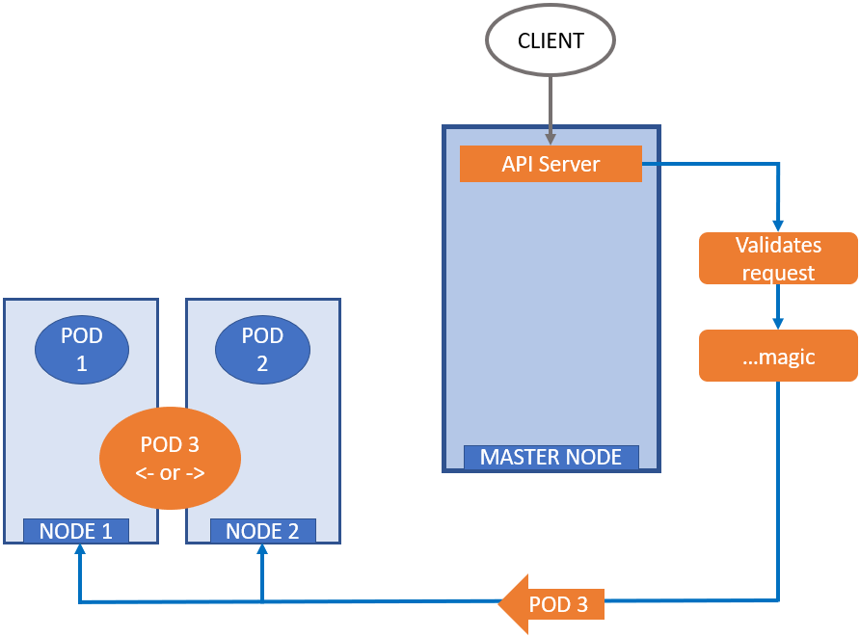
KUBE – API – SERVER
MASTER NODE COMPONENTS
Etcd
Heart of Kubernetes
All actions “go through” the API
User interaction with cluster (frontend)
Offers REST API
Kube-Scheduler
Kube-API-Server
Source [29]
14
Notes:
https://www.aquasec.com/cloud-native-academy/kubernetes-101/kubernetes-complete-guide/
https://www.redhat.com/en/topics/containers/what-is-the-kubernetes-API
https://www.oreilly.com/library/view/managing-kubernetes/9781492033905/ch04.html
https://www.containiq.com/post/kubernetes-control-plane
https://www.containiq.com/post/kubernetes-api

Slide 20
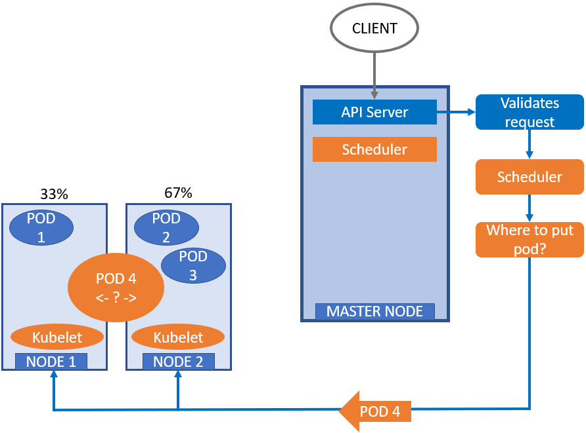
KUBE – SCHEDULER
Etcd
MASTER NODE COMPONENTS
Assign a pod to a node
Find best node for a pod
Kube-Scheduler
POD 4
←
Source [3], [24]
15
Notes:
https://www.aquasec.com/cloud-native-academy/kubernetes-101/kubernetes-complete-guide/
https://kubernetes.io/docs/concepts/scheduling-eviction/kube-scheduler/

Slide 21
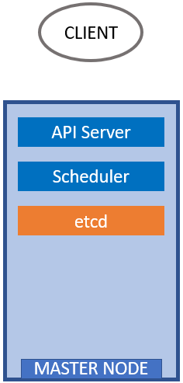
ETCD
Distributed, consensus based, key-value storage
Primary data storage
Store information:
Cluster configuration
Actual and desired state
Config map, secret
Any node in cluster can read and write data
Is a Tool: https://etcd.io/
Etcd
MASTER NODE COMPONENTS
Source [22], [23]
16
Notes:
https://www.aquasec.com/cloud-native-academy/kubernetes-101/kubernetes-complete-guide/
https://www.redhat.com/en/topics/containers/what-is-etcd
https://matthewpalmer.net/kubernetes-app-developer/articles/how-does-kubernetes-use-etcd.html

Slide 22
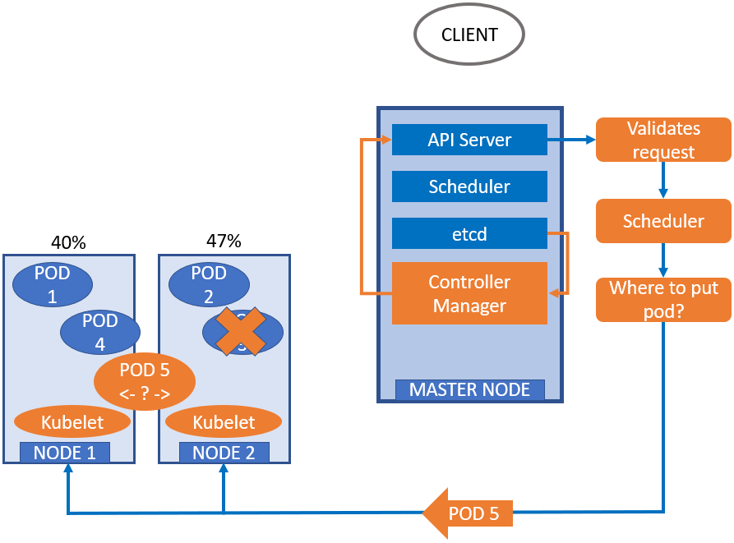
CONTROLLER MANAGER
Etcd
MASTER NODE COMPONENTS
Controllers bundled in this daemon
Monitor cluster state to guarantee desired cluster state
Ensure that pods are specified according to deployment
Kube-Scheduler
Kube-API-Server
POD 5
←
Controller Manager
Source [25]
17
Notes:
https://www.aquasec.com/cloud-native-academy/kubernetes-101/kubernetes-complete-guide/
https://komodor.com/learn/controller-manager/
https://medium.com/adeo-tech/how-to-build-a-zero-downtime-application-on-kubernetes-9f509fac3eb8

Slide 23
K8S SECURITY ASPECTS

Slide 24
BUILD-IN SECURITY
K8S SECURITY ASPECTS
IMAGE SCANNING
Enable some security measures yourself
Enable security measures on 3 levels: infrastructure, K8s platform and apps
Security begins before the deployment
Scan container images for critical vulnerabilities
No harmful images in deployment
Part of deployment process in CI/CD pipeline
External tools like Trivy (https://aquasecurity.github.io/trivy/v0.34/ )
Find CVEs: https://www.aquasec.com/cloud-native-academy/kubernetes-101/kubernetes-vulnerability-scanning/
Source [26], [27], [28]
18
Notes:
https://www.youtube.com/watch?v=oBf5lrmquYI
https://www.aquasec.com/cloud-native-academy/kubernetes-101/kubernetes-architecture/

Slide 25
CONTROL ACCESS TO
K8S SECURITY ASPECTS
COMMUNICATION ENCRYPTION
Kubernetes components:
Kubelet: unauthenticated access to API by default
Communication between pods is unencrypted
Read communication in plain text
Establish communication rules
Enable TLS between pods
Source [26], [27], [28]
19

Slide 26
LOCAL SETUP
INSTALL AND OPEN DOCKER
OPEN COMMAND LINE
ENTER THE FOLLOWING COMMAND
docker pull renkelp/kubernetes_workshop_online
docker run -d --name kubernetes_workshop renkelp/kubernetes_workshop_online sleep infinity
docker exec -it kubernetes_workshop /bin/sh
Navigate to: https://killercoda.com/playgrounds/scenario/kubernetes
Github repository
https://github.com/sebivenlo/esde_kubernetes_2022

Slide 27

KUBERNETES
QUIZ
GO TO: https://quizizz.com/join
WAIT FOR THE CODE TO JOIN ☺

Slide 28
RESOURCES
[1] https://kubernetes.io/docs/concepts/overview/
[2] Official Documentation: https://kubernetes.io/
[3] https://www.youtube.com/watch?v=X48VuDVv0do (Accessed: 21.09.2022)
[4] https://en.wikipedia.org/wiki/Kubernetes (Accessed: 28.09.2022)
[5] https://kubernetes.io/blog/2018/07/20/the-history-of-kubernetes-the-community-behind-it/ (Accessed: 03.11.2022)
[6] https://kubernetes.io/case-studies/adidas/ (Accessed: 06.10.2022)
[7] https://kubernetes.io/case-studies/pinterest/ (Accessed: 06.10.2022)
[8] https://kubernetes.io/case-studies/spotify/ (Accessed: 06.10.2022)
[9] https://www.jeremyjordan.me/kubernetes/ (Accessed: 21.09.2022)
[10] https://kubernetes.io/docs/concepts/overview/#why-you-need-kubernetes-and-what-can-it-do (Accessed: 26.10.2022)
[11] https://kubernetes.io/ (Accessed: 21.09.2022)
[12] https://deepsource.io/blog/zero-downtime-deployment/ (Accessed: 26.10.2022)
[13] https://www.ibm.com/cloud/blog/kubernetes-vs-docker (Accessed: 26.10.2022)
[14] https://www.ibm.com/cloud/blog/docker-swarm-vs-kubernetes-a-comparison (Accessed: 26.10.2022)
[15] https://matthewpalmer.net/kubernetes-app-developer/articles/kubernetes-networking-guide-beginners.html (Accessed: 03.11.2022)
[16] https://matthewpalmer.net/kubernetes-app-developer/articles/ingress.png (Accessed: 13.10.2022)
[17] https://k21academy.com/docker-kubernetes/configmaps-secrets/ (Accessed: 27.10.2022)
[18] https://kubernetes.io/docs/concepts/configuration/configmap/ (Accessed: 13.10.2022)
[19] https://kubernetes.io/docs/concepts/storage/volumes/ (Accessed: 20.10.2022)
[20] https://kubernetes.io/docs/concepts/overview/components/ (Accessed: 20.10.2022)
[21] https://www.aquasec.com/cloud-native-academy/kubernetes-101/kubernetes-cluster/ (Accessed: 21.09.2022)
[22] https://www.redhat.com/en/topics/containers/what-is-etcd (Accessed: 13.10.2022)
[23] https://matthewpalmer.net/kubernetes-app-developer/articles/how-does-kubernetes-use-etcd.html (Accessed: 26.10.2022)
[24] https://kubernetes.io/docs/concepts/scheduling-eviction/kube-scheduler/ (Accessed: 13.10.2022)
[25] https://komodor.com/learn/controller-manager/ (Accessed: 13.10.2022)
[26] https://www.youtube.com/watch?v=oBf5lrmquYI (Accessed: 27.10.2022)
[27] https://kubernetes.io/docs/tasks/administer-cluster/securing-a-cluster/ (Accessed: 27.10.2022)
[28] https://kubernetes.io/docs/concepts/security/ (Accessed: 27.10.2022)
[29] https://www.containiq.com/post/kubernetes-api (Accessed: 13.10.2022)

Slide 29
THANK YOU FOR YOUR ATTENTION!
Enterprise Software Development
Paul Renkel & Dorothee Schilling & Laura Baus

Slide 30
CLIENT
API Server
Validates request
POD 1
POD 2
…magic
POD 3
<- or ->
MASTER NODE
NODE 1
NODE 2
POD 3

Slide 31
CLIENT
API Server
Validates request
Scheduler
Scheduler
33%
58%
POD 1
POD 2
Where to put pod?
POD 4
<- ? ->
POD 3
MASTER NODE
Kubelet
Kubelet
NODE 1
NODE 2
POD 4

Slide 32
CLIENT
API Server
Scheduler
etcd
MASTER NODE

Slide 33
CLIENT
API Server
Validates request
Scheduler
Scheduler
40%
47%
etcd
POD 1
POD 2
Controller Manager
Where to put pod?
POD 4
POD 3
POD 5
<- ? ->
MASTER NODE
Kubelet
Kubelet
NODE 1
NODE 2
POD 5

Slide 34
POD A.1
POD A.2
Service A
Internal
(10.96.121.48)
CLIENT
Service B
External (47.157.36.42)
POD B.1
NODE 1
NODE 2

Slide 35
DEPLOYMENT “A“
(3 replicas, nginx image, …)
POD A.1
nginx
POD A.2
nginx
POD A.3
nginx

