Slide 1

Julia in production environments
Sebastian Zając, PhD
SGH Warsaw School of Economics
Preparation of this workshop has been supported by the Polish National Agency for Academic Exchange under the Strategic Partnerships programme, grant number BPI/PST/2021/1/00069/U/00001.

Slide 2
Business case
Let’s assume you work for company that sells apartments in Boston. We want to increase our sales and offer better quality services to our customers by new mobile application which can be used even by 1 000 000 people simultaneously.
We can realize this by serving a prediction of house value when the user sends a request for pricing over the web.
Mobile
Customers app
Tablet
ML Model
PC
Laptop
On a server we will run a machine learning model that is trained to predict house price based on its features. We will use the Housing data set from UCI repository to build it. *https://archive.ics.uci.edu/ml/machine-learning-databases/housing/.

Slide 3
What exactly is Serving a Model?
Training a good ML model is ONLY the first part: You do need to make your model available to your end-users You do this by either providing access to the model on your SERVER.
When serving ML Model You need: a model, an interpreter, input data.
Important Metrics: 1. Latency, 2. Cost, 3. Throughput (number of requests served per unit time)

Slide 4
REST API
Sharing data between two or more systems has always been a fundamental requirement of software development – DevOps vs MLOps.
API: Application Programming Interfaces
Client-Server: Client (systemA) makes an HTTP request to a URL hosted by SystemB, which returns a response. It’s identical to how a browser works. A browser makes a request for a specific URL. The request is routed to a web server which typically returns an HTML (text) page.
Stateless: The client request should contain all the information necessary to respond.
Client app
Request
Server
HTTP POST
Response
JSON

Slide 5
Request
- An Endpoint URL a domain, port, path, query string
- The HTTP methods
- HTTP headers contain authentication information, cookies
metadata
http://mydomain:8000/getapi?&val1=43&val2=3
GET, POST
Content-Type: application/json, text …
Accept: application/json
Authorization: Basic abase64string, Tokens etc

Slide 6
Request body
Response
json example
{
"RAD": 1,
"PTRATIO": 15.3,
"INDUS": 2.31,
"B": 396.9,
"ZN": 18,
"DIS": 4.09,
"CRIM": 0.00632,
"RM": 6.575,
"AGE": 65.2,
"CHAS": 0,
"NOX": 0.538,
"TAX": 296,
"LSTAT": 4.98
}
The response payload is defined in the response header:
200 OK
Content-Encoding: gzip
Content-Type: text/html; charset=utf-8
Date: Mon, 18 Jul 2016 16:06:00 GMT
Server: Apache
Path=/;
Header example:
"Content-Type" => "application/json; charset=utf-8",
"Server" => "Genie/Julia/1.8.5
Body example:
{":input":{"RAD":1,"PTRATIO":15.3,"INDUS":2.31,…..}}, {":prediction":[29.919737211857683]}
HTTP status code:
200 OK is used for successful requests,
40X Access Denied
50X Internal server error

Slide 7
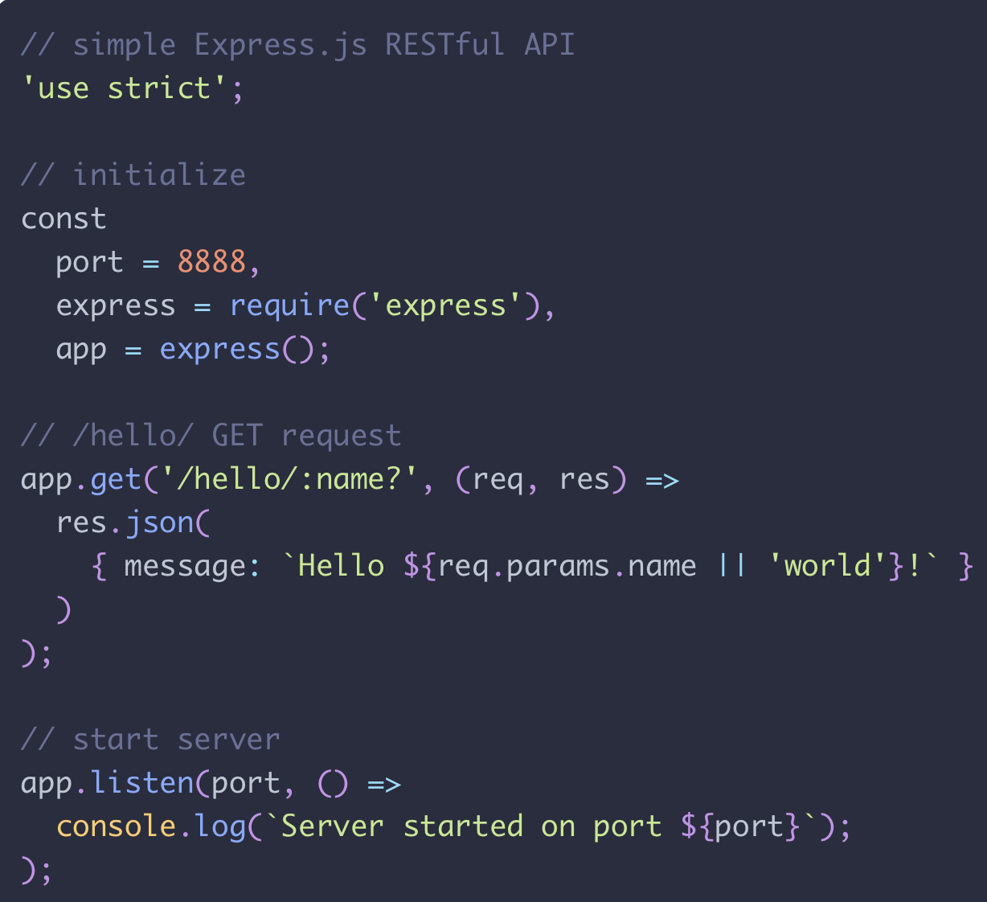
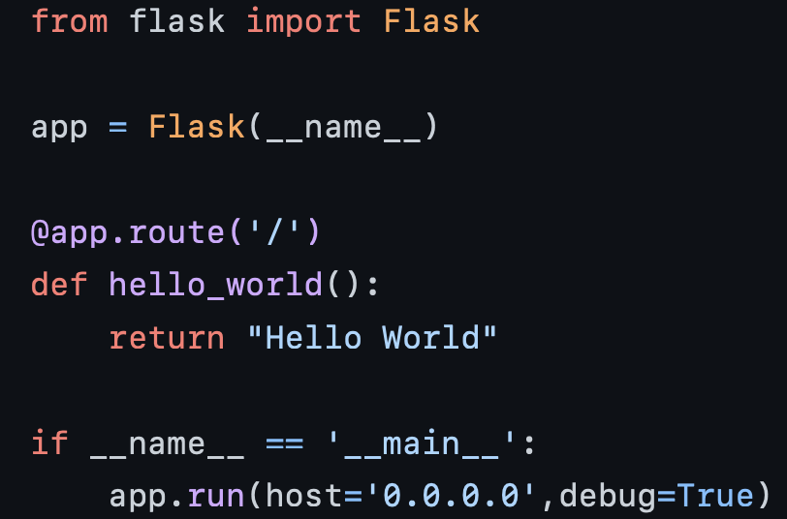
REST API examples

Slide 8
The ML project lifecycle
Scoping
Data
Deployment
Modelling
Define project
Business points
Define data
Take Label,
Select and train model
Perform error analysis
Deploy in production
Monitor & maintain system
organize data

Slide 9
The ML project lifecycle
Only a small fraction on real-world ML systems is composed of the ML code, as shown by the small black box in the middle. The required surrounding infrastructure is vast and complex.
Source: D. Sculley et All. Hidden Technical Debt in Machine Learning Systems (2015)
ML CODE

Slide 10
Docker
Docker is an amazing tool that allows you to ship your software along with all of its dependencies.
When You create Your model first you setup environment on your local machine. But now you want to share this model with a colleague of yours who does not have Python installed. In a pre-Docker time your colleague would have to install all of this software just to run the model.
Other solutions? Virtual Machine - why not?
Simple Installation - Docker Desktop (Windows, Mac OS, Linux) - with Kubernetes

Slide 11
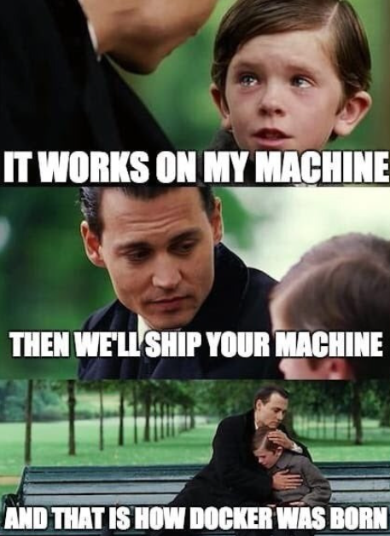
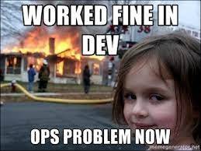
Docker

Slide 12
Docker components
Dockerfile: a file that contains all of the instructions required to build an image. Like with terminal commands.
Image: a collection of all your software in one single place. In our case study image will include Julia env and packages like Genie, GLM, DataFrames… Image saving the information of your code and its dependencies.
Container: a running instance of an image. Usually meant to perform a single task

Slide 13
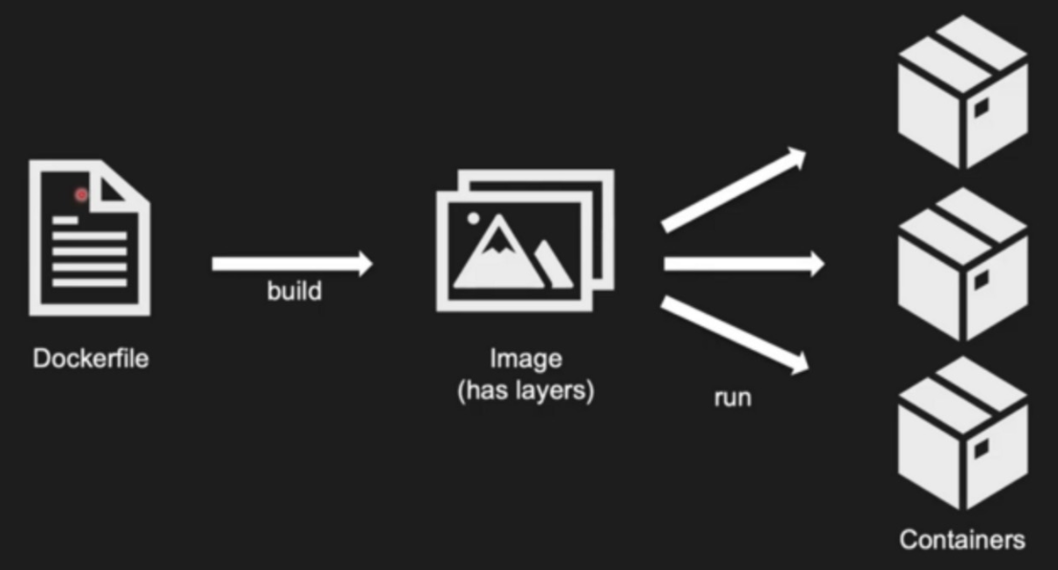
Running Docker
Prepare Dockerfile – ordinary text file
Build it and create image: docker biuld –t name .
Run container: docker run name

