Slide 1
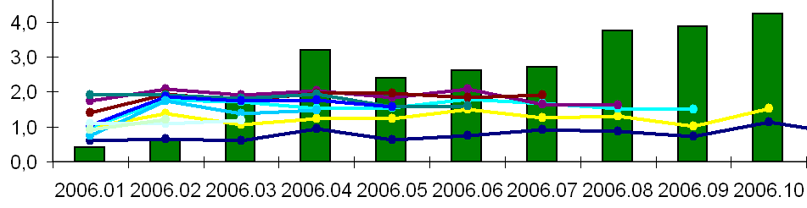
Credit Scoring and Real Time Analytics
Warsaw School of Economics – SGH
Institute of Statistics and Demography
Statistical Methods & Business Analytics Unit
Karol Przanowski, Sebastian Zając

Slide 2
Agenda
SGH - Warsaw School of Economics studies
  BIG Data studies
  SAS Certificate
Credit Scoring lecture
  General description
  Business case
Real Time Analytics lecture
  General description
  Business case

Slide 3
SGH studies and SAS certificate
In 2020/21the Statistical Methods & Business Analytics Unit is celebrating 15 years of operation. As the Unit we are responsible for:
Systematic international workshop Advanced Analytics & Data Science is related to the field of Advanced Analytics - Big Data studies and part of our postgraduate studies. The 8th „International Workshop Advanced Analytics & Data Science. Business Analytics & Academia” will be held on 14 September 2021. Welcome !;
Realization of Certificate Program “Data Scientist with SAS” for students Advanced Analytics - Big Data;
C. Realization of two post- diploma studies: the first: „Analytical Academy with SAS, R & Python” and the second: „Statistical Analysis & Data Mining in Business”;

Slide 4
SGH studies and SAS certificate
Education process at the Advanced Analytics – BIG Data program, which we have co-created and we have been responsible for the implementation of the following items for last 6 years (total 210 h):
Basic & advanced programming with SAS with Statistics
Data Mining
Real Time Analytics
Credit Scoring
Advanced Business Analytics. Power of Predictive Models.
Logistic Regression
Event History Analysis

Slide 5
Credit Scoring lecture
Credit Acceptance Process
  Profitability: ∆Gini - ∆Profit
Credit scorecard building in SAS 4GL
  WoE approach, Branch & Bound selection, Logistic regression, Partial score normalization
Model lifecycle
Customer Lifetime value approach
Reject Inference problems
Credit Acceptance Process
  Acquisition – Installment loans
  Cross-sell – Cash loans

Slide 6
Credit Scoring – Business case
Data randomly generated delivered to students
Acceptance process simulation
  Dynamic process dependent on historical decisions
  Decision Engine with 4 scoring models:
    Installment loan risk model (PD Ins)
    Cash loan risk model (PD Css)
    Risk model for a cash loan when applying for an installment loan (Cross PD Css)
    Model of the propensity to use a cash loan when applying for an installment loan (PR Css) (response model)
    Cut-off strategy
Financial result is calculated
To get a pass every group of students must (like a competition):
  Build 4 models and implement in Decision Engine
  Set cut-offs and get better financial result than the benchmark strategy

Slide 7
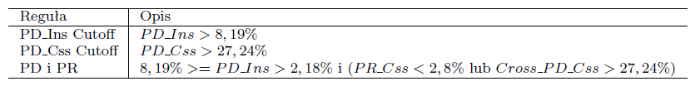
Benchmark strategy, part 1
Rule
Description
Rule
&
&
or
product css
Decline reason | N | Pct | Amount | Risk | Profit
1 PD cut-off on css | 8 436 | 32,97% | 42 180 000 | 67,99% | -13 098 591
998 not active custo | 12 999 | 50,80% | 64 995 000 | 65,91% | -19 171 357
999ok | 4 152 | 16,23% | 20 760 000 | 22,35% | 642 637
All | 25 587 | 100,00% | 127 935 000 | 59,53% | -31 627 311
product ins
Decline reason | N | Pct | Amount | Risk | Profit
2 PD cut-off on ins | 9 289 | 39,30% | 60 214 008 | 26,95% | -7 339 423
3 PD,PDCross and PR | 8 131 | 34,40% | 31 340 808 | 5,37% | -505 662
999ok | 6 217 | 26,30% | 22 698 240 | 2,14% | 20 690
All | 23 637 | 100,00% | 114 253 056 | 13,00% | -7 824 395
All rules are implemented in the Decision Engine
Water-fall reports are automatically calculated

Slide 8
Benchmark strategy, part 2
Period | Income | Loss | Profit
1975-1987 | 3 407 745 | 2 744 418 | 663 327
1988-1998 | 3 761 299 | 2 246 844 | 1 514 455
Strength of Prediction
Model | Gini
 | Accepted | All
Cross PD on cross | 21,34% | 40,72%
PD on css | 31,66% | 53,28%
PD on ins | 41,93% | 68,58%
PR on cross | 72,56% | 68,88%
Every model is validated by its documentation
Acceptance strategy is validated by various criteria:
  Financial result
  Acceptance rate on acquisition
  Acceptance rate on cross-sell

Slide 9
Real Time Analytics lecture
Structured and unstructured data
Batch vs Streaming processing
  The data are always produced in some stream proces
Business point of view – Time-critical decisions
Classical and new kind of Data Processing Models
  OLTP, OLAP, Lambda arch.
Time in stream data processing
  Event Time, Processing Time, Watermarks, Time-Based Window Aggregations

Slide 10
RTA – Business cases
Batch processing and production environment with Models from Credit scoring data in OOP Python
Data Stream from Twitter API and from random log generator based on Apache Kafka, Apache Spark and Apache Flink
(Python, Scala API)
Different time aggregations for streaming applications.
Databricks – Cloud environments for Real Time analytics
SAS Event Stream Processing as a tool for Decisions with Models and Business Conditions in the credit scoring case.

Slide 11
Statistical Methods & Business Analytics Unit
  2013 (International Year of Statistics 2013 www.statistics2013.org)
  Advanced Analytics and Data Science
  www.analytics-conference.pl
2014
  II Advanced Analytics and Data Science – 14.10
  http://www.sas.com/pl_pl/events/2014/advanced-analytics-and-data-science/index.html
2015
  III Advanced Analytics and Data Science – 20.10
  http://www.sas.com/pl_pl/events/2015/advanced-analytics-and-data-science/speakers-and-panelists-2015.html

Slide 12
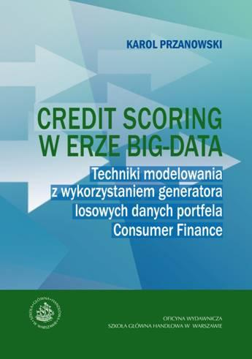
Book in PDF, only in Polish
http://www.wydawnictwo.sgh.waw.pl/produkty/profilProduktu/id/723//CREDIT_SCORING_W_ERZE_BIG-DATA_Karol_Przanowski/
http://administracja.sgh.waw.pl/pl/OW/publikacje/Documents/ostateczny_CreditScoring_KPrzanowski.pdf

Slide 13

Book in PDF, only in Polish
The presented business models of profitability and usability of predictive models in:
Acceptance of cash loans
Acceptance of the complex process: acquisition and cross-selling
Acceptance of mortgage loans
Amicable debt collection
Managing BTL campaigns
Counteracting customer churn
Enclosed Excel files with rules and practical indicators http://administracja.sgh.waw.pl/pl/OW/publikacje/Strony/2015.aspx

Slide 14
In English
Karol Przanowski, Credit acceptance process strategy case studies - the power of Credit Scoring - https://arxiv.org/abs/1403.6531
Karol Przanowski, Consumer finance data generator - a new approach to Credit Scoring technique comparison - https://arxiv.org/abs/1210.0057
Karol Przanowski, Banking retail consumer finance data generator - credit scoring data repository, e–FINANSE, 9(1), pp. 44–59, 2013

Slide 15
In English
The Credit scoring in the context of interpretable machine learning. Theory and practice. Edited by D. Kaszyński, B. Kamiński, T. Szapiro, Oficyna Wydawnicza SGH, Warszawa 2020
K.Przanowski, S. Zając, D. Kaszyński, Ł. Opiński, Variable selection methods, Chapter 3, Pages 57-81.
M. Wrzosek, D. Kaszyński, K.Przanowski, S. Zając, Selected machine learning methods used for credit scoring, Chapter 4, Pages 83-143.
https://ssl-kolegia.sgh.waw.pl/pl/KAE/struktura/IE/struktura/ZWiAD/publikacje/Documents/Credit_scoring_in_the_context_of_interpretable_machine_learning.pdf

