Slide 1
CICS 390B · FINAL PRESENTATION
Predicting asset behavior under macro stress.
A study of Gold, SPY, and Bitcoin under stress regimes — and whether macro-financial indicators help us forecast.
Dhruv Kartik
Sebastian Vaskes Pimentel
Nathan Dennis

Slide 2
PROBLEM & MOTIVATION
Predicting asset behavior under stress.
The problem. Financial stress frequently propagates across global markets, triggering elevated volatility in equities, credit, and alternative assets.
The motivation. During turbulent periods, investors rely on traditionally "defensive" assets to protect capital. Understanding if and when these assets actually work matters for algorithmic trading and portfolio risk management.
Our focus. Use macro-financial stress indicators — high-yield credit spreads, the VIX, the financial stress index — to predict cross-asset behavior across equities (SPY), commodities (Gold), and crypto (Bitcoin).

Slide 3
RESEARCH QUESTIONS
Core research questions.
Primary question. Does Gold genuinely behave defensively as a "safe haven" during periods of macroeconomic stress?
01
How do the returns and volatility of Gold, SPY, and Bitcoin compare under statistically defined stress regimes?
02
Can credit-market and macro-stress indicators provide reliable predictive signals for short-term asset returns and volatility?
03
Do non-linear machine learning models (XGBoost) capture safe-haven dynamics better than standard linear baselines?

Slide 4
DATA · METHODOLOGY
How we set up the study.
The dataset.
Three stress-regime definitions.
4,150 daily observations from October 2014 through February 2026 — covering the 2020 COVID crash, the 2022 inflation/rate-hike cycle, and the 2023 banking stress episode. Each row pairs prices for Gold, SPY, and Bitcoin with macro-stress indicators: VIX, the financial stress index, the high-yield credit spread, the yield-curve spread, drawdown, RSI, and rolling volatilities.
REGIME
THRESHOLD
% OF DAYS
High-yield credit spread
≥ 66th pct (4.40)
34.2%
Financial Stress Index
≥ 66th pct (-0.17)
34.1%
VIX
≥ 66th pct (19.06)
34.0%
Targets we modeled.
stress_any (≥ 1 fires)
Robustness check
56.3%
Next-day Gold returns, 5-day directional outperformance vs SPY, multi-asset volatility (h = 1 and 5), and a one-week-ahead stress-regime forecast — all on a strict chronological 80 / 20 split with no random shuffling.
stress_all (all 3 fire)
Severe stress only
14.3%
We use multiple stress definitions so a finding only counts when it survives more than one threshold.

Slide 5
KEY FINDINGS FROM DATA ANALYSIS · 1 OF 3
Key findings from exploratory analysis.
Statistical foundation.
Mean daily log return by VIX regime
Asset prices proved non-stationary, while log returns were stationary. Granger causality tests indicated that lagged equity returns provide a statistically significant predictive signal for Gold at medium lags.
REGIME
GOLD
SPY
Low VIX (calm)
+0.015%
+0.102%
The stress premium.
High VIX (stress)
+0.068%
−0.092%
Under high-stress regimes (e.g. elevated VIX), Gold reliably outperformed equities. During VIX stress, Gold's mean daily log return was positive while SPY's was negative — widening the differential significantly.
In calm markets, SPY earns more than Gold. When the VIX spikes, the sign flips — Gold goes up while SPY loses money on average. That sign-flip is what "safe haven" means in the data.
Volatility & crisis events.
Gold's volatility rises during stress, but far less dramatically than SPY's. Event studies showed Gold protected capital during the 2020 COVID crash, though its defensive behavior was much more mixed during the 2022 inflation / rates crisis.

Slide 6
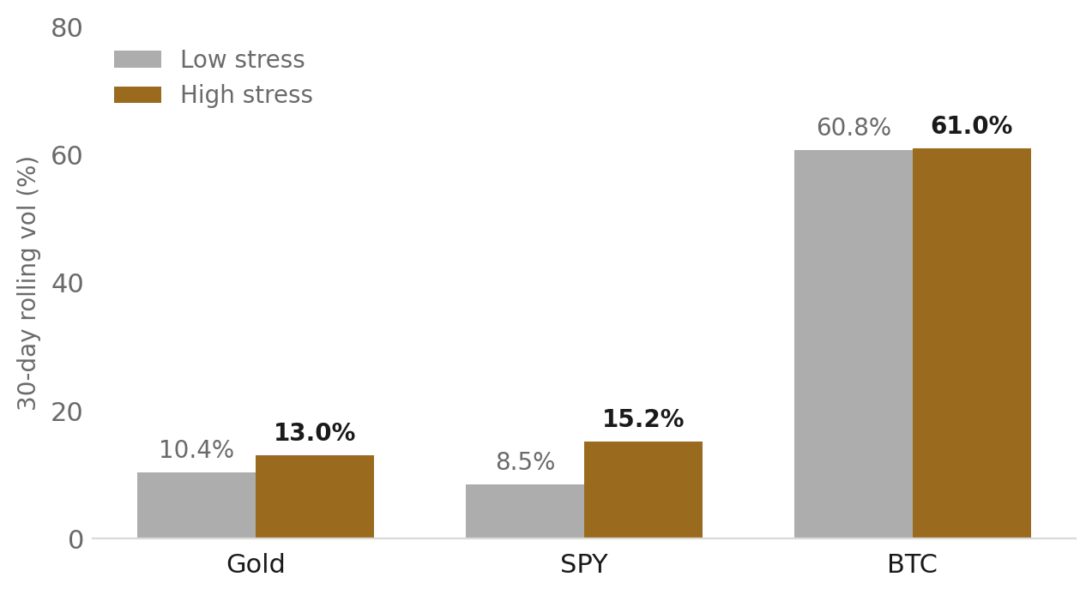
KEY FINDINGS FROM DATA ANALYSIS · 2 OF 3
Volatility & correlation tell the cleanest story.
Volatility expansion is asymmetric.
30-day rolling volatility · low vs high stress
When stress hits, SPY's 30-day volatility nearly doubles — jumping from 8.5% to 15.2%. Gold barely flinches: 10.4% to 13.0%. That gap is the data definition of defensiveness — Gold doesn't avoid risk entirely, it just absorbs far less of it. Bitcoin sits at ~60% in both regimes, behaving like a permanently risky asset.
Correlation drops when stress hits.
The 60-day rolling correlation between Gold and SPY falls toward zero in stress periods — and a bootstrap 95% confidence interval on that drop excludes zero. In plain terms: Gold genuinely decouples from equities exactly when investors need it to. Bitcoin behaves the opposite way — its correlation with Gold rises in stress, reinforcing that BTC moves with risk assets, not against them.
The bars tell the story. SPY's stress bar towers over its calm bar; Gold's barely moves; Bitcoin is just permanently elevated. Defensiveness shows up as a small gap, not a low absolute level.

Slide 7
KEY FINDINGS FROM DATA ANALYSIS · 3 OF 3
Event studies: did Gold actually protect capital?
EVENT 1 · COVID CRASH
EVENT 2 · INFLATION & RATES
EVENT 3 · BANKING STRESS
February – April 2020.
Jun – Oct 2022.
March – April 2023.
Equities collapse on pandemic fear; central banks intervene at unprecedented speed. The textbook risk-off shock.
Persistent CPI prints, aggressive Fed hikes, real rates rising fast. A non-classical stress regime where everything sells off together.
SVB and Credit Suisse fail; flight-to-quality drives a sharp but contained risk-off episode in credit markets.
Gold
+6.4%
Gold
-11.9%
Gold
+8.5%
SPY
-14.4%
SPY
-5.9%
SPY
+5.2%
BTC
-17.5%
BTC
-43.9%
BTC
+23.5%
Gold protected — clearly.
Gold disappointed.
Gold rose, but BTC won.
The takeaway: Gold is a conditional safe haven — strong in liquidity-driven panics, weak when stress is driven by rising real rates.

Slide 8
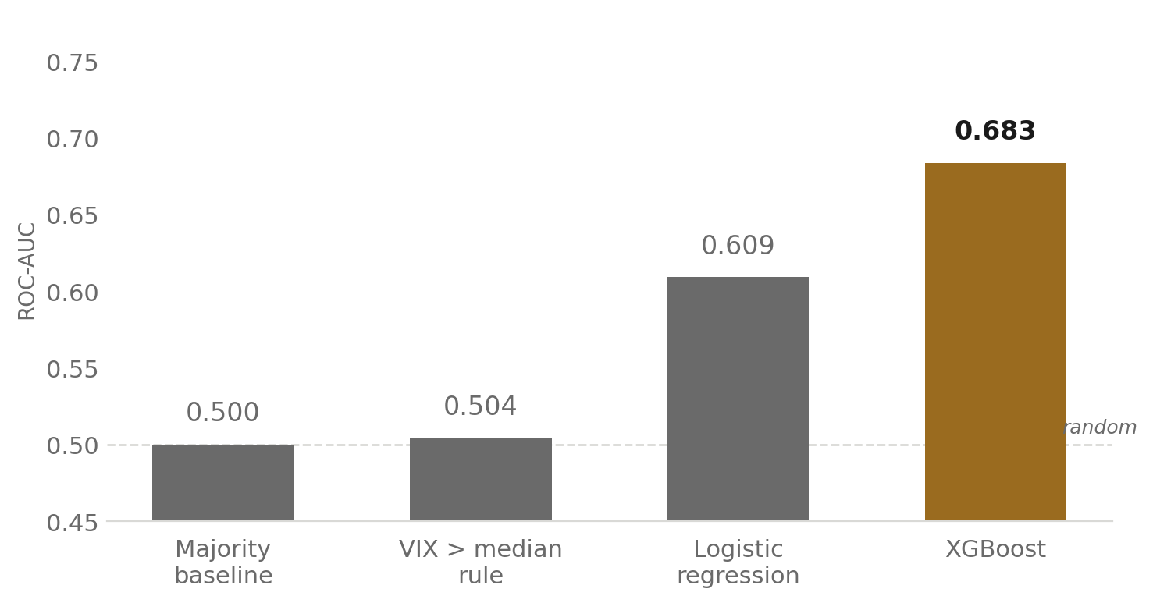
MODELS EXPLORED
Modeling pipeline: from baselines to XGBoost.
MILESTONE 1 · LINEAR BASELINES
MILESTONE 2 · NON-LINEAR & CLASSIFICATION UPGRADES
Ridge regression.
Logistic regression.
Used for short-horizon Gold return predictions and 5-day SPY volatility forecasting.
Added as a baseline for classification tasks.
Persistence baselines.
XGBoost — safe-haven classifier.
Naive forecasting to establish a "floor" for model performance.
Predicting if Gold will outperform SPY the next day.
XGBoost — multi-asset volatility.
Forecasting SPY, Bitcoin, and VIX volatility at 1-day and 5-day horizons.
XGBoost — stress-regime classifier.
Predicting high macro-stress conditions one week ahead.
HEAD-TO-HEAD · SAFE-HAVEN CLASSIFIER (ROC-AUC)
Each step up the ladder helps. Naive baselines hover at chance. Logistic regression starts using the macro signals (~0.61). XGBoost reaches 0.68 — a clear, repeatable lift over chance and over the simple VIX rule.

Slide 9
SAFE-HAVEN CLASSIFIER
Can we predict when Gold beats SPY?
What we're predicting.
Test-set performance
A simple yes/no question every day: will Gold's return tomorrow be higher than SPY's? The model sees today's macro picture — VIX, credit spreads, drawdowns, recent volatility — and tries to call the next-day winner.
MODEL
ACC
BAL ACC
ROC-AUC
Majority baseline
0.617
0.500
0.500
VIX > median rule
0.537
0.513
0.504
Logistic (balanced)
0.577
0.588
0.609
What XGBoost found.
XGBoost
0.646
0.592
0.6835
ROC-AUC of 0.6835 — clearly above the 0.50 random line and above both naive baselines. The features doing the heavy lifting are drawdown, recent SPY volatility, and the high-yield credit spread — exactly the macro-stress signals we expected to matter.
Confusion matrix · XGBoost
PRED · Gold ≤ SPY
PRED · Gold > SPY
True Gold ≤ SPY
417
90
True Gold > SPY
201
114

Slide 10
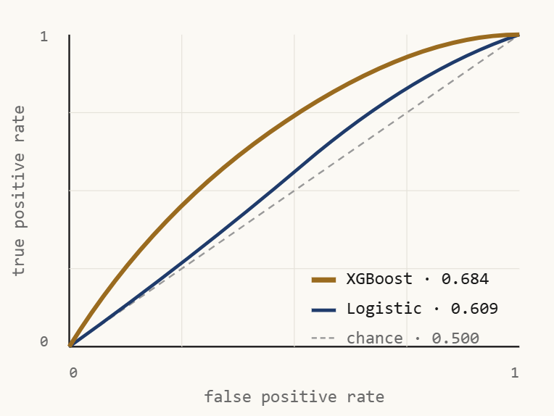
COMPARATIVE ANALYSIS
What worked (and what didn't).
Safe-haven classification — success.
Safe-haven ROC · Gold vs. SPY (next day)
XGBoost significantly improved our ability to predict directional outperformance. The model achieved an ROC-AUC of 0.6835 when classifying if Gold would beat SPY the next day, indicating that non-linear models capture market stress relationships well.
Volatility forecasting — the baseline wins.
Surprisingly, XGBoost and other non-linear methods failed to consistently beat simple Persistence or Ridge regression for forecasting volatility. Because volatility is "sticky" and slow-moving, simple linear models proved incredibly difficult to beat.
SPY 5-day vol forecast · RMSE (lower = better)
MODEL
RMSE
Bitcoin vs. Gold.
Persistence
0.0248
The models and analysis heavily rejected the "digital gold" narrative. Bitcoin behaved more like a high-beta tech equity, suffering massive volatility spikes during macro stress compared to Gold's relative stability.
Ridge
0.0210
XGBoost
0.0246

Slide 11
WHERE WE GO NEXT
Beyond a single 80/20 split.
01
Walk-forward validation.
Today, every result rests on one chronological train/test split. We'll move to an expanding-window scheme that retrains every quarter and reports metrics year-by-year — so we can see whether the safe-haven signal holds up across regimes, or whether 2020 is doing all the work.
02
Explain the model, not just score it.
ROC-AUC tells us the classifier works; SHAP values will tell us why. We want to know which macro signals push the model toward a Gold-over-SPY call in vol-driven stress versus credit-driven stress — a real story instead of a single number.
03
Turn the signals into a portfolio rule.
Combine the safe-haven prediction with the stress-regime forecast: tilt allocation toward Gold only when both flag risk-off conditions. Then measure Sharpe and max drawdown against a static 60 / 40 benchmark to see whether the lift is real money or just a backtest artifact.
04
Stress-test the stress definitions.
Re-run all of our regime-conditional analyses using 75th and 90th percentile cutoffs of the high-yield spread, the financial stress index, and VIX — and only keep findings that survive every threshold. A real safe-haven effect shouldn't depend on where we draw the line.

Slide 12
LIMITATIONS & FINAL TAKEAWAYS
Limitations & conclusion.
LIMITATIONS
CONCLUSION
Next-day Gold returns are noisy.
Gold is a conditional safe haven.
Short-horizon prediction for Gold returns remains highly vulnerable to market noise, making pure return forecasting difficult.
The data supports a conditional safe-haven interpretation of Gold.
Linear baselines still dominate volatility forecasting.
Static 80/20 chronological split.
Standard linear baselines remain very hard to beat for sticky, slow-moving volatility series.
Limits how well we can evaluate model robustness across shifting market decades — we plan to fix this with walk-forward validation.
XGBoost leverages macro-stress indicators effectively.
Machine learning models can predict directional safe-haven outperformance using stress signals.
Dhruv Kartik · Sebastian Vaskes Pimentel · Nathan Dennis

