Slide 1
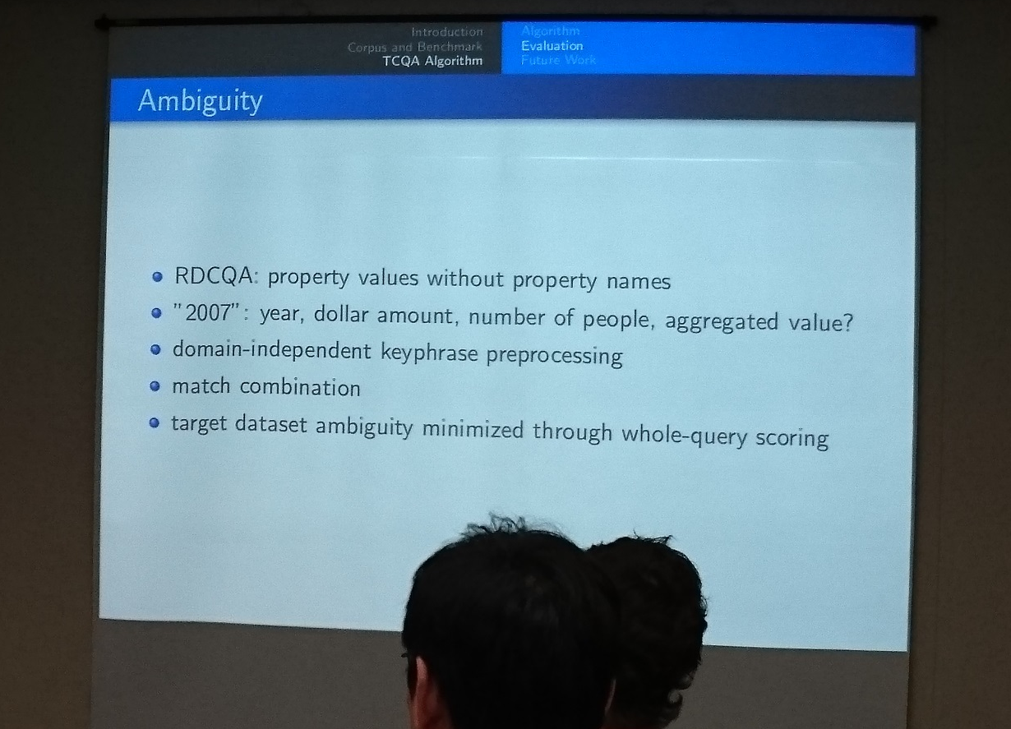
Notes:
Yesterday in a talk this slide was presented.
Our approach which I will present now is maybe a way to tackle this problem.

Slide 2
Multi-level semantic labelling of numerical values
Sebastian Neumaier,¹ Jürgen Umbrich,¹ Josiane Xavier Parreira,² Axel Polleres¹ 1. Vienna University of Economics and Business, Vienna, Austria
2. Siemens AG Österreich, Vienna, Austria

Slide 3
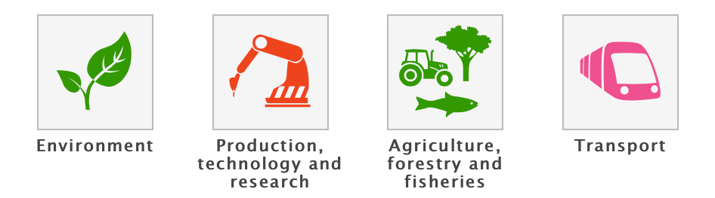

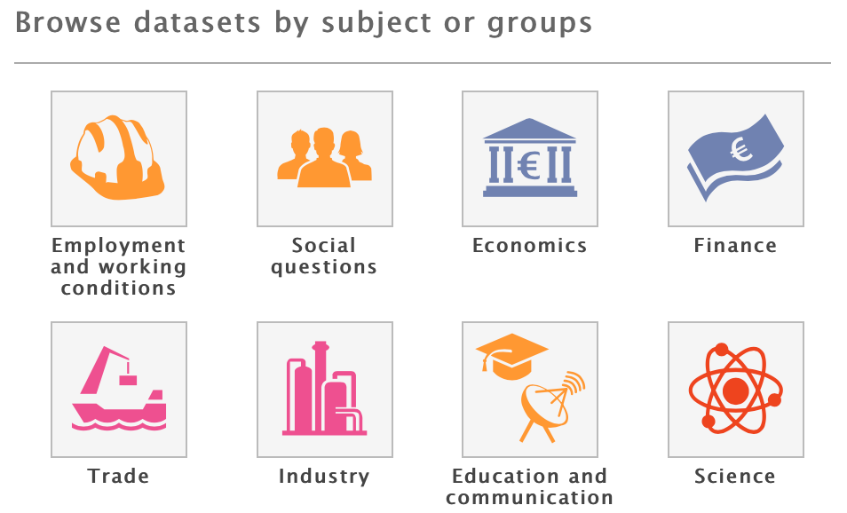
Motivation: Open Data
Available information is (partially) structured and tabular [1]:
3-star
2-star
1-star
82 data portals 160K datasets
Exploiting the potential:
Improve existing 3-star (CSV) Open Data
Propose semantic labels/context for the content of columns
Integrate and interlink data
[1] | Umbrich, J., Neumaier, S., Polleres, A.: Quality assessment & evolution of open data portals. In: IEEE International Conference on Open and Big Data, Rome, Italy (2015)
Notes:
A few years ago many public institutions and governments started to open up some of their data and published it on central points.
This datasets certainly contain interesting and useful information like transport, geography, economics or science data.
However, when we looked in more detail into these datasets, we found out…

Slide 4
Example
dpo:Stadium
dpo:City
dpo:Country
dbp:capacity
stadium name | capacity | city | country
Emirates Stadium | 60361 | London | England
Villa Park | 42785 | Birmingham | England
Ewood Park | 31154 | Blackburn | England
… | … | … | …
Notes:
Of course we are not the first ones who work with tabular data

Slide 5
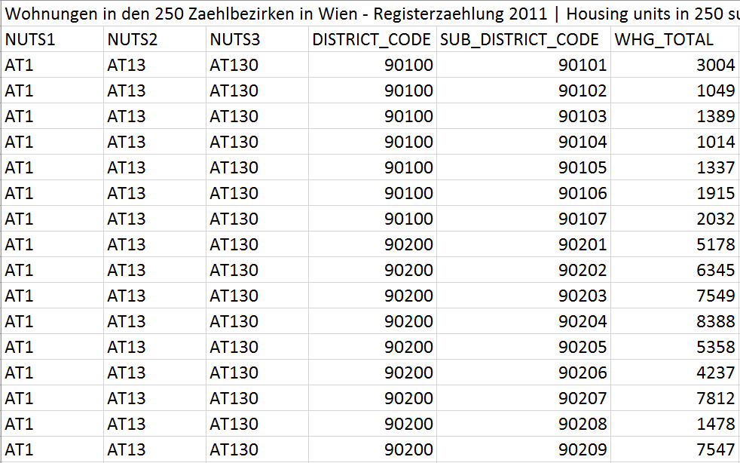
But:
Web/HTML tables differ from typical Open Data tables:
Domain: e.g., public administration data, statistical data, weather data, elections, …
Structure: OD tables contain large amount of numerical columns

Slide 6
Example (Cont’d)
stadium | capacity | city | country
Emirates Stadium | 60361 | London | England
Villa Park | 42785 | Birmingham | England
Ewood Park | 31154 | Blackburn | England
… | … | … | …
Notes:
Realistic open data csv would look more like this
Which makes the previous showed job much more harder

Slide 7
Example (Cont’d)
 | TOTAL | DISTRICT_CODE | ISO_2
Emirates Stadium | 60361 | SW1A 0AA | GB
Villa Park | 42785 | B23 7QG | GB
Ewood Park | 31154 | B26 6QA | GB
… | … | … | …
Notes:
Realistic open data csv would look more like this
Which makes the previous showed job much more harder

Slide 8
Why not use numeric values?
Identifying the most likely semantic label for a bag of numerical values
Deliberately ignore surroundings
 | TOTAL | DISTRICT_CODE | ISO_2
Emirates Stadium | 60361 | SW1A 0AA | GB
Villa Park | 42785 | B23 7QG | GB
Ewood Park | 31154 | B26 6QA | GB
… | … | … | …

Slide 9
Why not use numeric values?
Identifying the most likely semantic label for a bag of numerical values
Deliberately ignore surroundings
Emirates Stadium | 60361 | SW1A 0AA | GB
Villa Park | 42785 | B23 7QG | GB
Ewood Park | 31154 | B26 6QA | GB
… | … | … | …

Slide 10
Why not use numeric values?
Identifying the most likely semantic label for a bag of numerical values
Deliberately ignore surroundings
60361
42785
31154
…

Slide 11
Why not use numeric values?
Identifying the most likely semantic label for a bag of numerical values
Deliberately ignore surroundings
capacity <a stadium> <country England>
 | 60361
 | 42785
 | 31154
 | …

Slide 12
Our Approach
Hierarchical clustering over an RDF knowledge base
to build background knowledge graph (BKG)
nodes consist of typical numerical values, annotated with context information, i.e.: grouped by properties and their shared domain (subject) pairs
k-nearest neighbors search
Aggregation of the results at different levels to find the most likely context:
property
type
context

Slide 13
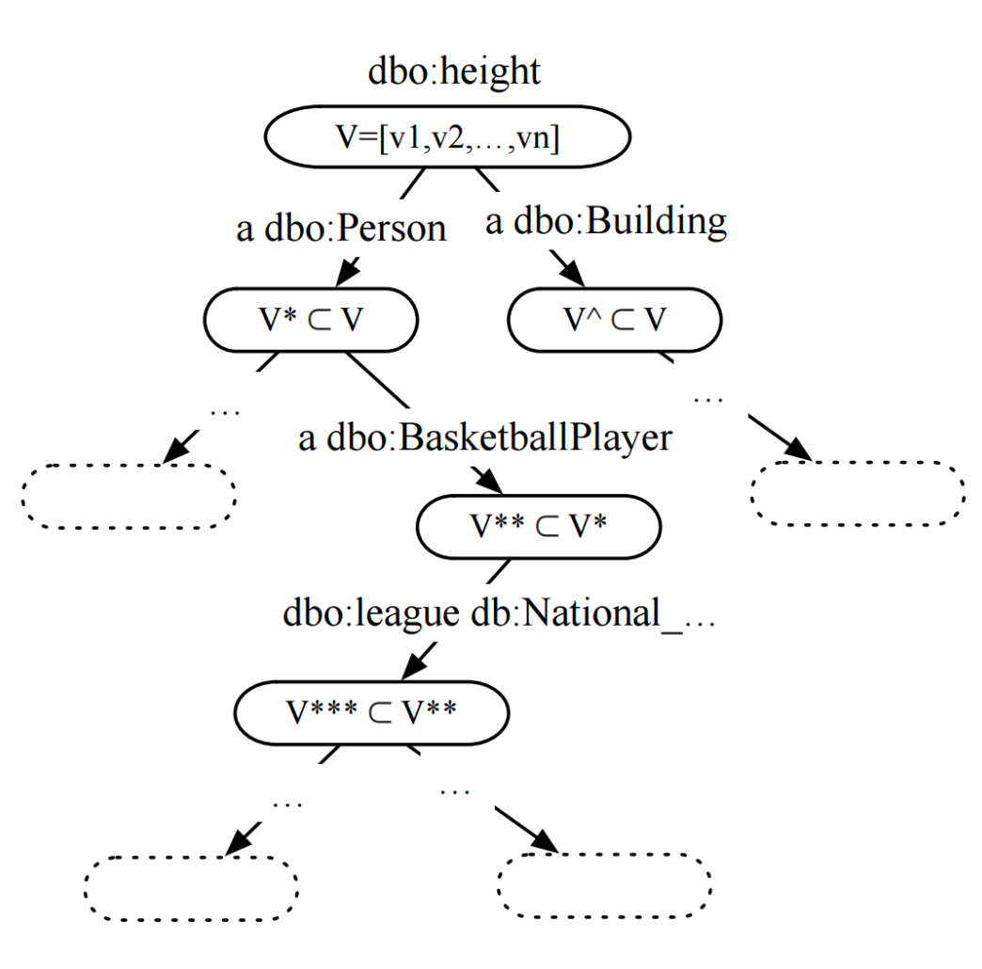
1. Background Knowledge Graph
Find properties with numerical range
Hierarchical clustering approach
Two hierarchical layers:
Type hierarchy (using OWL classes)
Property-object hierarchy (shared property-object pairs)

Slide 14
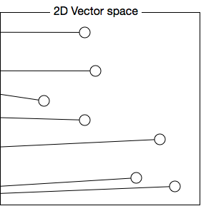
2. k-Nearest neighbor search
Mapping bags of numerical value to vector space (feature vector)

Slide 15
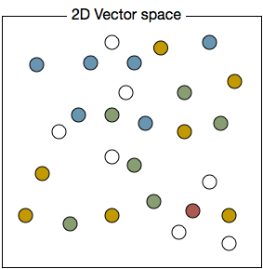
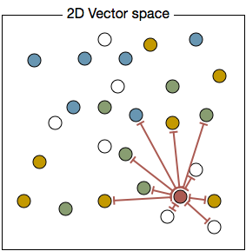
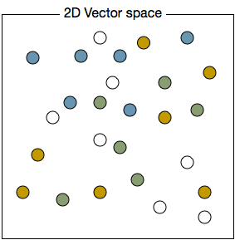
2. k-Nearest neighbor search (cont’d)
Compute & rank k-nearest neighbours for input values
1) input: [ 187, 201, 199, 198, 195, 199, 203, … ]
2) mapping:
3) compute distance to neighbours
4) select K nearest
2
4
3
6
5
1

Slide 16
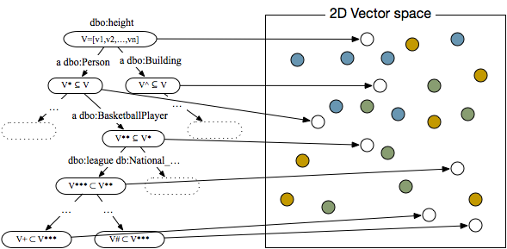
3. Result Aggregation
2
4
3
6
5
1

Slide 17
Evaluation: Setup
Data
DBPedia 3.9
50 most frequent numerical properties
Aggregation Levels
Aggregation Function
majority vote and average distance
Evaluation of different distance functions
Best: Kolmogorov-Smirnov (KS) distance
property | type | p-o level

Slide 18
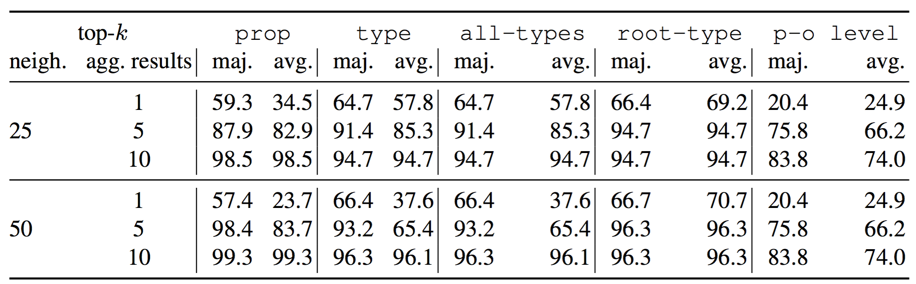
Evaluation 33657 Test Nodes
Majority vote slightly better
More neighbors also better
Top-5 shows already clear better results than top-1
9% of test nodes are contained 1-1 in knowledge graph !!
Accuracy results:

Slide 19
Experimental OD Column labelling
Data from two selected Open Data portals
1170 CSV tables
Manual inspection of top 100 tables
Lessons learned:
Missing domain knowledge
Timeline data
Combine with (existing) complementary approaches

Slide 20

Conclusions
Semantic labelling of numerical values
Hierarchical unsupervised background knowledge (BK)
We can assign fine-grained semantic labels if there is enough evidence in BK
Complementary to existing approaches
Future work
Find and integrate more background knowledge
Solve the domain mismatch between Open Data and existing KGs
Potentially applicable in other use cases
Sebastian Neumaier
WU Vienna, Institute for Information Business
email: sebastian.neumaier@wu.ac.at
url: https://sebneumaier.wordpress.com/
twitter: @sebneum

Slide 21
Backup Slides

Slide 22
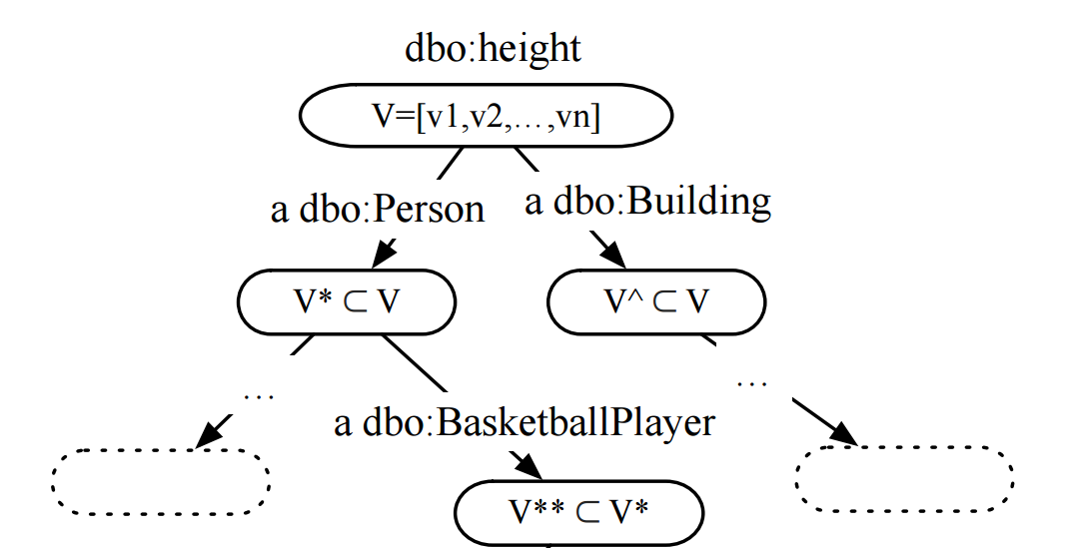
BKG: Type hierarchy
Represents rdfs:subClassOf relation for all available types
Construction:
Find properties with numerical range
Collect entities and all of their p-o pairs
Materials the OWL class hierarchy
Form a cluster for each type, containing all entity information

Slide 23
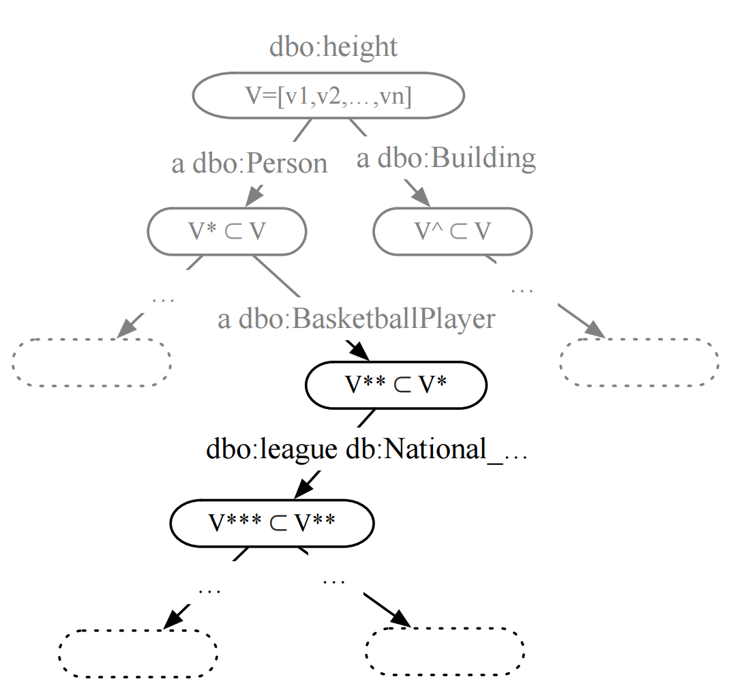
BKG: p-o hierarchy
Hierarchical clustering approach
Start with one node cluster
Build candidates:
constrain property-object: all subject share the same property-object pair
constrain size: candidate nodes are larger than 1% of the parent node and smaller than 99%
Sort candidates by their distance
Select candidate with largest distance, subsequently select non-overlapping candidates

Slide 24
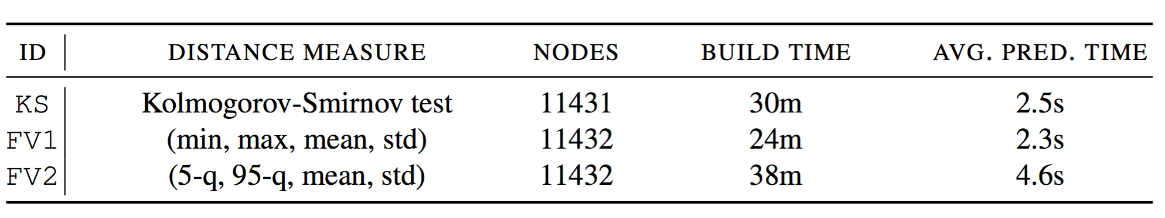
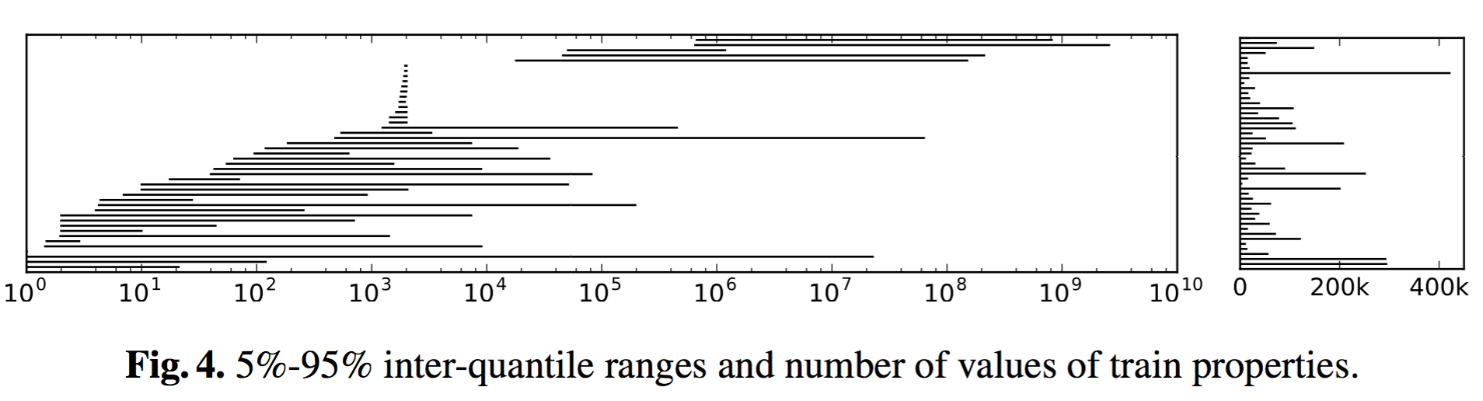
Evaluation: Setup
30 GB RAM
3 different knowledge bases:
DBpedia properties:

Slide 25
Evaluation: Test/train data
train/test split : 80/20
20% of the subjects for each property as test data
test context graph: similar as background construction, however, without constrains
randomly select leaf nodes

Slide 26
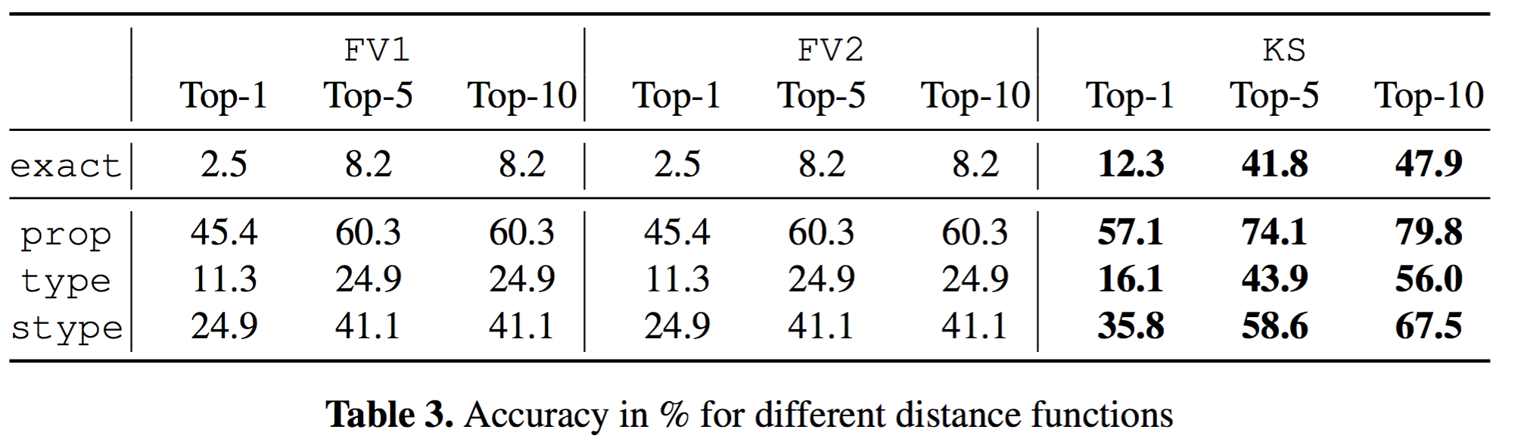
Evaluation: Distance Function 1787 Test Nodes
Best: Kolmogorov-Smirnov (KS) distance
exact = correct property, type and p-o
prop = correct property
type = correct type
stype = correct super type

Slide 27
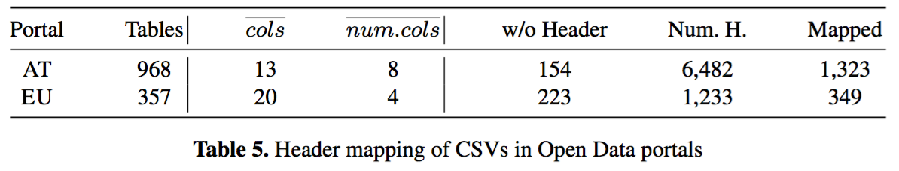
Open Data (OD) tables
Open Data tables typically contain
a large portion of numerical columns
missing headers
and/or non-textual headers
BabelNet
solutions that solely focus on textual “cues” are
only partially applicable for mapping such data sources

Slide 28
Lessons Learned from OD tables
Missing domain knowledge
Open Data is potentially very domain specific
Mismatch between knowledge bases like DBpedia and Open Data
Enrich knowledge graph with domain knowledge (e.g., extracted from Open Data tables)
Timeline data
values for different time points not in DBpedia
Detect time dependency and regroup/transform tables
Include complementary approaches
Deliberately excluded in this paper
Linguistic clues and string similarity measures (cf. approach by Pham et al.)

