Slide 1


Open Data Quality Assessment and Evolution of (Meta-)Data Quality in the Open Data Landscape
 | Sebastian Neumaier
 | seb.neumaier@gmail.com
Advisor: | Univ.Prof. Dr. Axel Polleres
Co-Advisor: | Dr. Jürgen Umbrich

Slide 2
Contents
Preliminaries: Open Data Landscape and Portals
Problem Statement and Motivation
Quality Metrics
Automated Quality Assessment Framework
Findings
Conclusion and Future Work

Slide 3
What is Open Data?
Freely available data,
published in an open and machine readable format
which allows everybody
to do everything without restrictions
at anytime
open access, preferable on the WWW
e.g., CSV, JSON, RDF
open license which allows use, reuse, modification, redistribution
private, non-commercial and commercial
24/7
See more at: http://opendefinition.org/okd/
Notes:
Open Knowledge Foundation: founded in 2004 in GB
Goals: also Open Science

Slide 4

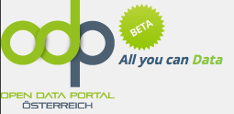









The Open Data Landscape
Cities, International Organizations, National and European Portals:
Socrata
CKAN
other data management systems
Notes:
GB leading in europe, but also multiple Austrian data portals
TODO group by

Slide 5



Open Data Portals
Single point of access
Meta data
Licenses
Provenance
Formats
…
Typical software
Open Data Portal
CSV
title
license
...
JSON
XML
Dataset
CSV
CSV
CSV
Resource
Notes:
CKAN: OpenSource portal by OKF
Socrata: A company offering portal software and hosting of data, mainly in US
OpenDataSoft: small France-based company, very similar to Socrata

Slide 6
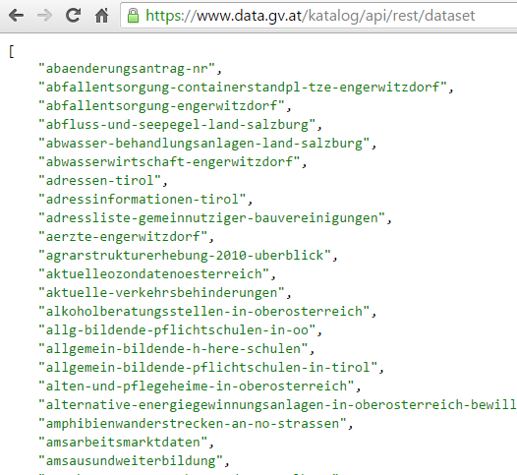
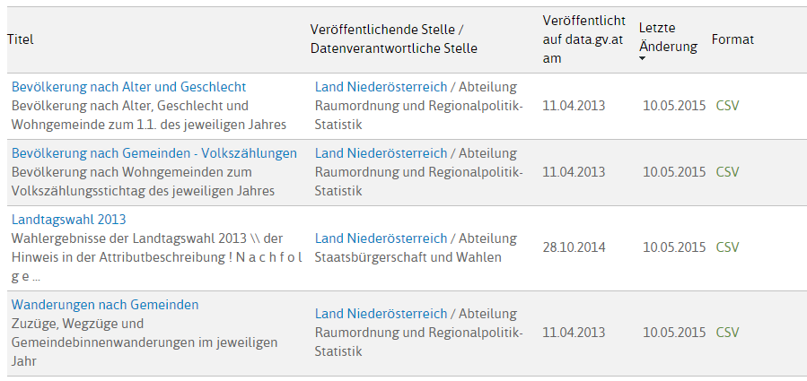
E.g.: data.gv.at
Open Data Portal by the Austrian Government

Slide 7
CKAN Metadata (JSON)
d: {
"license_title": "Creative Commons Namensnennung", "maintainer": "Stadtvermessung Graz",
"author": "",
"author_email": "stadtvermessung@stadt.graz.at",
"resources": [
{
"size": "6698",
"format": "CSV",
"mimetype": "",
"url": "http://data.graz.gv.at/.../Bibliothek.csv"
}
], "tags": [
"bibliothek",
"geodaten",
"graz",
"kultur",
"poi" ],
"license_id": "CC-BY-3.0",
"organization": null,
"name": "bibliotheken",
"notes": "Standorte der städtischen Bibliotheken...",
"extras": {
"Sprache des Metadatensatzes": "ger/deu Deutsch"
},
"license_url": "http://creativecommons.org/.../by/3.0/at/",
}
core keys
resource keys
extra keys
Notes:
TODO

Slide 8
What is the Problem?
There is a concern of quality issues on data portals [1]:
Metadata
Missing values
Incorrect values
No contact info
Wrong/missing file format description
Resources
Changing URLs
Formats (e.g. CSV not RFC 4180 compliant -> [,;\t#])
Encoding (e.g., mixed)
[1] http://www.business2community.com/big-data/open-data-risk-poor-data-quality-01010535

Slide 9
Hypothesis
Objective Quality Metrics
discover, point out and measure quality and heterogeneity issues in data portals
Automated Quality Assessment Framework
monitor and assess the evolution of quality metrics over time
Notes:
Approach:
Find a set of suitable quality metrics
Monitor the quality of data portals over time
Outcome:
Current quality of open data
Find out development and growth rate of open data
Find out impact of improvement initiatives

Slide 10
Quality Metrics

Slide 11
Metrics
Dimensions | Description
Retrievability | The extent to which meta data and resources can be retrieved.
Usage | The extent to which available meta data keys are used to describe a dataset.
Completeness | The extent to which the used meta data keys are non empty.
Accuracy | The extent to which certain meta data values accurately describe the resources.
Openness | The extent to which licenses and file formats conform to the open definition.
Contactability | The extent to which the data publisher provide contact information.
Objective measures which can be automatically computed in a scalable way

Slide 12
Concrete Metrics (1/2)
Retrievability:
HTTP GET lookup for datasets (API) and resources
Usage:
Ratio of used keys and all identified keys (on a data portal)
Completeness:
Ratio of non-empty keys in a dataset

Slide 13
Concrete Metrics (2/2)
Openness:
Licenses: map to list by opendefinition.org
Formats: pre-defined set of file formats, e.g. CSV, XML, …
Contactability:
Availability of contact information: (i) text, (ii) url, (iii) email
Accuracy:
Formats, file size, mime-type
Currently based on respective HTTP response header fields

Slide 14
Automated QA Framework

Slide 15
Architecture
CKAN
CKAN
OpenDataSoft
Dashboard
(nodejs)
Reporting
Dumps (json)
CKAN
CKAN
CKAN
Socrata
Meta data harvester
MongoDB
Quality
Assessment
Resource harvester
HTTP HEAD
Notes:
Harvester stores raw metadata in mongodb
Resource-harvester performs HTTP header lookups on resource URLs
QA component calculates quality metrics

Slide 16
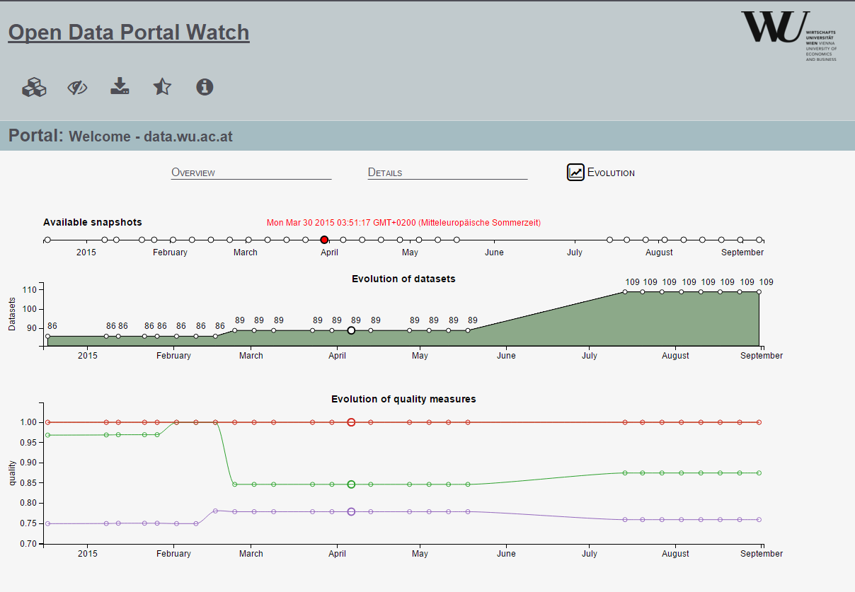
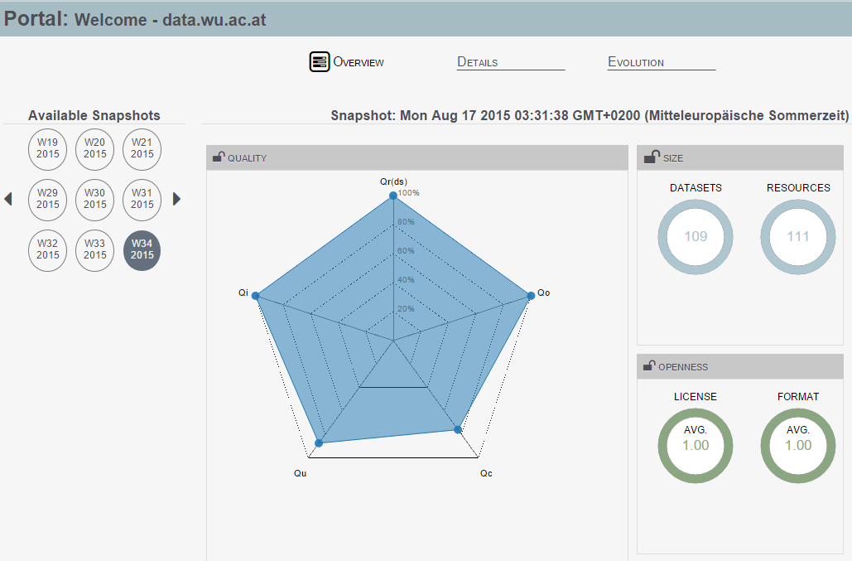
Open Data Portal Watch
Scalable quality assessment & monitoring framework for Open Data Portals
http://data.wu.ac.at/portalwatch/

Slide 17
Findings

Slide 18
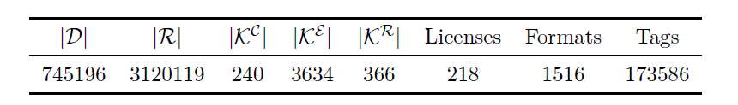
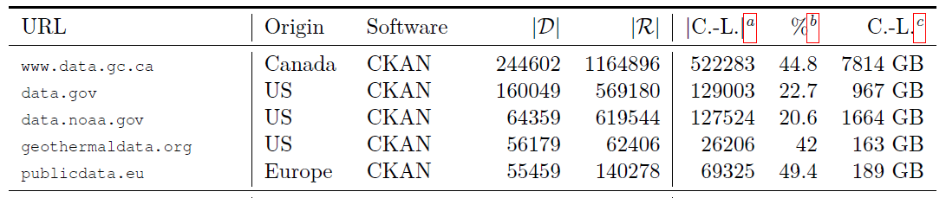
Portals Overview
Based on 126 CKAN data portals:
Top 5 (wrt. datasets):
3.12M URL values, 1.92M distinct, 1.91M are syntactically valid URLs
1.1M Content-Length HTTP header fields resulting in 12.297 TB

Slide 19
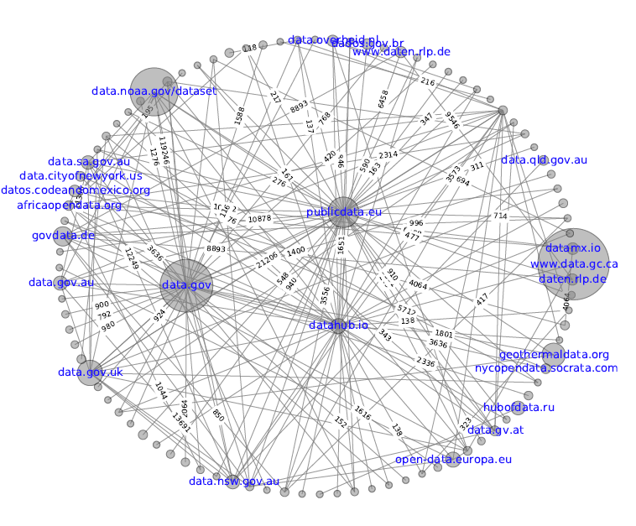
Portal Overlap
13% (260K) of the unique resources appear in more than one dataset
12% (227K) resources in more than one portal
biggest portals act as parent/harvester portals (e.g. data.gov, publicdata.eu)

Slide 20
Retrievability

Slide 21
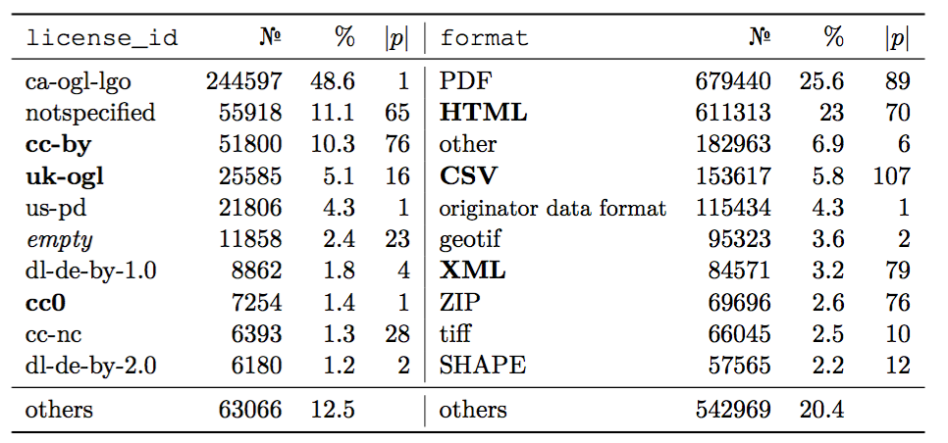
Openness
Top 10 licenses and formats over all portals:
confirmed open
Notes:
Future Work: distinction between Open and Machine-Readable formats

Slide 22
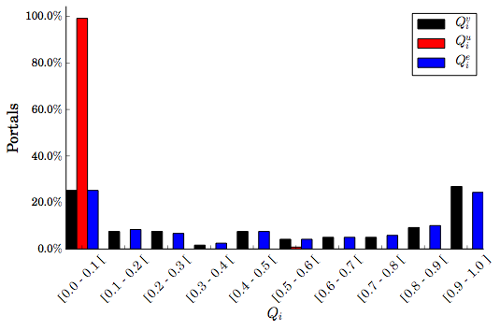
Contactability
Contact information in form of URLs, email adresses, or any value
very few URLs
35% of the portals with very good contractibility
25% with hardly any contact values

Slide 23
Conclusion
Main findings (126 CKAN Portals):
High metadata heterogeneity for portal specific keys/tags
Low confirmed openness (wrt. licenses and formats)
About 80% resource retrievability
Only 35% of the portals have a high contactability

Slide 24
Impact
Peer Reviewed Publications
Jürgen Umbrich, Sebastian Neumaier, and Axel Polleres. Quality assessment & evolution of open data portals. In IEEE International Conference on Open and Big Data, Rome, Italy, August 2015.
Jürgen Umbrich, Sebastian Neumaier, and Axel Polleres. Towards assessing the quality evolution of open data portals. In ODQ2015: Open Data Quality: from Theory to Practice Workshop, Munich, Germany, March 2015.
Follow-up Project: “ADEQUATe” [1]
develop and evaluate mechanisms to measure, monitor and improve data quality in Open Data
In cooperation with WU, Danube University Krems and Semantic Web Company
[1] http://www.adequate.at/

Slide 25
Current and Future Work
Notes:
Adequate: FFG project to develop and evaluate mechanisms to measure, monitor and improve data quality in Open Data.
Paper in progress: generalized qa framework

Slide 26
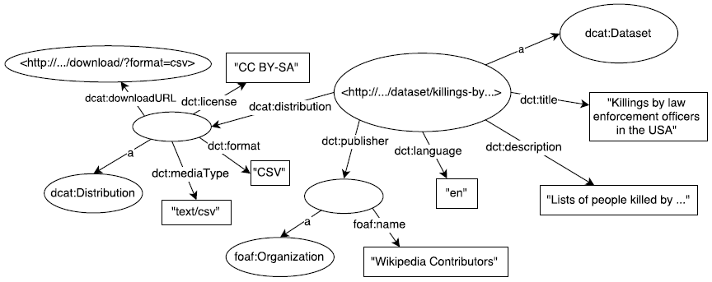
Towards a general QA Framework
More Open Data Portals:
Harvest data from other portal frameworks, e.g. Socrata, OpenDataSoft, …
Metadata Homogenization:
Map metadata keys from different frameworks to the RDF-based DCAT [1]
DCAT specific Quality Dimensions:
E.g., Existence and conformance of access, license or file format information.
[1] http://www.w3.org/TR/vocab-dcat/

Slide 27
Thank you for your attention.

Slide 28
Backup Slides

Slide 29
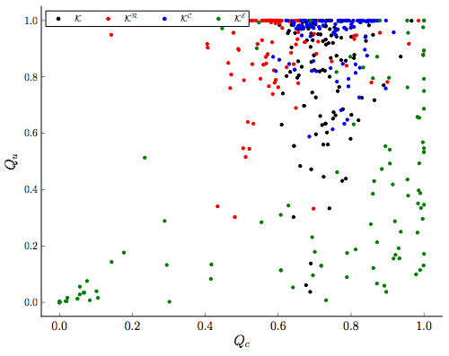
Usage & Completeness
Avg. usage and completeness for different keys per portal
core and resource keys are well established
extra keys can be grouped
(usage)
Core keys „quite“ complete
Portals with „unused“ extra keys
(completeness)

Slide 30
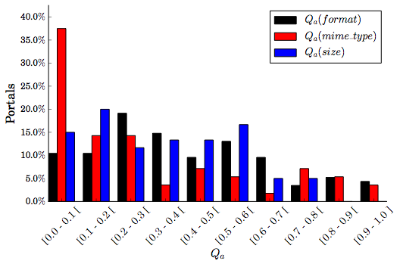
Accuracy
HTTP HEAD | 1.64M
response header | 1.55M | 94.5%
content-type | 1.4M | 85.4%
content-length | 1.1M | 67%
Datasets with metadata:
27K size
252K mime type
625K format

Slide 31
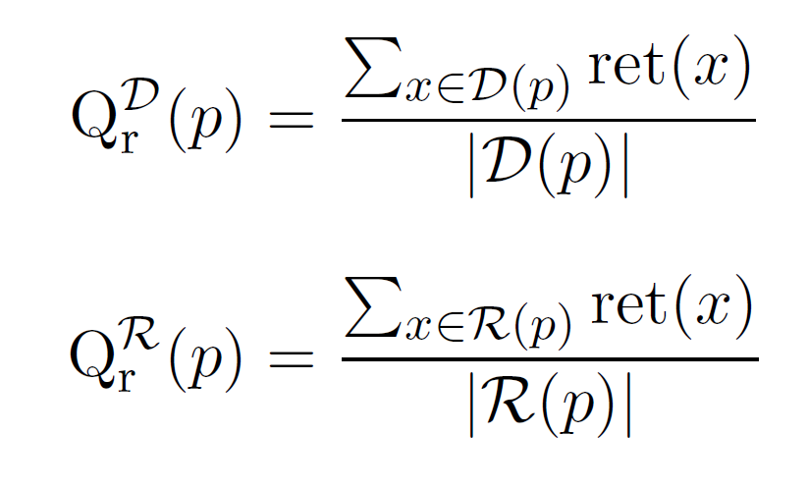


Formal Metrics (1/4)
Retrievability:
Usage:

Slide 32
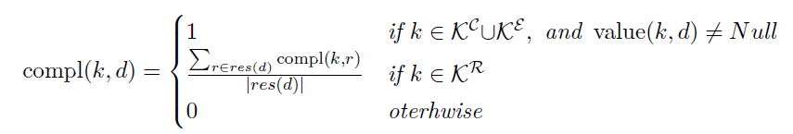
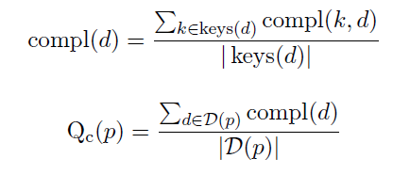
Formal Metrics (2/4)
Completeness:

Slide 33

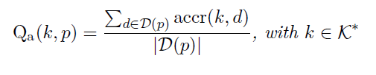
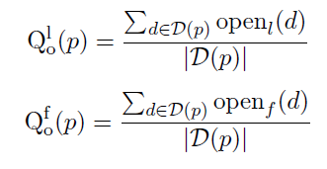

Formal Metrics (3/4)
Accuracy:
Openness:

Slide 34

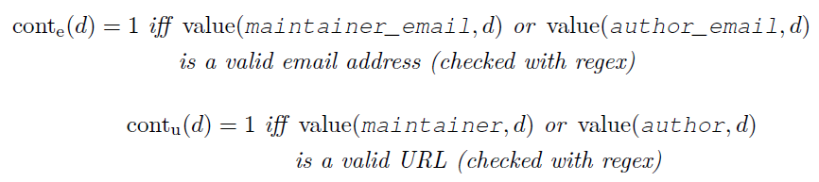
Formal Metrics (4/4)
Contactability:

Slide 35
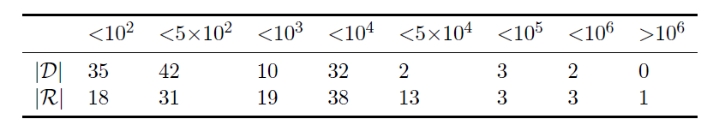
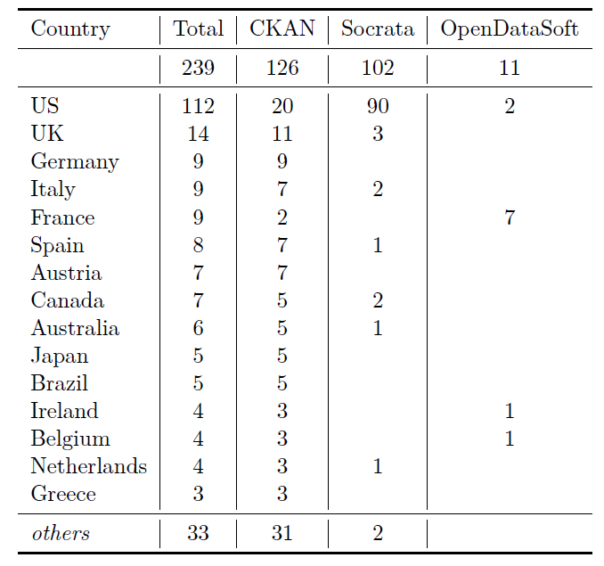
Portals Detail

Slide 36
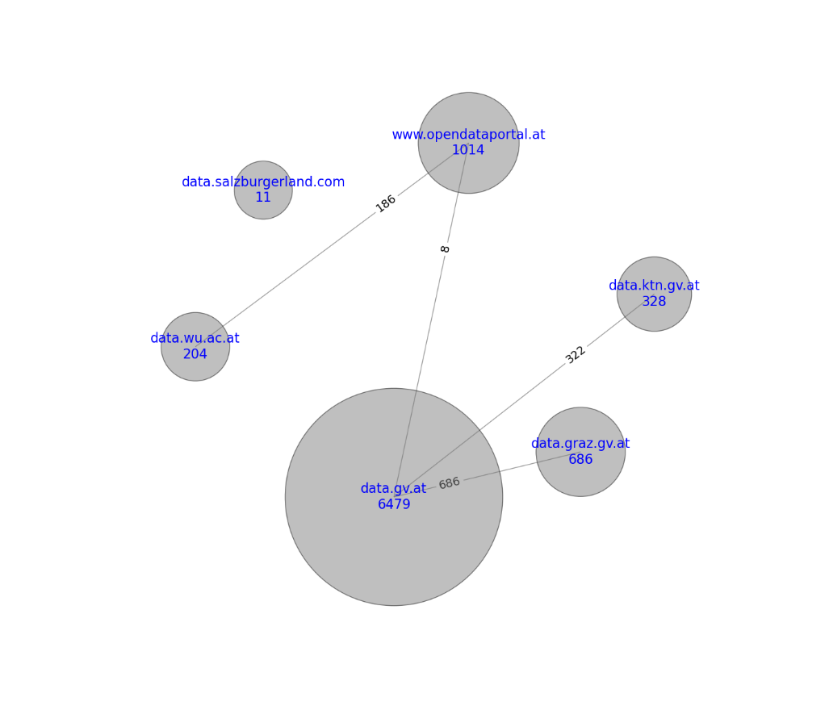
Austrian Data Portals
Evolution of datasets and quality metrics
data.gv.at as harvesting portal

