Slide 1
Challenges of mapping current CKAN metadata to DCAT
Sebastian Neumaier, Jürgen Umbrich, Axel Polleres Vienna University of Economics and Business, Vienna, Austria

Slide 2
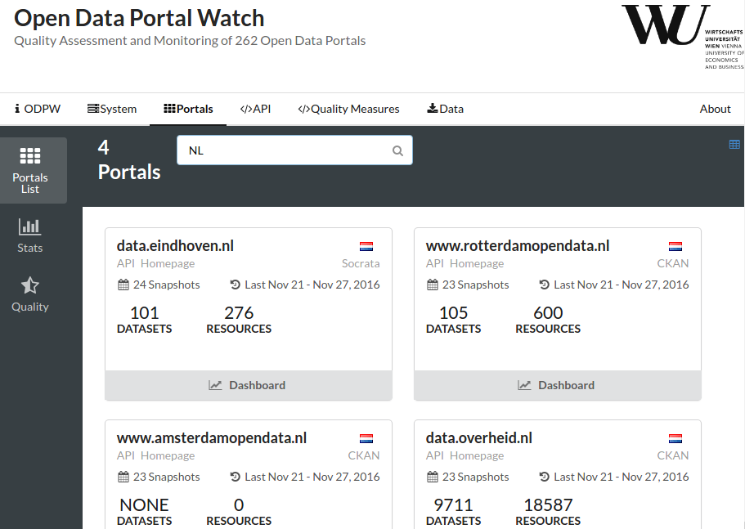
What we do:
Profiling Open Data portals:
Quality assessment
Evolution monitoring
Different software frameworks:
We monitor ~250 portals in total
Most of them CKAN: 133 portals, 514k datasets
We harmonize metadata by mapping it to DCAT
http://data.wu.ac.at/portalwatch

Slide 3
CKAN (mostly) exports DCAT
CKAN provides extension to export DCAT
Mapping of datasets and resources to dcat:Dataset and dcat:Distribution
Recent version of extension supports DCAT-AP
93 of 133 CKAN portals provide DCAT export

Slide 4
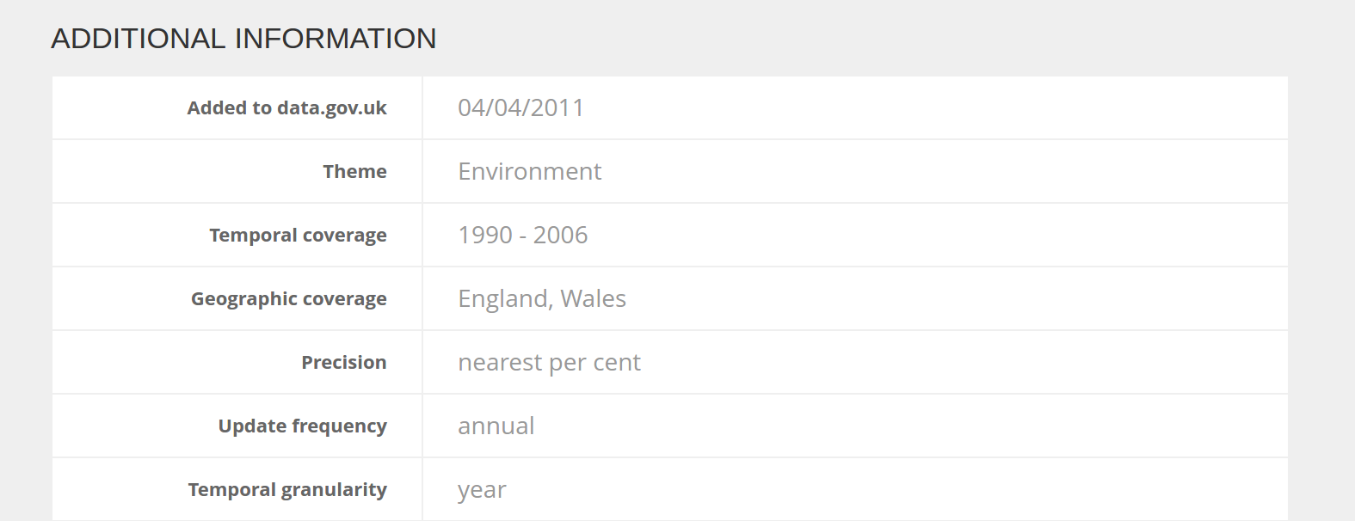
CKAN provides “extra” keys
CKAN can include additional metadata keys
Added by portal provider, or other CKAN extension
Example from: https://data.gov.uk/dataset/river-water-quality-regions

Slide 5
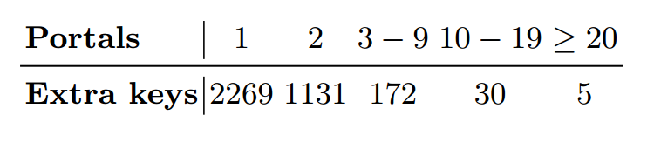
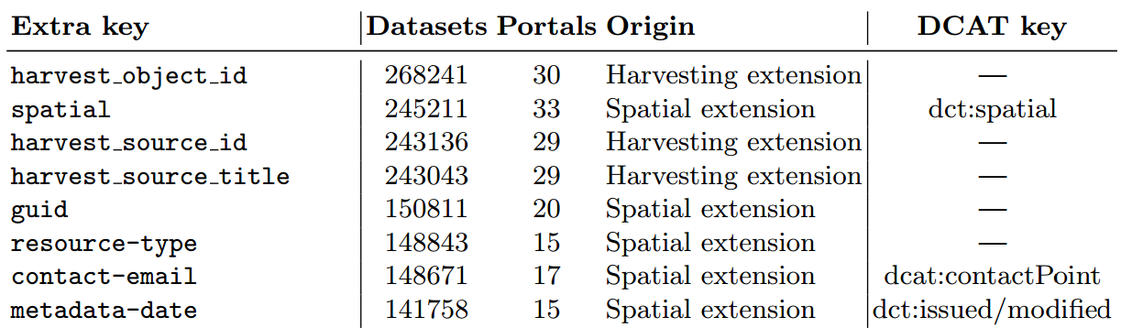
What “extra” keys are available?
3607 different extra keys in 514k datasets
Extra keys in multiple portals:
Most frequent extra keys:

Slide 6
Current mapping of “extra” keys
3 different cases, depending on version and configuration of CKAN-to-DCAT extension:
Portal-specific mapping: Portal defines mapping for metadata key to property, e.g.:
Generic mapping by extension: Pattern for exporting all available extra keys, e.g.:
No mapping: Retrieved DCAT description returns no mapping for extra keys
"temporal_coverage" → dct:temporal
dc:relation [
rdfs:label "geographic_coverage" ;
rdf:value "101000: England, Wales"
]

Slide 7
How to model CKAN resources?
DCAT distribution:
dataset might be available in different forms, these forms might represent different formats or endpoints
Use of resources in CKAN:
DCAT distribution
Example from: https://data.gov.uk/dataset/river-water-quality-regions

Slide 8
Summary
We do: monitoring of ~250 Open Data portals
We gained insights:
… into current use of CKAN metadata keys
… into issues when mapping these keys to DCAT:
Different mapping output for “extra” keys
No predefined mapping for frequently used “extra” keys
DCAT specification defines distributions as different forms/formats of same content (and not by other dimensions)

Slide 9

Conclusions & Suggestions
Different output: install/activate/update DCAT extension
The widely used CKAN extension lacks mappings for popular extra keys (e.g. spatial)
DCAT recommendation could provide properties for frequent extra keys, e.g., harvested datasets (owl:sameAs?)
Distribution level should recommend(/allow) other dimension descriptions (e.g., dct:temporal, dct:spatial)
Sebastian Neumaier
WU Vienna, Institute for Information Business
email: sebastian.neumaier@wu.ac.at
url: https://sebneumaier.wordpress.com/
twitter: @sebneum

