Slide 1
Lifting Data Portals to the Web of Data
Sebastian Neumaier, Jürgen Umbrich, Axel Polleres
Vienna University of Economics and Business, Vienna, Austria

Slide 2
Lifting Data Portals to the Web of Data

Slide 3
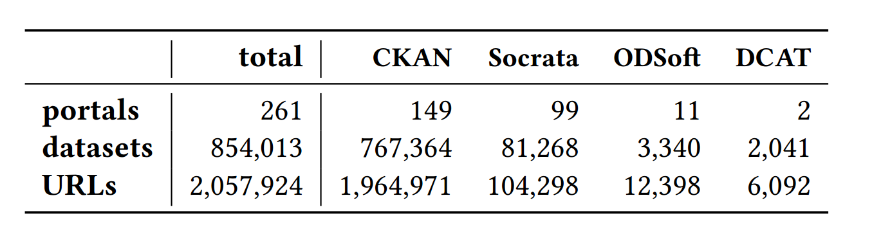
Open Data Portal Watch Project Monitoring and QA over evolving data portals
3/2015 [1]:
- 90 portals - Only CKAN
8/2015 [2]:
- 6 quality metrics - QA
6/2016 [3]:
- 260 portals - CKAN, Socrata, OpenDataSoft - 18 metrics
[1] | Towards assessing the quality evolution of open data portals. In ODQ2015: Open Data Quality Workshop, Munich, Germany
[2] | Quality assessment & evolution of open data portals. In: International Conference on Open and Big Data, Rome, Italy (2015)
[3] | Automated quality assessment of metadata across open data portals. ACM Journal of Data and Information Quality (2016)

Slide 4
Identified challenges
Metadata is heterogeneous and (partially) messy
Software-specific metadata (CKAN vs Socrata vs …)
Portal-specific metadata
Missing metadata (file formats, API descriptions, …)
Metadata not available as Linked Data
Only partially in DCAT vocabulary
No mappings for additional metadata fields
Poor discoverability of datasets
No content information in metadata (e.g., CSV headers)
Datasets’ metadata not optimized for search engines
Notes:
Metadata still in silos -> bring it to the Web

Slide 5
Current progress
Mapping to standard vocabularies DCAT, Schema.org
Enrich the datasets DQV, CSVW, PROV
Enable access SPARQL, Memento, sitemap.xml

Slide 6
Mapping to standard vocabularies
DCAT export of metadata from CKAN, Socrata and OpenDataSoft portals
Mapping of most frequent (portal/domain specific) extra-metadata fields
Mapping and publishing of Schema.org:
Mapping of DCAT to Schema.org‘s dataset vocabulary
Enabling integration into knowledge graphs of major search engines

Slide 7
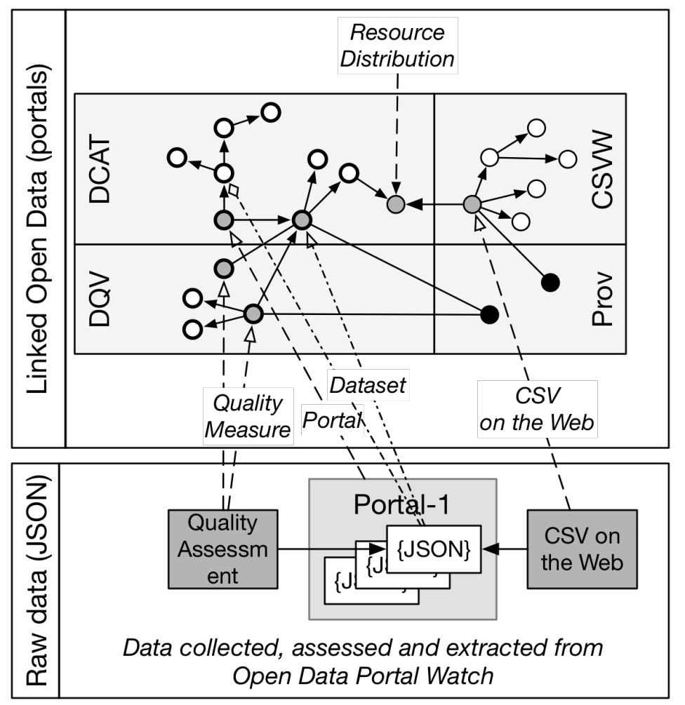
Enrich the datasets
Portal Watch quality dimensions:
Data Quality vocabulary
Metadata for tables:
CSV on the Web vocabulary
Record provenance:
PROV ontology

Slide 8
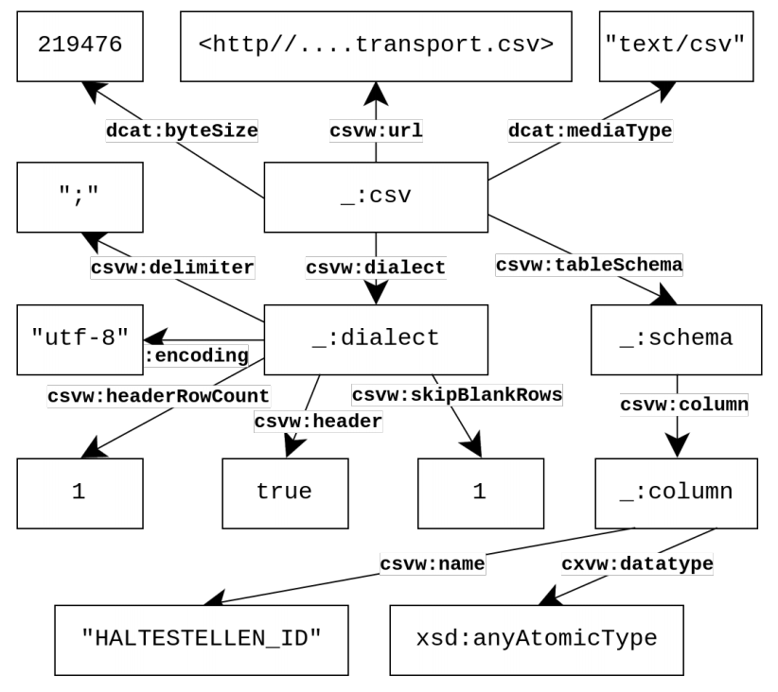
CSV on the Web metadata
Dialect properties:
HTTP Content-Type → dcat:mediaType
Encoding detection → csvw:encoding
Delimiter detection → csvw:delimiter
Schema properties:
CSV header line → csvw:name
Column type detection → xsd:datatype

Slide 9
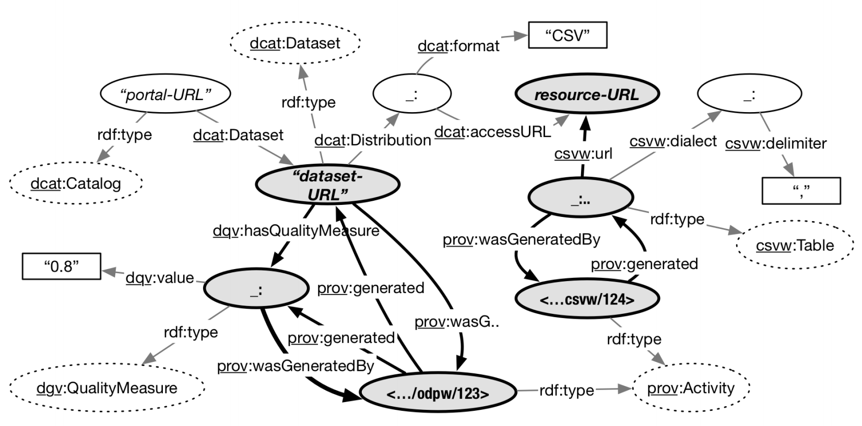
The big picture
Notes:
Bold arraws _> cross vocab links

Slide 10
Enable Access
SPARQL endpoint [1]:
Three versions in RDF triple store (as named graphs)
120 million triples each
Memento framework:
Datetime negotiation on “Accept-Datetime” HTTP header
Access to original metadata, DCAT, and DQV measures
Schema.org via sitemap.xml [2]:
Publishing of all 850k datasets as HTML-embedded Schema.org
[1] | http://data.wu.ac.at/portalwatch/sparql
[2] | http://data.wu.ac.at/odso/

Slide 11

Outlook & Future Work
data.wu.ac.at/portalwatch
Richer CSVW metadata
XSD datatypes, date(time) patterns, …
Access/query historical data
Named graphs vs change-based vs timestamp-based
Add links to datasets and external knowledge
Enrich/link metadata (e.g., tags/keywords)
Derive semantic labels from data sources
Sebastian Neumaier
WU Vienna, Institute for Information Business
email: sebastian.neumaier@wu.ac.at
url: https://sebneumaier.wordpress.com/
twitter: @sebneum
Notes:
Enrichment:
CSV to RDF
Metadata to RDF
Historical data: 2 years of data -> 5 billion statement. Allow users to query over prior versions
Linked data fragments
BEAR work on benchmarking, evolution of RDF (put reference in)

Slide 12
Backup Slides

Slide 13
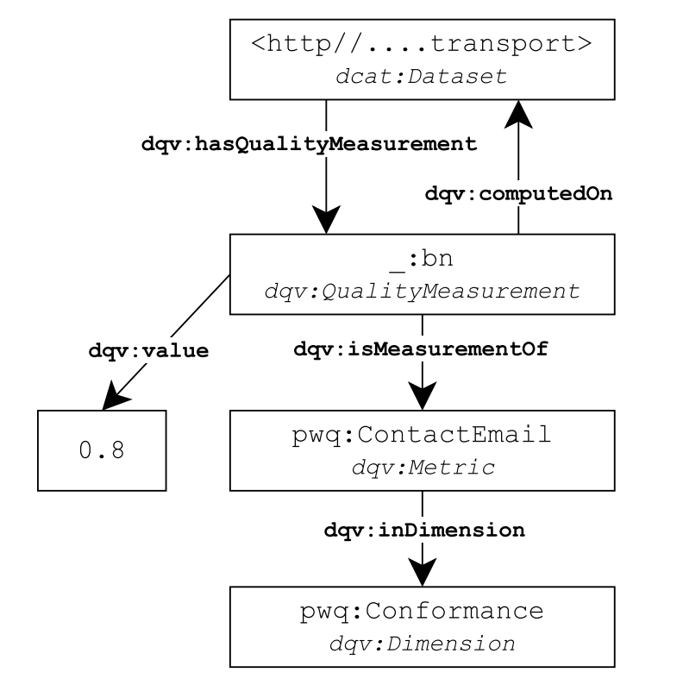
Portal Watch quality measures
Existence
Is certain metadata available
Conformance
Valid emails/URLs/dates
Open Data
Open format
Machine-readable
Open license

Slide 14
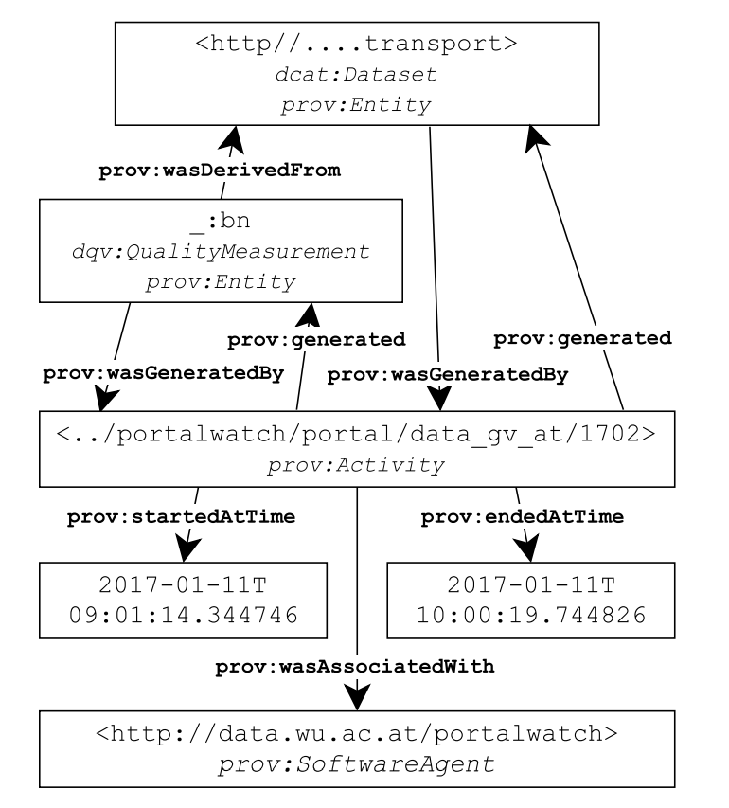
Add provenance information
We annotate:
Mapped DCAT description
Quality measurements
CSVW metadata
PROV-Activities:
„fetch“-activity
„csvw“-activity

