Slide 1
Search, Filter, Fork, and Link Open Data
The ADEQUATe platform: data- and community-driven quality improvements
Sebastian Neumaier, Lőrinc Thurnay,
Thomas J. Lampoltshammer, Tomáš Knap

Slide 2


Analytics & Data Enrichment to improve the QUAliTy of Open Data
The project is based on two oberservations…
An increasing amount of Open Data becomes available
The integration of such open, freely re-usable data sources is a key success factor
… and two identified issues:
The quality issues with metadata and the data itself
The lack of interoperability between data sources
2 Austrian Use Case Portals: data.gv.at & opendataportal.at
ADEQUATe is funded by the Austrian Federal Ministry of Transport, Innovation and Technology (BMVIT) under the program “ICT of the Future” (grant no. 849982) between October 2015 and June 2018.
Notes:
An increasing amount of Open Data becomes available as an important resource for emerging businesses and further on the integration of such open, freely re-usable data sources into organisations’ data warehouse and data management systems is seen as a key success factor for competitive advantages in a data-driven economy.
The project now identifies crucial issues which have to be tackled to fully exploit the value of open data and the efficient integration with other data sources:
the overall quality issues with metadata and the data itself
the lack of interoperability between data sources
The project's approach is to address this points already in an early stage – when the open data is freshly provided by either governmental organisations or others.

Slide 3
3 Partners:
Semantic Web Company
Danube University Krems
University of Economics Vienna
33 Months project duration: Oct. 2015 - June 2018
2 Use Case Partners: data.gv.at & opendataportal.at
Objective: Improvement of Data Quality through
Quality Assessment and Monitoring
Quality Improvement Algorithms
Data Linkage
Improvements of the data by the user (community)
Notes:
An increasing amount of Open Data becomes available as an important resource for emerging businesses and further on the integration of such open, freely re-usable data sources into organisations’ data warehouse and data management systems is seen as a key success factor for competitive advantages in a data-driven economy.
The project now identifies crucial issues which have to be tackled to fully exploit the value of open data and the efficient integration with other data sources:
the overall quality issues with metadata and the data itself
the lack of interoperability between data sources
The project's approach is to address this points already in an early stage – when the open data is freshly provided by either governmental organisations or others.

Slide 4
Requirements Elicitation
Four focus group interviews, addressing different stakeholder
Lay-persons @ Vienna Open Data meet-up
Open (Government) Data interested @ GovCamp Vienna
Platform providers @ Austrian OGD Plaform meeting
Scientists @ IRIS conference 2016
106 attendees
Online based survey
Data quality issues on Austrian data portals
Sent to various channels: community mailing lists, social media groups, etc.
183 participants

Slide 5
Survey Results
Users want..¹
Consistent data formats, complete and correct descriptions, up-to-date data, clarity about legal aspects
See issues, changes and development of datasets over time
Find all resources for a certain entity (e.g. city), filter based on concepts
Discuss and collaborate on datasets, fork/work on own versions
Quality report
Quality improvements
Linkage & Search
Collaboration
¹ We already filtered out requirements that are beyond our control, e.g., that users want the public data to be qualified as correct.

Slide 6
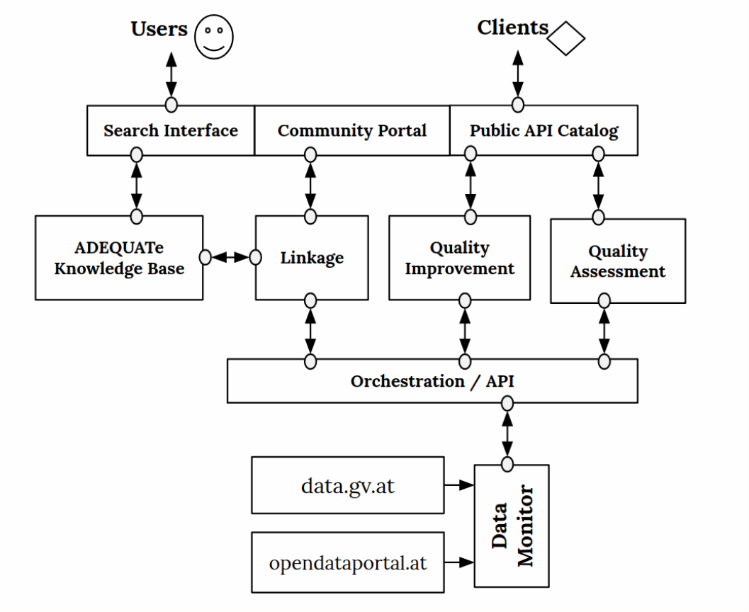
The Platform
Data Monitoring
QA & QI
Linkage & Search
Community Portal

Slide 7
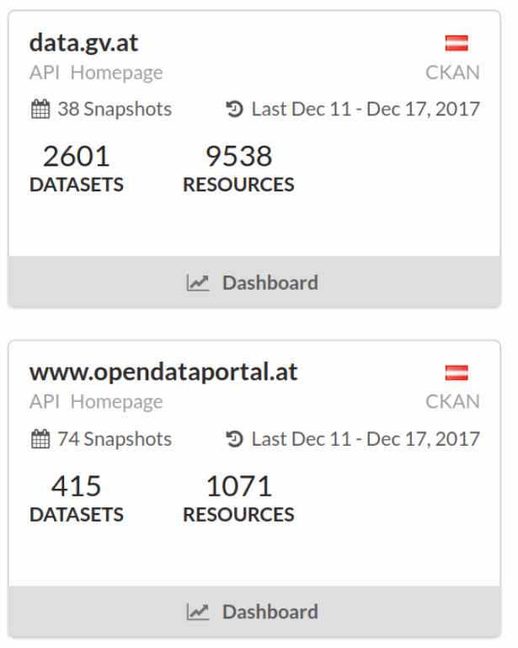
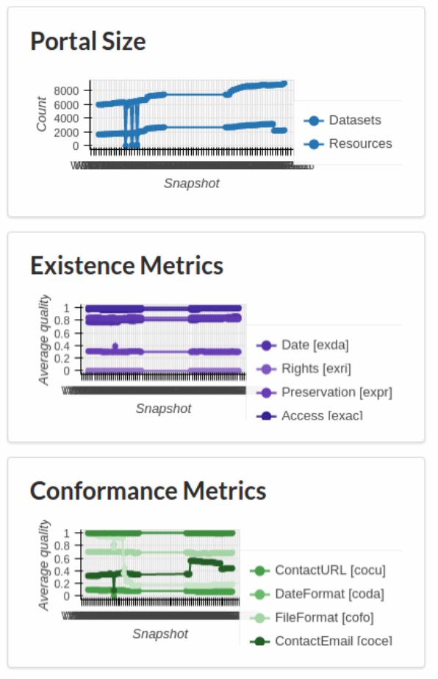
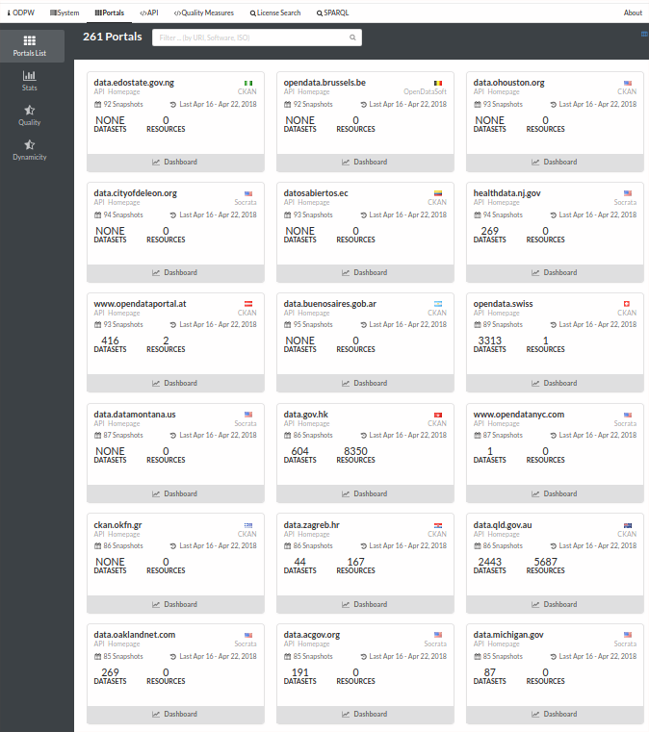
(i) Data Monitoring
Monitors and reports the quality of the use case partner portals
Based on Open Data Portal Watch Monitoring and QA of > 250 data portals
http://data.wu.ac.at/portalwatch

Slide 8
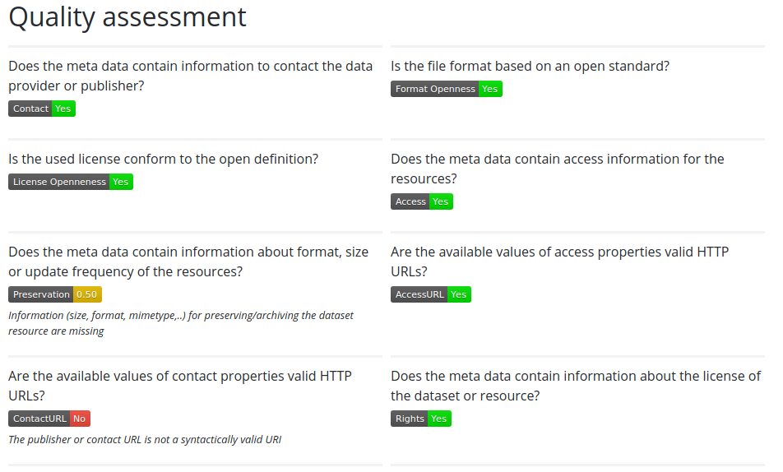
(ii) Quality Assessment …

Slide 9
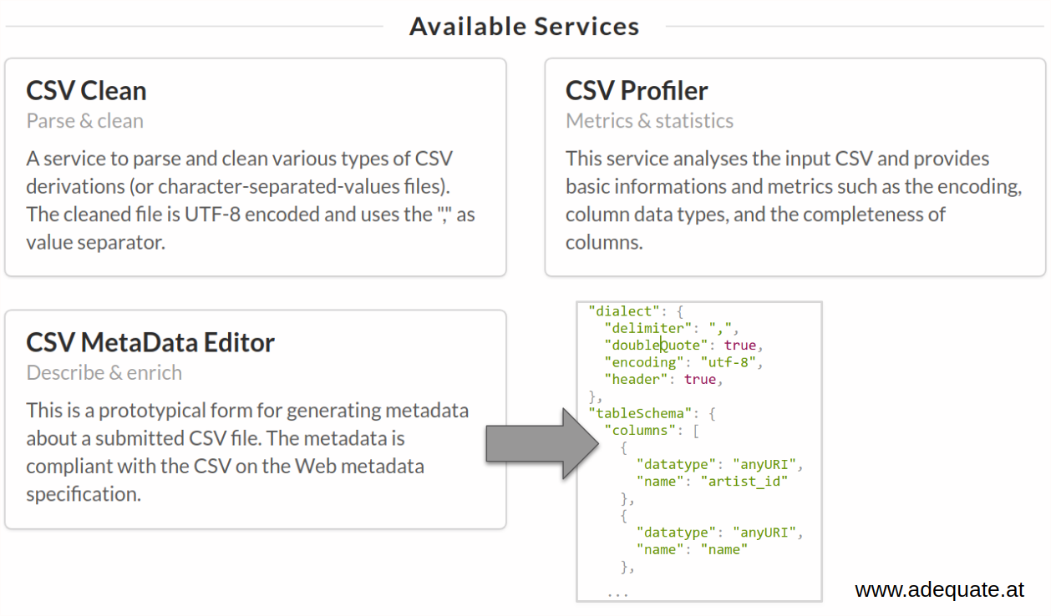
(ii) … & Quality Improvements

Slide 10
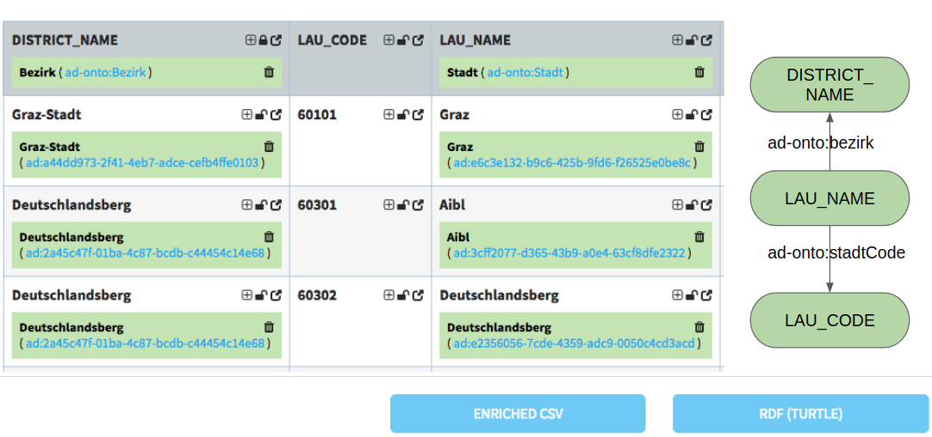
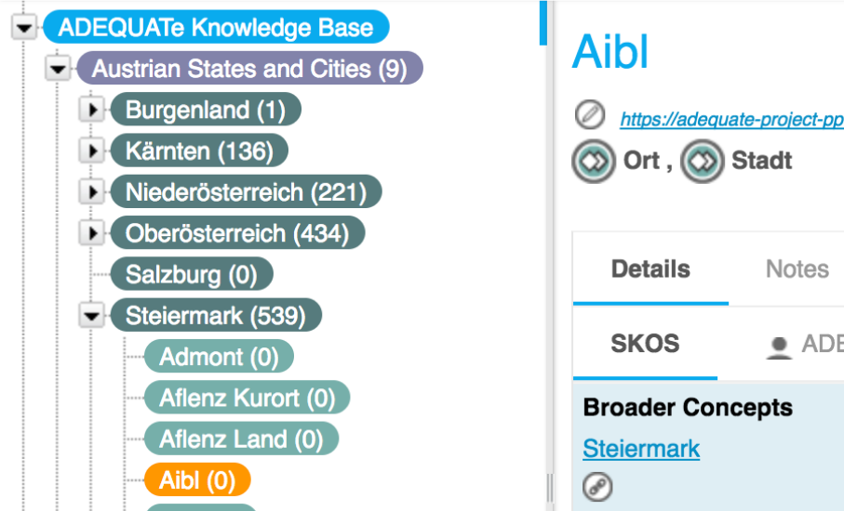
(iii) Linkage …
Odalic [1]:
Semantic interpretations of tabular data
Annotations of (i) columns, (ii) cell values, and (iii) relations between columns
Re-publishing as RDF
Using ADEQUATe knowledge base (Austrian-specific knowledge)
[1] Tomáš Knap. Towards Odalic, a Semantic Table Interpretation Tool in the ADEQUATe Project. In LD4IE Workshop 2017
Notes:
A tool for:
Classification/Disambiguation/Relation discovery
Has UI - to see results, provide feedback, export!

Slide 11
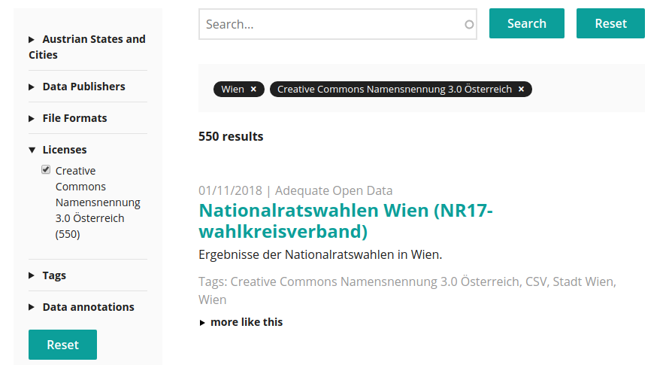
(iii) … & Search
PoolParty GraphSearch:¹
Full text search
Faceted search, based on entities in ADEQUATe knowledge base
TODO: Integrating Odalic annotations in the GraphSearch
¹ https://www.poolparty.biz/poolparty-semantic-graph-search-server/

Slide 12
Exemplary User Journey

Slide 13
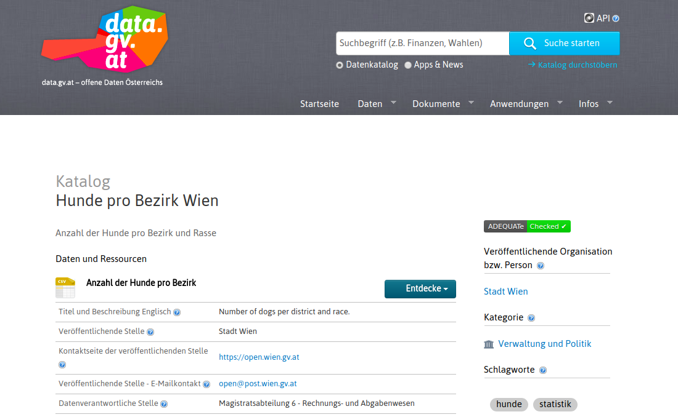

Slide 14
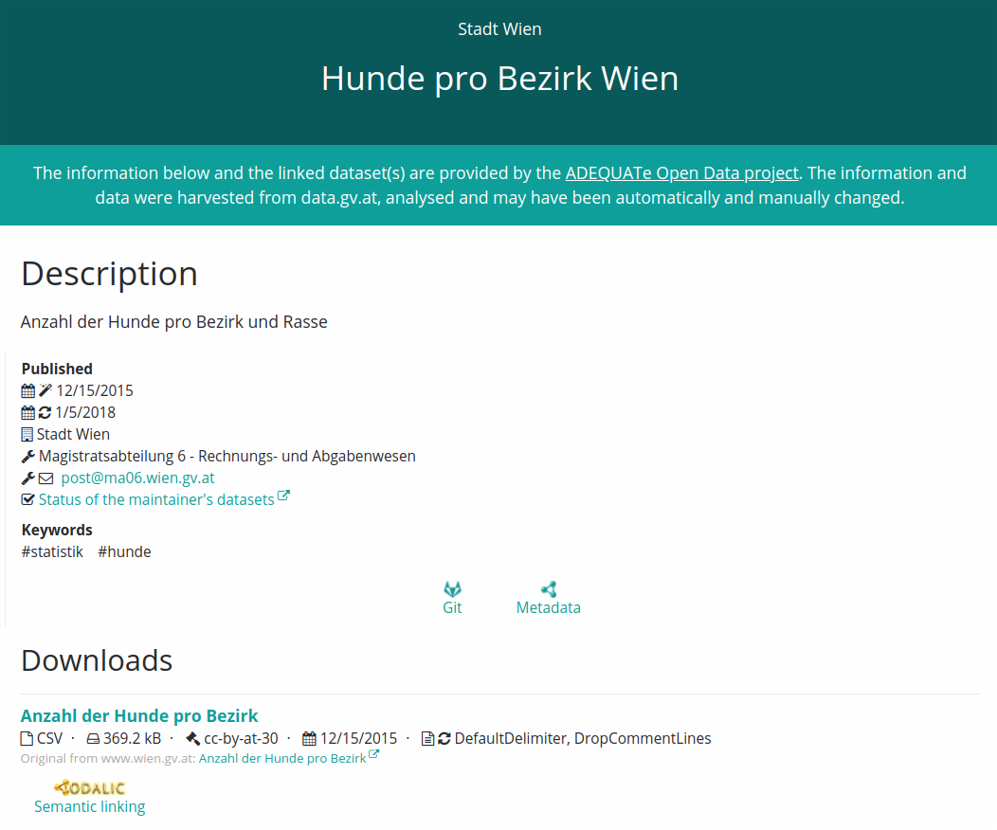
Demo

Slide 15
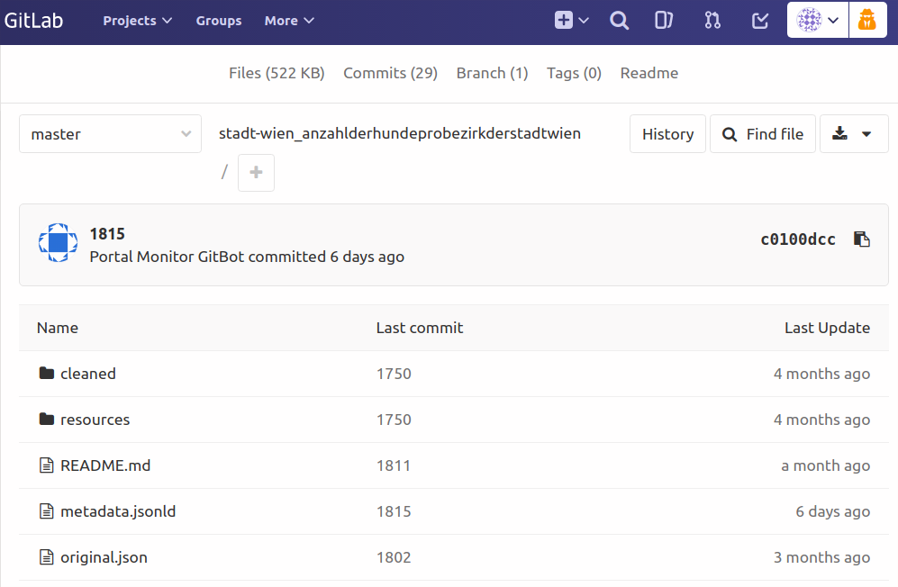

Slide 16
Outlook & Open Challenge
Platform, source code, and data online available:
www.adequate.at
Outlook:
Integration of other QI tools, e.g. Open Refine
Continuation in substantively related Austrian project CommuniData: www.communidata.at
Open Challenge:
We have the tools, services & platform… How to get the users?
Thank you! sebastian.neumaier@wu.ac.at
https://sebneumaier.wordpress.com/
twitter: @sebneum

