Slide 1

Introduction to
Sarah Bowden, Ph.D.
14 June 2017

Slide 2
What is R?
Statistical programming environment
Programming language

Slide 3
Why should you use R?
Open source (non-proprietary)
Constantly improved and added to by a large community of users
Code-sharing and ease of collaboration
Reproducible and easily adaptable

Slide 4
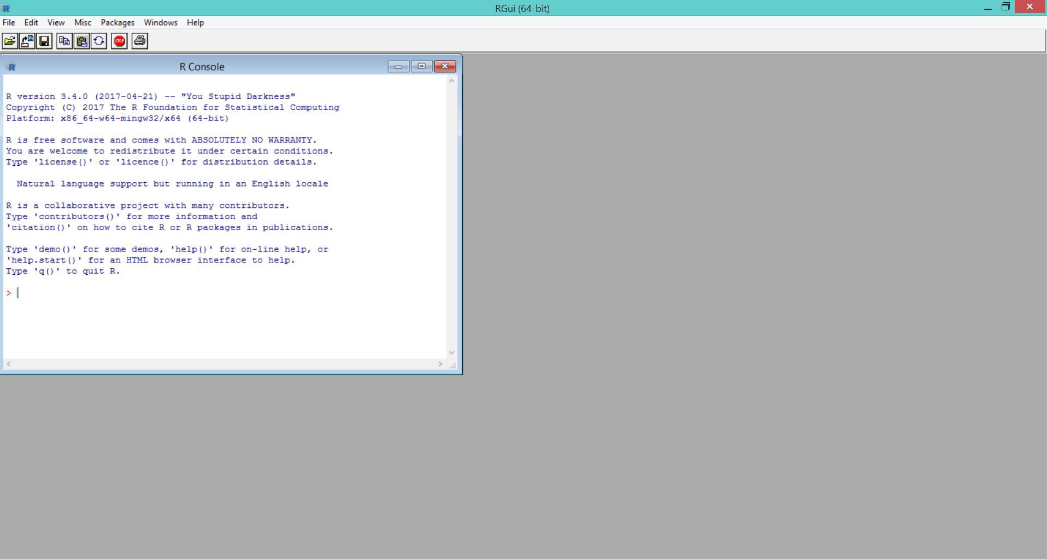
GUI: graphical user interface

Slide 5

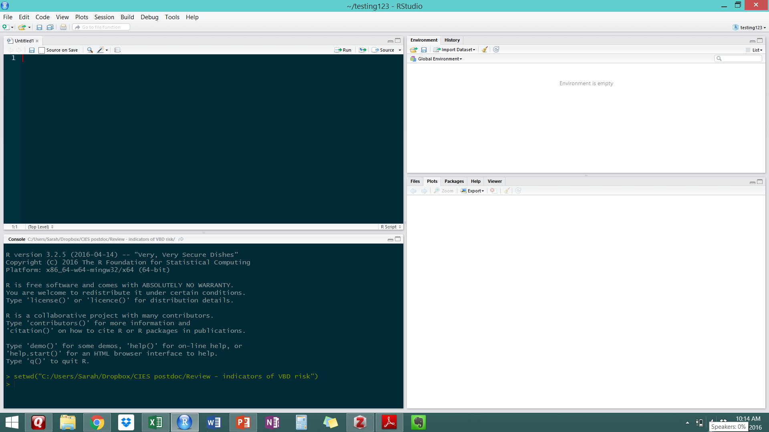
IDE: integrated development environment
Script
Environment
Console
Plots/Files/Help

Slide 6
Writing + executing your code
Always start a new script for a new project
Annotate, annotate, annotate! (see next slide)
Execute from your script 3 ways:
Highlight line(s) of code + hit Run
Highlight line(s) of code and hit Ctrl+Enter
Place cursor anywhere in a single line of code and hit Ctrl+Enter

Slide 7
Basic functionality: code annotation
Use one or more # to add comments (annotate) your code
Title your script
Include author(s), date started and/or last edited date
Use this to remind your (future) self or explain to someone else what a line or chunk of code is doing
When you’re learning R, you can never annotate too much
Exercise:
Start your own new script to use throughout this tutorial
Annotate it: give it a title, add your name and today’s date

Slide 8
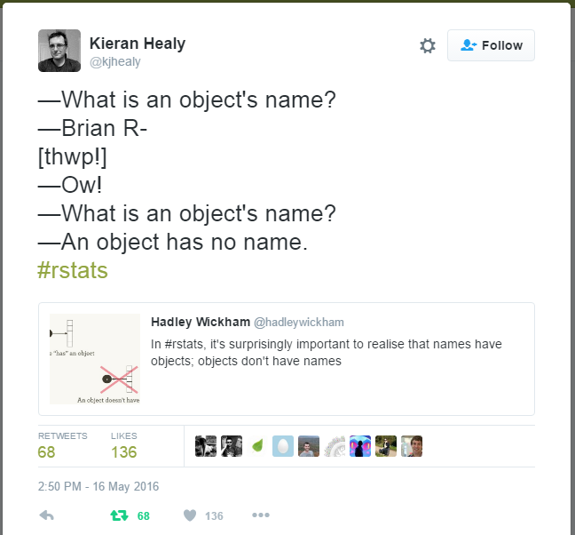
Basic functionality: assignments
In R, we’re always working with ‘objects’
Objects can be single numbers
Vectors, matrices, lists, data frames
We need to assign these objects to name to more easily access them
Assignments use <- to associate an object with a name
Exercise:
Pick four numbers and assign each of them to a different name of your choice
*everything in R is CASE SENSITIVE
So myvariable =/= MyVariable

Slide 9
Basic functionality: math
R has a wide range of mathematical functionally
Addition, subtraction, multiplication, division
Exponents, logs, square roots
Linear algebra (manipulation of vectors and matrices)
Built-in summary functions
Build your own functions*
Exercise:
Write a line of code for each math function we reviewed using the objects you previously assigned
Make sure you’re comfortable with the syntax of each of these mathematical functions
(P.S. – Are you still annotating your code?)

Slide 10
Basic functionality: vectors
R uses multiple different data structures that are assigned to names
vectors, matrices, lists, data frames
Vectors are the most basic = collection of numbers in a specific order
Exercise:
Create a two vectors of the same length and write a few lines of code to manipulate them individually and together
Create a new vector consisting of your two previous vectors

Slide 11
Basic functionality: sequences + repetitions
Sometimes we need to created a vector that is a sequence of numbers or the same number repeated several times
Exercise:
Create a sequence that contains 250 numbers between 6 and 15
Create a vector that repeats that sequence 8 times
Add a sequence of numbers from 1 to 10 to the end of the previous vector

Slide 12
If you want to learn more…
Swirl (R package with interactive courses) http://swirlstats.com/students.html
R code school https://www.codeschool.com/courses/try-r
ComputerWorld Beginner’s guide to R http://www.computerworld.com/article/2497143/business-intelligence/business-intelligence-beginner-s-guide-to-r-introduction.html
R Style guide http://adv-r.had.co.nz/Style.html
DataCamp Intro to R https://www.datacamp.com/courses/free-introduction-to-r
DataCamp R functions (advanced) https://www.datacamp.com/courses/writing-functions-in-r
Introduction to R (Venables and Smith) https://cran.r-project.org/doc/manuals/R-intro.pdf
The R book (Crawley 2009) – available @ Cary library

Slide 13
Working with your own data

Slide 14
Entering + formatting your data
Standard: Excel spreadsheet
One table per sheet/file
Short, descriptive column names (no spaces)
Camel-case: VariablesNamedLikeThis
Period-case: variables.named.like.this
Snake-case: variables_named_like_this
Column names can’t start with a number

Slide 15
Metadata requirements
Variable (column name)
Variable description
Units
Variable type (continuous, categorical, binary, logical/Boolean (True/False), count)
Save 1st sheet (data only) as .csv
Save entire worksheet (data + metadata) as .xlsx
Give BOTH files the SAME NAME

Slide 16
Future workshops
Working with data (June 19) – manipulating and summarizing your own data in R
Data visualization (July 7) – scatterplots, bar plots, regression, and plot customization
Basic statistical tests (July 19) – t-tests, ANOVA, linear regression, choosing the right statistical test, interpreting your results
End of summer (July 31 – August 4): individual meetings by appointment
bowdens@caryinstitute.org

